Slide 1
CAPSTONE PROJECT Optimizing Revenue Streams: A Holistic Study of Grain Weight Change and Charging Practices
RITIK KUMAR BADIYA
21F3001509

Slide 2
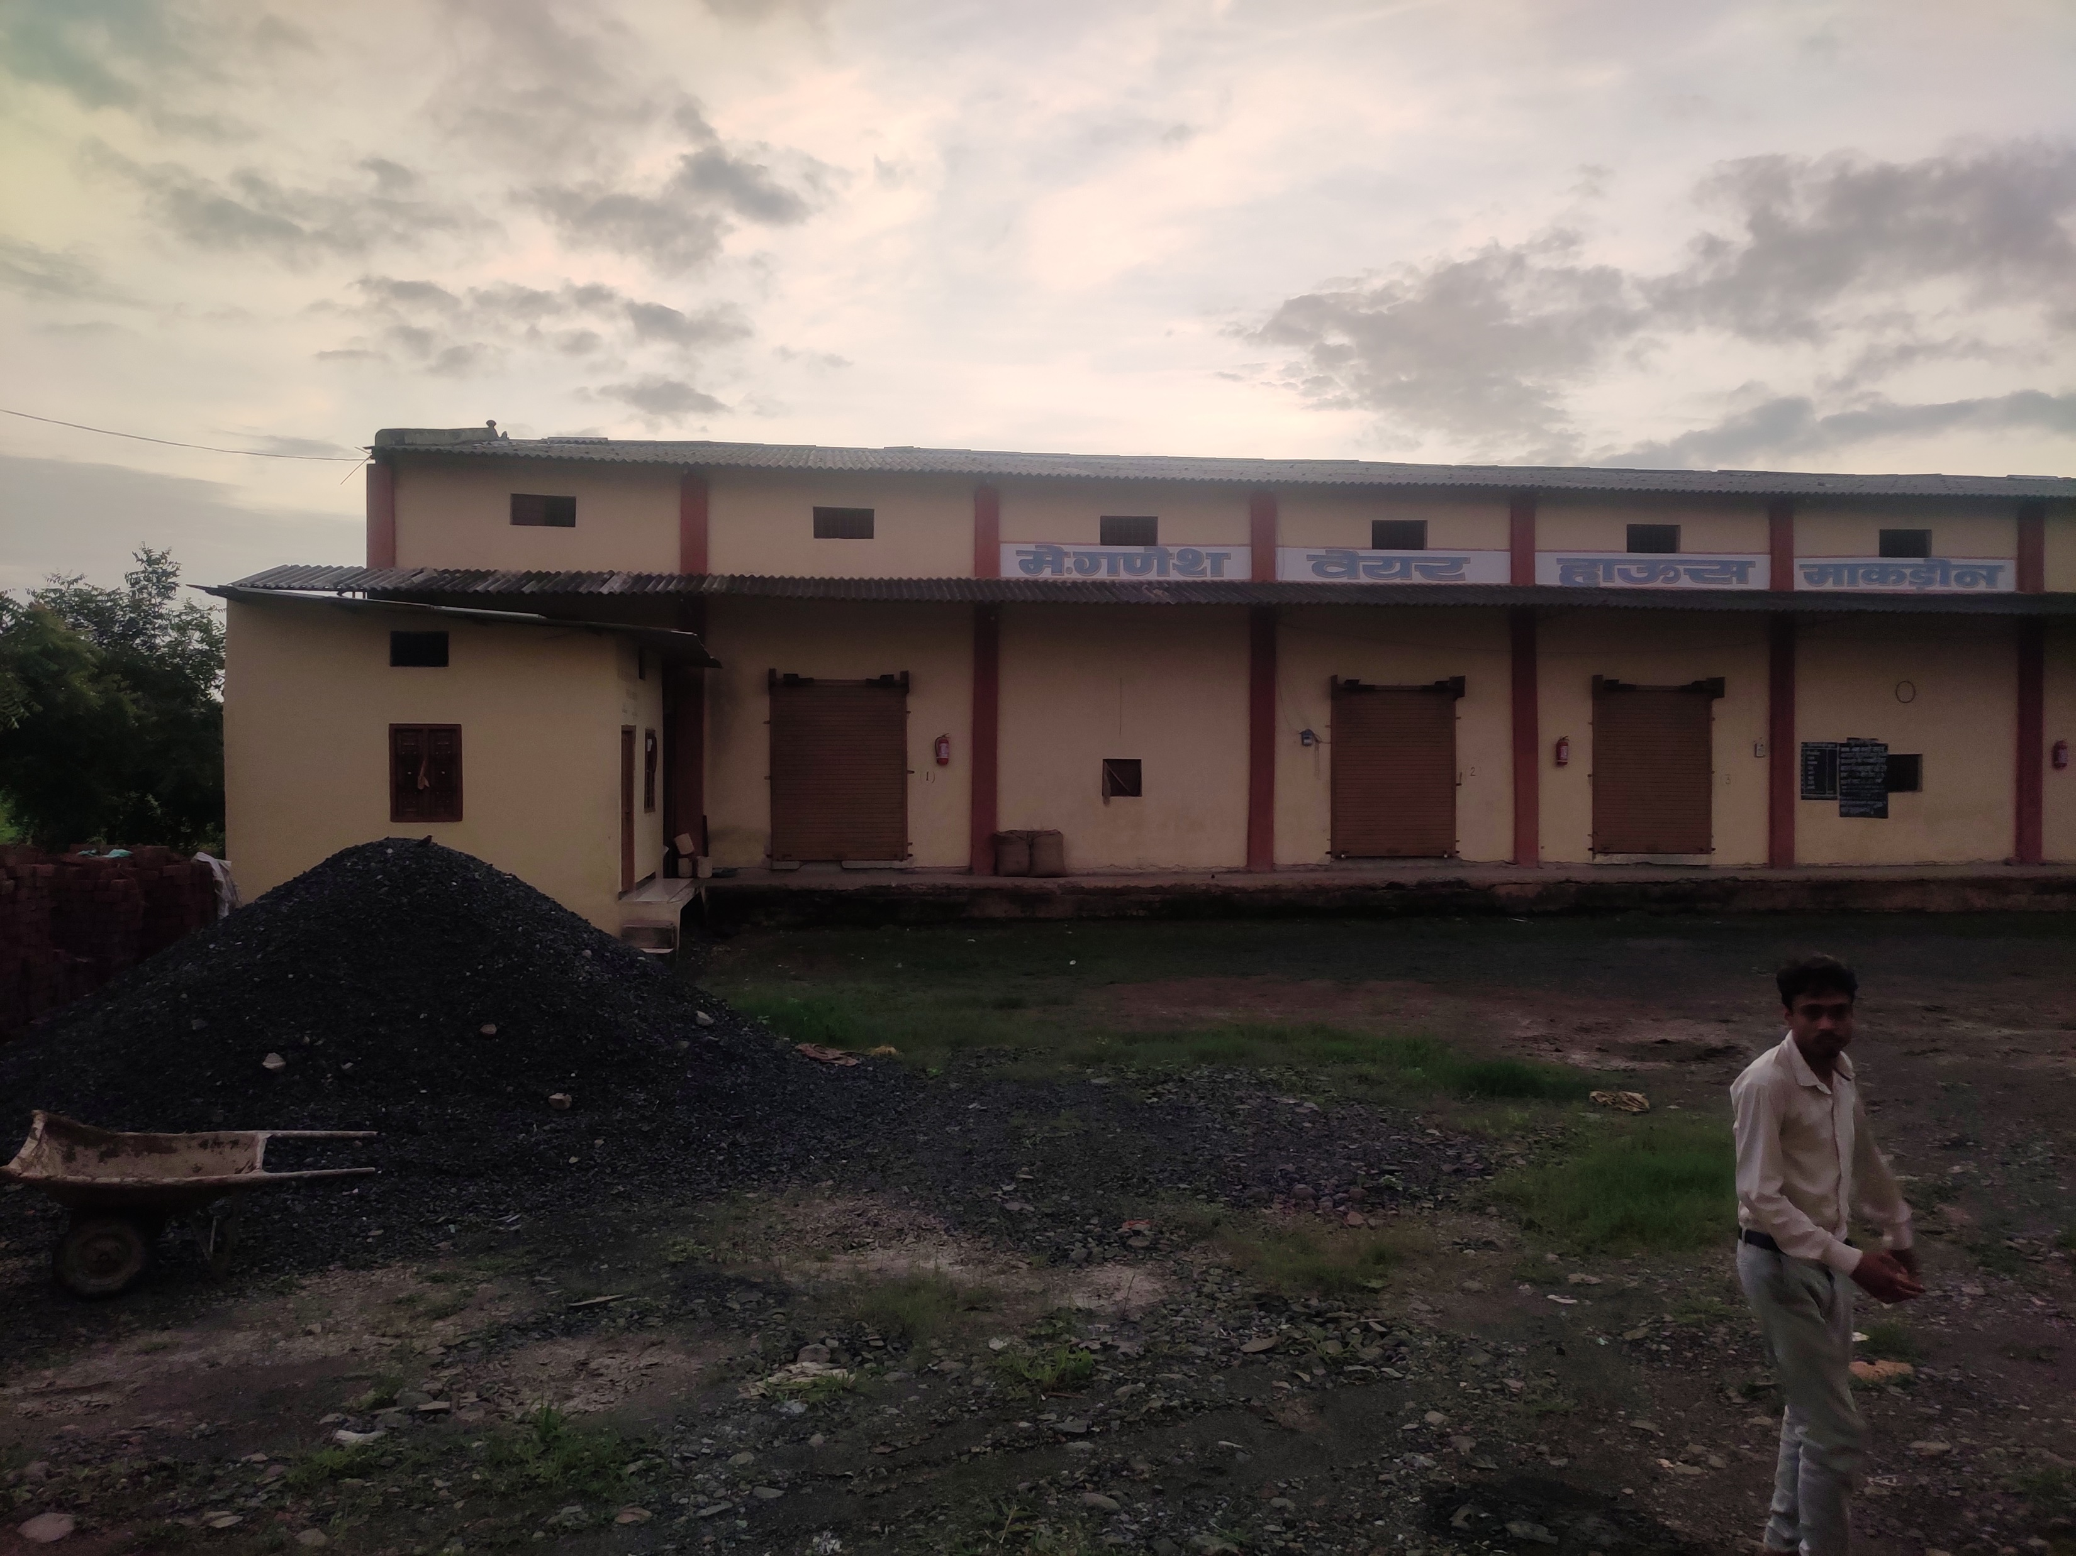





ABOUT ORGANISATION Ganesh Warehouse
Makdone
Mansingh Patidar
Chana, Soyabean, Wheat
12 lakhs per year
B2B, B2C
challenges encountered
 | Charge at Beggining | Charge at End
Charge at initial weight | ------------------------------- | Proposed Method 2
Charge at final weight (less) | Proposed Method 1 | Current practice
Charging Practice: Determining the optimal charging practice
Workforce Decision: Choosing between permanent or temporary labor

Slide 3


DATA SYNOPSIS [Data was collected for date 20-feb-2020 to 30-oct-2023]
Weight in (90kg)
Loss in weight
Number of Days
Charge paid
Date wise Bags count in and out
Labour cost paid

Slide 4
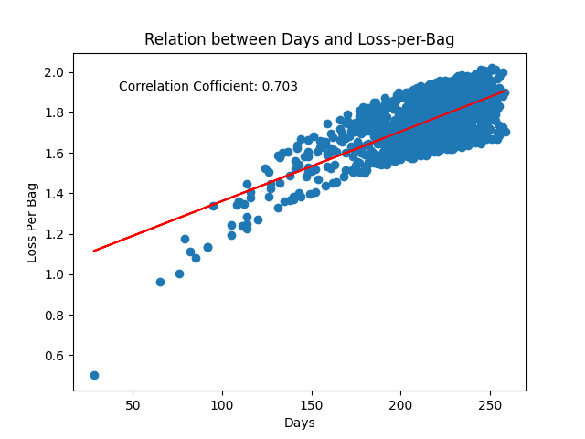
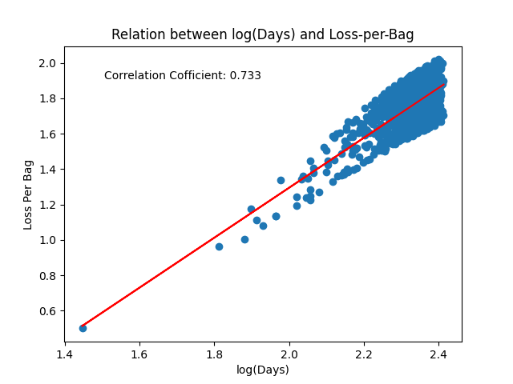
LINEAR RELATION

Slide 5



LINE FITTING AND EQUIVALENT INTEREST RATE
Objective: To compare the two proposed methods
Procedure: Employing line fitting to determine the equivalent interest rate (I)
Outcome: We discovered that when accounting for the initial weight, it is tantamount to a 3.35% interest rate per annum.
Current Practice
Gives 3.35% pa interest
Gives 12% pa interest

Slide 6
TOTAL REVENUE AT DIFFERENT PRACTICES

Slide 7
Simulation

Slide 8
TRENDS OF LABOURS
Key Points:
Average monthly cost of 5835 rupees
Approximately 5 to 6 workers are required simultaneously for smooth workflow.

Slide 9
SUGGESTIONS AND RECOMMENDATIONS
To enhance charging procedures, the organization should take into account the accrual of interest if fees are applied at the conclusion.
For labor practices, the organization should manage irregular labor.

Slide 10
THANK YOU
Open to QA
RITIK KUMAR BADIYA
21F3001509

