Slide 1


Term Project - PH3203
By —
Ritik Dubey (22MS208)
Ankit kumar (22MS211)
Raj Gaurav Tripathi (22MS215)
Delayed Choice Quantum Eraser
(Kim et al. 1999)

Slide 2

Motivation
Experimental Setup
Calculation
Results
Conclusion

Slide 3

Motivation
  N. Bohr(1920s) —> wave & particle behaviour can’t be observed in the same setup.
Scully & Druhl(1982)—> using entangled photons they proved this wrong.
Kim et al.(1999)—> Experimental realisation of Scully’s proposal
                +
                Modifying further by introducing delayed choice

Slide 4

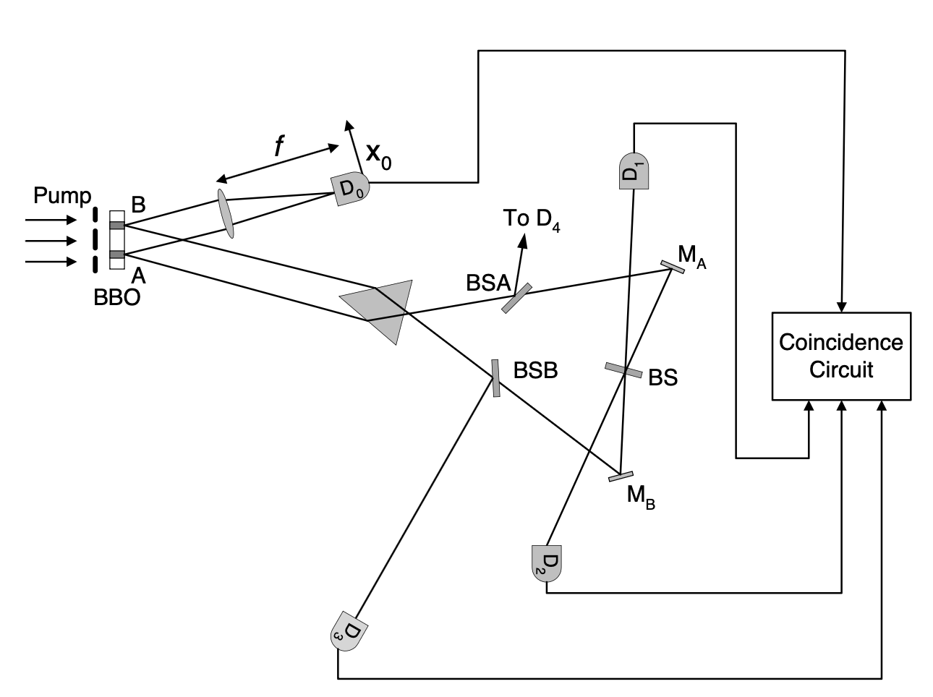
  The Experimental Setup
351 nm pump
photon beam

Slide 5

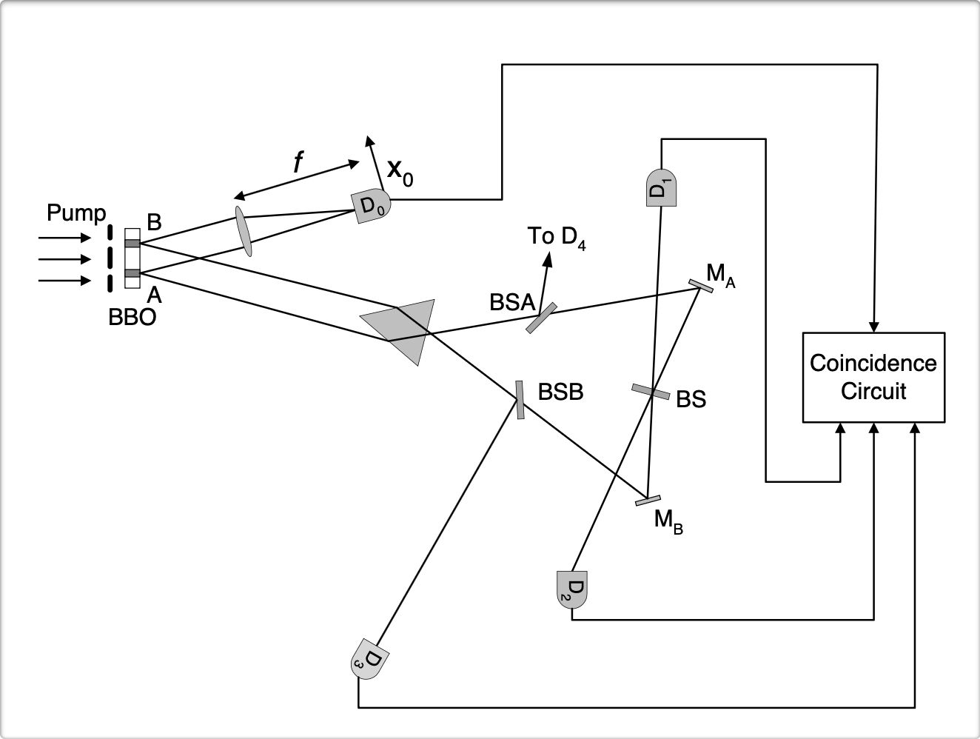
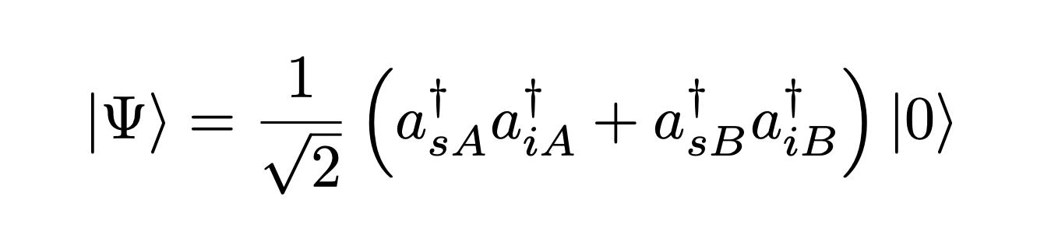
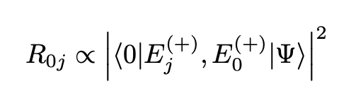
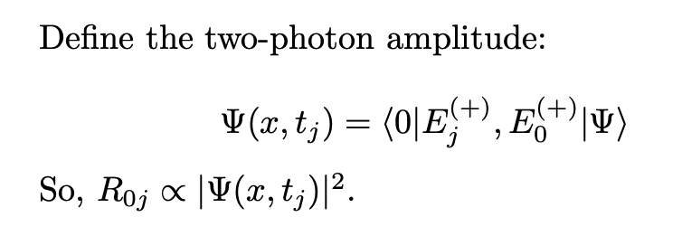
Calculation

Slide 6
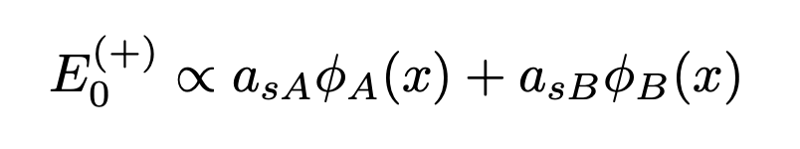
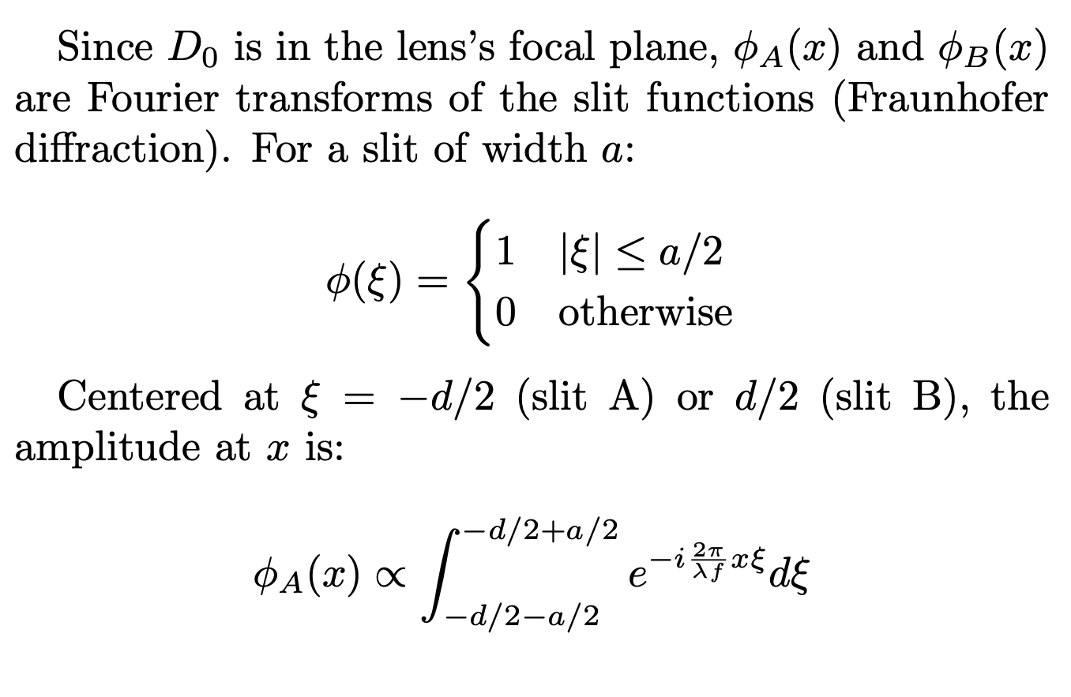
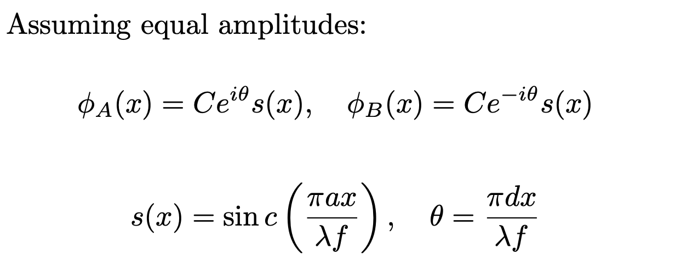

Slide 7
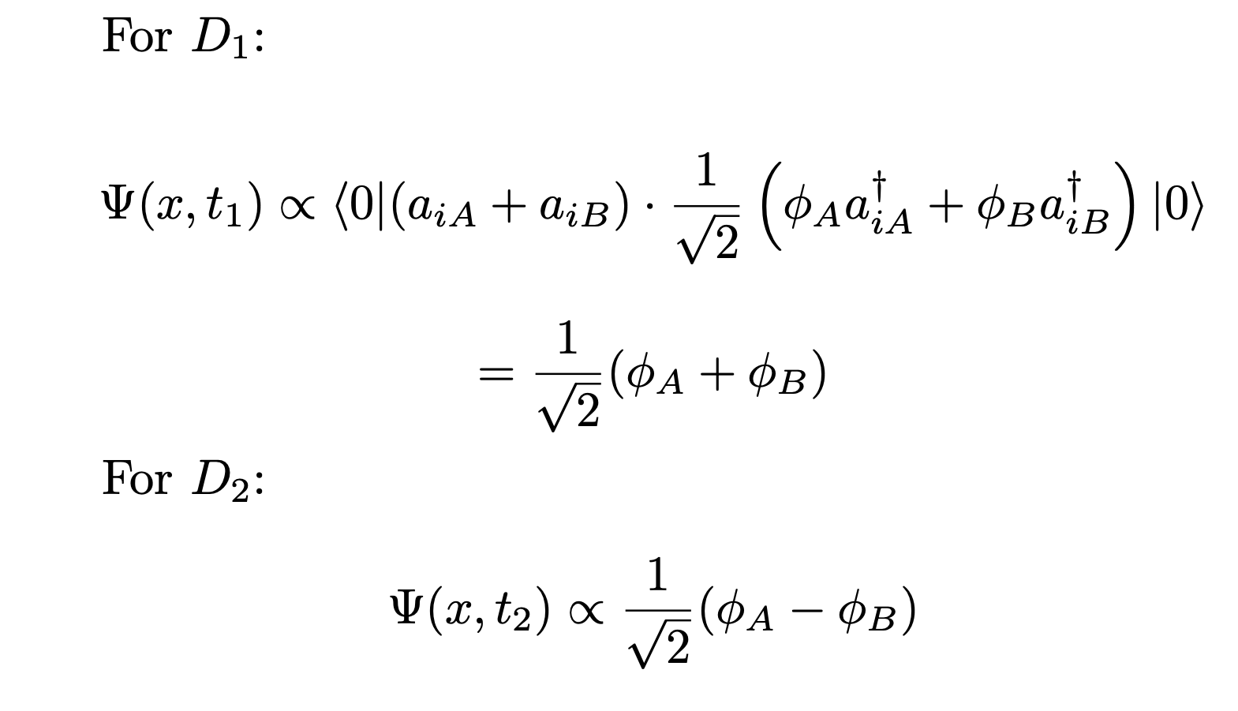
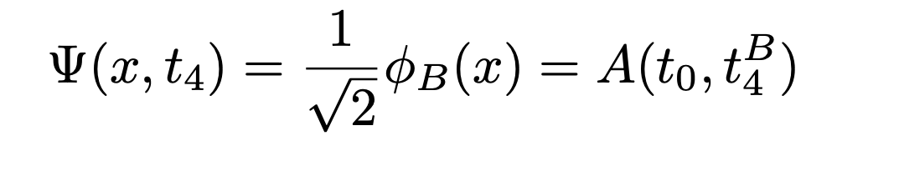
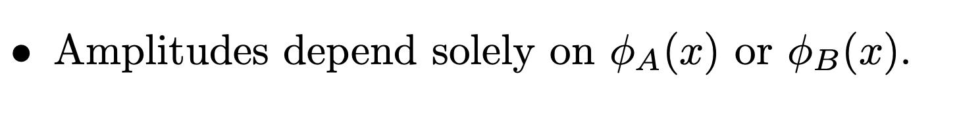
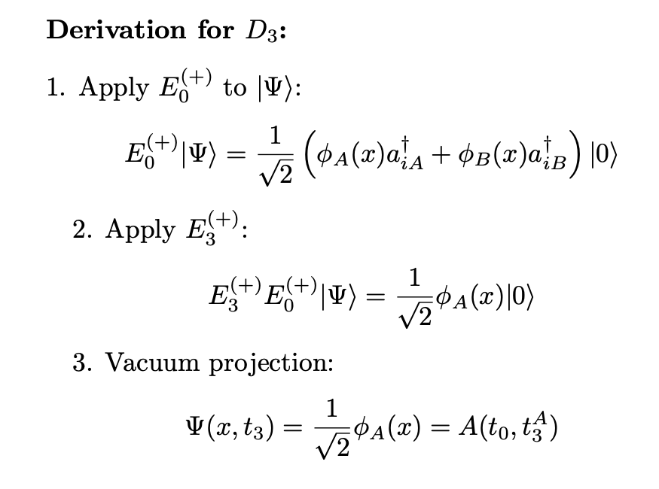
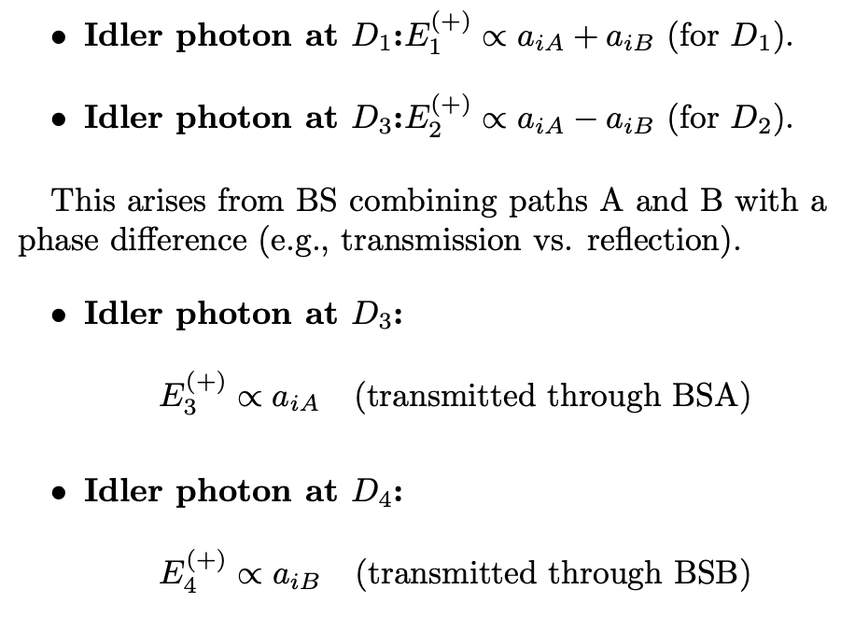

Slide 8
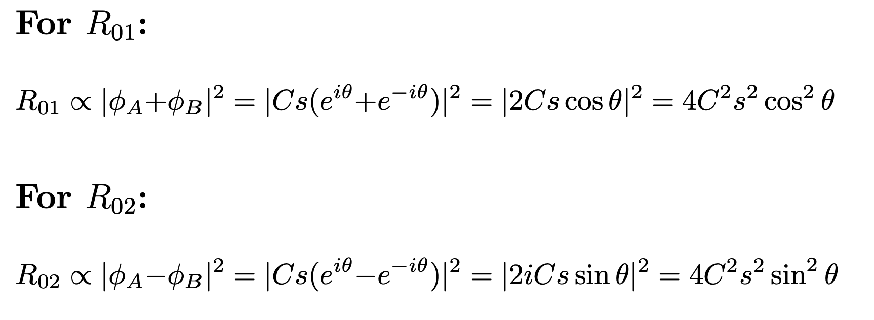
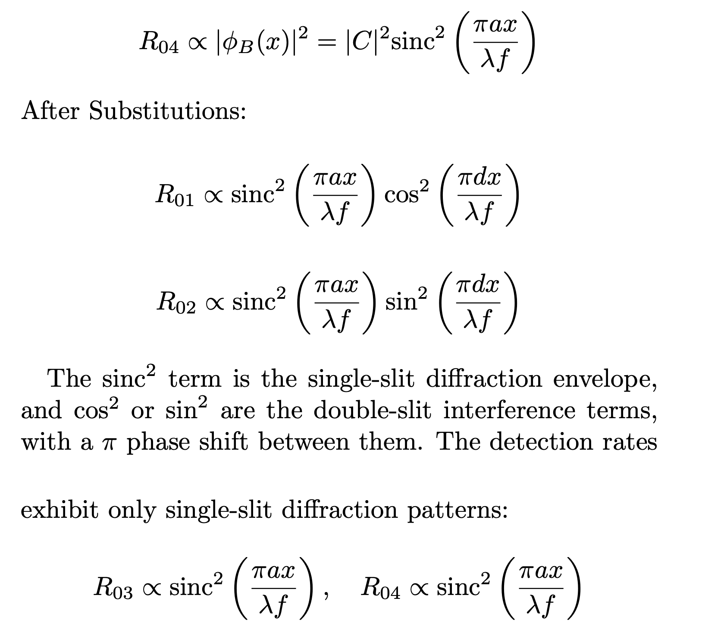
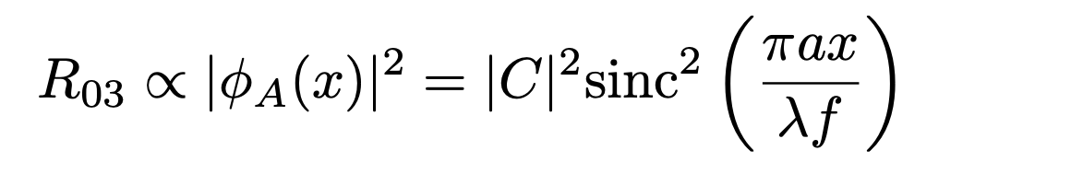
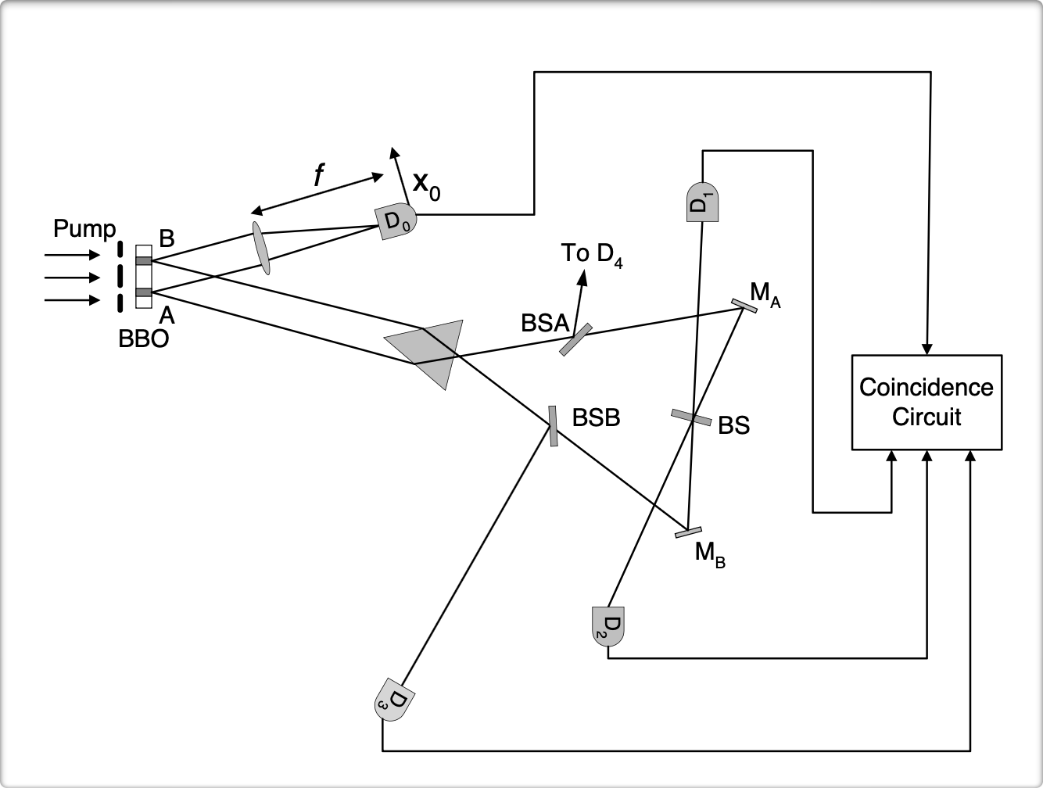
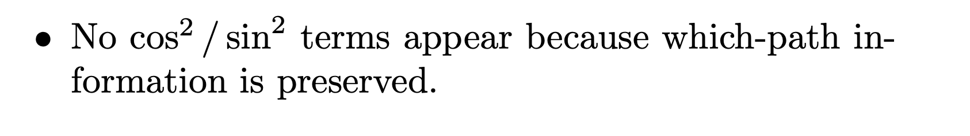

Slide 9
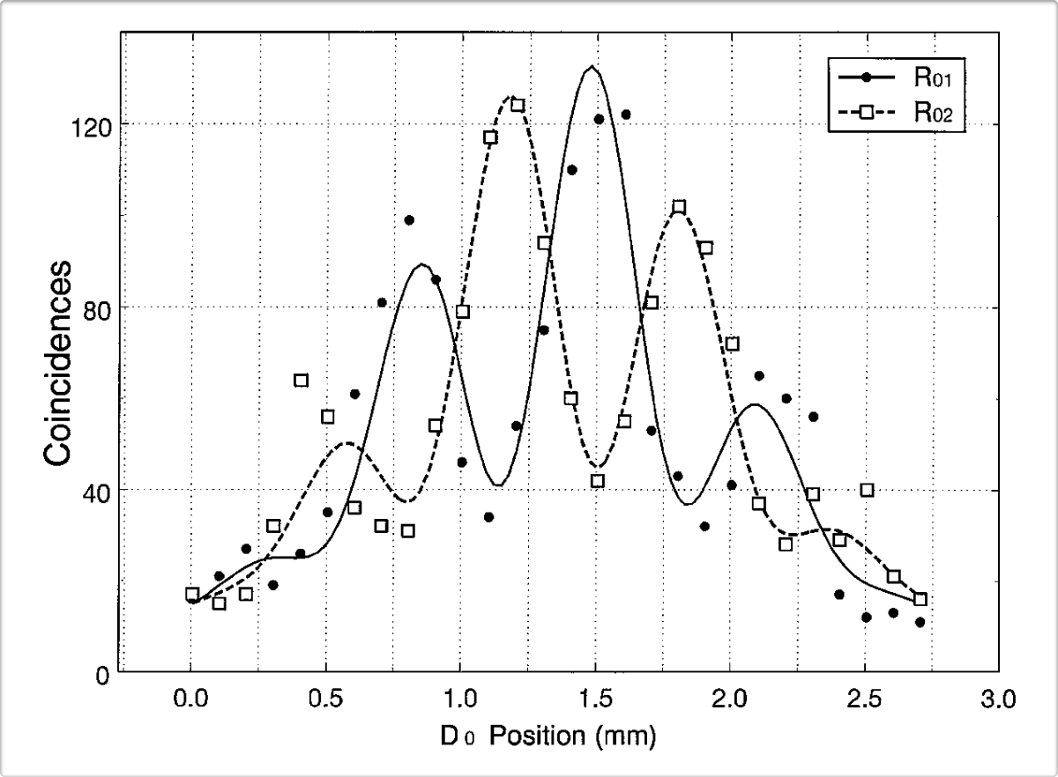
Results

Slide 10
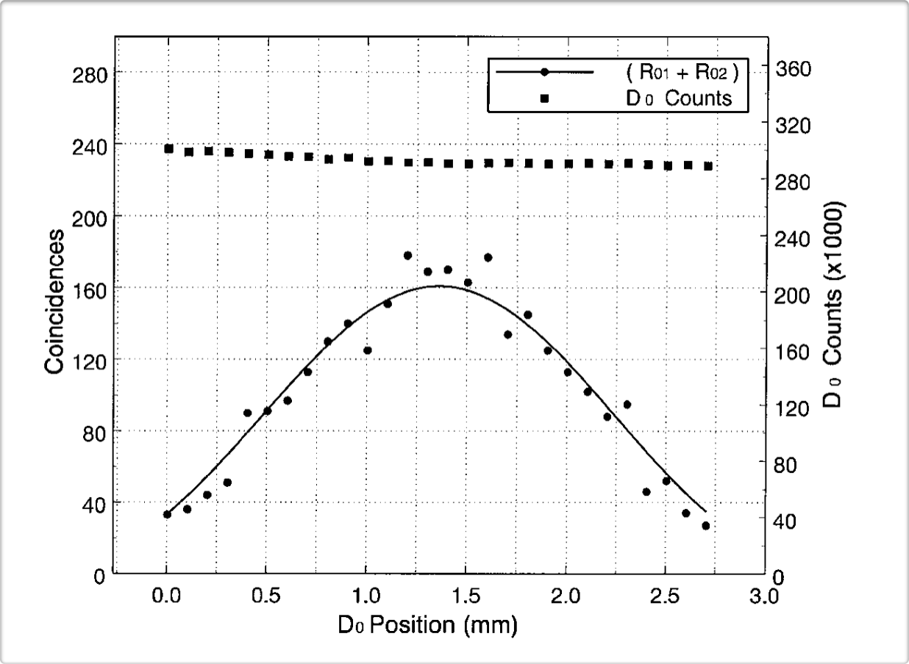
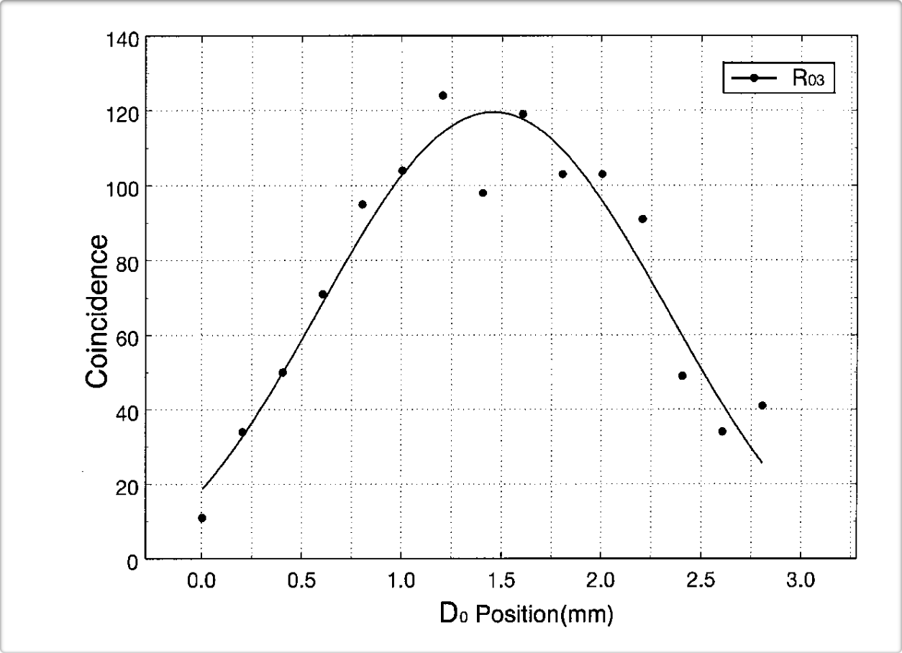

Slide 11
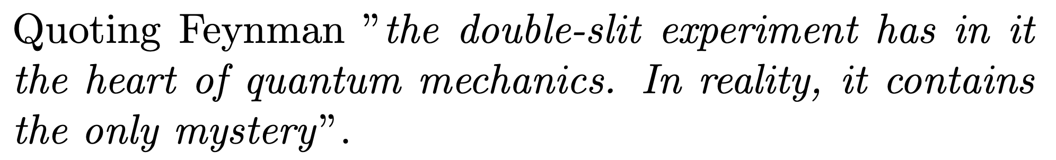
Conclusion
The experimental results demonstrate the possibility of determining particle-like and wave-like behaviours of a photon via quantum entanglement.

