Slide 1


Basics on Spin-Orbit-Interactions
—by
Ritik Dubey(22MS208)

Slide 2
Outline
Polarisation and Spatial DOF
Foundation of SOI
Optical angular momenta
SAM
Intrinsic OAM
Extrinsic OAM
Geometrical phases
spin redirection Berry phase
Pancharatnam-Berry phase
SOI in inhomogeneous anisotropic medium

Slide 3
Polarisation & Spacial DOF
Light
Polarization DOF
Spatial DOF
DOF mean I have the freedom to manipulate light without effecting other properties
Polarisation: it is the specific directions in which the electric field of light oscillate over time.

Slide 4
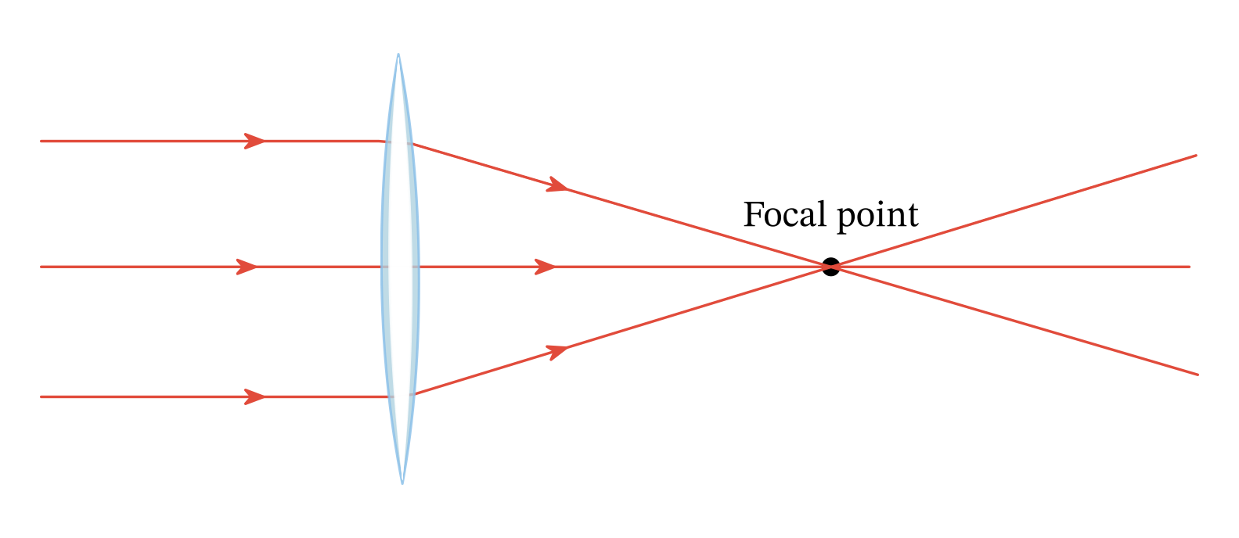
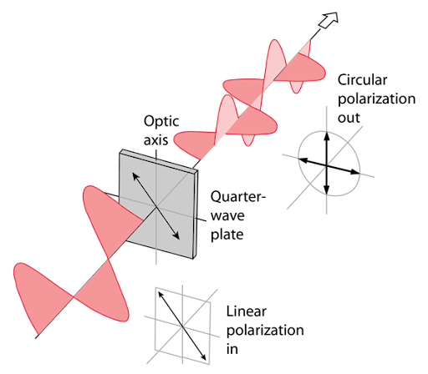
Foundation of SOI
In traditional Geometrical Optics, we can manipulate both DOF independently, No SOI
Only Spatial DOF changes (phase front)
Interaction of light at subwavelength scale introduces SOI.
e.g, SHE
Only Polarisation DOF changes

Slide 5
Before Discussing SOI
Optical Angular momenta
Geometrical phase

Slide 6
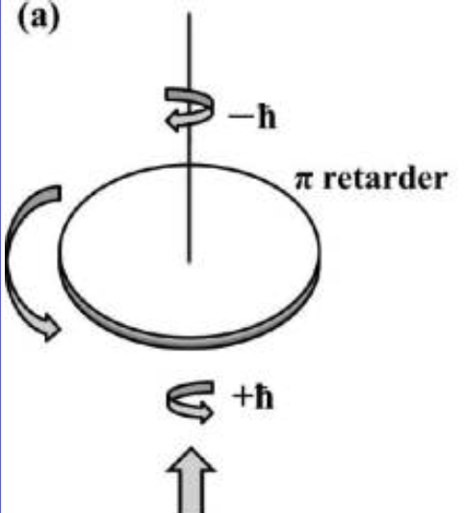
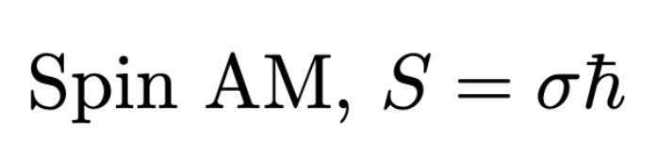
Optical Angular momenta
Beth’s experiment:
Circular Polarised light -> Electric field vector oscillates in circle
thus carries Angular momentum (Polarisation DOF)
elliptically polarized light characterized by −1 ≤ σ ≤ +1 (σ = ±1 for left/right circularly polarized light, respectively, and σ= 0 for linearly polarized light)
Spin AM is intrinsic as it solely depends on Polarisation and it is frame independent

Slide 7
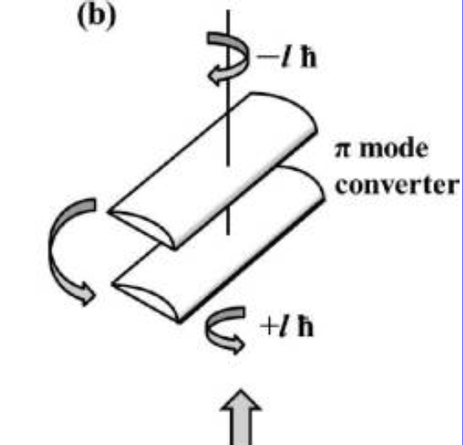
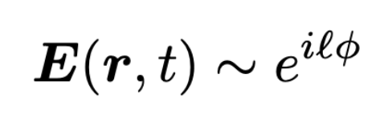
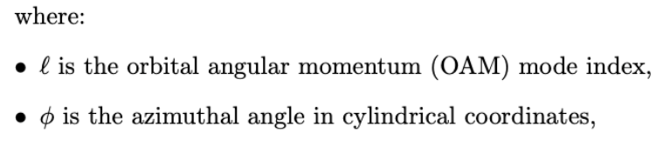
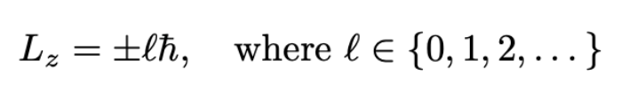
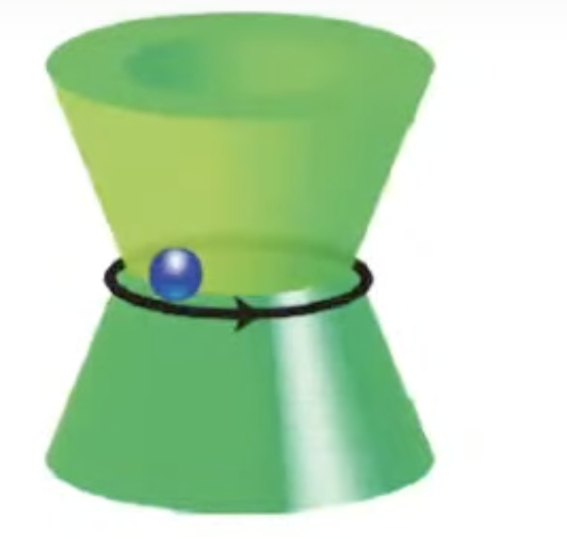
Analogous experiment proposed by Allen et al.
As wave propagate, Phase front rotate (Spatial DOF), thus carries Angular momentum
optical vortex beam
Optical tweezer
This orbital AM is intrinsic as it only depends on l and it is frame independent

Slide 8
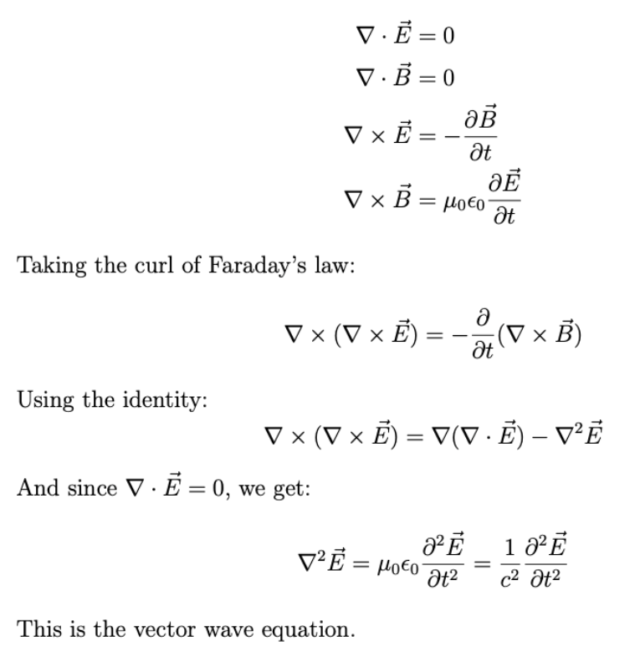
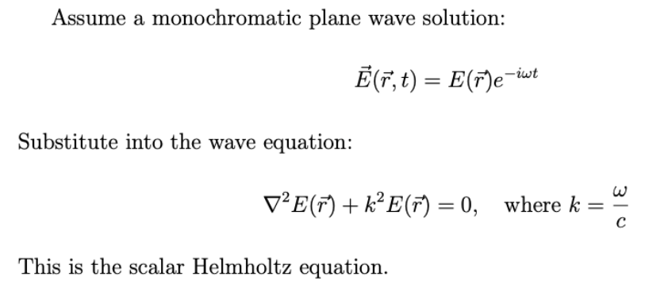
Derivation

Slide 9
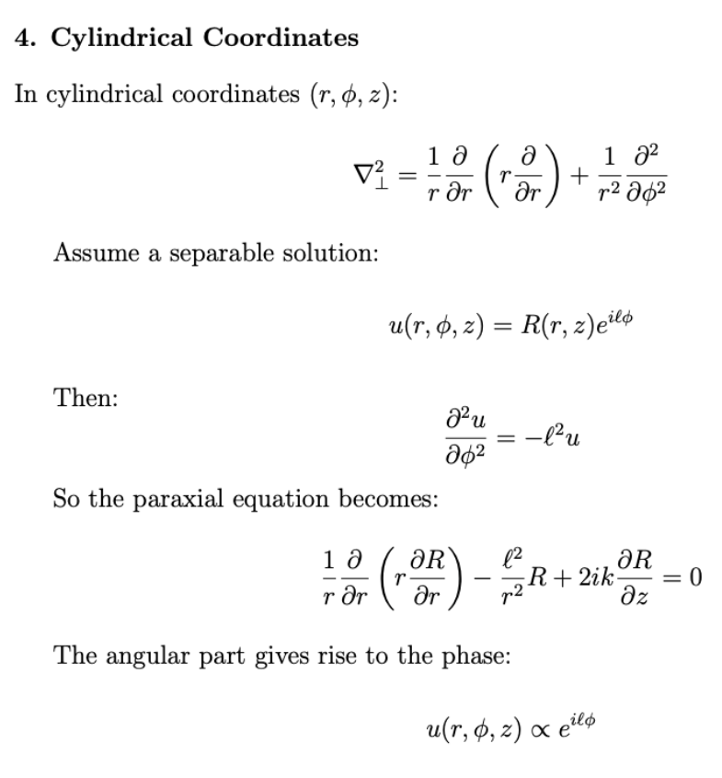
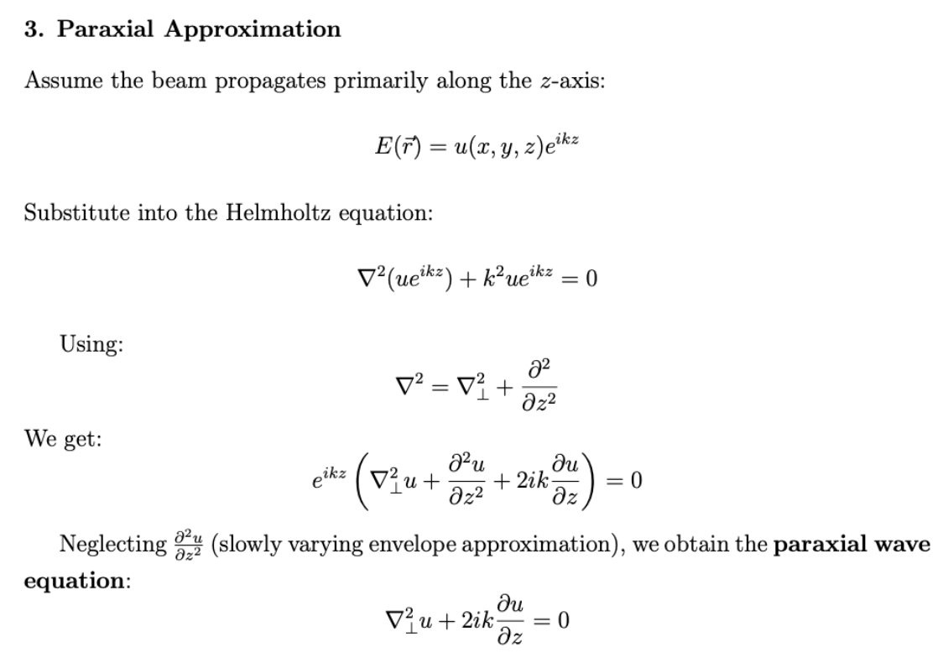

Slide 10
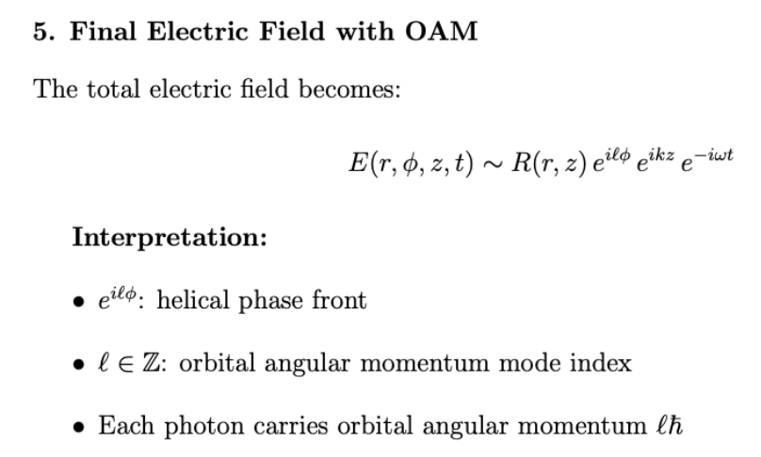

Slide 11
One last type of optical Angular momenta -> Extrinsic Orbital AM
simple Classical Angular momentum, L = r x p
coordinate origin dependent, Extrinsic

Slide 12
Geometrical phase
Dynamical phase: phase difference arises from optical path length or refractive index
e.g, YDSE
Geometrical phase
spin redirection Berry phase
Pancharatnam-Berry phase

Slide 13
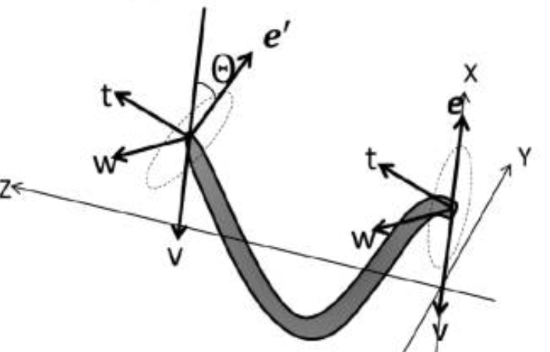
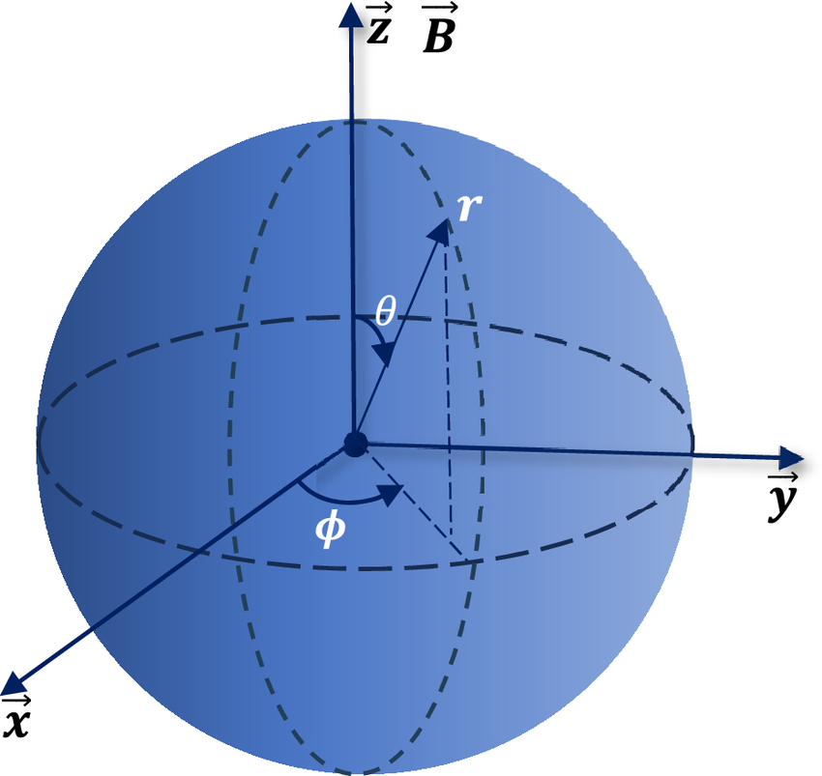
spin redirection Berry phase
spin redirection Berry phase: Adiabatic evolution of the wavevector in a helically wound isotropic waveguide leads to an extra geometric phase, observed as a rotation of polarization in the lab frame, caused by the parallel transport of the polarization vector.
Intuition

Slide 14
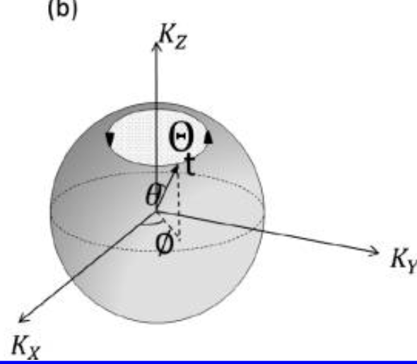
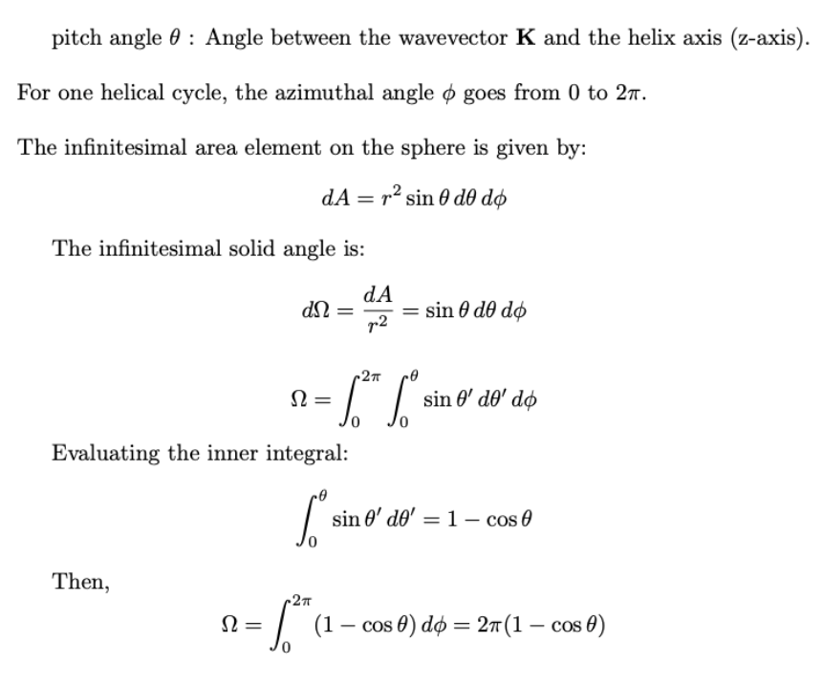

Slide 15
Experimental validation
Left Hand Helix optical fiber
RCP
Interference pattern !!!
Right Hand Helix optical fiber

Slide 16
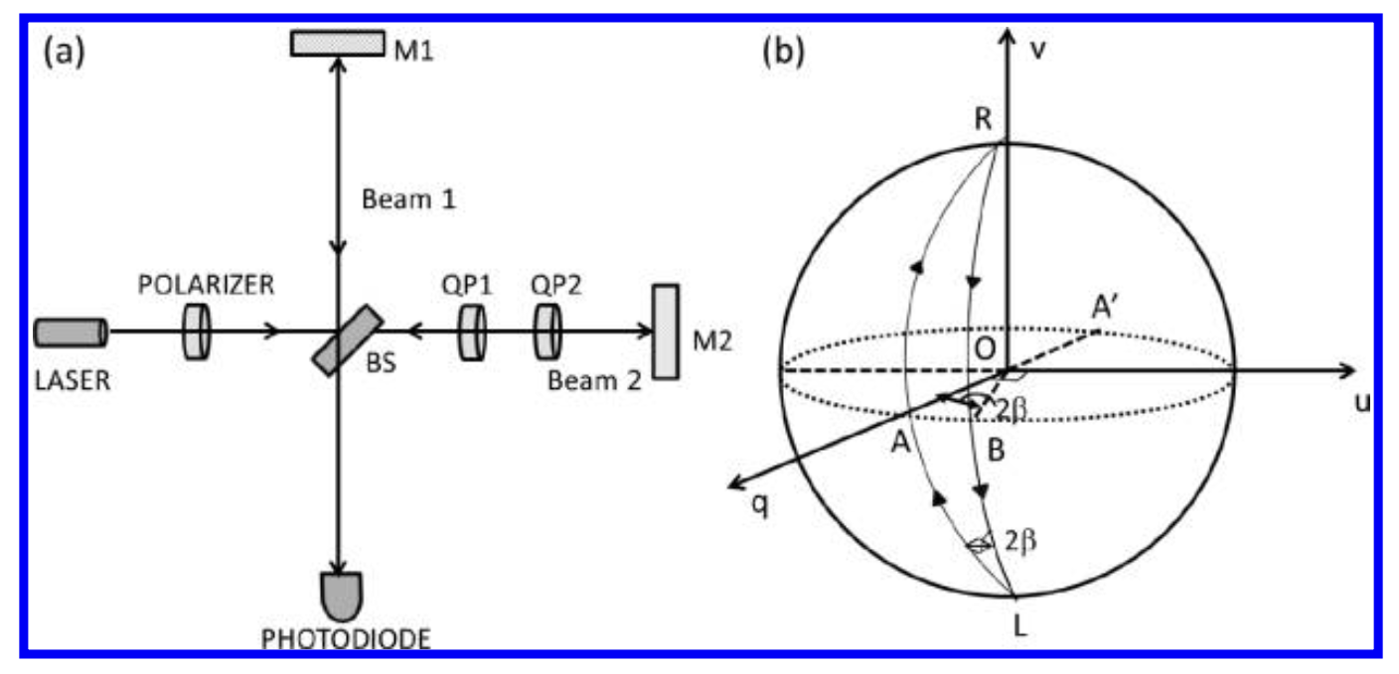
Pancharatnam-Berry phase
Pancharatnam-Berry phase: It arises when a polarized wave undergoes a continuous change in its polarization state, keeping the wavevector remains fixed, when propagate through an anisotropic medium.
Experimental validation

Slide 17
How exactly changing polarisation state induces a geometrical phase?
Mathematics, by using Jones vector and Jones matrix

Slide 18
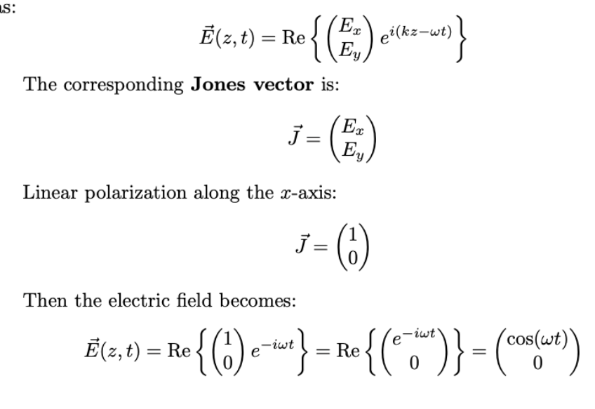
Jones vector
Y
X

Slide 19
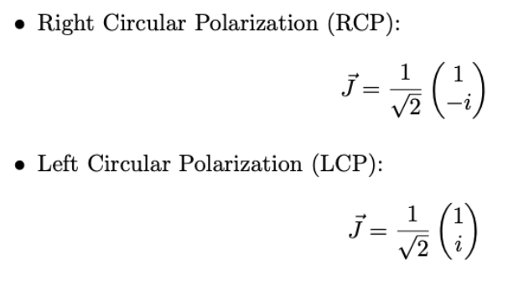
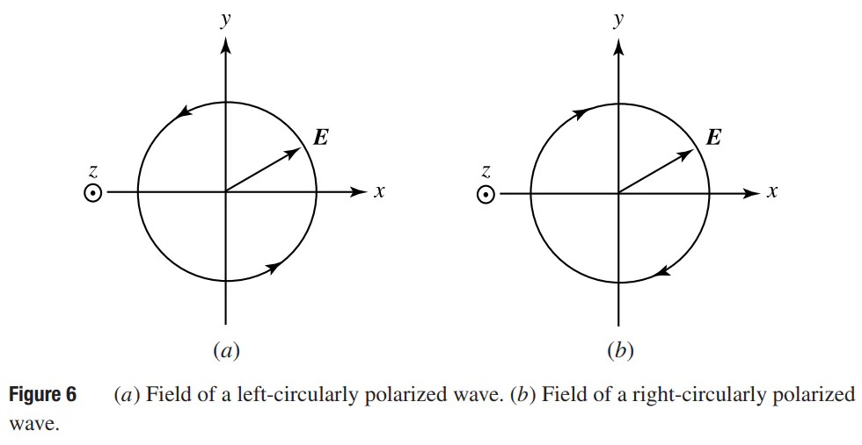

Slide 20
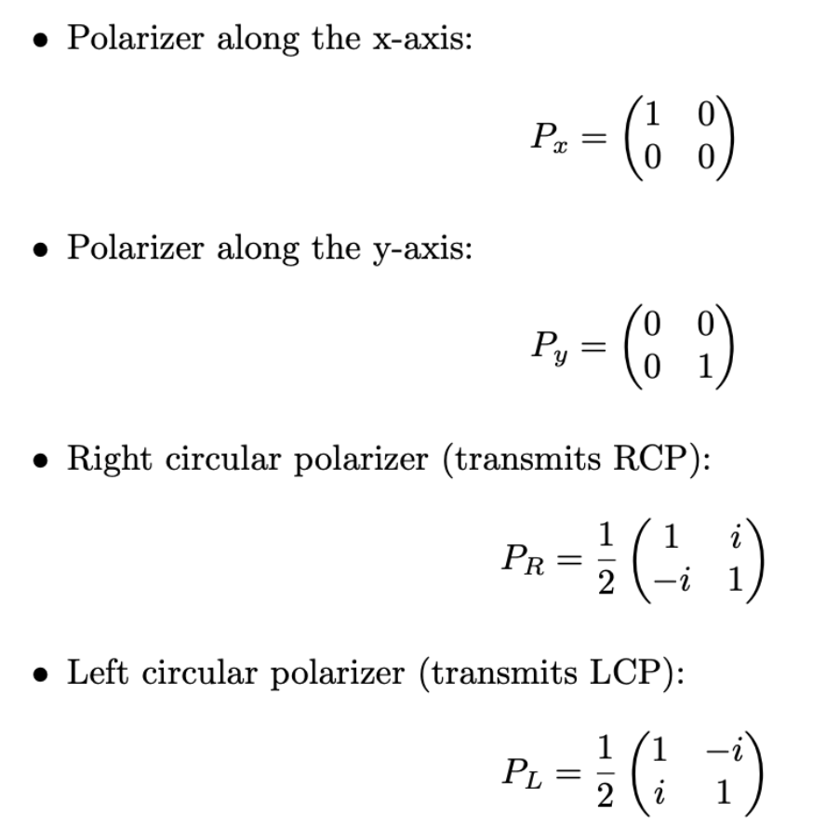
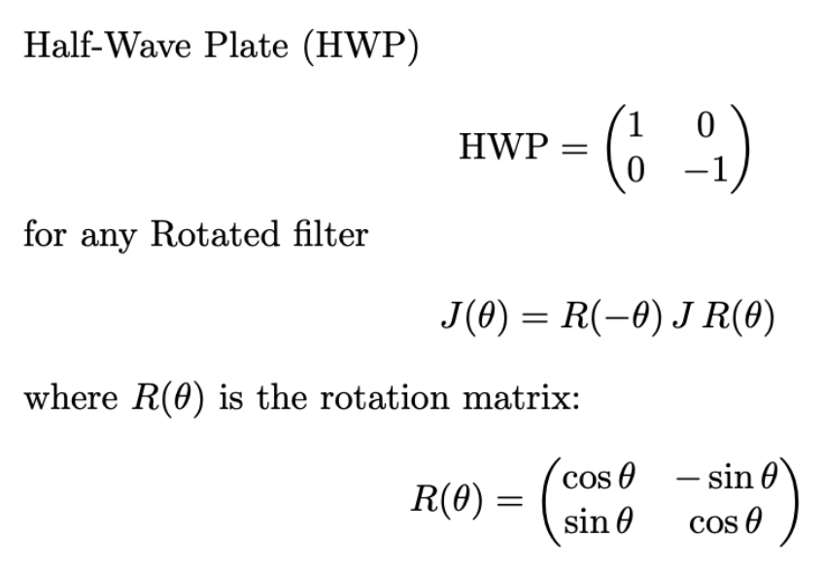
Jones matrix

Slide 22
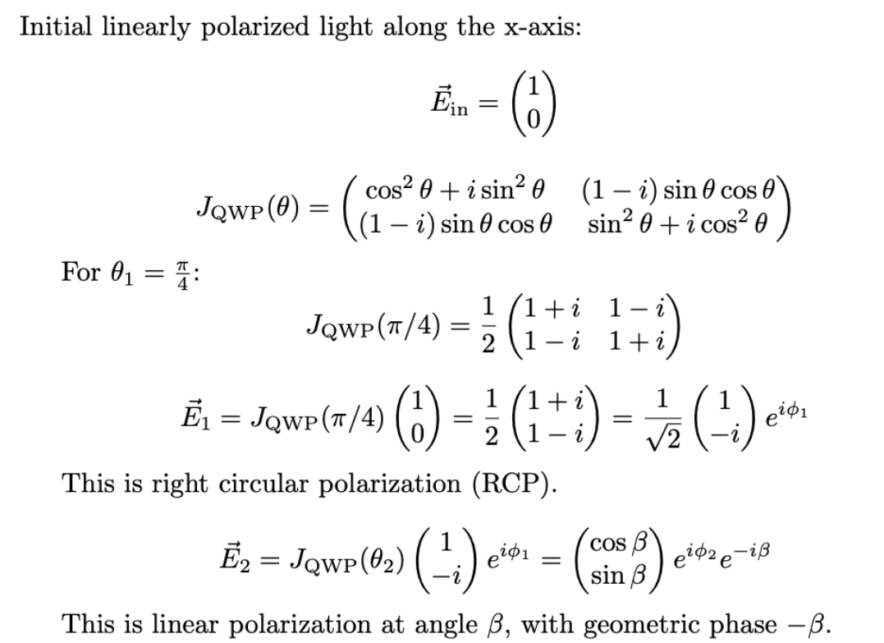

Slide 23
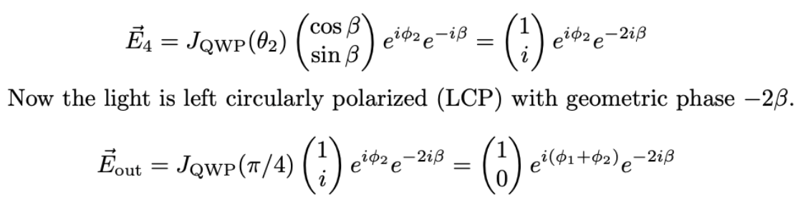
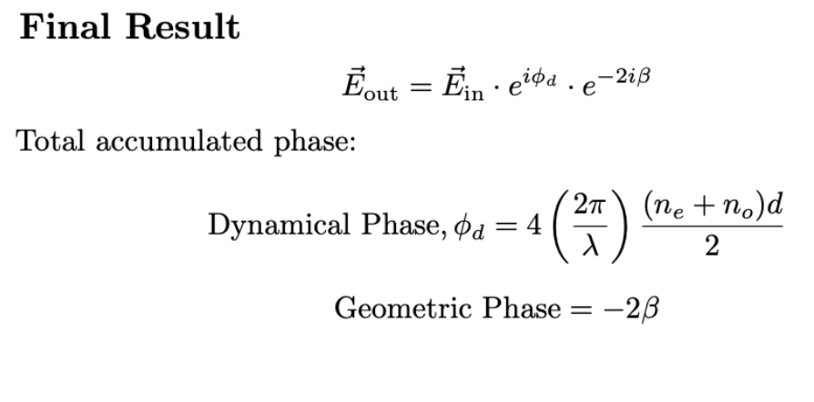

Slide 24
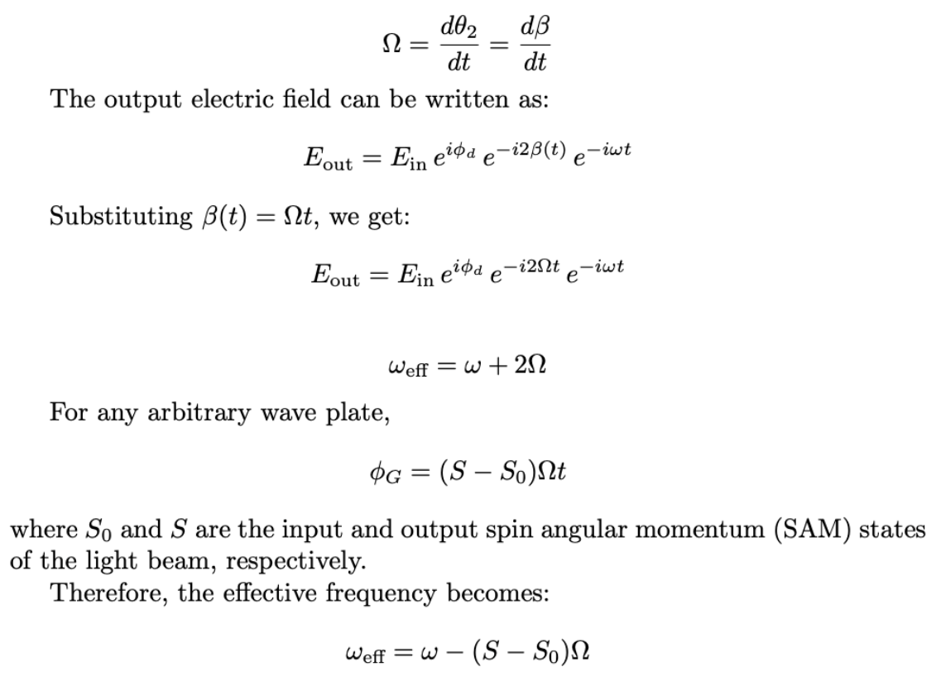
Let’s Rotate the QWP2 with uniform angular velocity

Slide 25
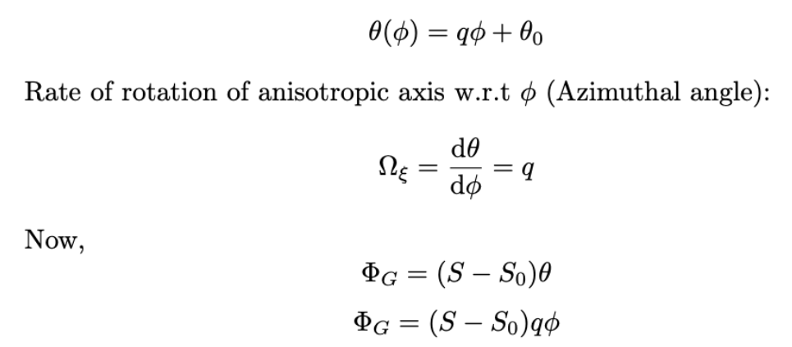
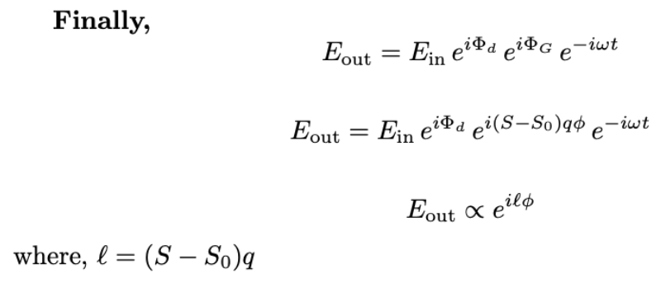
SOI in inhomogeneous anisotropic medium
inhomogeneous anisotropic medium( i.e., a medium having a spatially varying axis of anisotropy),
Specially, axis of anisotropy varying linearly on Azimuthal angle.
As,

Slide 26
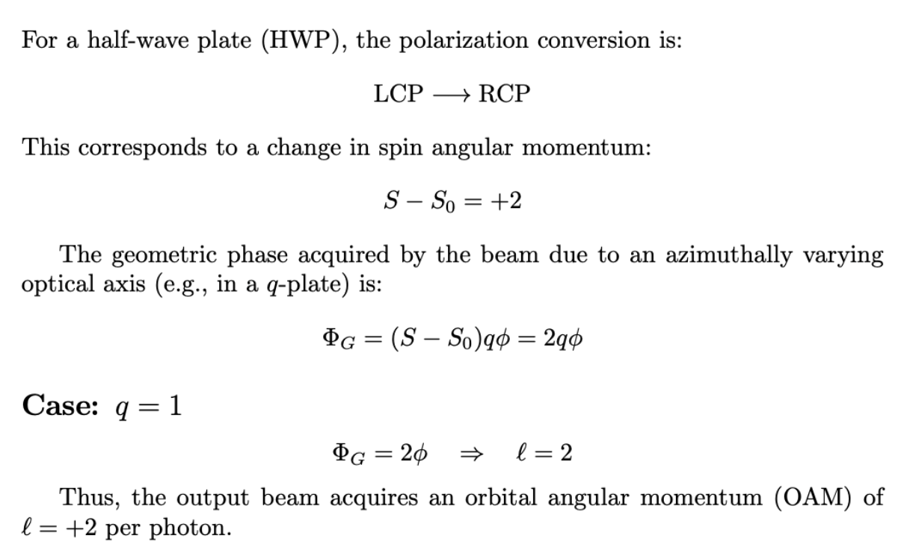
Example

Slide 27
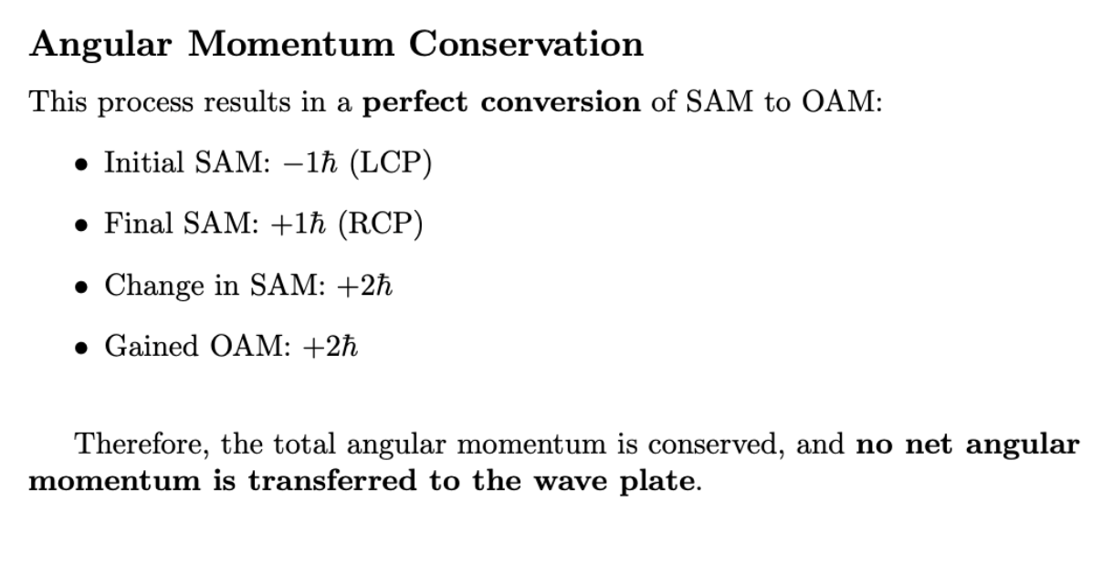

Slide 28
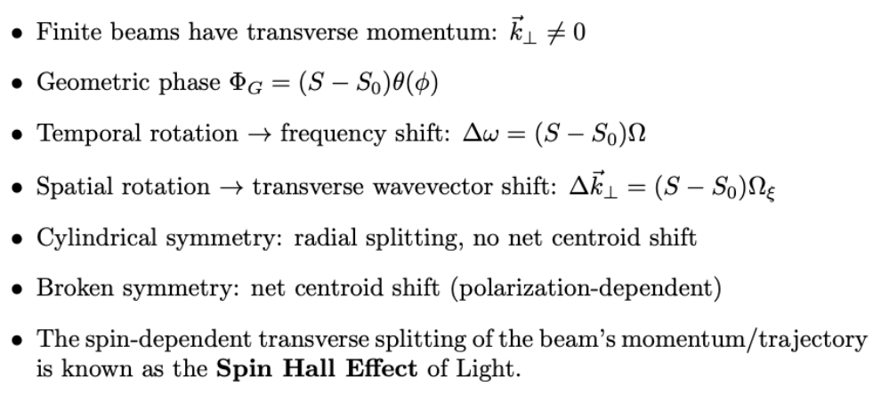

Slide 29
Thank you

