Slide 1
AR-BoT Virtual Personal Assistant
1
BY:-
RITIK THAKUR (319021007)
ANUJ ATTRI (319021005)

Slide 2
Introduction 2 gji
A virtual assistant is a technology based on artificial intelligence.
A VPA is an program that can understand natural human language , speak natural language and complete electronic tasks for the end user.
It provide support 24 x 7
VPA comes in mobile phones , desktop system and also speakers.
Some popular VPA are : siri from apple, Cortana from Microsoft , Alexa from Amazon and etc……

Slide 3






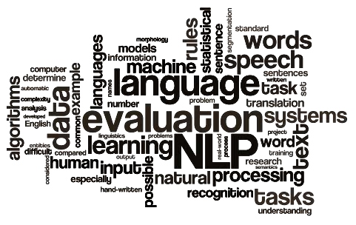
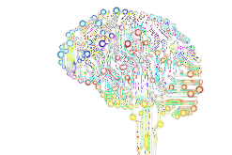

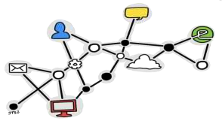
The working of Virtual Assistant uses following principles:
3
Natural Language Processing.
To Understand user’s speech input.
Automatic Speech Recognition.
To understand command according to user’s input.
Artificial Intelligence.
To learn things from user and to store all information bout behavior and relations of user
Inter Process Communication.
To get important information from other software applications.

Slide 4
Hardware And Software Requirements 4
Hardware:
A system with intel i3 or above
Ram should be of a minimum 4 GB.
Internet connectivity.
Software:
Operating system: Windows or any equivalent .
IDE : Visual Studio or any equivalent
Support of other basic applications like music, web connection etc.

Slide 5


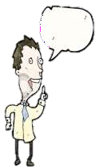
Any Virtual Assistant basically consists of three layers.
5
Speech to text
Text Analysing
Interpret commands

Slide 6



1. Speech to text:
6
A Piece of software used that converts audio to text.
It doesn’t understand just anything you might say.
Text Analysing:
Converted text is just letters for computer.
A piece of software converts text to something that is understandable for computer.
Computer understands the command, so Virtual Assistant like google asisstant convert this text to computer command.

Slide 7
7
VPAs maps the words to functions and parameters to create a command that
computer can understand.
Example of Reminder.
Interpret commands:
In this layer, that mapped computer command, go to server through internet.
Simultaneously, your speech evaluated locally.
A local recogniser communicate with server to judge whether command will be best handle locally or not.
Example:
Play Music, Restaurant reservation, Movie Rating

Slide 8


Some of the features of Virtual Assistant, you may ask him in day by day
8
uses are shown below:
search anything on Wikipedia
Open google and search
Open YouTube
Check Instagram profile and download profile picture
Latest news
Restart and shutdown the system
Play Music & Videos
Wake me up at 6.00AM

Slide 9

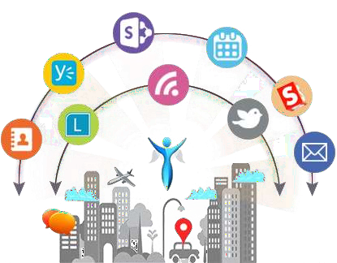
Some of the features of Virtual Assistant, you may ask him in day by day
9
uses are shown below:
Take screenshot
Tell us jokes
Geeksforgeeks (education)

Slide 10



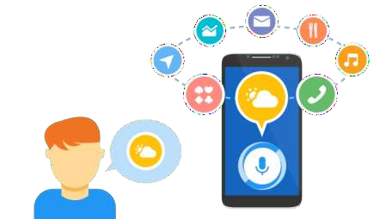
10
These applications make small and smart hand-held devices to combine
multiple features.
They allow you to export and import data.
Store various information.
Make to do lists.
Recognizes voice commands.
Controls various applications of device.
Provides services regarding your location.
Helps to plan your whole day.
Reminds you important things on accurate situations or location. (Geofencing)

Slide 11




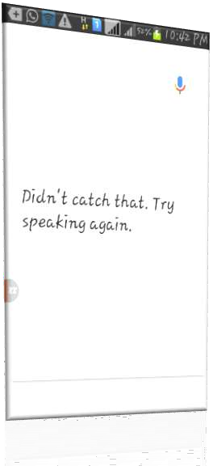
11
Listening problem.
VPA get problem to process wrong pronounced words and miscellaneous words.
Navigation languages.
Most of VPAs can understand only English language.
Internet access.
VPA needs internet connection to give desired output.

Slide 12


Any query email me :- ritikthakur342@gmail.com - Ritik Thakur rulerxanuj@gmail.com - Anuj Attri You can also find me on Instagram:- @p1anuj @ritikk_thakurr
13

Slide 13


14
☺

