Slide 1
Placement system
Ritik Kumar Jain

Slide 2
Overview

Slide 3
Brief Overview
Placement System is a Student/TPC(Training Placement Cell) is a information based web based system. This project can be used by students for storing and retrieving the information and can be used by TPC’s to update placement data of system with respect to student. The software is used to retrieve the data and display as per user requirement. Usually most of the colleges do the task of storing the details manually with hand. So this software is developed in order to ease the storing of data.

Slide 4
Technologies and framework used

Slide 5







Technology and Framework
Front End
Middleware
Testing
Back End
React
.Net Framework
EntityFramework
SQL Server
Future Plan(Currently working on it 18/9/2022) for the project is to deploy on Cloud Service – AZURE, AWS

Slide 6
Microservices

Slide 7
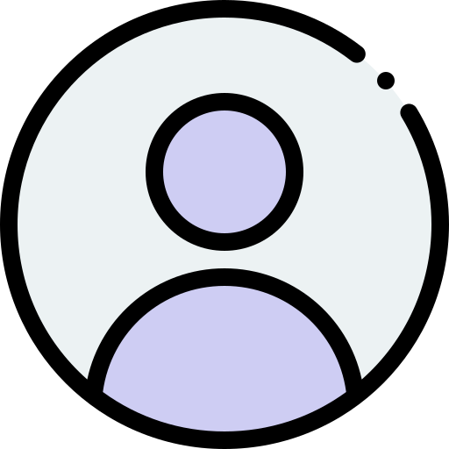
Authorization
Student
DB
Coordinator
DB
React Application
Students/Coordinators
Use Case Diagram

Slide 8
Students Microservice
A Student through the web application can interact with Students Service in order to create his/her details, Update and View it later.
POST: Add their details
PUT: Update their details
GET: Retrieve their details

Slide 9
Coordinators Microservice
A coordinator through the web application can interact with Coordinators service in order to create placement details of a students by simply using his Institute ID and Update it and Later view it
GET: View details of a particular Student
PUT: Edit Placement details of a student
POST: Create Placement Details for a Student

Slide 10
Authorization microservice
Authorization microservice for dealing with authorization details of a students/coordinators.
POST: For New user to create a new Account basis of Student/Coordinator
POST: Authorization System that will be able to generate tokens on the basis of given Id and password which will then allow access to respective student and coordinator portal

Slide 11
React Application
Allows students to Log In or Sign up to the website. Once successfully logged in the website will navigate to their respective portal based on Role i.e. whether it is student or coordinator.

Slide 12
Future work

Slide 13
Future work
Since each microservice is independent to each other and each has it own table/database so new microservices can be created and connected to database and then to web application without hindering the flow of the current application

