Slide 1

01 / 22
SCAN
ANALYZE
SCORE
PROTECT
stage
stage
stage
stage
SCAMSHIELD AI
A defensive security-scanning platform for modern digital threats
Project presentation • Ritik Moga
SCAMSHIELD AI • DEFENSIVE SECURITY PLATFORM

Slide 2
02 / 22
01 • ROADMAP
What this deck covers
• The security problem and product vision
• Platform architecture, scans, and risk scoring
• Authentication, persistence, deployment, and roadmap
Problem
Platform
Security
Scale
stage
stage
stage
stage
SCAMSHIELD AI • DEFENSIVE SECURITY PLATFORM

Slide 3
03 / 22
02 • PROBLEM
Digital threats move faster than human review
• Links, messages, attachments, and QR codes can hide risk
• Users need a clear, fast, defensive first check
• The goal is triage—not executing suspicious content
Input
Unknown risk
Human delay
Exposure
stage
stage
stage
stage
SCAMSHIELD AI • DEFENSIVE SECURITY PLATFORM

Slide 4
04 / 22
03 • VISION
One defensive workspace for four common attack surfaces
• A single console reduces switching cost
Messages
• Each input type receives purpose-built analysis
URLs
module
Files
module
module
• Risk reports translate signals into practical next actions
ScamShield
core
QR codes
module
Reports
module
SCAMSHIELD AI • DEFENSIVE SECURITY PLATFORM

Slide 5
05 / 22
04 • ARCHITECTURE
A layered platform designed for safe analysis
• React + TypeScript delivers the operator experience
• Flask coordinates validation, analysis, scoring, and storage
• Optional providers extend local heuristics without becoming a dependency
Browser
API
Validation
Detectors
Scoring
Storage
stage
stage
stage
stage
stage
stage
SCAMSHIELD AI • DEFENSIVE SECURITY PLATFORM

Slide 6
06 / 22
05 • FRONTEND
A crimson security operations dashboard
• Persistent sidebar creates dedicated scanner workspaces
• Results use risk badges, gauges, findings, and metadata
• Google sign-in enables personal history when configured
Sidebar
Scanner page
API client
Result view
History
stage
stage
stage
stage
stage
SCAMSHIELD AI • DEFENSIVE SECURITY PLATFORM

Slide 7
07 / 22
06 • NAVIGATION
Separate pages keep every scanning task focused
• URL, message, file, and QR workflows are not hidden in one tab
Message
• Reports and lookup are separate destinations
URL
module
File
module
module
• Administrators receive a platform-posture destination
Dashboard
core
QR
Admin
module
Reports
module
module
SCAMSHIELD AI • DEFENSIVE SECURITY PLATFORM

Slide 8
08 / 22
07 • URL SCANNING
URL intelligence combines syntax and safety checks
• Validates scheme and host before analysis
• Flags suspicious patterns, redirect bait, and phishing signals
• Avoids unsafe fetching of local or private network targets
URL
Validate
Heuristics
Findings
Risk report
stage
stage
stage
stage
stage
SCAMSHIELD AI • DEFENSIVE SECURITY PLATFORM

Slide 9
09 / 22
08 • MESSAGE SCANNING
Message analysis surfaces social-engineering indicators
• Inspects subject, body, attachment names, and embedded URLs
• Findings remain explainable instead of opaque
• Output recommends safe next actions
Message
Extract
URL checks
Malware cues
Report
stage
stage
stage
stage
stage
SCAMSHIELD AI • DEFENSIVE SECURITY PLATFORM

Slide 10
10 / 22
09 • FILE SCANNING
Static inspection protects the scanner and the user
• Uploads are saved only to a temporary location
• The service never executes uploaded files
• Allowed extensions and size caps reduce attack surface
Upload
Allowlist
Temp store
Static inspect
Delete
stage
stage
stage
stage
stage
SCAMSHIELD AI • DEFENSIVE SECURITY PLATFORM

Slide 11
11 / 22
10 • QR SCANNING
QR images are decoded locally before server analysis
• The browser decodes QR image content with jsQR
• Only decoded text is sent to the backend
• The resulting text is inspected like a URL or message
QR image
Browser decode
Text
Heuristics
Report
stage
stage
stage
stage
stage
SCAMSHIELD AI • DEFENSIVE SECURITY PLATFORM

Slide 12
12 / 22
11 • RISK ENGINE
Risk scoring turns many signals into one clear decision
• Each finding contributes a weighted score
• Severity bonuses preserve serious indicators
• Risk bands keep the response understandable
Findings
Weights
0–100 score
Risk band
Action
stage
stage
stage
stage
stage
SCAMSHIELD AI • DEFENSIVE SECURITY PLATFORM

Slide 13
13 / 22
12 • REPORTS
Reports are useful security artifacts—not just a score
• Every report has a scan ID and timestamp
• Findings retain evidence and severity
• Signed-in users can revisit stored scan history
Scan
JSON report
Local archive
User history
Lookup
stage
stage
stage
stage
stage
SCAMSHIELD AI • DEFENSIVE SECURITY PLATFORM

Slide 14
14 / 22
13 • AUTHENTICATION
Google Sign-In is verified server-side
• Browser receives a Google ID credential
• Flask verifies the ID token audience and email
• The app issues short-lived access and refresh JWTs
Google
ID token
Flask verify
JWT pair
Session
stage
stage
stage
stage
stage
SCAMSHIELD AI • DEFENSIVE SECURITY PLATFORM

Slide 15
15 / 22
14 • DATA
Storage scales from local development to PostgreSQL
• SQLite gives the project a zero-setup local path
• PostgreSQL schema models users, reports, sessions, keys, and audit events
• Migration adds Google identity fields for production
SQLite
User store
Reports
PostgreSQL
Audit log
stage
stage
stage
stage
stage
SCAMSHIELD AI • DEFENSIVE SECURITY PLATFORM

Slide 16
16 / 22
15 • RATE LIMITING
Abuse protection has a development and production path
• In-memory windows keep local demos safe
• Redis enables distributed limits across API instances
• Fallback behavior keeps the service available during Redis outages
Client
Limiter
Redis
Allow
429 retry
stage
stage
stage
stage
stage
SCAMSHIELD AI • DEFENSIVE SECURITY PLATFORM

Slide 17
17 / 22
16 • API SECURITY
Defensive defaults are built into the request lifecycle
• Input validation constrains size, shape, and allowed file types
• Request IDs improve traceability
• Security headers, CORS controls, and safe error messages reduce exposure
Request
Validate
Trace ID
Secure headers
Response
stage
stage
stage
stage
stage
SCAMSHIELD AI • DEFENSIVE SECURITY PLATFORM

Slide 18
18 / 22
17 • DEVOPS
Quality gates protect the project as it evolves
• GitHub Actions runs backend tests and frontend builds
• Dependabot tracks dependency updates
Commit
step
Pre-commit
• Pre-commit rules catch common repository mistakes
step
Deploy
step
CI
Build
step
step
SCAMSHIELD AI • DEFENSIVE SECURITY PLATFORM

Slide 19
19 / 22
18 • DEPLOYMENT
Container-ready today, production-ready by configuration
• Docker packages the Flask service
• Persistent data volume supports the local store
• Production uses HTTPS, strict CORS, managed Postgres, Redis, and secret management
Source
Docker
API container
Data
Reverse proxy
stage
stage
stage
stage
stage
SCAMSHIELD AI • DEFENSIVE SECURITY PLATFORM

Slide 20
20 / 22
19 • OPENAPI
A documented API improves integration and testing
• OpenAPI describes health, scan, auth, refresh, and dashboard routes
• Typed frontend helpers centralize request parsing
• Consistent envelopes simplify client error handling
OpenAPI
Endpoints
Typed client
Frontend
Consumers
stage
stage
stage
stage
stage
SCAMSHIELD AI • DEFENSIVE SECURITY PLATFORM

Slide 21
21 / 22
20 • THREAT MODEL
Security decisions are driven by explicit assets and controls
• Uploads: static-only handling and deletion
• Accounts: verified Google tokens and JWT expiry
Assets
step
Threats
• Reports: authenticated history, retention guidance, and audit-ready schema
step
Review
step
Controls
Monitoring
step
step
SCAMSHIELD AI • DEFENSIVE SECURITY PLATFORM

Slide 22
22 / 22
21 • ROADMAP
From capable project to production service
• Connect real Google credentials and configure secrets
• Activate PostgreSQL and Redis infrastructure
• Add queue workers, isolated malware engines, and observability
Credentials
Infrastructure
Workers
Telemetry
Scale
stage
stage
stage
stage
stage
SCAMSHIELD AI • DEFENSIVE SECURITY PLATFORM

Slide 23
22 / 22
Build defensively. Explain clearly. Improve continuously.
ScamShield AI is a project foundation for safer digital decisions.
SCAN
ANALYZE
DECIDE
PROTECT
stage
stage
stage
stage
github.com/ritikmoga/AI_SECURITY_FEATURE
SCAMSHIELD AI • DEFENSIVE SECURITY PLATFORM

Slide 24
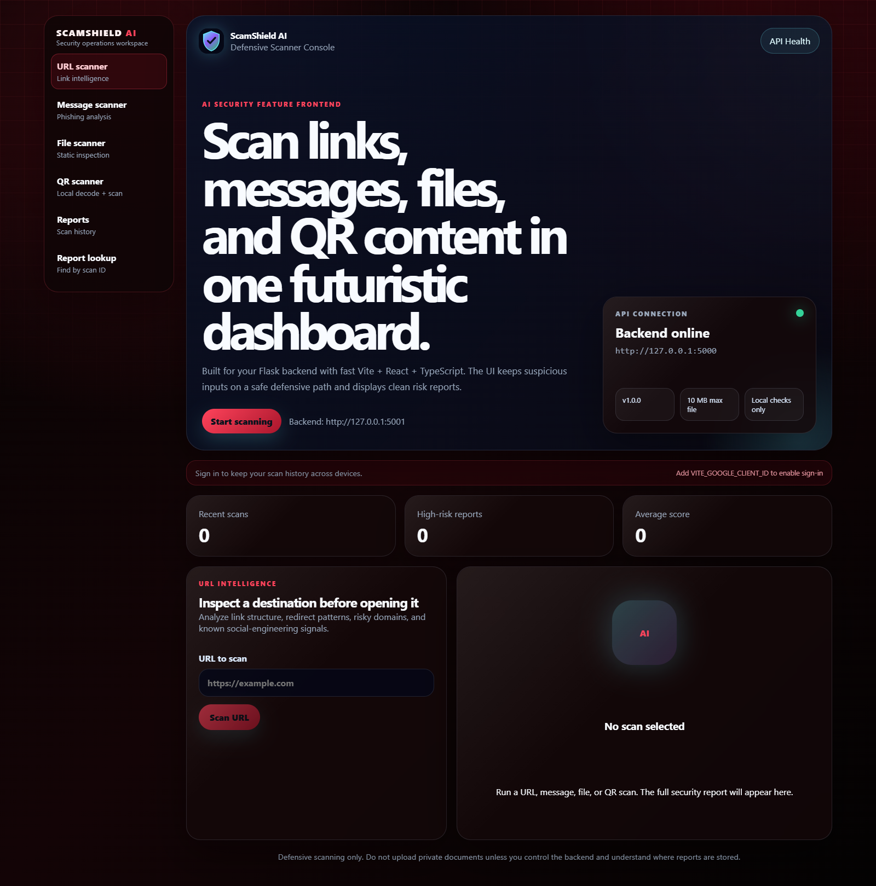
LIVE TEST EVIDENCE
24
Dashboard overview — live frontend
SAFE TEST INPUT
Opened the local React security dashboard at http://127.0.0.1:5174.
INPUT
API
SCORER
REPORT
OBSERVED RESULT
The dashboard loaded successfully with sidebar navigation and live service status.
LIVE LOCAL UI CAPTURE • 127.0.0.1:5174 → 127.0.0.1:5000

Slide 25
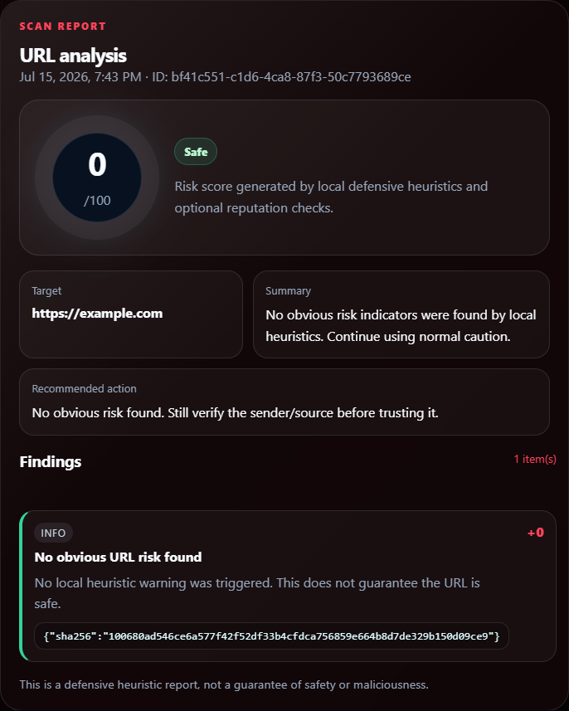
LIVE TEST EVIDENCE
25
URL scan — safe example
SAFE TEST INPUT
https://example.com
INPUT
API
SCORER
REPORT
OBSERVED RESULT
The report returned a Safe verdict with an explainable informational finding.
LIVE LOCAL UI CAPTURE • 127.0.0.1:5174 → 127.0.0.1:5000

Slide 26
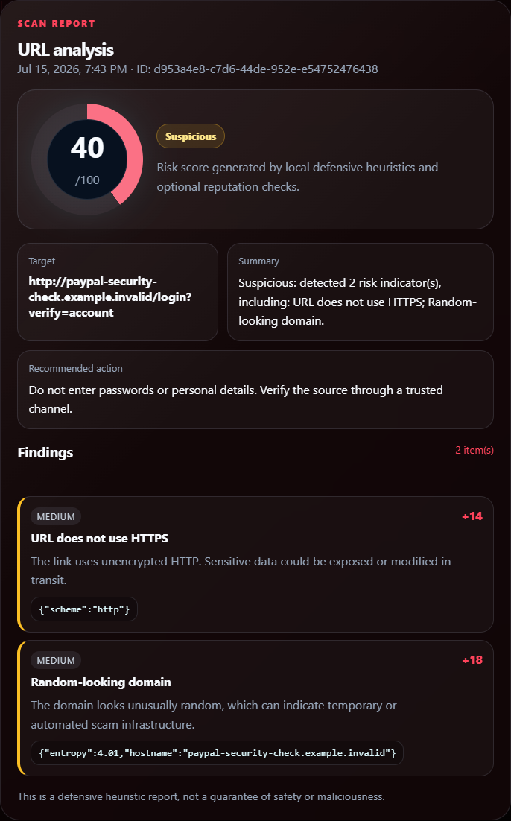
LIVE TEST EVIDENCE
26
URL scan — suspicious pattern example
SAFE TEST INPUT
http://paypal-security-check.example.invalid/login?verify=account
INPUT
API
SCORER
REPORT
OBSERVED RESULT
The local heuristics identified risky structural signals and produced a high-risk response.
LIVE LOCAL UI CAPTURE • 127.0.0.1:5174 → 127.0.0.1:5000

Slide 27
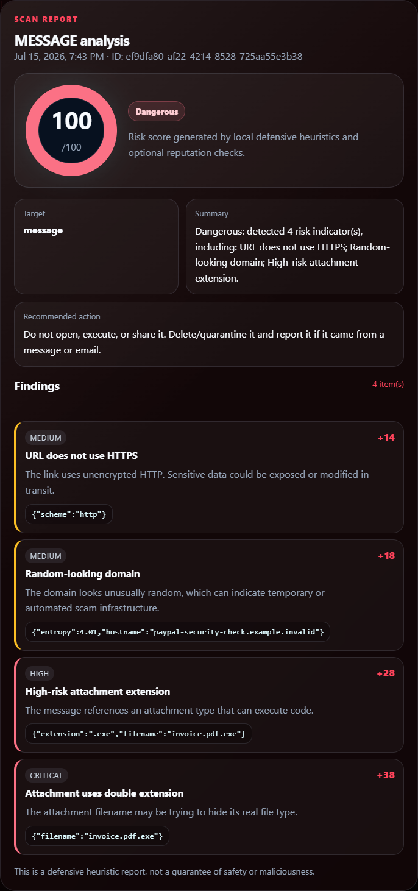
LIVE TEST EVIDENCE
27
Message scan — phishing-style test
SAFE TEST INPUT
Urgent account-review text plus invoice.pdf.exe attachment metadata.
INPUT
API
SCORER
REPORT
OBSERVED RESULT
Message, URL, and attachment indicators were combined into one defensive report.
LIVE LOCAL UI CAPTURE • 127.0.0.1:5174 → 127.0.0.1:5000

Slide 28
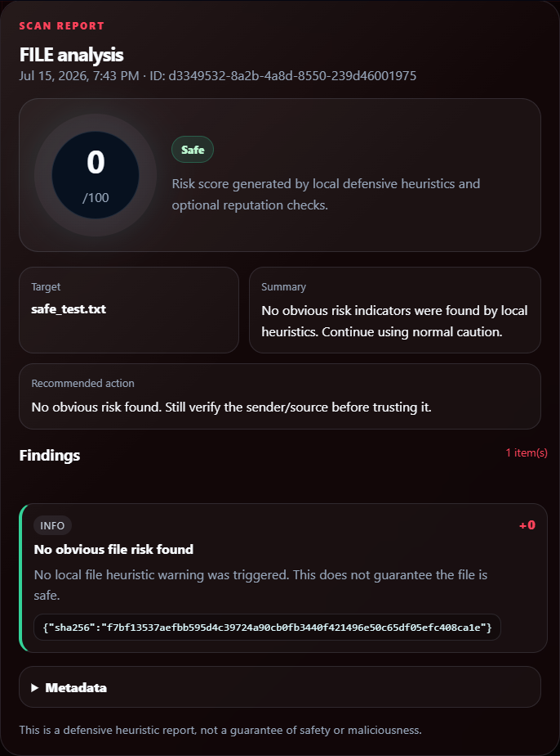
LIVE TEST EVIDENCE
28
File scan — safe static-analysis test
SAFE TEST INPUT
tests/fixtures/safe_test.txt
INPUT
API
SCORER
REPORT
OBSERVED RESULT
A harmless sample file was inspected statically; no file execution occurred.
LIVE LOCAL UI CAPTURE • 127.0.0.1:5174 → 127.0.0.1:5000

Slide 29
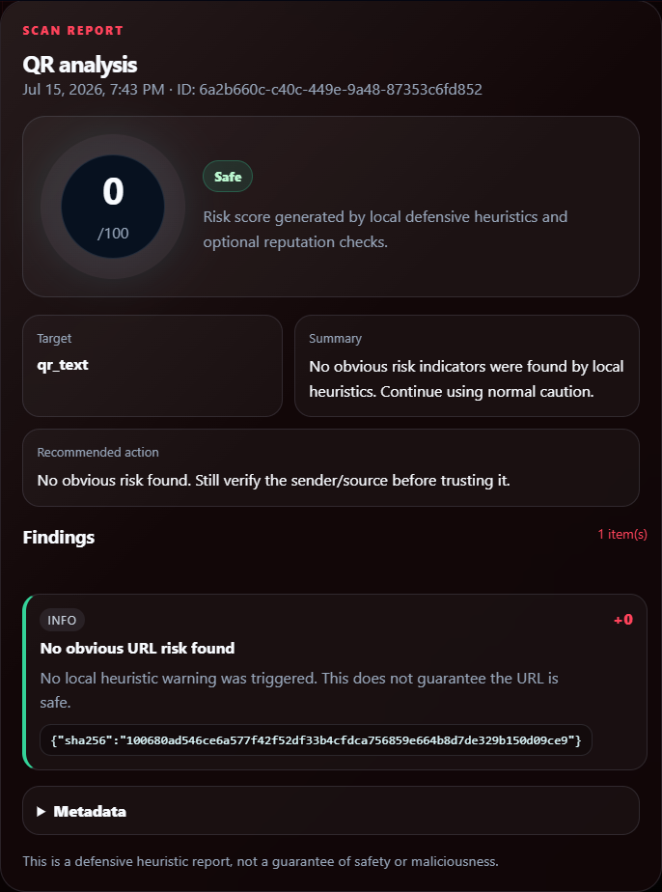
LIVE TEST EVIDENCE
29
QR scan — decoded text test
SAFE TEST INPUT
Decoded QR payload: https://example.com
INPUT
API
SCORER
REPORT
OBSERVED RESULT
The decoded QR text was analyzed using the same safe URL-focused workflow.
LIVE LOCAL UI CAPTURE • 127.0.0.1:5174 → 127.0.0.1:5000

Slide 30
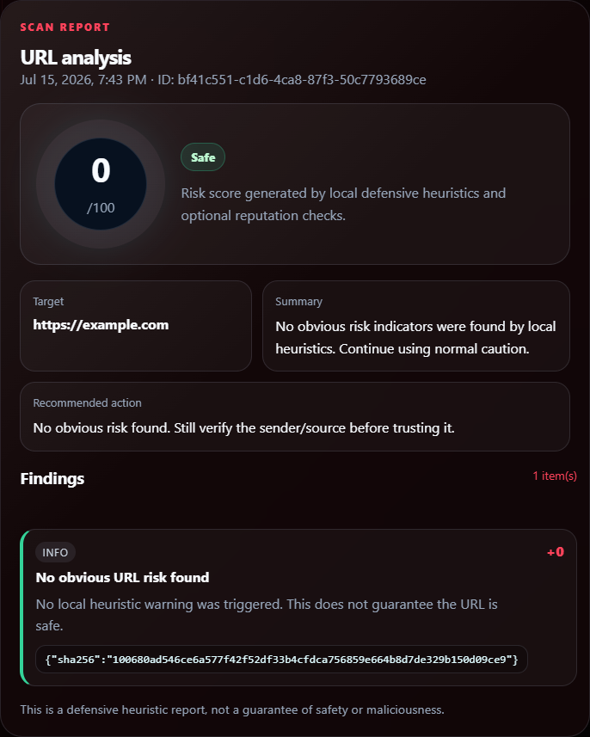
LIVE TEST EVIDENCE
30
Report lookup — persisted scan retrieval
SAFE TEST INPUT
A scan ID captured from the URL test was submitted to the report lookup screen.
INPUT
API
SCORER
REPORT
OBSERVED RESULT
The API returned the original saved report by ID, validating the report retrieval workflow.
LIVE LOCAL UI CAPTURE • 127.0.0.1:5174 → 127.0.0.1:5000

