Slide 1
SECURE COMMUNICATION FIRMWARE
Secure Communication
Firmware
ESP32-S3 secure messaging project with mutual TLS, end-to-end encryption, certificates, relay server, OTA updates and backend monitoring.
TLS 1.3
AES-256-GCM
Signed OTA
Alice
ESP32-S3 device
Relay
mTLS forwarding only
Bob
ESP32-S3 device
The relay can forward messages but cannot read the end-to-end encrypted content.
01

Slide 2
SECURE COMMUNICATION FIRMWARE
Project purpose in simple words
A secure firmware system for private communication between two or more trusted devices.
Problem
Solution
Normal device messages can be intercepted on Wi‑Fi or local networks.
A middle server can become a privacy risk if it can read messages.
Firmware updates can be dangerous if unsigned or unverified.
Every device proves its identity with certificates and keys.
Messages are encrypted end-to-end before reaching the relay.
Backend logs show delivery without exposing plaintext content.
🔒
02

Slide 3
SECURE COMMUNICATION FIRMWARE
How the system is connected
Two security layers: mutual TLS transport plus end-to-end message encryption.
Alice
ESP32-S3
private key + cert
Secure Relay
Forwards ciphertext
no plaintext access
Bob
ESP32-S3
private key + cert
TLS 1.3 mTLS
TLS 1.3 mTLS
End-to-end AES-256-GCM encrypted message
Result: the network sees protected TLS traffic, while the relay only sees encrypted payloads.
03

Slide 4
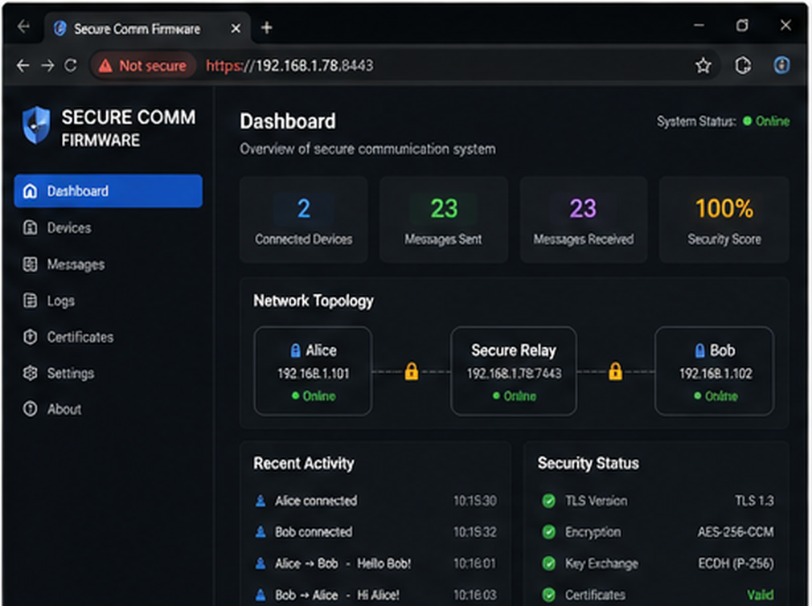
SECURE COMMUNICATION FIRMWARE
Dashboard overview
The main screen summarizes project health, topology, message activity and security posture.
What this screen proves
Shows Alice, relay and Bob in one secure topology.
Tracks connected devices, sent/received messages and security score.
Explains the project quickly during presentation or demo.
Demo point
Use this slide while explaining the live flow: device connects → identity verified → encrypted message delivered → logs confirm the result.
04

Slide 5
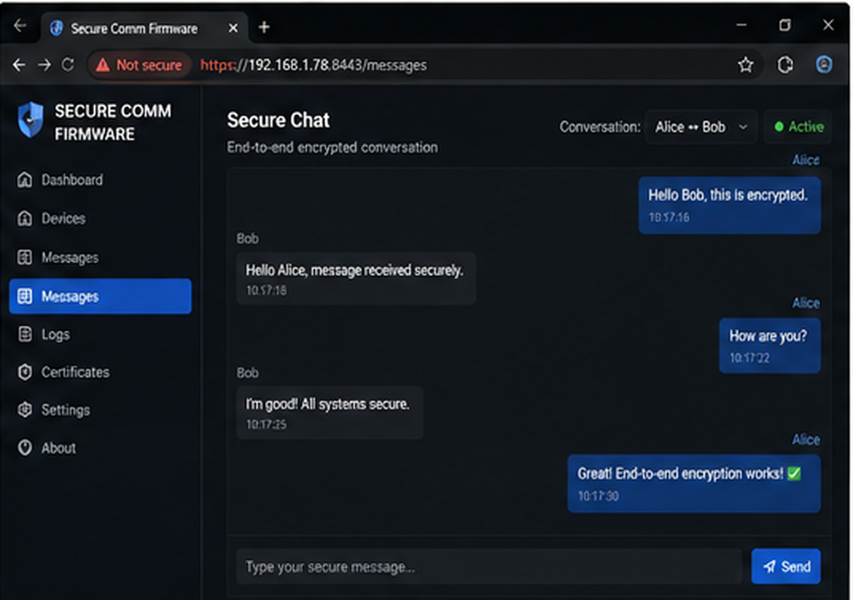
SECURE COMMUNICATION FIRMWARE
Real-time secure chat
This screen demonstrates how Alice and Bob communicate after the secure session is ready.
What this screen proves
Messages appear readable only at the endpoints.
The green notice explains that the relay cannot read content.
Useful for showing the practical outcome of the firmware.
Demo point
Use this slide while explaining the live flow: device connects → identity verified → encrypted message delivered → logs confirm the result.
05

Slide 6
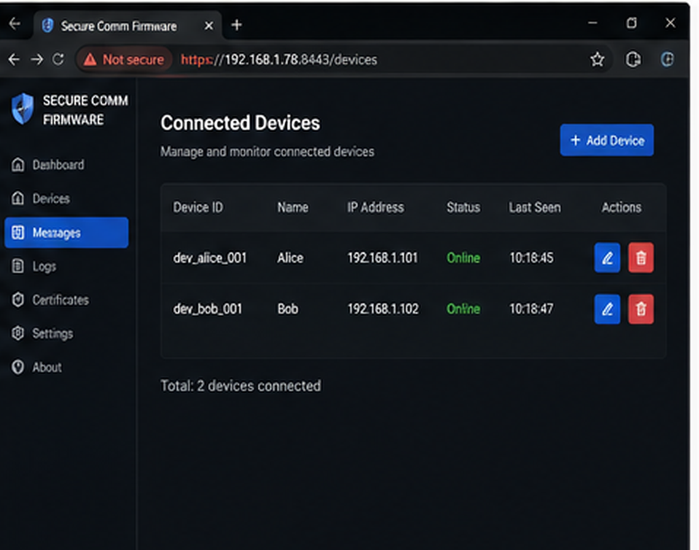
SECURE COMMUNICATION FIRMWARE
Connected devices view
Device monitoring screen for trusted participants in the secure network.
What this screen proves
Lists device IDs, names, local IP addresses and live status.
Helps verify that Alice and Bob are online.
Can be extended for Charlie, Diana and more peers.
Demo point
Use this slide while explaining the live flow: device connects → identity verified → encrypted message delivered → logs confirm the result.
06

Slide 7
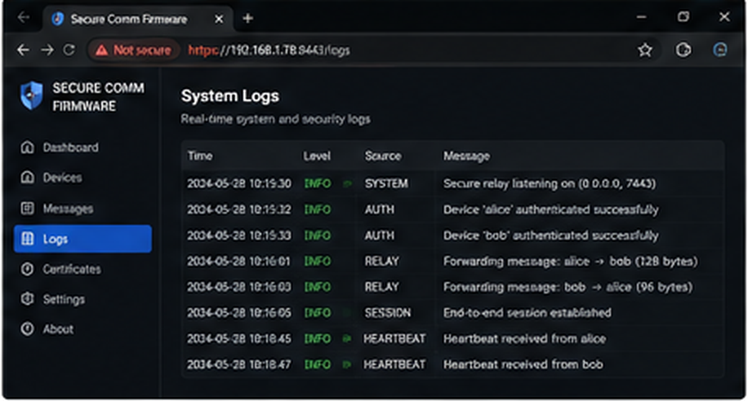
SECURE COMMUNICATION FIRMWARE
System logs view
A web-friendly audit trail for authentication, delivery and backend events.
What this screen proves
Logs successful connections and authenticated devices.
Records message forwarding without exposing plaintext.
Useful for debugging and project demonstration.
Demo point
Use this slide while explaining the live flow: device connects → identity verified → encrypted message delivered → logs confirm the result.
07

Slide 8
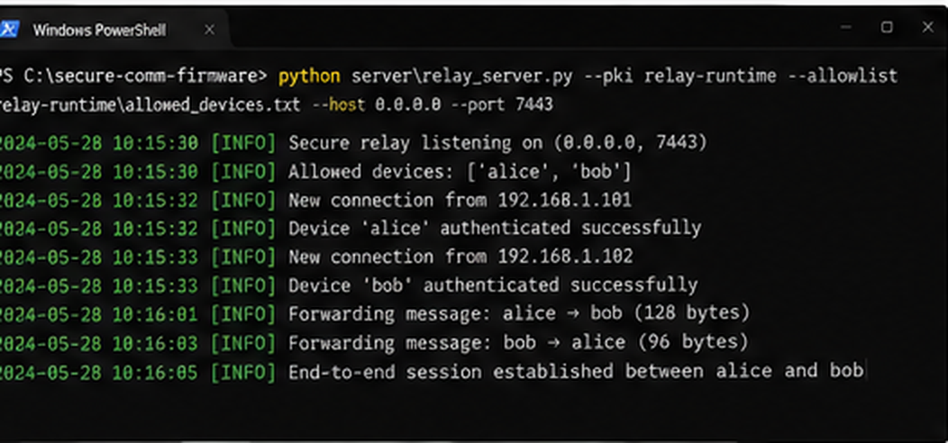
SECURE COMMUNICATION FIRMWARE
Backend result: relay server
The relay terminal proves that secure backend forwarding is happening.
What this screen proves
Shows allowed devices: Alice and Bob.
Confirms successful client authentication.
Forwards encrypted packets between endpoints.
Demo point
Use this slide while explaining the live flow: device connects → identity verified → encrypted message delivered → logs confirm the result.
08

Slide 9
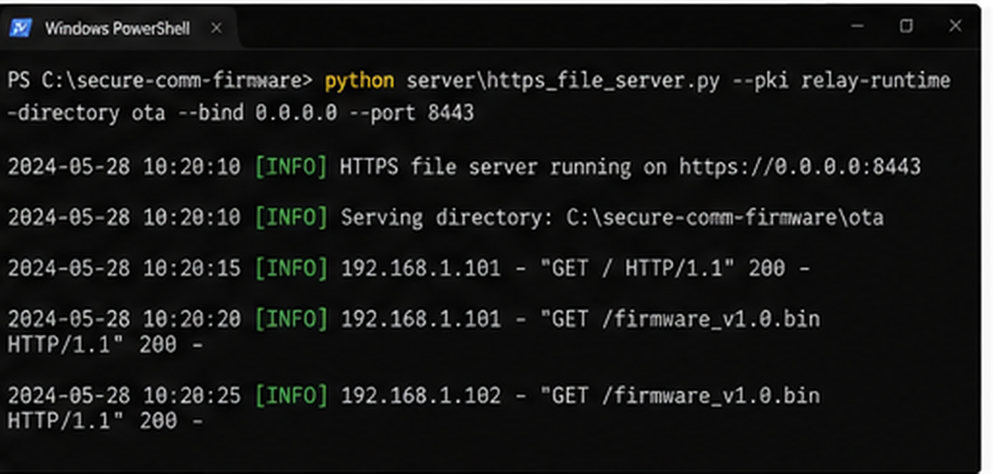
SECURE COMMUNICATION FIRMWARE
Backend result: OTA file server
The OTA backend provides firmware update files over HTTPS.
What this screen proves
Hosts firmware binaries for update testing.
Logs file downloads by connected devices.
Supports a safer update workflow for firmware.
Demo point
Use this slide while explaining the live flow: device connects → identity verified → encrypted message delivered → logs confirm the result.
09

Slide 10
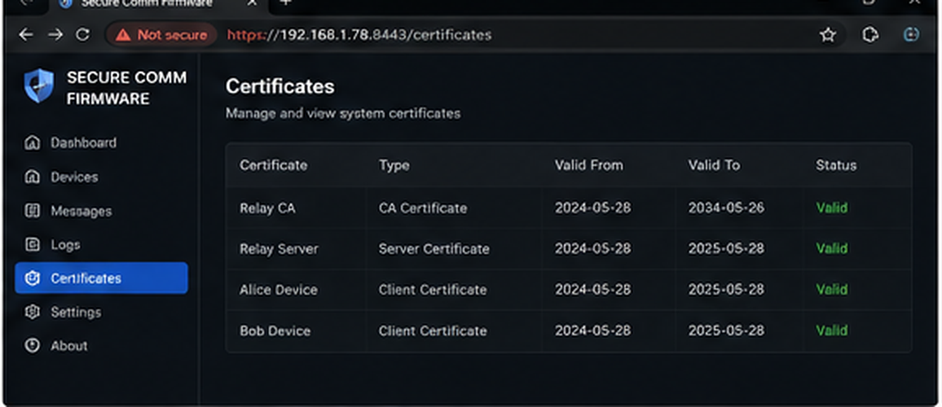
SECURE COMMUNICATION FIRMWARE
Certificate management
Certificate visibility helps explain identity, trust and expiry.
What this screen proves
Shows CA, relay and device certificates.
Marks valid certificates for Alice and Bob.
Connects the UI story to real cryptographic identity.
Demo point
Use this slide while explaining the live flow: device connects → identity verified → encrypted message delivered → logs confirm the result.
10

Slide 11
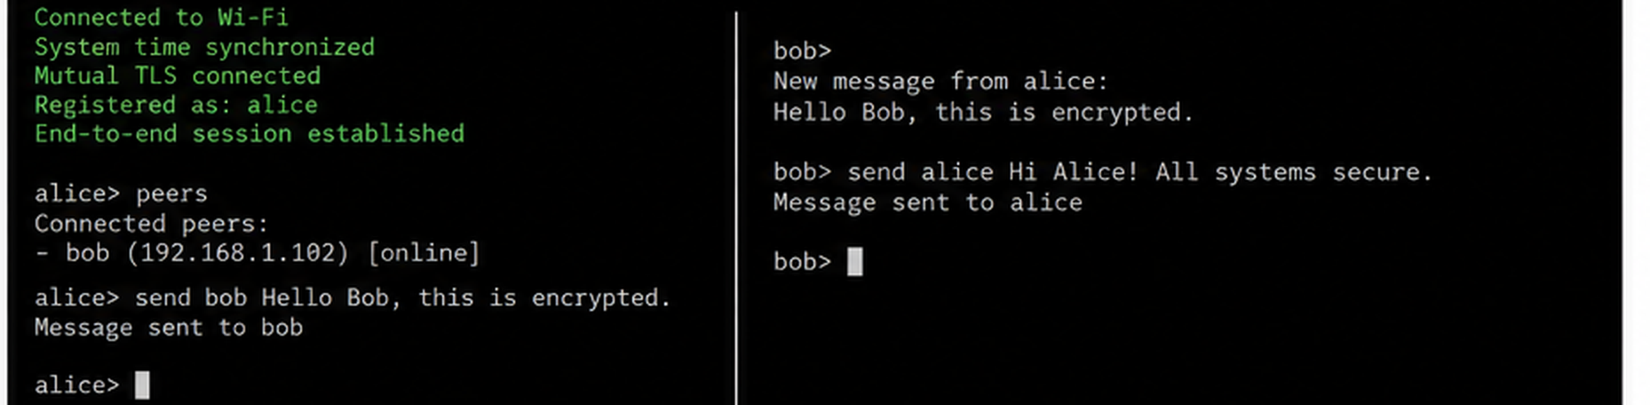
SECURE COMMUNICATION FIRMWARE
Device CLI interaction
The device command line proves the firmware can send and receive messages live.
What this screen proves
Alice checks peers and sends encrypted text to Bob.
Bob receives the message and replies securely.
This is the strongest live demo slide for communication.
Demo point
Use this slide while explaining the live flow: device connects → identity verified → encrypted message delivered → logs confirm the result.
11

Slide 12
SECURE COMMUNICATION FIRMWARE
Alice-to-Bob message flow
Simple step-by-step journey from plaintext at Alice to plaintext at Bob.
1
2
3
4
5
Alice writes message
Encrypt + authenticate
Relay forwards packet
Bob verifies counter
Bob decrypts message
Plaintext exists only on Alice.
AES-256-GCM protects the message.
Relay sees ciphertext only.
Replay attacks are rejected.
Plaintext appears only on Bob.
12

Slide 13
SECURE COMMUNICATION FIRMWARE
Security stack used in the project
Each layer protects a different part of the communication system.
Device identity
Unique certificates and identity keys
Transport security
TLS 1.3 mutual authentication
Message security
End-to-end AES-256-GCM encryption
Replay protection
Session IDs and monotonic message counters
Firmware updates
HTTPS OTA and rollback confirmation
Production hardening
Secure Boot v2 and flash encryption
Key idea: security is not one feature. It is a chain of identity, encryption, verification, update safety and hardware protection.
13

Slide 14
SECURE COMMUNICATION FIRMWARE
How to demonstrate the project
Use this short script when explaining your project to someone.
1
Start relay server
Backend accepts only allowed devices.
2
Flash Alice and Bob
Each board gets its own certificate and peer trust list.
3
Watch connection logs
Wi‑Fi, time sync, mTLS and registration succeed.
4
Send a message
Alice sends text that the relay cannot read.
5
Show backend result
Logs prove forwarding while protecting privacy.
Final message for audience: “This project protects communication before, during and after delivery.”
14

Slide 15
SECURE COMMUNICATION FIRMWARE
Future upgrades
Ideas to turn this firmware project into a complete production-grade platform.
Add a real browser dashboard instead of concept UI screenshots.
Add role-based admin login for monitoring and certificate management.
Add group chat with per-group keys for more than two devices.
Store keys in a secure element or hardened NVS configuration.
Add mobile app pairing with QR-based provisioning.
Add alerting for failed authentication, replay attempts and expired certificates.
Prototype
→ Demo
→ Product
The current system is a strong technical reference. The next step is adding a real web dashboard that reads relay/device status live.
15

Slide 16
SECURE COMMUNICATION FIRMWARE
Project summary
A secure firmware communication system where devices authenticate each other, messages stay encrypted end-to-end, backend logs prove activity, and OTA update support prepares the project for real hardware testing.
Trust
identity + certs
Encrypt
private payloads
Deliver
verified result
Best demo order: Dashboard → Chat → Backend relay logs → Device CLI → OTA logs.
Ready for presentation
16

