Slide 1

OBJECT ORIENTED PROGRAMMING USING C++

Slide 2
Topics Covered
importance of operator overloading,
Unary operator overloading,
binary operator overloading,

Slide 3
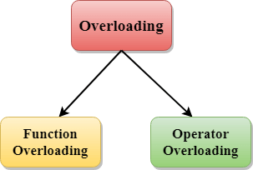
Polymorphism

Slide 4
Operator overloading
Operator overloading is a compile-time polymorphism in which the operator is overloaded to provide the special meaning to the user-defined data type.

Slide 5
Consider this example
class A {
};
int main() { A a1,a2,a3;
a3= a1 + a2;
return 0; }
This is not allowed, because the addition operator “+” is predefined to operate only on built-in data types. But here, “class A” is a user-defined type, so the compiler generates an error. This is where the concept of “Operator overloading” comes in.

Slide 6
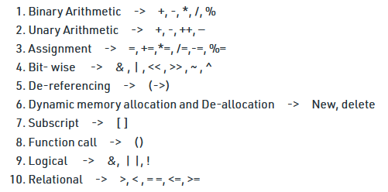
Operators which can overload

Slide 7
Operators which can’t overload
Scope resolution operator (::)
sizeof
member selector(.)
member pointer selector(.*)
ternary operator(?:)

Slide 8
Operator Overloading Can be achieve through either
using member function
Or, using friend function

Slide 9
Operator Overloading Using Member function Syntax:
class className
{
public:
return_type operator operator_Symbol(parameters)
{
}
};

Slide 10
Operator Overloading Using Friend function Syntax:
class className
{
public:
return_type friend operator operator_symbol(Parameters);
};
return_type operator operator_symbol(parameters)
{
}

Slide 11
Rules for Operator Overloading
Existing operators can only be overloaded.
The overloaded operator contains at least one operand of the user-defined data type.
When unary operators are overloaded through a member function take no explicit arguments, but, if they are overloaded by a friend function, takes one argument.
When binary operators are overloaded through a member function takes one explicit argument, and if they are overloaded through a friend function takes two explicit arguments.

Slide 12
Operator overloading for Unary operators:
The unary operators operate on a single operand :
The increment (++) and decrement (--) operators.
The unary minus (-) operator.
The unary minus (+) operator.
The logical not (!) operator.

Slide 13
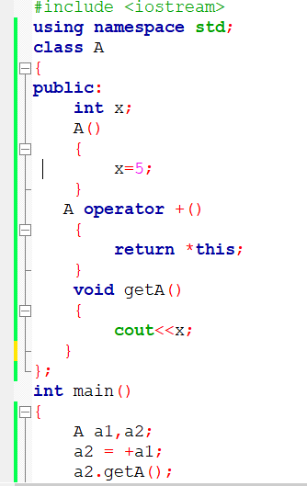

Unary + Operator Overloading Using
Member Function

Slide 14
Problem Statement
You are designing a distance calculator system for a transport department. Create a class Distance that represents distance data in Miles.
Overload the unary plus (+) operator to calculate and return the distance value in Km.
Write a program that demonstrates the usage of these unary operators for distance calculations.

Slide 15
Operator overloading for binary operators:
The binary operators operate on two operands :
Binary +
Binary -
Binary *
Binary /
Binary %
a + b

Slide 16

Operator overloading for binary operators –using member function
complex operator+(complex &c)
{
complex res;
res.real = real + c.real;
res.imag = imag + c.imag;
return res;
}
void display() {
cout << real << "+" << imag << "i" << "\n";
}
};
int main()
{
complex c1(1,2),c2(2,3),c3;
c3=c2+c1;
c3.display();
return 0;
}
#include <iostream>
using namespace std;
class complex {
int real, imag;
public:
complex()
{
real=0;
imag=0;
}
complex(int r, int i )
{
real=r;
imag=i;
}

Slide 17
We know about Friend function
It can access all private and protected member of a class
It can be call without object of the class
It can define out side of the class scope
Rule:
Prototypes of friend function must be declare inside the class
It can be declared either in the private or the public part.

Slide 18
Overloading binary operators using friend function
Friend function takes two parameters in case when we want to overload binary operators using friend function

Slide 19
Any Query?

