Slide 1

ThreatVault
A scalable, cloud-native cyber evidence & multimedia sharing platform for security professionals.
Student Name – Ritik Sah
Student Number – B00925356

Slide 2
The Problem: Why Traditional Infrastructure Fails Security Teams
Traditional on-premise and IaaS systems fundamentally cannot meet the demands of modern cybersecurity evidence management. Four critical technical failures drive the need for a cloud-native solution.
📈 Scalability Wall
⚙️ Management Overhead
Traditional RDBMS scales reads only. Zero-day disclosure events cause sudden, unpredictable traffic spikes that fixed-capacity servers cannot absorb. Relational databases are difficult to scale across nodes [17].
On-premise deployments require organisations to invest additional time and resources to manage the database. Security analysts must investigate threats — not patch servers and manage infrastructure [03].
💸 Cost Inefficiency
⚠️ Availability Risk
Traditional N-Tier architectures operate on a Pay 24/7 billing model. Evidence platforms have highly irregular usage — burst during incidents, idle otherwise. This model is commercially unsustainable [17].
Achieving 99.99% SLA on-premises requires manually implementing additional VMs and availability groups. Cloud PaaS guarantees 99.995% availability automatically, with three data replicas ensuring high durability [03].
The Need: A system that scales elastically, manages itself, costs only what it consumes, and maintains forensic data integrity — properties that only a cloud-native architecture can deliver.

Slide 3
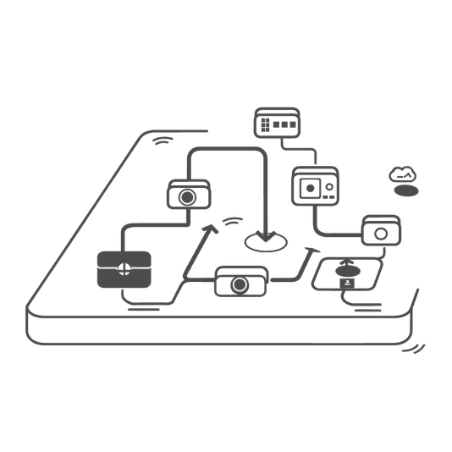
Why Cloud-Native? Critical Appraisal
Cloud-native architecture addresses every traditional limitation and introduces capabilities impossible on-premise.
Technical Justifications
Traditional vs Cloud-Native Comparison
Geo-Redundancy
Concern
Traditional On-Premise
ThreatVault Cloud-Native
Evidence must survive regional disasters. Azure replicates data across data centers and geographical regions. Cosmos DB supports multi-region writes for global analyst teams [1].
Scaling
Manual, node-limited
Auto, granular, serverless
Cost Model
Pay 24/7
Pay-per-execution
Elastic Auto-Scaling
Availability
Manually configured HA
99.995% SLA guaranteed
Serverless PaaS scales like an electrical grid — you use what you need [17]. Critical for unpredictable incident response workloads. Automatic and instant scalability with no capacity planning.
Schema
Rigid, static, pre-defined
Flexible JSON per document
Management
Full admin burden
Fully managed PaaS
PaaS Zero-Management
Azure managed services handle hardware maintenance, security patches, and updates automatically — freeing the security team from all infrastructure concerns.
NoSQL Flexibility
Cybersecurity evidence is semi-structured. Document databases provide flexible schema as defined by document contents — impossible with rigid SQL [17].
Fault Isolation
Decoupled, stateless architecture prevents single points of failure across all platform services.

Slide 4
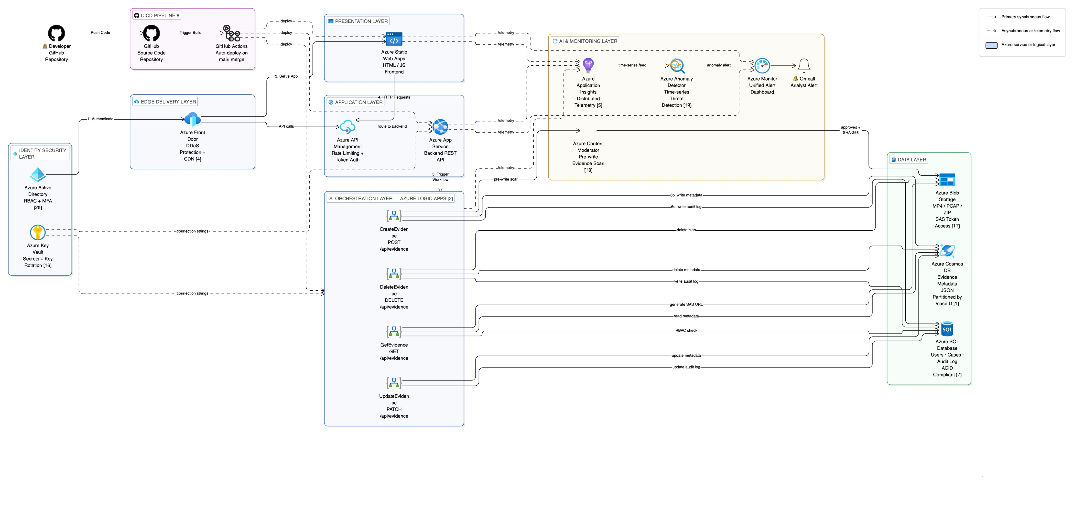
Solution Architecture: Five-Tier Cloud-Native Azure Design
ThreatVault uses a five-tier cloud-native Azure architecture with clear separation of concerns at every layer.
Primary Request Flow:
1. Authenticate → Azure AD — RBAC + MFA for internal analysts [20]
2. Access Platform → Azure Front Door — DDoS protection, CDN caching [04]
3. Serve App → Azure Static Web Apps delivers frontend UI
4. HTTP Requests → Frontend calls Azure API Management → routes to App Service (Backend REST API) over HTTPS
5. Trigger Workflow → App Service triggers Logic Apps — serverless, event-driven
6. Data Operations (parallel):
6a. Blob Storage — MP4/PCAP binary evidence; Content Moderator scans pre-write [18]
6b. Cosmos DB — JSON metadata, partitioned by /caseID [01]
6c. Azure SQL — Users, Cases, Audit Log (ACID-compliant) [07]
CI/CD Pipeline Flow:
Developer → GitHub → GitHub Actions → auto-deploys to App Service, Static Web Apps & Logic Apps on every main branch merge [06]
Async/Monitoring Flow:
App Service, Static Web Apps & Logic Apps continuously emit telemetry → Azure Application Insights & Azure Monitor — tracking API latency, upload failures, and session anomalies in real time for rapid incident response [05]. Content Moderator scans evidence uploads pre-write; Anomaly Detector analyses telemetry time-series to flag abnormal access patterns [18][19].

Slide 5
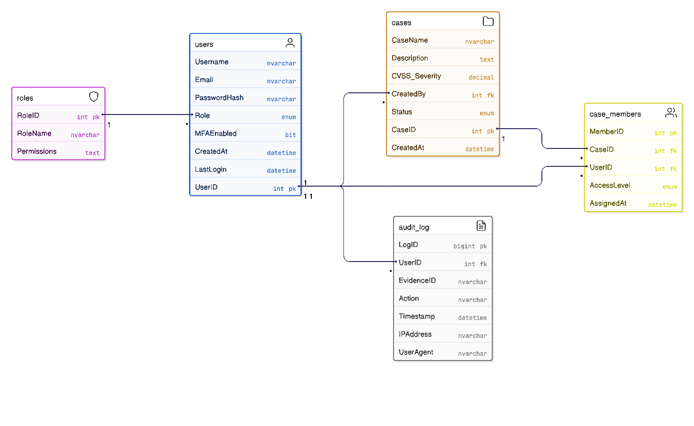
Database Schema: Azure SQL (Relational)
Why Azure SQL?
Users and cases are traditional business domain entities with low update frequency and complex joins required for RBAC — exactly where SQL excels. ACID transactions ensure data integrity for user authentication, access control, and legal audit logging [13].
Entity Relationships
Users ONE-TO-MANY Cases (via CreatedBy FK)
Users MANY-TO-MANY Cases (via CASE_MEMBERS junction table)
Users ONE-TO-MANY AUDIT_LOG entries
ROLES ONE-TO-MANY USERS
Cosmos DB Integration
Evidence metadata in Cosmos DB is linked to SQL via EvidenceID string key, CaseID foreign reference, and UploadedBy UserID reference. Audit log writes to SQL for legal admissibility.

Slide 6
Database Schema: Azure Cosmos DB (NoSQL)
Cybersecurity evidence is semi-structured — a malware execution video has entirely different attributes to a PCAP network capture. Cosmos DB's flexible JSON schema means each document can have a different structure, providing High scalability for both reads and writes [17].
Design Decisions
1
Sample Evidence Document
Partition Key: /caseID
All evidence for a case is stored on the same physical replica, enabling fast queries without cross-partition scatter [1].
{
"_id": "EVD-2024-00142",
"caseID": "CASE-2024-007",
"title": "Cobalt Strike Beacon C2 Traffic",
"mediaType": "video/mp4",
"blobUrl": "https://threatvault.blob.core.windows.net/...",
"sha256Hash": "a3f5c91b...",
"uploadedBy": "analyst_rsmith",
"uploadedAt": "2024-11-14T09:32:00Z",
"severity": {
"cvss": 9.1,
"label": "Critical"
},
"tags": [
"ransomware",
"lateral-movement",
"C2"
],
"threatType": "APT",
"analysisNotes": "Beacon interval observed: 60s..."
}
2
Flexible Schema
No ALTER TABLE operations needed. Each evidence type (video, PCAP, screenshot) carries only its relevant fields [17].
3
Arrays & Nested Docs
Tags as arrays: ["ransomware","APT"]. Severity as nested object: {cvss, label} — impossible in rigid SQL without extra tables.
SQL to Cosmos DB Mapping
SQL Concept
Cosmos DB Equivalent
Database
Database
Table
Collection
Row
Document
Column
Field

Slide 7
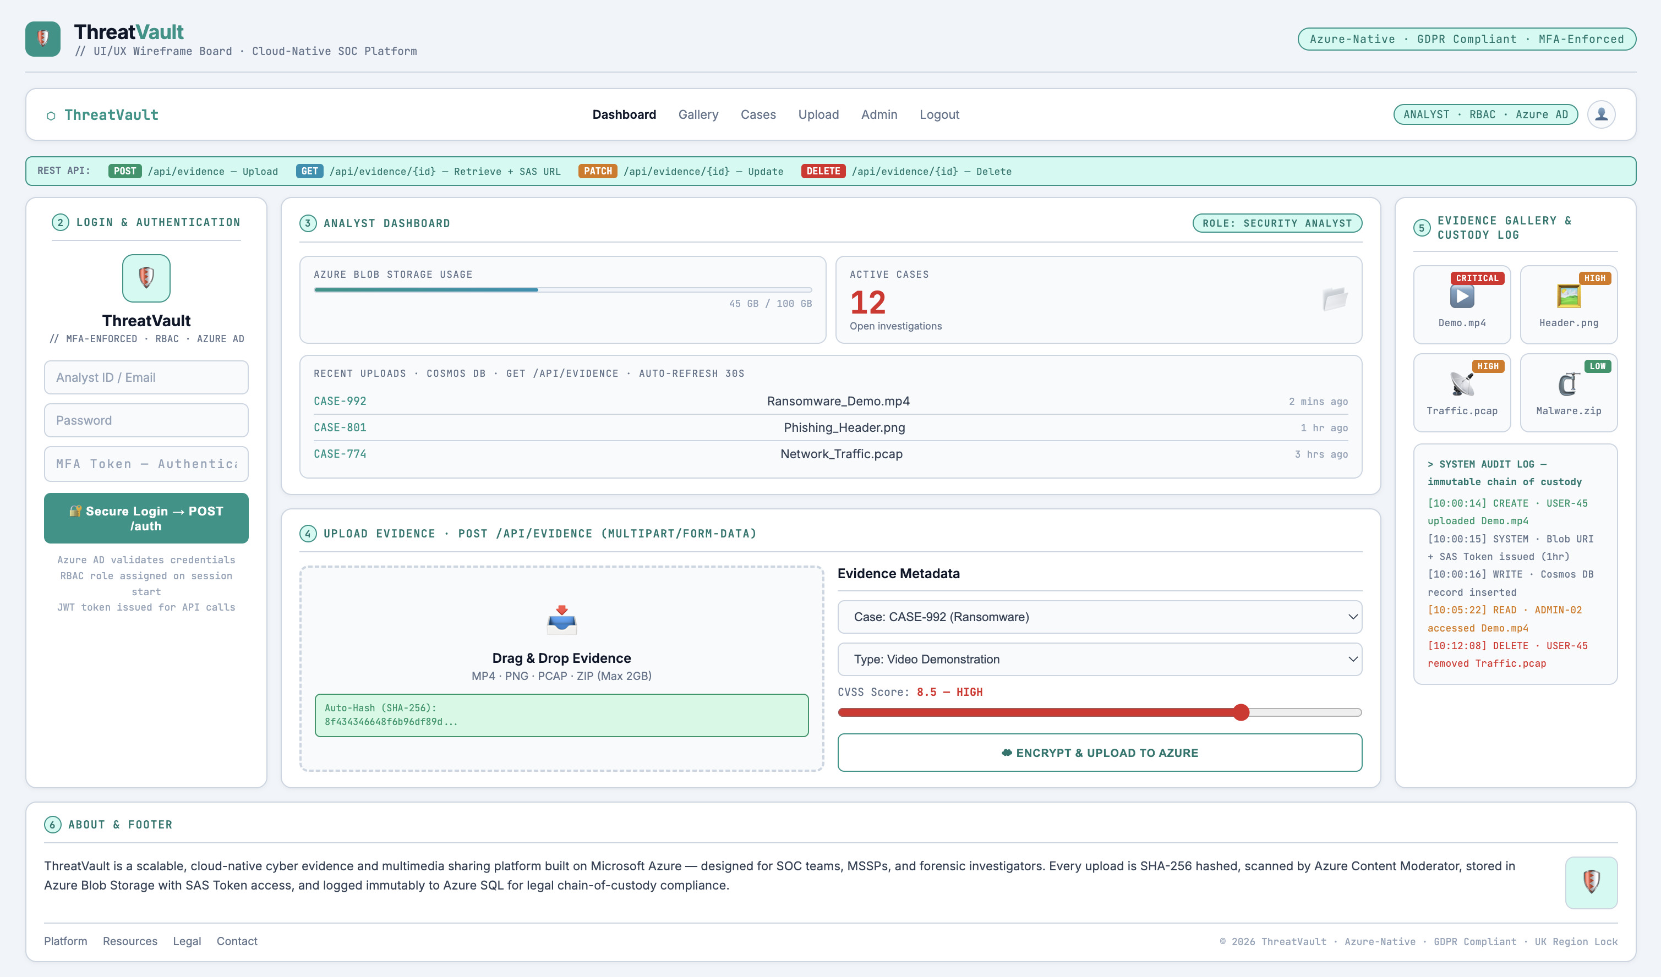
Wireframe: ThreatVault Web Application
Wireframes are structural blueprints that define layout without visual design details. They communicate site structure and user flow before any development begins.
Header
1
Logo left, sticky navigation right: Dashboard | Gallery | Cases | Upload | Admin | Logout. Azure AD session token — active role displayed top-right. REST API reference strip below header showing all four CRUD endpoints with HTTP verb colour coding: POST (green), GET (cyan), PATCH (amber), DELETE (red).
Login & Authentication
2
MFA-enforced login: Analyst ID, Password, MFA Token (Authenticator App). Azure AD validates credentials — RBAC role assigned on session start. Secure Login → POST /auth → JWT token issued for subsequent API calls.
Analyst Dashboard
3
Post-login landing: Azure Blob Storage usage bar (45GB / 100GB), Active Cases counter (12 open investigations). Recent Uploads feed (Cosmos DB) showing Case ID, filename, and timestamp. Stats auto-refresh every 30s via GET /api/evidence.
Upload Evidence
4
Drag-and-drop zone: MP4, PNG, PCAP, ZIP (max 2GB per file). Form fields: Case ID | Evidence Type | CVSS Severity slider. SHA-256 hash auto-computed on upload and displayed before submit — analyst can verify file integrity. POST /api/evidence (multipart/form-data). Evidence scanned by Azure Content Moderator pre-write before being committed to Blob Storage [18].
Evidence Gallery & Custody Log
5
Gallery: severity-badged cards (Critical=red, High=amber, Low=green) with View / Edit / Delete CRUD actions per evidence item revealed on hover. System Audit Log panel: immutable timestamped log of every CREATE, READ, UPDATE, DELETE action across Logic Apps, Cosmos DB, and Blob Storage — legal chain of custody record.
About & Footer
6
Two-column about: platform description left (ThreatVault — Azure-native cyber evidence platform for SOC teams, MSSPs, and forensic investigators), shield icon right. Footer: ThreatVault links | Resources | Legal | Contact | © 2026 ThreatVault · Azure-Native · GDPR Compliant · UK Region Lock.

Slide 8
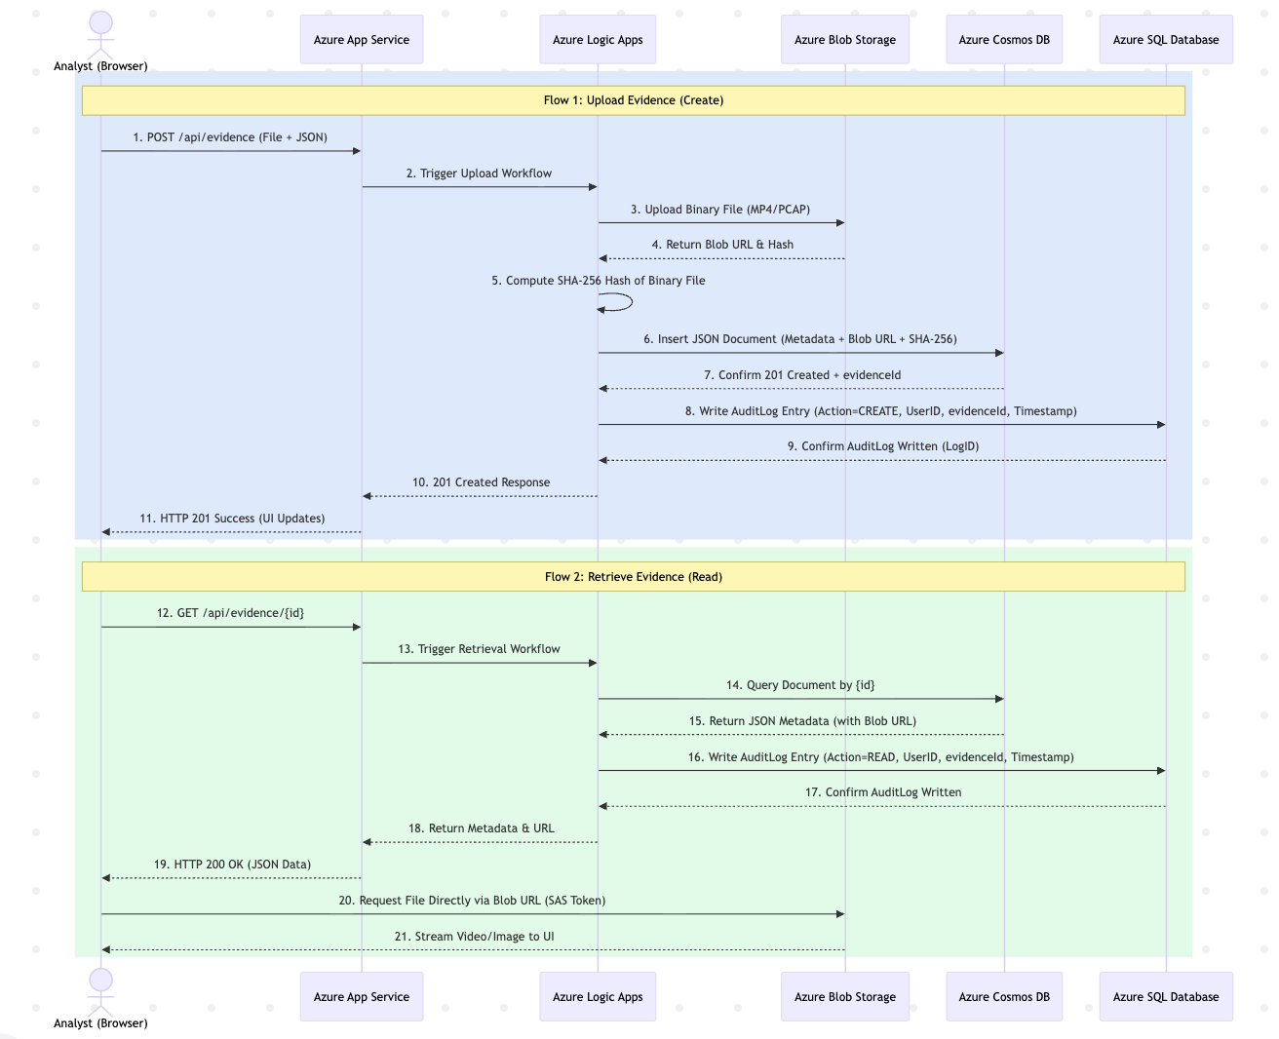
REST API Design — CRUD Operations via Azure Logic Apps & UML Sequence Diagram
REST (Representational State Transfer) uses a stateless client-server model with standard HTTP verbs for CRUD operations on resources identified by noun-based URIs [15].
Operation | HTTP Verb | URI | Logic App | HTTP Response
Upload Evidence | POST | /api/evidence | CreateEvidence | 201 Created + evidenceId
Retrieve Evidence | GET | /api/evidence/{id} | GetEvidence | 200 OK + JSON + SAS URL
List All Evidence | GET | /api/evidence | GetEvidence | 200 OK + array
Update Metadata | PATCH | /api/evidence/{id} | UpdateEvidence | 200 OK
Delete Evidence | DELETE | /api/evidence/{id} | DeleteEvidence | 204 No Content
URI Design Principles: Noun-based routing (/api/evidence not /api/create-evidence) | Plural collections | Hierarchical structure | Decoupled from internal DB schema

Slide 9

Advanced Features
Four advanced cloud-native platform features planned for the final ThreatVault implementation — shifting the platform from passive evidence storage to intelligent, self-defending forensic infrastructure.
Azure Application Insights — Distributed Telemetry & Anomaly Detection
Azure Content Moderator — Automated Evidence Flagging
Tracks API latency, upload failure rates, and Logic App execution times across all platform endpoints via distributed tracing. Correlation IDs link a single evidence upload across App Service, Logic Apps, Cosmos DB, and Blob Storage into one unified trace — making cross-service incident investigation possible. Automatic performance anomaly detection alerts on-call analysts to degraded response times during active incident response operations [05].
Investigators routinely upload evidence from dark web operations, malware campaigns, or compromised endpoints. Content Moderator's computer vision API automatically scans uploaded images and video frames for potentially illegal or harmful material before the file is written to Blob Storage. Flagged content is quarantined and routed to a senior analyst review queue - protecting the platform's legal integrity and ensuring regulatory compliance [18].
Shared Access Signature (SAS) Tokens — Zero-Trust Blob Access
Azure Anomaly Detector — Cyber Threat Pattern Recognition
Evidence files are never exposed via public URL. Each Logic App generates a time-limited, analyst-scoped SAS URL (1-hour expiry) per request, scoped to read-only permissions for the specific blob. Azure Key Vault stores all storage account keys and Cosmos DB connection strings — eliminating hardcoded credentials, providing automatic key rotation, and maintaining a full secret-access audit log [11][16].
Analyses time-series telemetry streamed from Application Insights — upload volumes, API call rates, and analyst login frequencies — to detect statistically significant deviations without requiring custom ML models. A sudden spike in evidence uploads from a single analyst account, or an abnormal sequence of DELETE operations, triggers an automated alert to Azure Monitor. This transforms ThreatVault from a passive evidence store into an active insider-threat detection system [19].

Slide 10
Technology Justification & Alternatives
Every technology in ThreatVault was evaluated against alternatives before selection. All chosen services are Azure-native PaaS or Serverless — eliminating infrastructure management, guaranteeing SLAs, and enabling autoscaling without operator intervention.
Layer | Chosen Technology | Alternatives Considered | Why Chosen
CDN / Global Routing | Azure Front Door | AWS CloudFront / Nginx | Global load balancing, DDoS protection, CDN caching — native Azure integration, no additional infrastructure required [04]
Authentication | Azure AD | AWS Cognito / Auth0 | Native Azure identity management, RBAC support, MFA built-in, designed for internal organisational users — not a consumer app
Binary Storage | Azure Blob Storage | AWS S3 / On-premise NAS | Massively scalable, SAS tokens for secure time-limited access, native Azure integration, Block Blobs up to 190.7 TiB
Evidence Metadata | Azure Cosmos DB | MongoDB Atlas / DynamoDB | Planet-scale NoSQL, multi-region writes, flexible JSON schema per document, native Azure, single-digit millisecond reads [01]
User & Case Data | Azure SQL Database | PostgreSQL / MySQL | ACID compliance for RBAC data, Azure-native PaaS, 99.995% SLA, Microsoft Defender integration
API Orchestration | Azure Logic Apps | Azure Functions / AWS Lambda | Visual workflow designer, native connectors to all Azure services, no-code CRUD design, serverless auto-scaling
Frontend Hosting | Azure Static Web Apps | VM-based hosting / AWS Amplify | PaaS removes server management, auto-patching, GitHub Actions CI/CD built-in via native GitHub integration
Backend API | Azure App Service | Azure Container Apps / VM | PaaS managed hosting, auto-scaling, integrated Application Insights, supports GitHub Actions deployment
Monitoring | Azure Application Insights | Azure Monitor only / Datadog | Native SDK integration, automatic anomaly detection, distributed tracing, performance profiling
API Gateway | Azure API Management | Custom Nginx / AWS API Gateway | Native Azure integration, built-in auth token validation, rate limiting, enterprise-grade request routing
CI/CD | GitHub Actions | Azure DevOps / Jenkins | Taught in module, directly integrates with GitHub repository, auto-deploys to App Service on every push to main branch
AI Evidence Scanning | Azure Content Moderator | Custom ML model / Manual review | Pre-built computer vision API — no ML expertise required, instant integration with Blob Storage pipeline [18]
Threat Pattern Detection | Azure Anomaly Detector | Custom time-series ML / Azure Stream Analytics | Pre-built anomaly detection on telemetry time-series — no training data required, native App Insights integration [19]
Key Selection Principle: All chosen services are Azure-native PaaS or Serverless — eliminating infrastructure management, guaranteeing SLAs, and enabling autoscaling without operator intervention.

Slide 11
Limitations of the Solution
A comprehensive, honest assessment of ThreatVault's constraints — each paired with a concrete mitigation strategy.
⚠ Vendor Lock-In
⚠ Serverless Cold Starts
⚠ Eventual Consistency in Cosmos DB
Problem: Heavy reliance on Azure-proprietary services (Logic Apps, Cosmos DB, Blob Storage) makes future migration to AWS or GCP complex and costly. The N-Tier pattern offers better portability [17].
Problem: Logic Apps experience cold start latency after idle periods — unacceptable during urgent incident response when seconds matter in a live breach scenario [02].
Problem: Default Session consistency level may cause briefly stale evidence metadata for analysts in distant regions during multi-region Cosmos DB deployments [01].
Mitigation: Abstract storage and database access behind API interfaces; use open standards (REST, JSON); containerise frontend with Docker for cross-platform portability.
Mitigation: Enable "Always Ready" instances for critical CRUD endpoints; migrate high-frequency endpoints to Azure Functions with Dedicated hosting plan for consistent response times.
Mitigation: Use Strong consistency for audit log operations (required for legal admissibility); Session consistency is acceptable for gallery read operations where minor latency is tolerable.
⚠ Cost Unpredictability
⚠ Governance & Logging Complexity
⚠ AI Feature Accuracy Constraints
Problem: Pay-per-RU serverless billing is excellent for bursty workloads but can produce unexpected cost spikes during large-scale incident evidence dump events. Mitigation: Set maximum autoscale RU/s cap in Cosmos DB configuration [01]; configure Azure Cost Management budget alerts with automatic spend threshold notifications.
Problem: Correlated logging across Logic Apps, Cosmos DB, Blob Storage, and SQL is complex. A single evidence upload spans four separate service logs — making incident investigation difficult. Mitigation: Azure Application Insights distributed tracing with correlation IDs [05]; centralise all logs in Azure Log Analytics Workspace; implement project-wide structured logging standards.
Problem: Content Moderator and Anomaly Detector are general-purpose pre-trained models, not tailored for cybersecurity evidence. This may lead to false positives potentially disrupting analyst workflows [18][19].
Mitigation: Implement a human-review queue for all AI-flagged content; tune Anomaly Detector sensitivity thresholds using historical platform telemetry once live data is available.
Mitigation: Set maximum autoscale RU/s cap in Cosmos DB configuration; configure Azure Cost Management budget alerts with automatic spend threshold notifications.
Mitigation: Azure Application Insights distributed tracing with correlation IDs; centralise all logs in Azure Log Analytics Workspace; implement project-wide structured logging standards.

Slide 12
Scalability Assessment
ThreatVault employs cloud-native scaling mechanisms at every architectural tier — from the frontend to the data layer.
Scalability by Component
Three Key Scalability Design Decisions
Component
Mechanism
Type
Trigger
1
Stateless Logic Apps
Azure App Service
Autoscale rules
Horizontal scale-out
CPU % / request count
No session state is stored — any Logic App instance handles any request. The architecture can scale horizontally from 1 to hundreds of concurrent instances with zero coordination overhead [20].
API Management
Built-in tier scaling
Horizontal
Traffic volume
Azure Logic Apps
Serverless auto
Event-driven granular
Per HTTP trigger event
2
Cosmos DB Partition Strategy
Partition Key /caseID co-locates all evidence for a case on the same physical replica. Ensures low-latency reads at scale. Azure automatically adds additional physical partitions as volume grows [1].
Azure Cosmos DB
Serverless RU/s autoscale
Elastic horizontal
Read/write demand
Azure Blob Storage
Unlimited object store
Intrinsic
No limit — automatic
3
Independent Component Scaling
Azure SQL Database
Managed DTU scaling
Vertical + HA replicas
Load-based
The web frontend and Logic App workers scale completely independently. A burst of 10,000 simultaneous uploads does not degrade gallery browsing performance.
Real-World Zero-Day Scenario: During a major CVE disclosure, ThreatVault auto-scales Logic App instances from 1→50 within seconds, Cosmos DB auto-adjusts from 400→40,000 RU/s, and Blob Storage absorbs unlimited concurrent uploads — all with zero operator intervention.

Slide 13
Cloud-Native Patterns: Trade-offs & Future Evolution
ThreatVault deliberately applies multiple cloud-native architectural patterns, each with clear benefits and trade-offs.
Pattern
Applied In
Benefit
Trade-off
Serverless (Logic Apps)
API orchestration
Auto-granular scaling; pay-per-execution
Cold start latency; unsuitable for long-running processes
PaaS (App Service)
Frontend hosting
Auto-patch; integrated CI/CD
Reduced OS-level control compared to VMs
NoSQL (Cosmos DB)
Evidence metadata
Scales reads AND writes; flexible schema
Eventual consistency; complex query model
SQL (Azure SQL)
User/case management
ACID transactions; complex joins
Moderate scalability; difficult write scaling
Separation of Concerns
One Logic App per operation
Independent deployment; fault isolation
More resources to manage and monitor [20]
Microservices-Inspired Benefits
Future Architecture Evolution
Each Logic App is independently deployable — updating GetEvidence does not redeploy CreateEvidence
"If an individual microservice becomes unavailable, it won't disrupt the entire application"
Correlated logging tracks single user operations across multiple distinct service calls [19]
Add Azure Queue Storage for Web-Queue-Worker pattern — decouple large PCAP file processing from the frontend
Decompose into full microservices: Evidence Service, User Service, Audit Service — each with its own data store
Add Azure Redis Cache for evidence gallery query results and session state
Integrate Microsoft Sentinel SIEM for advanced threat correlation across ThreatVault audit logs and external threat intelligence feeds

Slide 14
Concluding Comments
ThreatVault demonstrates the power of cloud-native design to solve a genuine, high-stakes security operations challenge.
Solution Summary
What Can Be Improved
ThreatVault leverages a fully cloud-native Microsoft Azure architecture to deliver infinite scalability, forensic data integrity, zero-maintenance operations, and strict access control — capabilities impossible with traditional on-premise deployments. Every architectural decision maps directly to a cloud-native principle: PaaS over IaaS, serverless over always-on, NoSQL for flexible data, SQL for structured relational data, separation of concerns, and independent component scaling.
Extend Content Moderator with custom AI classifiers trained on known malware visual signatures — reducing analyst manual triage workload beyond generic content flagging
Implement Web-Queue-Worker pattern with Azure Queue Storage for large PCAP processing jobs — preventing frontend blocking
Add Cosmos DB multi-region write configuration for worldwide distributed security teams
Decompose Logic Apps into full microservices for even greater deployment independence
Commercial Applicability
Ethical Considerations
Target market: MSSPs, enterprise SOC teams, CVE research organisations, penetration testing firms
Business model: SaaS subscription — tiered pricing by storage volume (GB) and analyst seat count
Integration potential: MISP threat intelligence, VirusTotal API, Microsoft Sentinel SIEM
The global cybersecurity tools market represents significant and growing commercial opportunity — cloud-native SaaS platforms are increasingly the preferred deployment model for enterprise SOC teams" This removes the uncited statistic while keeping the commercial argument.
Evidence may contain sensitive victim data from real breaches — strict GDPR compliance via Azure Policy UK region lock [08]
SHA-256 hashing and immutable SQL audit log ensure legal admissibility of digital forensic evidence [12]
RBAC with MFA prevents internal misuse of sensitive threat intelligence
Responsible disclosure obligations must be enforced — ThreatVault must not become a platform for distributing active zero-day exploits

Slide 15
References
[01] Microsoft Azure (2024) Azure Cosmos DB documentation. Available from: https://docs.microsoft.com/en-us/azure/cosmos-db/ [Accessed 16 February 2026].
[02] Microsoft Azure (2024) Azure Logic Apps documentation. Available from: https://docs.microsoft.com/en-us/azure/logic-apps/ [Accessed 16 February 2026].
[03] Microsoft Azure (2024) Azure App Service documentation. Available from: https://docs.microsoft.com/en-us/azure/app-service/ [Accessed 16 February 2026].
[04] Microsoft Azure (2024) Azure Front Door and CDN documentation. Available from: https://docs.microsoft.com/en-us/azure/frontdoor/ [Accessed 16 February 2026].
[05] Microsoft Azure (2024) Azure Application Insights overview. Available from: https://docs.microsoft.com/en-us/azure/azure-monitor/app/app-insights-overview [Accessed 16 February 2026].
[06] GitHub (2024) GitHub Actions documentation. Available from: https://docs.github.com/en/actions [Accessed 21 February 2026].
[07] Microsoft Azure (2024) Azure SQL Database documentation. Available from: https://docs.microsoft.com/en-us/azure/azure-sql/ [Accessed 23 February 2026].
[08] Microsoft Azure (2024) Azure Policy documentation. Available from: https://docs.microsoft.com/en-us/azure/governance/policy/ [Accessed 23 February 2026].
[09] Microsoft Azure (2024) Azure architecture center: Web-queue-worker architecture style. Available from: https://docs.microsoft.com/en-us/azure/architecture/guide/architecture-styles/web-queue-worker [Accessed 23 February 2026].
[10] Microsoft Azure (2024) Azure architecture center: N-tier architecture style. Available from: https://docs.microsoft.com/en-us/azure/architecture/guide/architecture-styles/n-tier [Accessed 23 February 2026].
[11] Microsoft Azure (2024) Shared access signatures (SAS) overview. Available from: https://docs.microsoft.com/en-us/azure/storage/common/storage-sas-overview [Accessed 26 February 2026].
[12] Codd, E.F. (1970) A relational model of data for large shared data banks. Communications of the ACM, 13(6), pp. 377–387.
[13] NIST (2019) Common vulnerability scoring system v3.1 specification document. Available from: https://www.first.org/cvss/specification-document [Accessed 28 February 2026].
[14] Fielding, R.T. (2000) Architectural styles and the design of network-based software architectures. PhD thesis, University of California, Irvine. Available from: https://ics.uci.edu/~fielding/pubs/dissertation/rest_arch_style.htm [Accessed 26 February 2026].
[15] Fowler, M. (2014) Microservices. Available from: https://martinfowler.com/articles/microservices.html [Accessed 28 February 2026].
[16] Microsoft Azure (2024) Azure Key Vault documentation. Available from: https://docs.microsoft.com/en-us/azure/key-vault/ [Accessed 28 February 2026].
[17] Ulster University (2024) COM682 cloud native development: Lecture materials weeks 1–6. Ulster University, unpublished.
[18] Microsoft Azure (2024) Azure Content Moderator documentation. Available from: https://learn.microsoft.com/en-us/azure/ai-services/content-moderator/ [Accessed 4 March 2026].
[19] Microsoft Azure (2024) Azure Anomaly Detector documentation. Available from: https://docs.microsoft.com/en-us/azure/cognitive-services/anomaly-detector/ [Accessed 4 March 2026].
[20] Microsoft Azure (2024) Azure Active Directory documentation. Available from: https://docs.microsoft.com/en-us/azure/active-directory/ [Accessed 4 March 2026].

Slide 16
Submission Checklist
Appendix III — CW1 Submission Checklist
GENERAL
✅ Title slide includes project name, one-line description, student name and student number
✅ Submission produced in PowerPoint format and within 15 slides (excluding checklist appendix)
PROBLEM & CONTEXT
✅ Problem being solved is clearly discussed — traditional infrastructure failures for cybersecurity evidence management
✅ Scalability issues of resources identified and discussed — RDBMS moderate scalability, N-Tier monolithic constraints, Pay 24/7 cost model
SOLUTION DESIGN
✅ Solution architecture diagram using Azure resources only — Slide 4
✅ Multimedia hosting webpage layout presented as wireframe — Slide 7
✅ Network/architecture diagram showing compute, storage, networking — Slide 4
✅ Database schema as ERD (SQL) and commented JSON (NoSQL) — Slides 5 and 6
✅ REST API designed for full CRUD operations, presented as UML sequence diagrams — Slide 8
✅ Static HTML hosting of webpage frontend proposed (Azure App Service) — Slide 4
✅ REST endpoints for service logic and storage connections proposed — Slide 8
✅ SQL database structure (Azure SQL — Users, Cases, RBAC, AuditLog) — Slide 5
✅ NoSQL database structure (Azure Cosmos DB — Evidence metadata) — Slide 6
CRITICAL EVALUATION
✅ Advanced features overview included — Content Moderator, Application Insights, Anomaly Detector, SAS Tokens — Slide 9
✅ Limitations of designed solution assessed — 6 limitations with mitigations — Slide 11
✅ Scalability assessment included — horizontal/vertical/autoscaling at every tier — Slide 12
✅ Azure service selection justified against alternatives — Slide 10
CONCLUSION & REFERENCES
✅ Concluding comments summaries design, improvements, commercial potential, and ethics — Slide 14
✅ References provided in IEEE format to Azure documentation and academic sources — Slide 15

