Slide 1
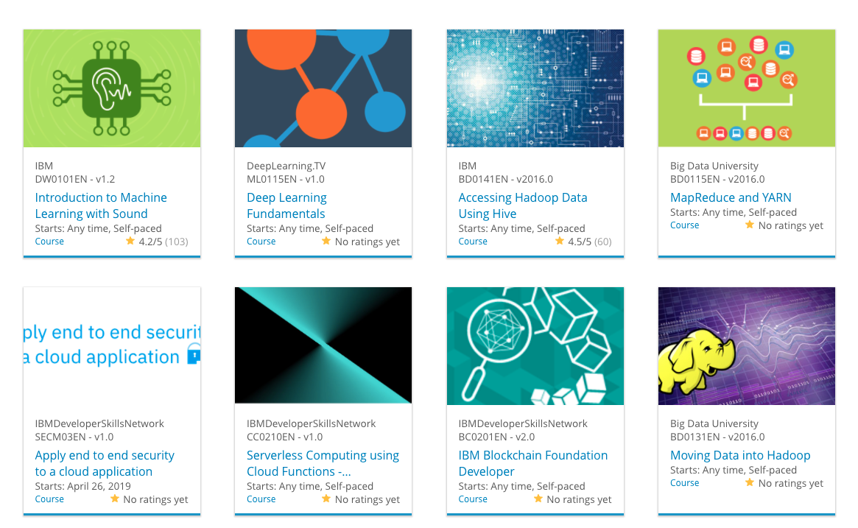

Build a Personalized Online Course Recommender System with Machine Learning
Abdul Kuddus (G23 AI 2044)
Mohit Mathur
(G23AI2034)
Ritik Sharma
(G23AI2024)

Slide 2

Outline
Introduction and Background
Exploratory Data Analysis
Content-based Recommender System using Unsupervised Learning

Slide 3
Introduction
A Course Recommender System is a personalized tool designed to suggest educational courses to users based on their interests, preferences, and past behaviors. It leverages data-driven algorithms to enhance the learning experience by helping individuals find courses that best match their academic and career goals.

Slide 4

Exploratory Data Analysis

Slide 5
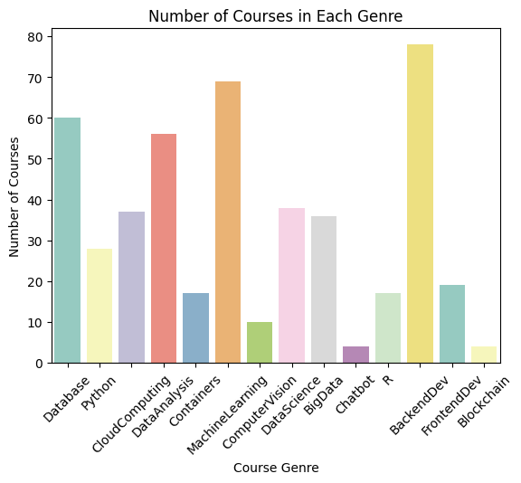
Course counts per genre

Slide 6
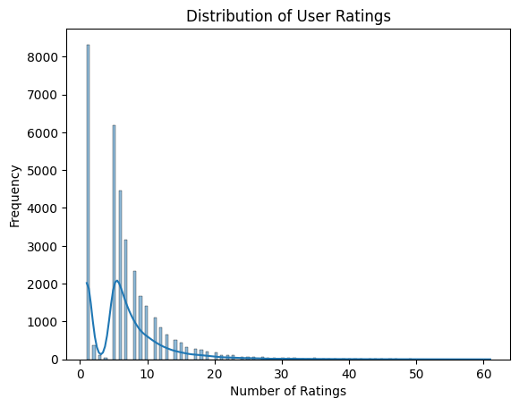
Course enrollment distribution

Slide 7
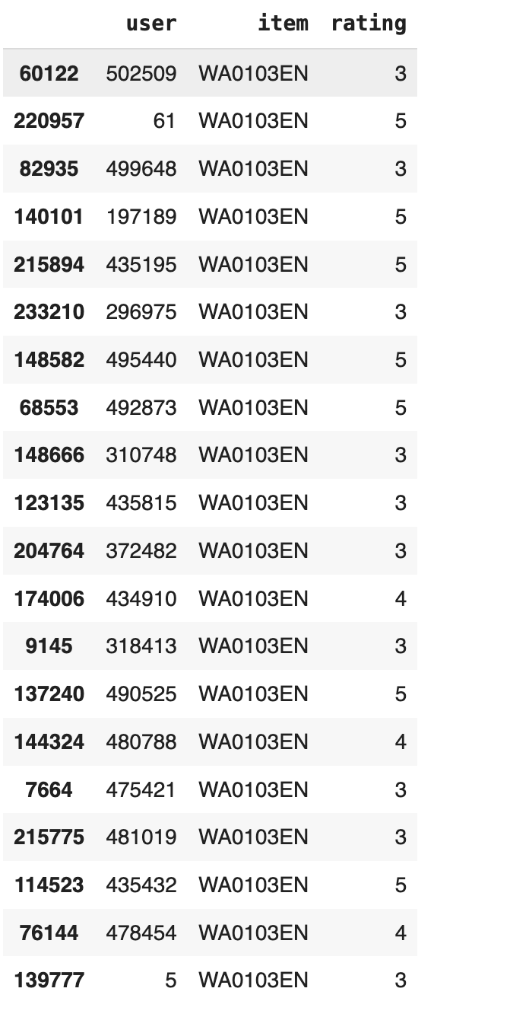
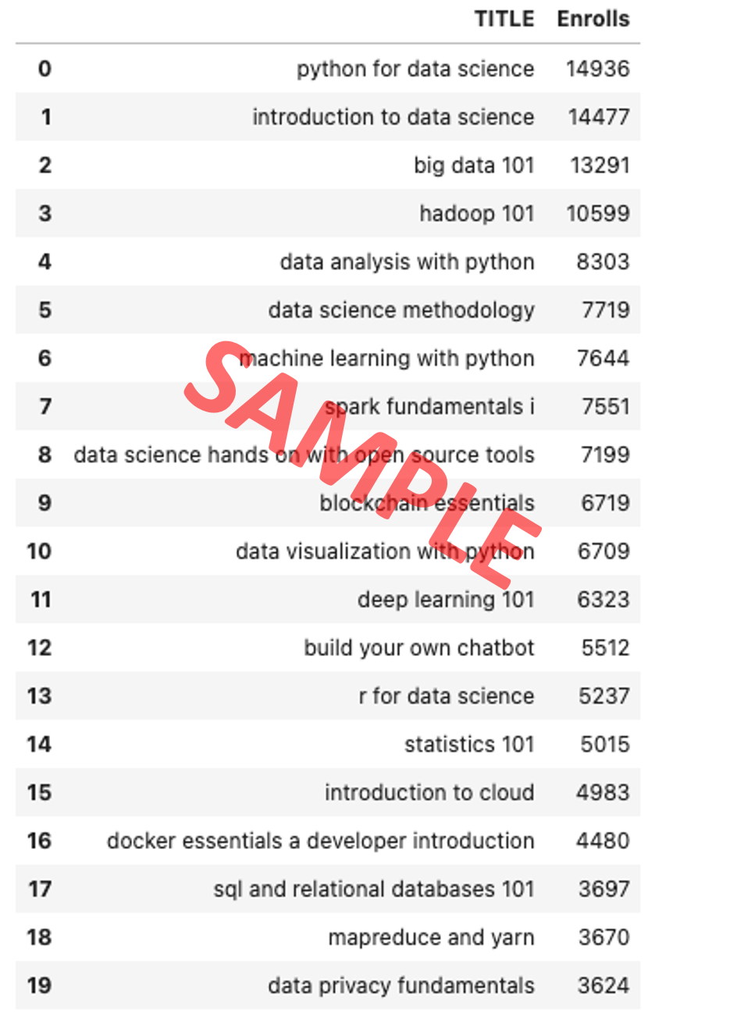
20 most popular courses

Slide 8
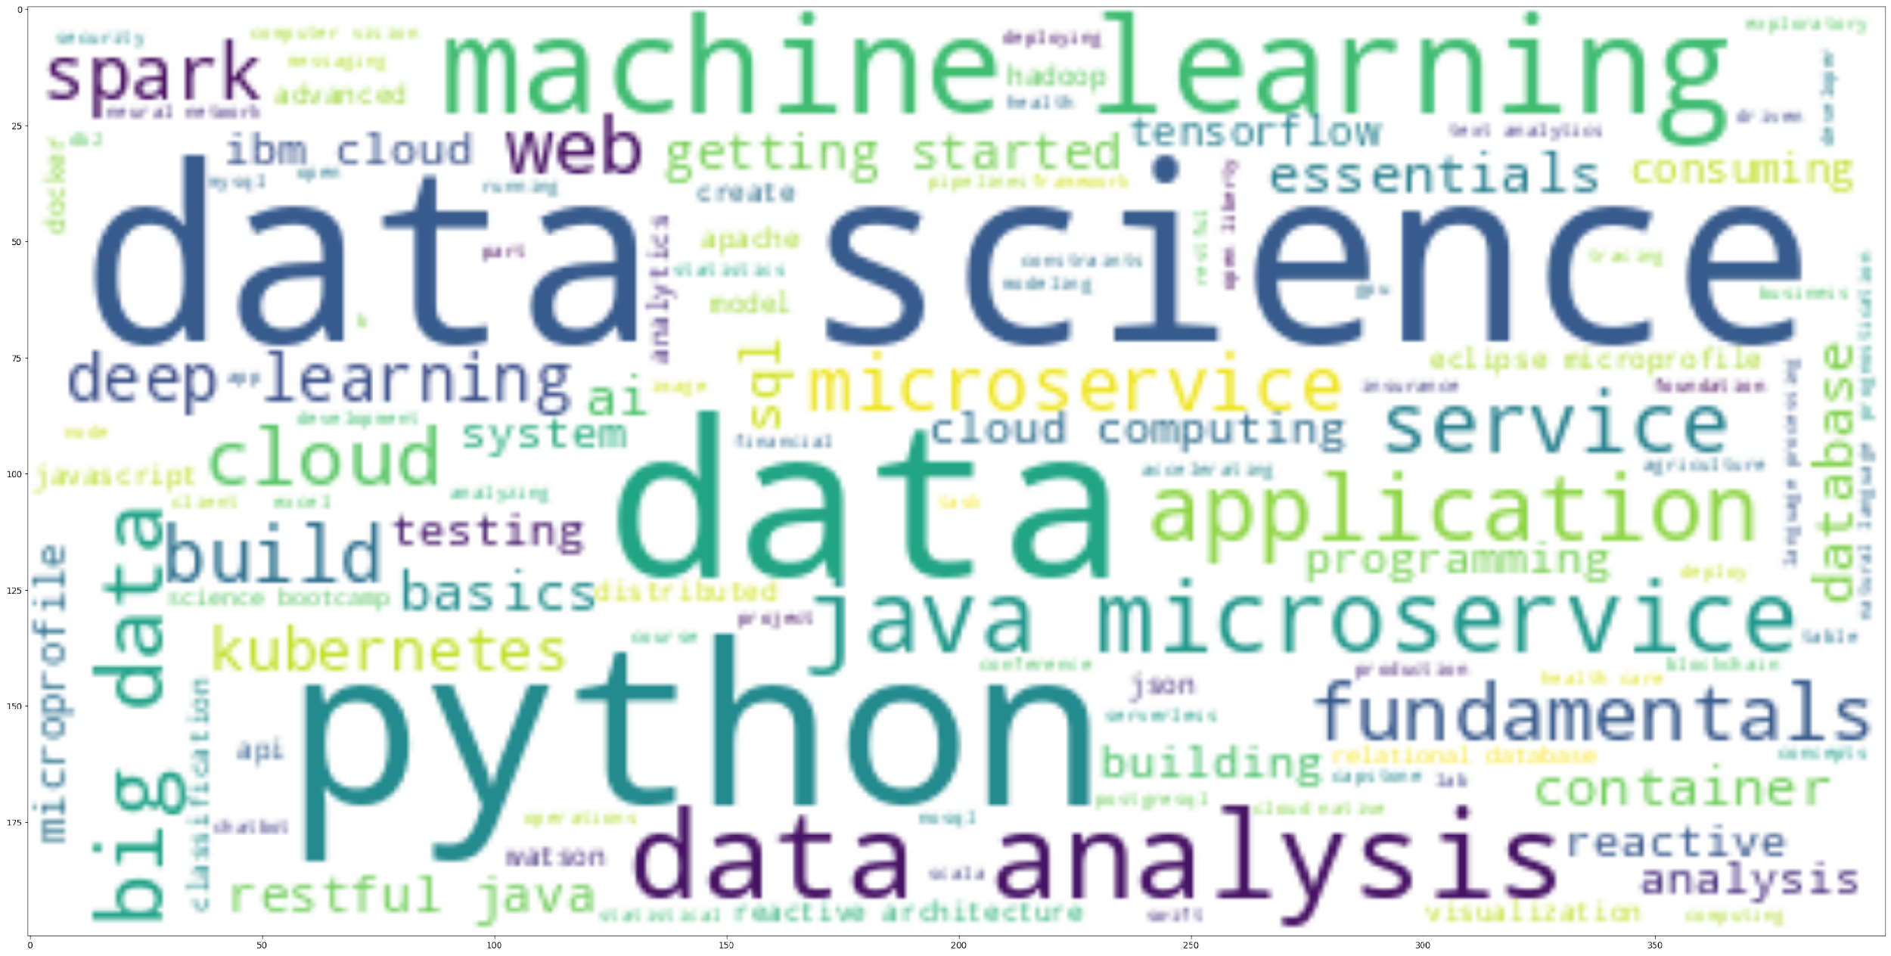
Word cloud of course titles

Slide 9
Content-based Recommender System using Unsupervised Learning
Cluster2
Cluster1

Slide 10
Flowchart of content-based recommender system using user profile and course genres
Raw data
Data processing
Cleaned datasets
Feature engineering
Features

Slide 11
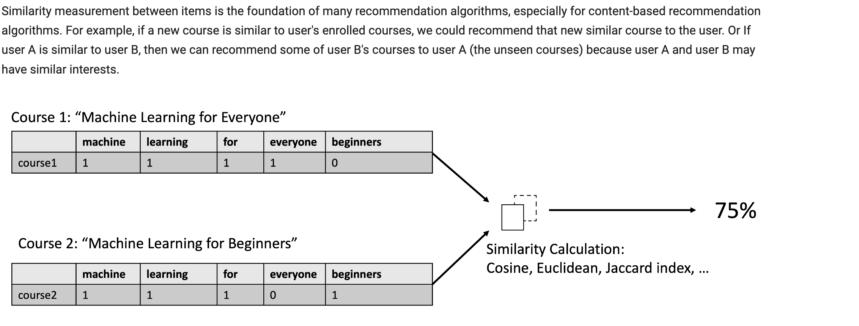
Similarity Measurement

Slide 12
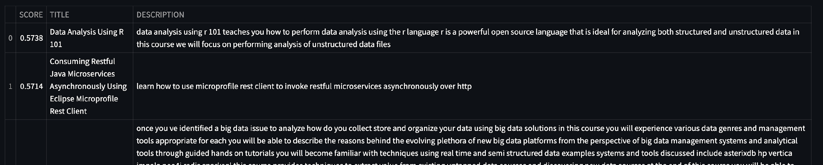
Evaluation results of course similarity based recommender system
Top 8 Courses with threshold of 50%

Slide 13
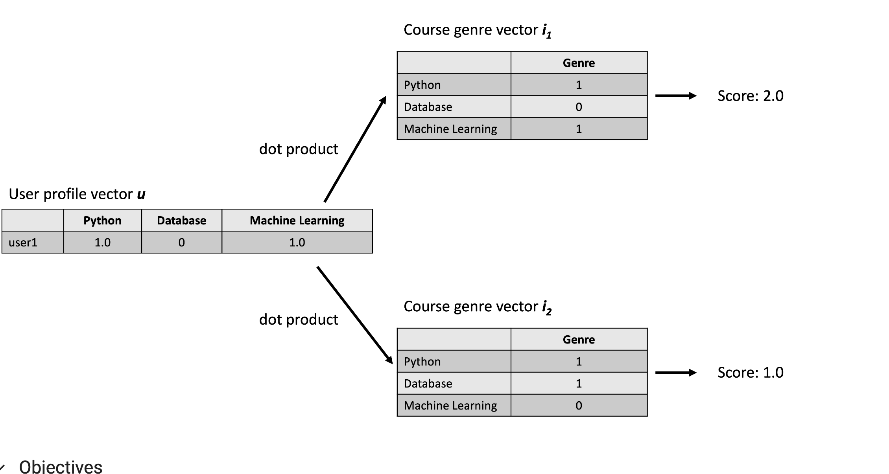
User Profile Similarity Score calculation

Slide 14
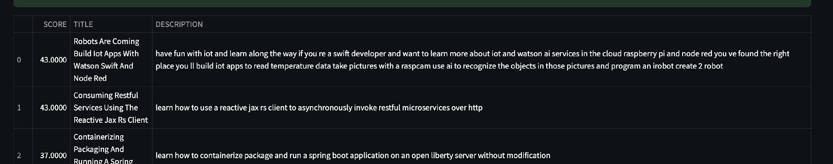
Evaluation results of user profile-based recommender system
Hyperparameter Recommendation score > 10

Slide 15
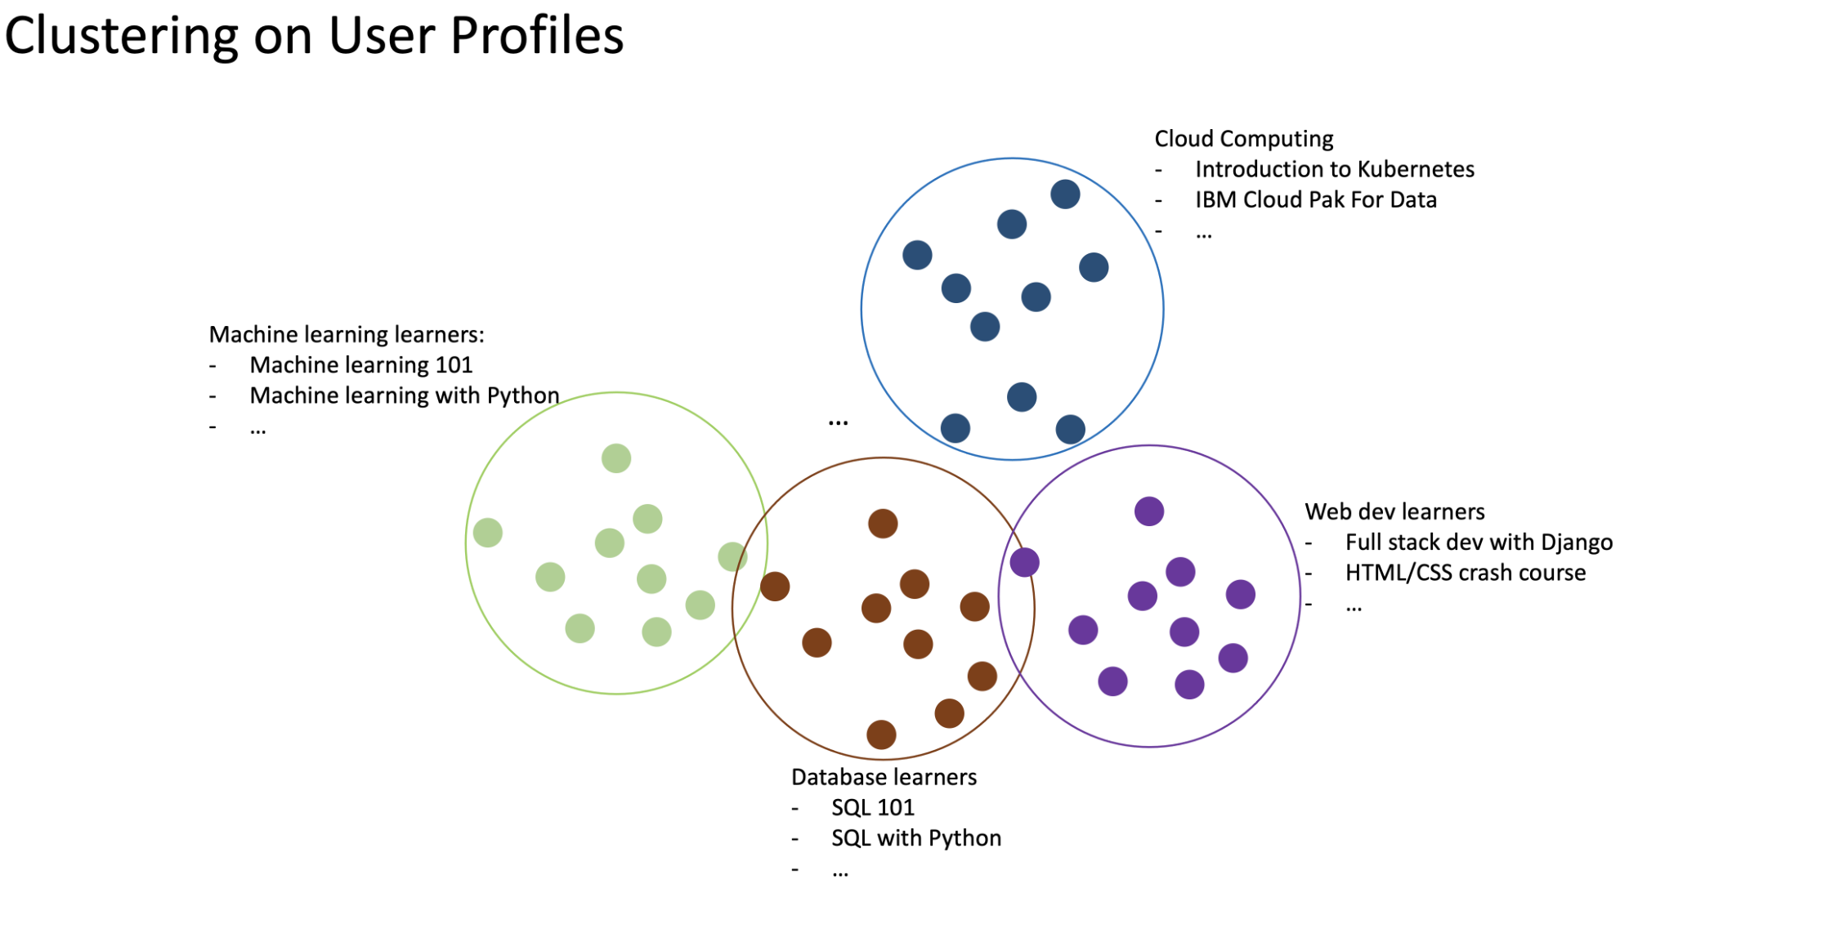
Clustering on User Profiles

Slide 16
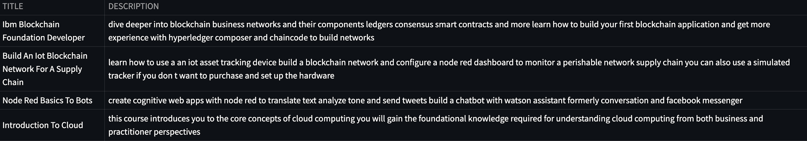
Evaluation results of clustering-based recommender system
Hyperparameter – Number of cluster 20

Slide 17
Thank You

