Slide 1
Multithreading

Slide 2
THREAD
A thread is a lightweight sub-process, the smallest unit of processing. Multiprocessing and multithreading, both are used to achieve multitasking.
However, we use multithreading than multiprocessing because threads use a shared memory area. They don't allocate separate memory area so saves memory, and context-switching between the threads takes less time than process.
Java Multithreading is mostly used in games, animation, etc.

Slide 3
Advantages of Java Multithreading
1) It doesn't block the user because threads are independent and you can perform multiple operations at the same time.
2) You can perform many operations together, so it saves time.
3) Threads are independent, so it doesn't affect other threads if an exception occurs in a single thread.

Slide 4
Multitasking
Multitasking is a process of executing multiple tasks simultaneously. We use multitasking to utilize the CPU. Multitasking can be achieved in two ways:
Process-based Multitasking (Multiprocessing)
Thread-based Multitasking (Multithreading)

Slide 5
Process-based Multitasking (Multiprocessing)
Each process has an address in memory. In other words, each process allocates a separate memory area.
A process is heavyweight.
Cost of communication between the process is high.
Switching from one process to another requires some time for saving and loading registers, memory maps, updating lists, etc.

Slide 6
Thread-based Multitasking (Multithreading)
Threads share the same address space.
A thread is lightweight.
Cost of communication between the thread is low.

Slide 7
What is Thread in java
A thread is a lightweight subprocess, the smallest unit of processing. It is a separate path of execution.
Threads are independent. If there occurs exception in one thread, it doesn't affect other threads. It uses a shared memory area.

Slide 8
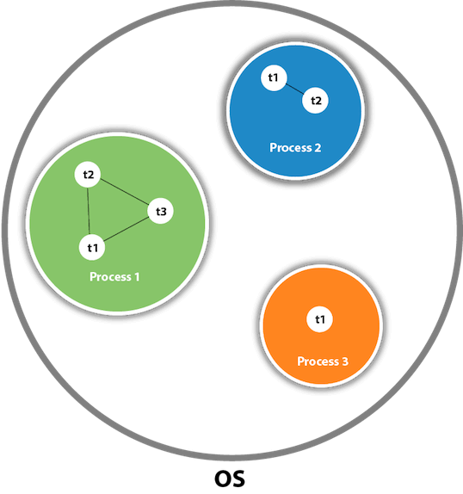

Slide 9
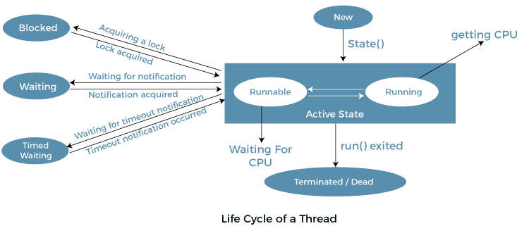
Note: At a time one thread is executed only.

Slide 10
Java Thread class
Java provides Thread class to achieve thread programming. Thread class provides constructors and methods to create and perform operations on a thread. Thread class extends Object class and implements Runnable interface.

Slide 11
How to create a thread in Java
There are two ways to create a thread:
By extending Thread class
By implementing Runnable interface.

Slide 12
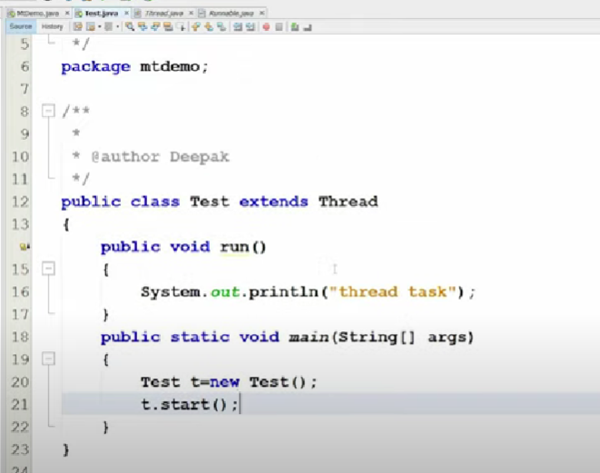

Slide 13
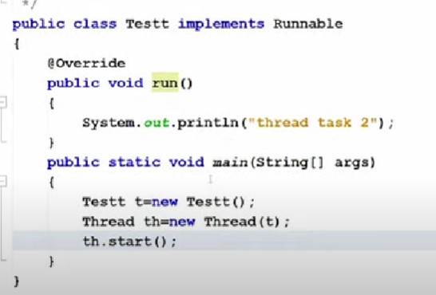

Slide 14
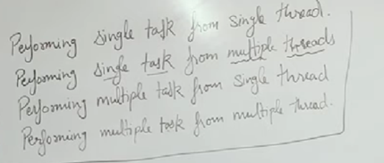

Slide 15
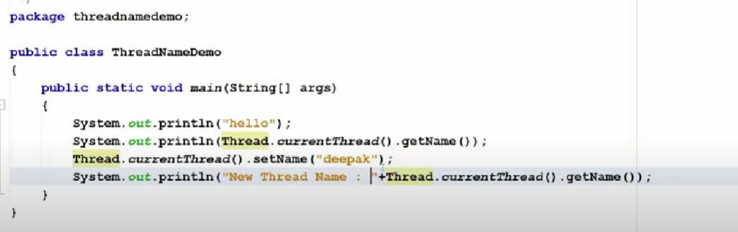
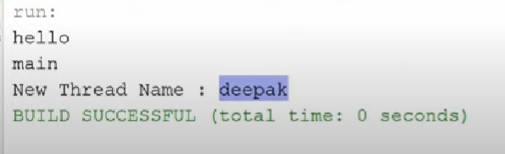

Slide 16
Priorities in threads is a concept where each thread is having a priority which in layman’s language one can say every object is having priority here which is represented by numbers ranging from 1 to 10.
The default priority is set to 5 as excepted.
Minimum priority is set to 1.
Maximum priority is set to 10.
Here 3 constants are defined in it namely as follows:
public static int NORM_PRIORITY
public static int MIN_PRIORITY
public static int MAX_PRIORITY

Slide 17
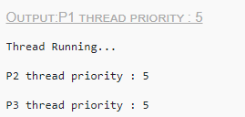
class MyThread extends Thread { public void run() { System.out.println("Thread Running..."); } public static void main(String[]args) { MyThread p1 = new MyThread(); MyThread p2 = new MyThread(); MyThread p3 = new MyThread(); p1.start(); System.out.println("P1 thread priority : " + p1.getPriority()); System.out.println("P2 thread priority : " + p2.getPriority()); System.out.println("P3 thread priority : " + p3.getPriority()); } }

Slide 18
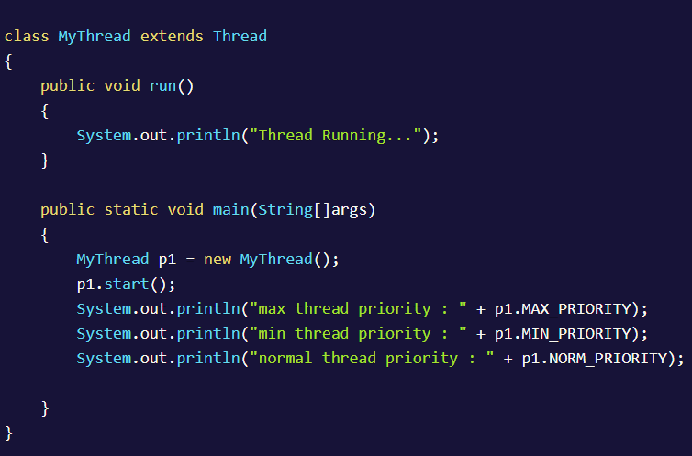

Slide 19
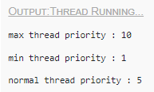

Slide 20
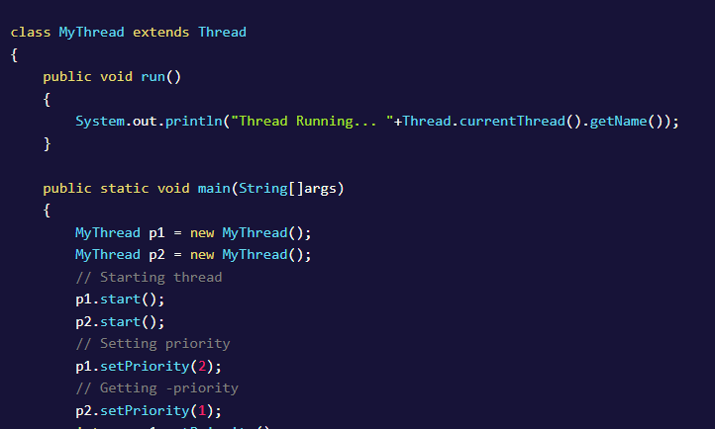

Slide 21
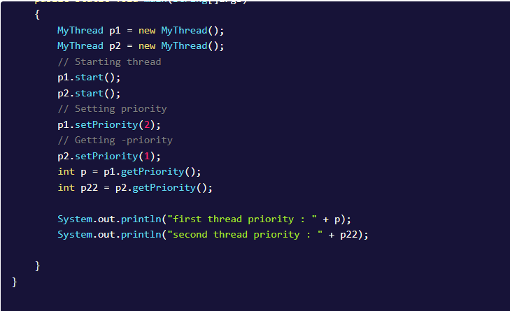

Slide 22

class TestSleepMethod1 extends Thread{
public void run(){
for(int i=1;i<5;i++){
// the thread will sleep for the 500 milli seconds
try{Thread.sleep(500);}catch(InterruptedException e){System.out.println(e);}
System.out.println(i);
}
}
public static void main(String args[]){
TestSleepMethod1 t1=new TestSleepMethod1();
TestSleepMethod1 t2=new TestSleepMethod1();
t1.start();
t2.start();
}
}

Slide 23
Join Method in Java
The join() method in Java is provided by the java.lang.Thread class that permits one thread to wait until the other thread to finish its execution. Suppose th be the object the class Thread whose thread is doing its execution currently, then the th.join(); statement ensures that th is finished before the program does the execution of the next statement.

Slide 24
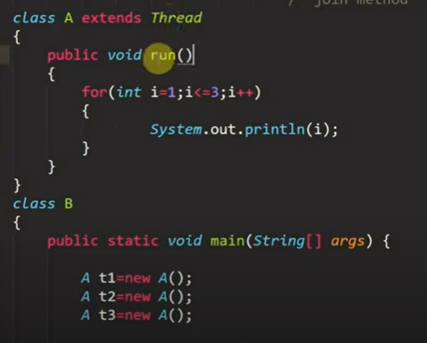
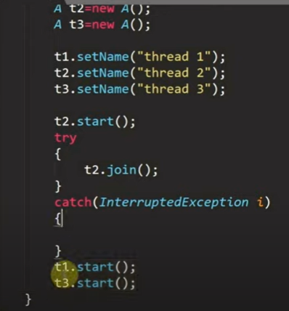
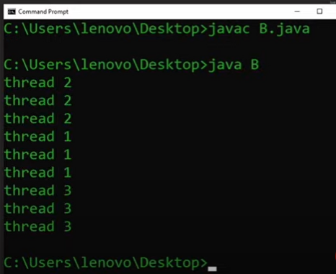

Slide 25
Synchronization in Java
Synchronization in Java is the capability to control the access of multiple threads to any shared resource.
Java Synchronization is better option where we want to allow only one thread to access the shared resource.

Slide 26
Why use Synchronization?
The synchronization is mainly used to
To prevent thread interference.
To prevent consistency problem.

Slide 27
Types of Synchronization
There are two types of synchronization
Process Synchronization
Thread Synchronization

Slide 28
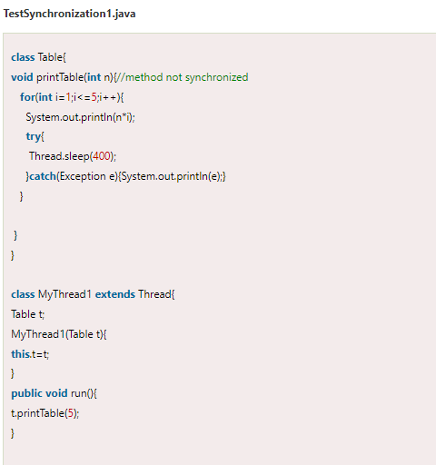

Slide 29
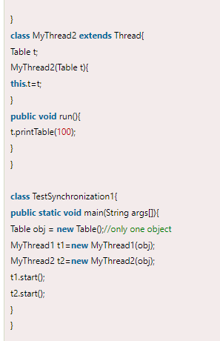


Slide 30
Java Synchronized Method
If you declare any method as synchronized, it is known as synchronized method.
Synchronized method is used to lock an object for any shared resource.
When a thread invokes a synchronized method, it automatically acquires the lock for that object and releases it when the thread completes its task.

Slide 31
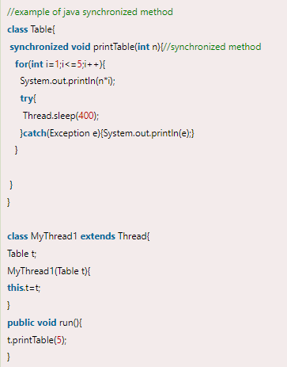
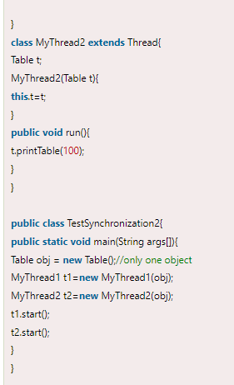

Slide 32


Slide 33
Synchronized Block in Java
Synchronized block can be used to perform synchronization on any specific resource of the method.
Suppose we have 50 lines of code in our method, but we want to synchronize only 5 lines, in such cases, we can use synchronized block.
If we put all the codes of the method in the synchronized block, it will work same as the synchronized method.

Slide 34
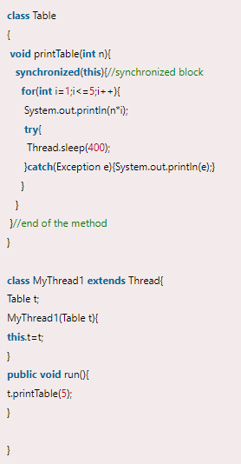
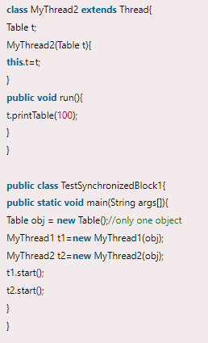

Slide 35


