Slide 1
Network Reliability
Group 9:
C Sneha (181IT112) - 9611401333
Prakriti Goyal (181IT233) - 9036150451
Karthik R (181IT235) - 9148250518
Ritik Pansuriya (181IT237) - 9727859172

Slide 2
Problem Statement
Given a complete graph with N nodes and a probability P- the link reliability of an edge between any two nodes, design an algorithm to evaluate the network reliability of a given network configuration.

Slide 3
Introduction
Network reliability is the probabilistic measure that determines whether a network remains functional when its elements fail at random.
Since its introduction in the 1950’s, network reliability has remained more of an interesting theoretical construct than a practical tool.
Classification of network reliability is a NP-Hard problem.
We rely on the probability of up and down states of links in the network. We use these probabilities to determine the overall probability of the network.
The network availability is defined as the probability of any two network nodes connectivity.

Slide 4
Literature Survey
The availability of network connection is a possibility of packet transmission between any two network routers. By using the approach exhaustive enumeration, we don’t need any particular connectivity pattern like series or parallel or series-parallel.^{[1]}
They present a decomposition procedure for evaluating the reliability of a network whose elements fail independently with known probabilities. The running time for each iteration depends super exponentially on the network size. Finally, they showed that computing network reliability is NP-hard.^{[3]}

Slide 5
Methodology
We consider a complete graph and take the number of nodes and probability of link reliability as input.
Since we have n nodes as input, the total number of edges is ^{n}C₂ which is n(n-1)/2 and each link can have two possible states, active and inactive.
Hence the total number of possible combinations aggregates to 2^{n(n-1)/2}.

Slide 6
Methodology
To determine the network reliability, we consider all the possible 2^{n(n-1)/2} combinations of the topology. For example, consider 5 nodes as n0, n1, n2, n3, n4. Generate binary numbers from 0 to 1023 of 10-bit size.
1 0 0 1 0 0 0 1 1 1
0 1 2 3 4 5 6 7 8 9
The first four bits, 0, 1, 2, 3 represent edge state from n0 to n1, n2, n3 and n4 respectively.
The next 3 bits, 4, 5, 6, represent edge state from n1 to n2, n3 and n4.
The next 2 bits, 7, 8, represent edge state from n2 to n3 and n4.
The bit, 9, represent edge state from n3 to n4.

Slide 7
Methodology
We process edge_matrix to find combinations which represent a connected graph. This is done by transforming the edge-matrix into an adjacency matrix.
We then run Depth-First-Search to find whether the connected components go through all the nodes in the network, to confirm the network is connected.

Slide 8
Methodology
For each connected combination, we calculate the reliability of that combination using its edge-matrix. This is done as follows:
Set initial reliability as 1.0
For each edge:
If edge is up:
reliability = reliability * p
If edge is down:
reliability = reliability * 1-p
(where 1-p is the probability that the link is down).
We calculate the total network reliability as the sum for all possible network combinations

Slide 9
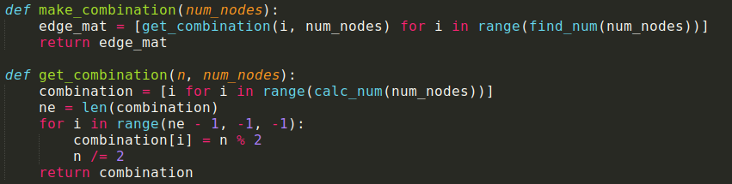
Code Explanation through Snippets
Code snippet of main.py file
Time taken : O(2^{n^2})

Slide 10
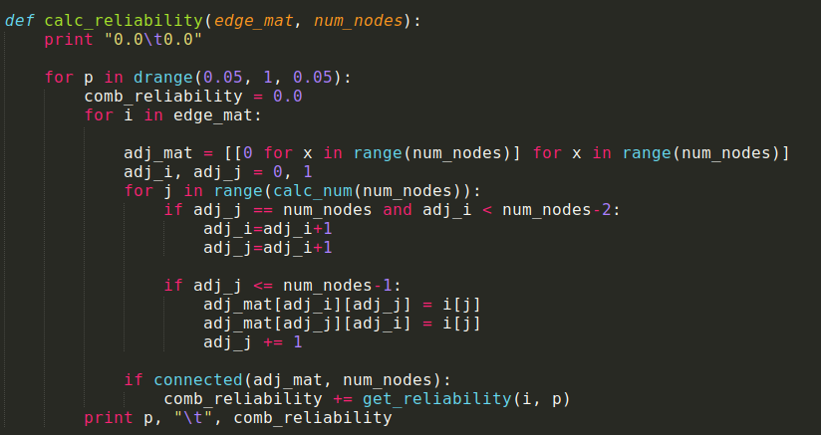
Code Explanation through Snippets
Time taken:
O(n² x 2^{n^2})

Slide 11
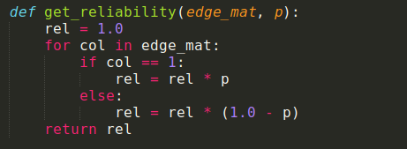
Code Explanation through Snippets
Time taken : O(n²)

Slide 12
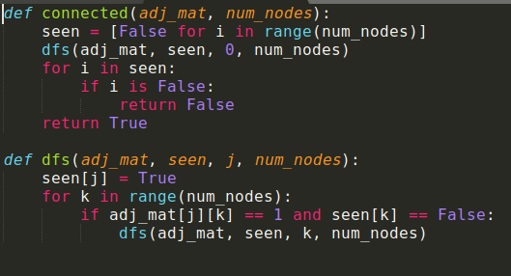
Code Explanation through Snippets
Code snippet of connected.py file
Time taken :O(n+E)=O(n²)
(E=n(n-1)/2)

Slide 13
Time Complexity
Major time-consuming operations:
Finding all possible combination: O(2^{n^2})
Converting each combination to adjacency matrix: O(n²)
Total time-complexity: O(n² x 2^{n^2})

Slide 14
Proof of NP-Hardness
The decision version of the Network Reliability problem can be defined as: For given reliability of the link (p) and minimum expected reliability (q) our problem can return YES if we have network reliability greater than or equal to q.
This problem is NP-Hard^{[3]}
In the paper in reference 3, they proved the hardness by solving the Steiner subgraph problem^{[4]} which is NP-Hard, by using our algorithm.
This proves that the decision version of Network Reliability is indeed NP-Hard.

Slide 15
Results
Live Demo

Slide 16
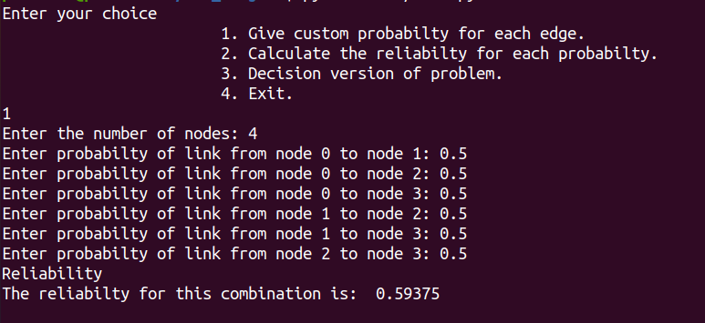
Choice 1:

Slide 17
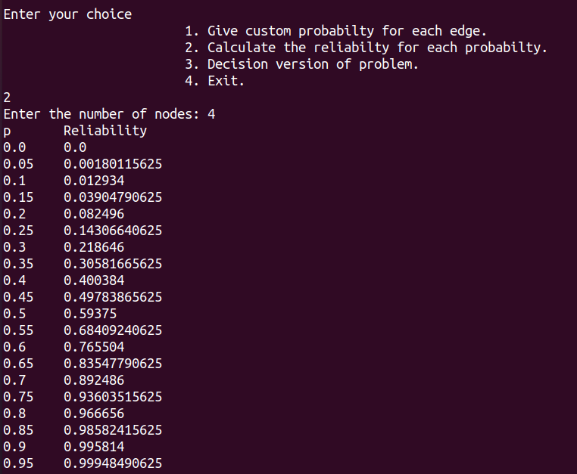
Choice 2:

Slide 18
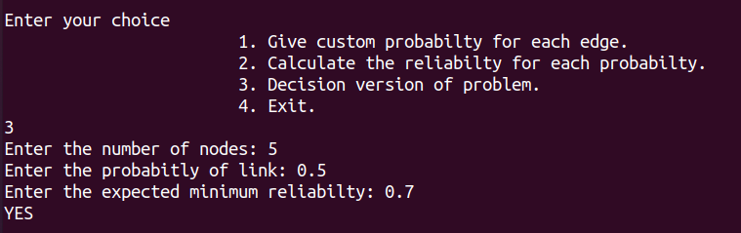
Choice 3:

Slide 19
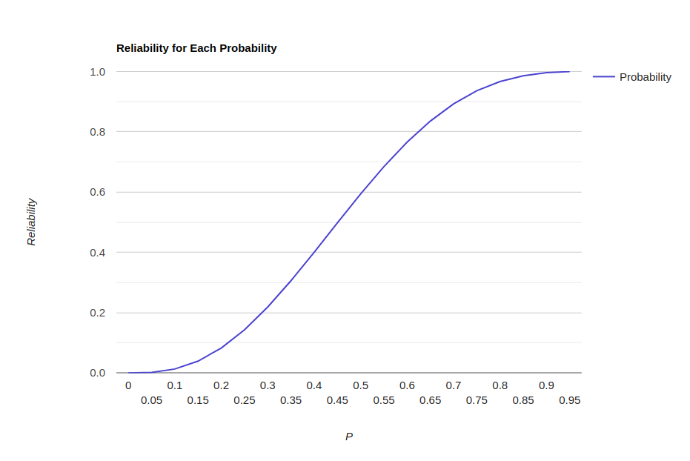
Reliability vs P (n = 4)

Slide 20
Applications
Network reliability has been used as a flexible tool to study diffusive phenomena on networks, for which network-based epidemiology is a direct application.
Network reliability can be utilized as a measure that captures the distribution of possible outcomes of a given disease outbreak.

Slide 21
Conclusion
We can confirm that the overall network reliability can be measured by using a probabilistic model for the up/down states of a link
The better the probability to stay up, the better is the reliability
We conclude that denser networks have a better network reliability

Slide 22
References
[1] L. E. Miller, J. J. Kelleher, and L. Wong, "Assessment of Network Reliability Calculation Methods," J. S. Lee Associates, Inc.
[2] Konstantin M. Zuev a,n , Stephen Wu b , James L. Beck, “General network reliability problem and its efficient solution by Subset Simulation”
[3] Rosenthal, A.: Computing the reliability of complex networks. SIAM J. Appl. Math. 32, 384–393 (1977)
[4] Gassner, Elisabeth. (2010). The Steiner Forest Problem revisited. J. Discrete Algorithms. 8. 154-163

Slide 23
Thank You

