Slide 1

SMART INDIA HACKATHON 2026
TITLE PAGE
Problem Statement ID – 26051
Problem Statement Title – Software-Based Model Development for Design of Area-Specific Shelter for Thermal Comfort Maintenance
Theme – Miscellaneous
PS Category – Software
Team ID – To be allotted after selection
Team Name – HimTaap

Slide 2
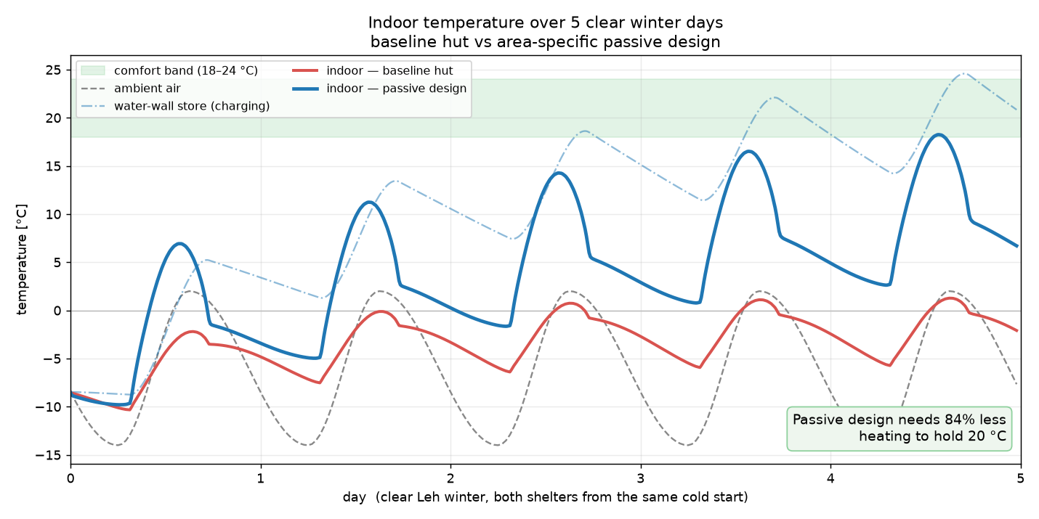
Thermal-Shelter — a shelter that stays warm on sunlight, not fuel.
HimTaap
Proposed solution — what it is
A design tool for cold, high-altitude shelters (Ladakh & border posts) that hold comfort on sunlight and smart materials — with little or no active heating.
You give it the site climate, the shelter's shape, and its materials; it simulates a full day–night cycle and outputs exactly what the problem asks:
  Indoor temperature over time
  Solar thermal energy captured
  Heat-flow vs ambient over the period
Then redesign it live — walls, glazing, orientation, thermal mass — and watch the heating it needs fall toward zero.
What makes it different
  Models the night and the cold sky (air −14 °C, sky ≈ −45 °C) — not just the average.
  Stores the sun in thermal mass — stone, water walls, PCM.
  Area-specific: one engine, any cold site (Leh, Drass, Siachen, Tawang).
  Fast — under 1 second per design — so you optimise, not guess. ANSYS validates the winner.
Simulated Leh winter — the passive design (blue) climbs into the comfort band on sunlight; the baseline hut (red) tracks the freezing air.

Slide 3
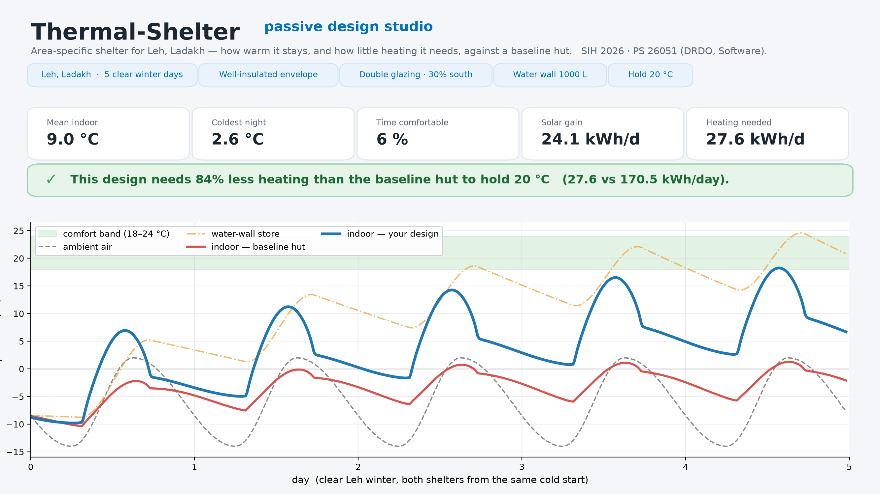
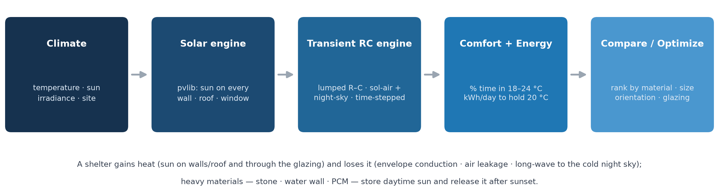
TECHNICAL APPROACH
HimTaap
Technologies used
  Python 3.12 — NumPy · SciPy · pandas
  pvlib — solar position & irradiance: clear-sky or real measured (snow albedo)
  PVGIS / EPW — real measured weather (TMY) fetched live for any site
  Streamlit + Plotly — the live design dashboard (prototype, right)
  matplotlib — figures & reporting
  ANSYS — CFD / thermal cross-validation (later phase)
Methodology
  Lumped resistance–capacitance (RC) thermal network, stepped through time
  Driven by sol-air outdoor temperature + long-wave night-sky cooling
  pvlib solar irradiance on every wall, roof and window
  Runs on a real measured year (PVGIS TMY / EPW) — rolled up month-by-month
  Score comfort (% time in 18–24 °C) and energy (kWh/day to hold 20 °C)
  Compare & rank designs by material, size, orientation and glazing
Working prototype — the live design studio (Streamlit).

Slide 4
FEASIBILITY AND VIABILITY
HimTaap
Why it's feasible
  Built on standard, peer-reviewed physics — ASHRAE sol-air & RC networks, Berdahl–Martin sky emissivity. Defensible, not a black box.
  Uses the mature, widely trusted pvlib solar model.
  Pure software — runs on any laptop, with no field hardware to build.
  The working prototype already reproduces the passive-design behaviour we expect.
Viability
  Cheap, fast and reusable across regions: screen hundreds of designs in software, then validate only the winner in CFD — where each case would otherwise take hours.
Potential challenges → how we overcome them
  Sparse climate data for remote posts → accept user CSV + a typical-day generator + built-in region presets.
  A lumped RC model simplifies real 3-D heat flow → validate and calibrate the shortlisted design in ANSYS CFD.
  Material properties vary by source → a sourced, editable material-property database.

Slide 5
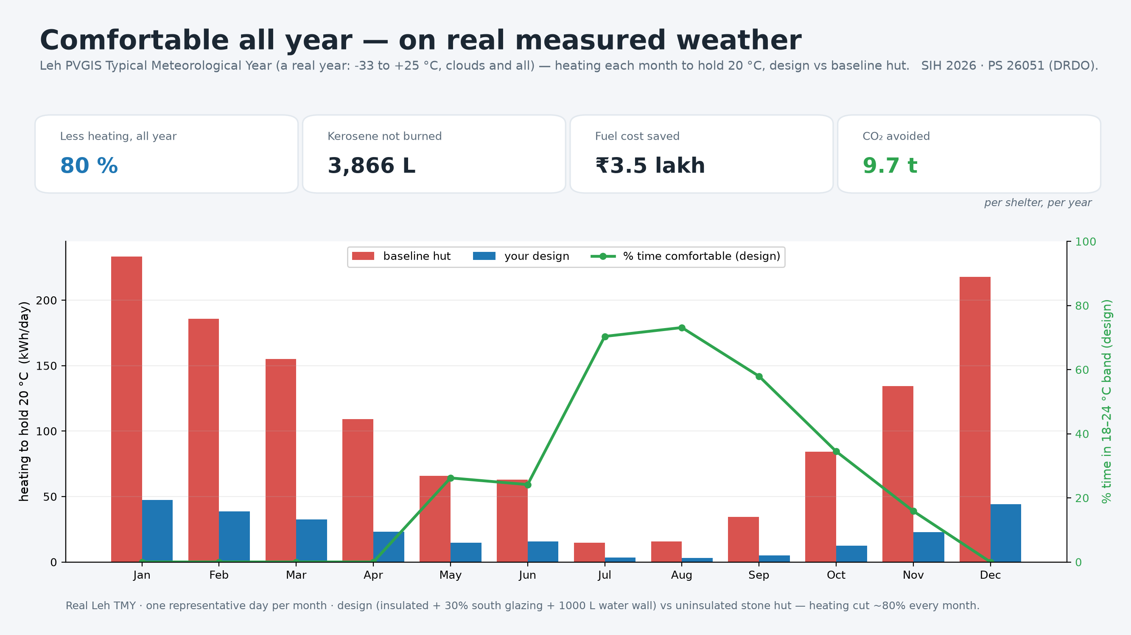
IMPACT AND BENEFITS
HimTaap
~80% less heating — every month of a real Leh year
7,960 vs 39,814 kWh/year to hold 20 °C — driven by a PVGIS Typical Meteorological Year (real clouds and irradiance, not a clear-sky day).
≈ 3,900 L kerosene · ₹3.5 lakh · ~10 t CO₂ — saved per shelter, per year.
(Clear design-day: 82–86% less across Leh, Drass, Siachen, Tawang — Leh 84%.)
Who it helps
  Armed forces & border posts · high-altitude communities · disaster relief.
Benefits
  Economic — thousands of litres of kerosene and ₹3.5 lakh saved per shelter each year; designs done in minutes, not months.
  Environmental — ~10 t less CO₂ per shelter per year in a fragile Himalayan ecosystem.
  Operational & social — energy resilience where supply lines are thin; warmer, safer shelters; fewer cold-related injuries.
All year on real measured weather — monthly heating (design vs baseline hut), % time comfortable, and the fuel / ₹ / CO₂ saved per shelter per year.

Slide 6
RESEARCH AND REFERENCES
HimTaap
1. pvlib-python (Sandia National Laboratories) — solar position & clear-sky irradiance — https://pvlib-python.readthedocs.io
2. PVGIS (EU Joint Research Centre) — Typical Meteorological Year, free, no API key — https://re.jrc.ec.europa.eu/pvg_tools/en/
3. Berdahl, P. & Martin, M. (1984), “Emissivity of clear skies” — long-wave radiative night-sky cooling
4. ASHRAE Handbook of Fundamentals — sol-air temperature, RC thermal networks, U-values & SHGC
5. Balcomb, J. D. / U.S. Department of Energy — passive-solar design: Trombe & water walls, thermal mass
6. DRDO–DIHAR (Defence Institute of High-Altitude Research), Leh — high-altitude habitat & thermal-comfort context
7. Project repository — https://github.com/ritikx-36/sih-2026

