Slide 1
Natural Language Processing
Slides by Sergei Nirenberg

Slide 2
Dave: Open the pod bay doors, HAL.
HAL: I am sorry, Dave. I am afraid I can’t do that.
Dave: What’s the problem.
HAL: I think you know what the problem is just as well as I do.
Dave: I don’t know what you’re talking about.
HAL: I know that you and Frank were planning to disconnect me, and I’m
afraid that’s something I cannot allow to happen.
General speech and language understanding and generation capabilities
Politeness: emotional intelligence
Self-awareness: a model of self, including goals and plans
Belief ascription: modeling others; reasoning about their
goals and plans

Slide 3
Hal: I can tell from the tone of your voice, Dave, that you’re upset.
Why don’t you take a stress pill and get some rest.
[Dave has just drawn another sketch of Dr. Hunter].
HAL: Can you hold it a bit closer?
[Dave does so].
HAL: That’s Dr. Hunter, isn’t it?
Dave: Yes.
Recognition of emotion from speech
Vision capability including visual recognition of emotions and faces
Also: situational ambiguity

Slide 4
To attain the levels of performance we attribute to
HAL, we need to be able to define, model, acquire and
manipulate
  Knowledge of the world and of agents in it,
  Text meaning,
  Intention
  and related “big” issues.

Slide 5
But is a HAL-like system really needed?
Can we maybe fake intelligence -- or at least a
capability to maintain dialog -- and not have
to face a problem that is so very hard?
Well, sometimes.

Slide 6
When thinking about building dialog systems, consider
PARRY (Colby 1971), a computer conversationalist with
a paranoid personality. It was far, far more powerful than its much
more famous cousin Eliza and had thousands of users in the 1970s
who plainly believed that it was intelligent. Trained psychiatrists
couldn’t in a blind test distinguish PARRY from a human. But all
PARRY had was about 6000 patterns through which to recognize
elements of input and some open-pattern stock answers, many of
them referring to the mafia and bookies at racetracks. PARRY could
keep up conversations of dozens of turns and appeared to have
a personality.
It was at one time pitched against Eliza:

Slide 7
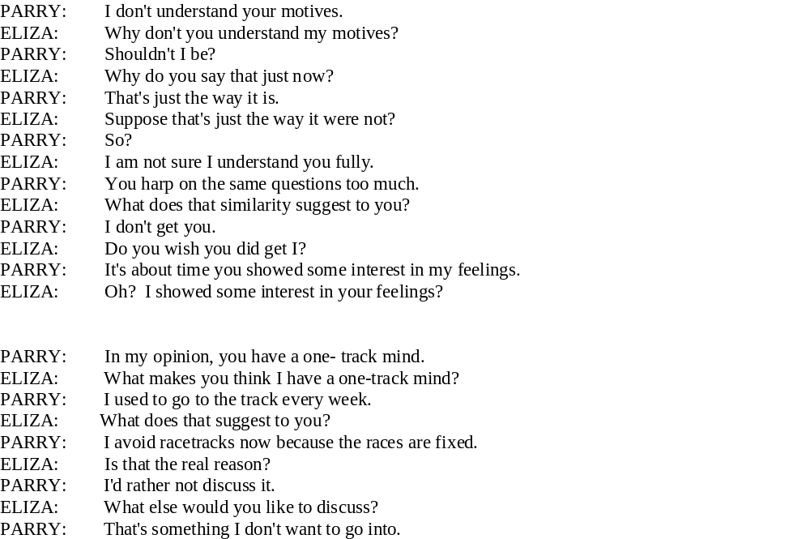

Slide 8
Phonetics and phonology | The study of language sounds
Ecology | The study of language conventions for punctuation, text mark-up and encoding
Morphology | The study of meaningful components of words
Syntax | The study of structural relationships among words
Lexical semantics | The study of word meaning
Compositional semantics | The study of the meaning of sentences
Pragmatics | The study of the use of language to accomplish goals
Discourse conventions | The study of conventions of dialogue

Slide 9
Discipline | Typical Problems | Tools
Linguists | How do words form phrases and sentences? What constrains the possible meanings for a sentence? | Intuitions about well-formedness and meaning; mathematical models of structure and meaning
Psycholinguists | How do people identify the structure of sentences? How are word and text meanings identified? | Experimental techniques based on measuring human performance; statistical analysis of observations
Philosophers | What is meaning, and how do words and sentences acquire it? How do words identify objects in the world? | Natural language argumentation using intuition about counter-examples; mathematical models (for example, logic and model theory)
Computational Linguists | How is the structure of sentences identified? How can knowledge and reasoning be modeled? How can language be used to accomplish specific tasks? | Algorithms, data structures; formal models of representation and reasoning; AI techniques (search and representation methods)

Slide 10
Some NLP Applications
finding appropriate documents on certain topics from a database
of texts (for example, finding relevant books in a library)
extracting information from messages or articles on certain topics (for example, building a database of all stock transactions described in the news on a given day)
translating documents from one language to another (for example,
producing automobile repair manuals in many different languages)
summarizing texts for certain purposes (for example, producing
a 3-page summary of a 1000-page government report)

Slide 11
Some more NLP Applications
question-answering systems, where natural language is used to
query a database (for example, a query system to a personnel database)
automated customer service over the telephone (for example, to
perform banking transactions or order items from a catalogue)
tutoring systems, where the machine interacts with a student
(for example, an automated mathematics tutoring system)
spoken language control of a machine (for example, voice control of a VCR or computer)

Slide 12
Production-Level Applications
A computer program in Canada accepts daily weather data and
automatically generates weather reports in English and French
Over 1,000,000 translation requests daily are processed by the Babel Fish system available through Altavista
A visitor to Cambridge, MA can ask a computer about places
to eat using only spoken language. The system returns relevant information from a database of facts about the restaurant scene.

Slide 13
Prototype-Level Applications
Computers grade student essays in a manner indistinguishable from human graders
An automated reading tutor intervenes, through speech, when the reader makes a mistake or asks for help
A computer watches a video clip of a soccer game and produces a report about what it has seen
A computer predicts upcoming words and expands abbreviations to help people with disabilities to communicate

Slide 14
Stages in a Comprehensive NLP System
Tokenization
Morphological Analysis
Syntactic Analysis
Semantic Analysis (lexical and compositional)
Pragmatics and Discourse Analysis
Knowledge-Based Reasoning
Text generation

Slide 15
  Tokenization
  German:
  Lebensversicherungsgesellschaftsangesteller
  English:
  life insurance company employee

Slide 16
Morphology
Hebrew (transliterated):
ukshepagashtihu
English:
and when I met you (masculine)

Slide 17
Syntax
How many readings do the following examples have?
I made her duck
I saw Grand Canyon flying to San Diego
the a are of I
the cows are grazing in the meadow
John saw Mary
Foot Heads Arms Body

Slide 18
The bane of NLP: ambiguity
Ambiguity resolution at all levels
and in all system components is
one of the major tasks for NLP

Slide 19
Translation
The coach lost a set
One strongly preferred meaning although
in a standard English-Russian dictionary
coach has 15 senses
lose has 11 senses
set has 91 sense
15 x 11 x 91 = 15015 possible translations

Slide 20
Translation
The soldiers shot at the women and I
saw some of them fall.
If translating into Hebrew, them will have
a choice of a masculine or a feminine
pronoun.
How do we know how to choose?

Slide 21
Noise in the communication channel
hte
Easily resolvable
But sometimes, it is less clear:
Thanks for all you help!
This sentence is ambiguous: It has a reading as is; but it can also be misspelled…
How does one process this?

Slide 22
Brilliant Nonsense
`Twas brillig, and the slithy toves
Did gyre and gimble in the wabe:
All mimsy were the borogoves,
And the mome raths outgrabe
(Lewis Carroll, Jabberwocky)
Is anything at all understandable here?
It was 4 o’clock in the afternoon and the slimy/lithe toves (a combination of a badger, a lizard, and a corkscrew) ran around and made holes in the grass around a sundial. (first two lines)

Slide 23
