Slide 1

𝓗𝓘𝓜𝓞𝓥𝓐𝓣𝓘𝓞𝓝 2026: 𝕊𝕠𝕝𝕧𝕖-𝕒-𝕋𝕙𝕠𝕟
RakshaNetra AI
AI-Assisted Semi-Autonomous Incident Response System
Theme: AI, ML & Intelligent Systems
Team: CodeScythe
Team Lead: Prashant Krishan Bharti
Team Members: Ritish Dhar, Aditya Rawat, Tabeer Hussain
College: Tulas University
Mentor: Not listed in the source PDF

Slide 2
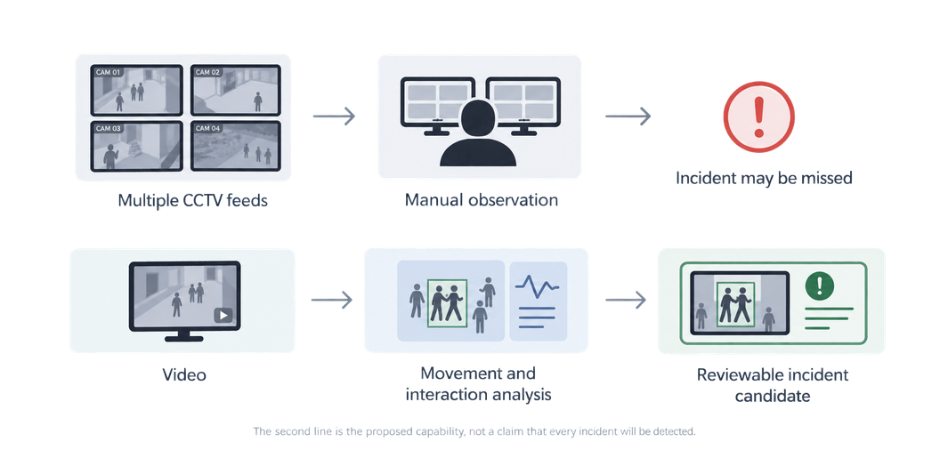
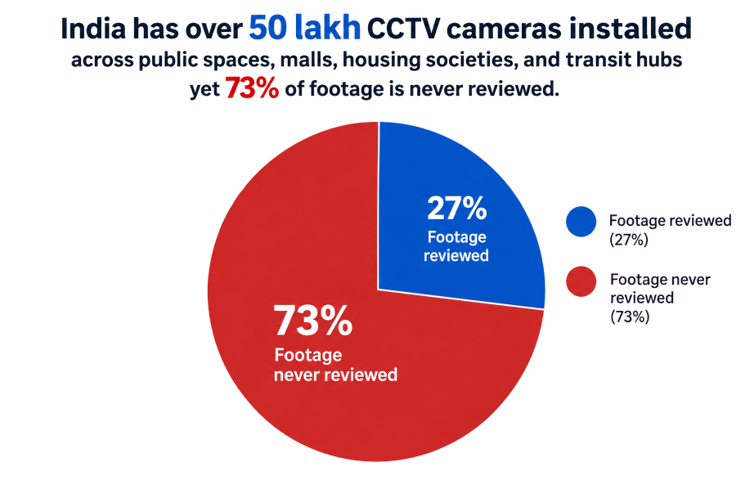
PROBLEM STATEMENT
India has over 50 lakh CCTV cameras across public spaces, malls, housing societies and transit hubs. The source PDF cites an industry-reported VuFindr estimate that 73% of footage is never reviewed.
Security staff can be overwhelmed or away from a live feed. By the time footage is reviewed, the opportunity for timely intervention may have passed.
Automated violence detection remains challenging; Omarov et al. (2022) reviewed 80 papers and described continuing research gaps.
SDG alignment: SDG 11 (Sustainable Cities and Communities) and SDG 16 (Peace, Justice and Strong Institutions).

Slide 3
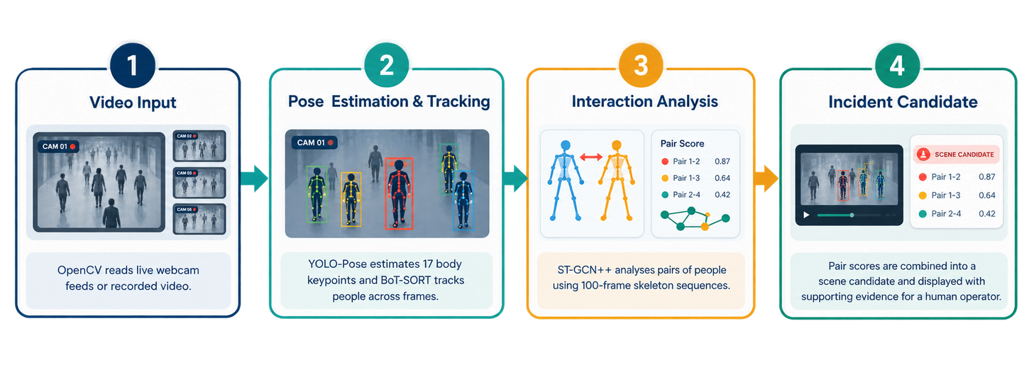
PROPOSED SOLUTION
RakshaNetra AI analyzes CCTV footage to identify potentially violent interactions, track people and interpret body movement in real time.
It flags suspicious moments for human review, helping operators locate critical events without continuously watching every feed.

Slide 4
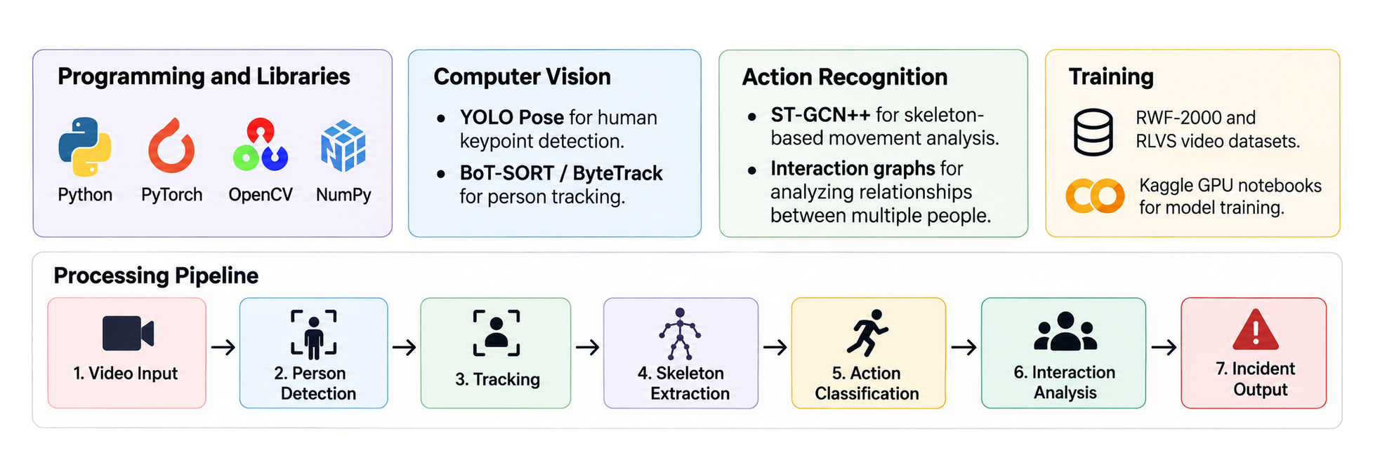
TECHNICAL APPROACH & FEASIBILITY
Core models: YOLOv26m-Pose (17 keypoints), BoT-SORT tracking and ST-GCN++ over 100-frame sequences; an interaction graph combines pair scores into incident candidates.
Feasibility and risks: build on existing CCTV where feasible; use RWF-2000 and RLVS for planned training and evaluation. Test in stages, tune alert thresholds and require human confirmation to manage video quality, compute load and false alerts.

Slide 5
IMPACT AND BENEFITS
Human-supervised alerts across existing CCTV networks
Social impact: Surfaces potential fights, falls, fire or smoke, weapons and unattended bags for human review across multiple feeds. It avoids facial recognition and automated judgments of guilt.
Economic impact: Event-based notifications aim to reduce continuous manual monitoring and may help operators prioritize significant incidents. A modular design could integrate with existing CCTV infrastructure.
Environmental impact: Earlier awareness of fire or smoke may support a faster response and limit property damage and associated material waste.
Target audience: Security and facility teams at campuses, universities, offices, public buildings and commercial sites, plus institutional administrators and control-room operators.

Slide 6
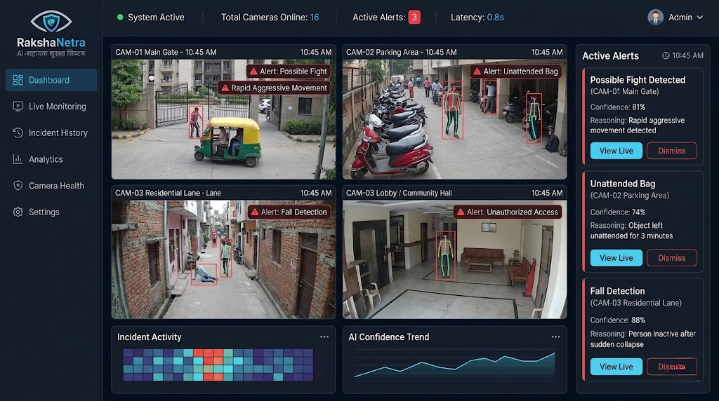
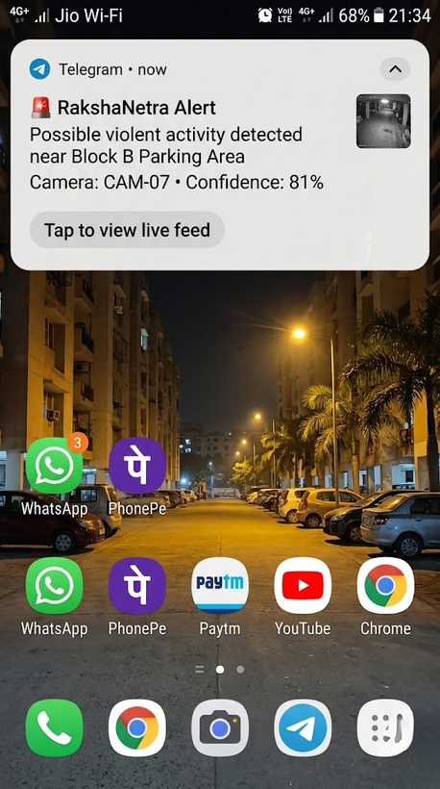
PROTOTYPE & RESEARCH
Illustrative dashboard, mobile alert, and research foundation
RESEARCH & REFERENCES
Omarov et al. (2022), “State-of-the-art Violence Detection Techniques in Video Surveillance Security Systems: A Systematic Review.” PeerJ Computer Science. https://doi.org/10.7717/peerj-cs.920
Bhatti et al. (2021), “Weapon Detection in Real-Time CCTV Videos Using Deep Learning.” IEEE Access. https://doi.org/10.1109/ACCESS.2021.3059170
Raza et al. (2025), “Human Fall Detection Using Pose Estimation: From Traditional Machine Learning to Vision Transformers.” Engineering Applications of AI. https://doi.org/10.1016/j.engappai.2024.109809
Lin et al. (2015), “Abandoned Object Detection via Temporal Consistency Modeling and Back-Tracing Verification.” IEEE TIFS.
YOLO-Pose documentation: https://docs.ultralytics.com/tasks/pose/
ST-GCN++ configurations: https://github.com/kennymckormick/pyskl/tree/main/configs/stgcn%2B%2B
Related patent: https://patents.google.com/patent/WO2022193412A1/en
Prototype dashboard
Mobile alert

