Slide 1
WEB SPEECH API
Using JavaScript API to create and capture vocal interactions

Slide 2
What is the Web Speech API?
A standard proposed to the W3C in October 2012
It is an unofficial standard and not part of the W3C standard
It has two parts: speech synthesis and speech recognition
Support for speech synthesis is good, recognition not so much

Slide 3
Speech Synthesis
Making the browser convert strings into audio speech

Slide 4
speechSynthesis
Properties | Events | Methods
paused pending True if there are more speeches queued speaking All of the above are read-only Booleans | onvoiceschanged Run when available voices are updated | cancel() getVoices() Returns an array of voices available pause() resume() speak(utterance) Starts speaking, takes a SpeechSynthesisUtterance object as a parameter

Slide 5
SpeechSynthesisUtterance
Properties | Events | Methods
lang pitch rate text voice volume | onboundary Run when a word or sentence boundary is reached onend onerror onmark Run when it encounters a SSML mark tag onpause onresume onstart | None
Constructor | new SpeechSynthesisUtterance() Can take the text to be spoken as an argument

Slide 6
Making your browser speak
Before making the browser speak, you need to create an utterance
An utterance is an object representing what the browser should say
Construction of an utterance is simple:
var message = new SpeechSynthesisUtterance("message");
You can then change the properties on the utterance to change how it is spoken
Once you have an utterance, you can make the browser say it:
speechSynthesis.speak(message);

Slide 7
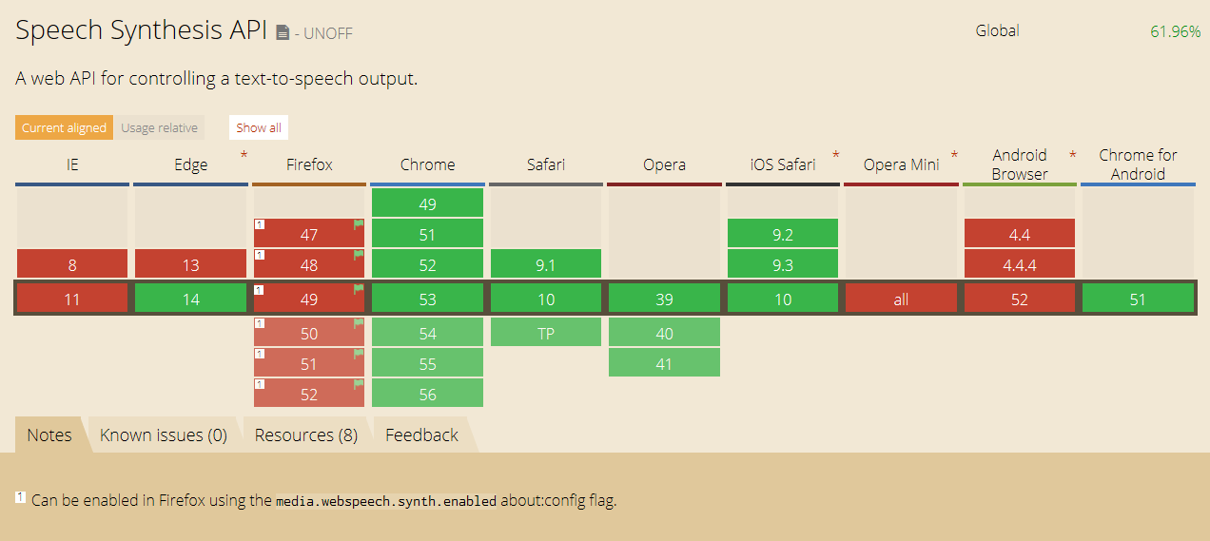
Browser Support

Slide 8
Speech Recognition
Making the browser accept microphone input and convert it to strings

Slide 9
speechRecognition
Properties | Events | Methods
grammars A list of grammar objects, which limit what words can be recognized by the object lang continuous Affects how results are returned interimResults Makes the object return results as they are recognized maxAlternatives serviceURI Allows changing the service that performs the speech recognition | onaudiostart onaudioend onend onerror onnomatch onresult This is probably the only event you’ll need, it runs when speech is recognized onsoundstart onsoundend onspeechstart onspeechend onstart | abort() start() stop()
Constructor | new SpeechRecognition()

Slide 10
SpeechRecognitionResult[List]
Speech recognition is returned in a speech recognition’s onresult event
In this event, there will be a SpeechRecognitionResultList object
This will be an array of SpeechRecognitionResult objects
Each object has an isFinal property, this is only false when interimResults is on and the recognition service is still determining the what was spoken
A SpeechRecognitionResult object is an array of SpeechRecognitionAlternative objects
Each alternative has a transcript property containing the recognized string
Each also has a confidence property containing a number representing how accurracy

Slide 11
Making your browser listen
First you must create a speech recognition object:
var recognition = new SpeechRecognition();
Then set any properties you want on it
Next, bind to it’s onresult event:
recognition.onresult = () => { // do stuff }
Finally, start listening:
recognition.start();

Slide 12
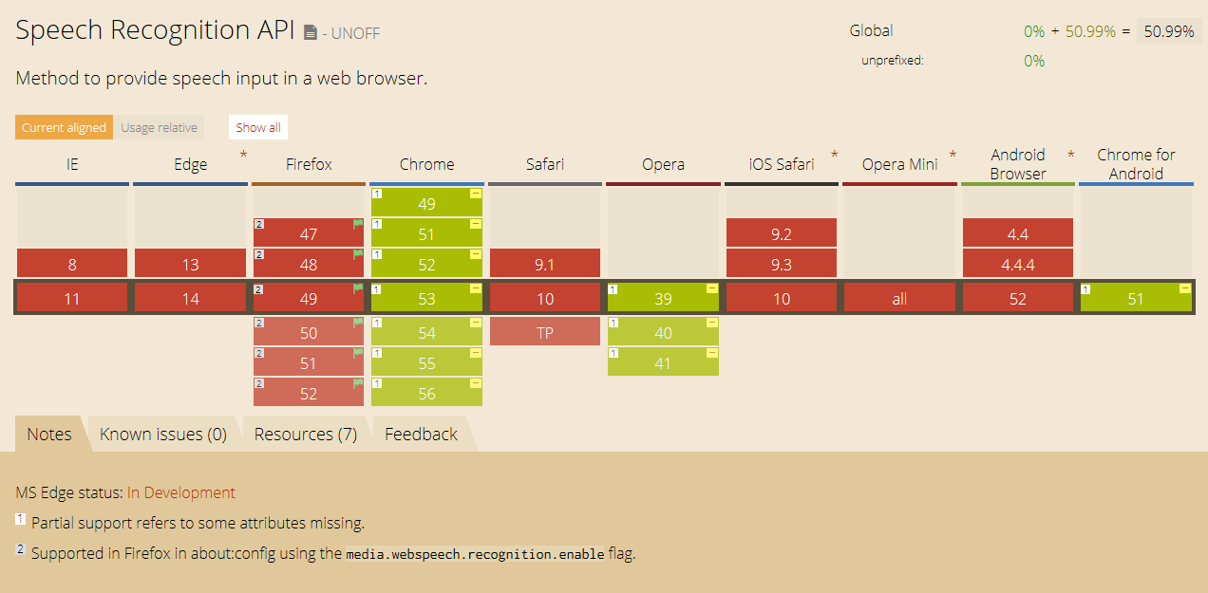
Browser Support

