Slide 1

Exploratory Data Analysis In Hospitality Domain
-Ritoja Kundu

Slide 2

AGENDA
AtliQ Grands – A hotel chain operating in Delhi, Mumbai, Bangalore and Hyderabad.
4 categories of hotels :
AtliQ seasons
AtliQ exotica
AtliQ bay
AtliQ palace
Project Objective : Explore customer behavior and purchasing patterns to identify growth opportunities, enhance customer engagement, and formulate strategies to outpace competitors

Slide 3


Online booking channels
Bookings Database
Data Warehouse
Analysis using Pandas
Offline booking
ETL
Bookings through Atliq.com

Slide 4

Datasets used :
Dimension tables
Fact tables
dim_date
fact_bookings
dim_hotels
fact_aggregated_bookings
dim_rooms

Slide 5
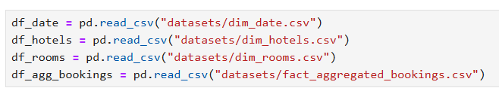
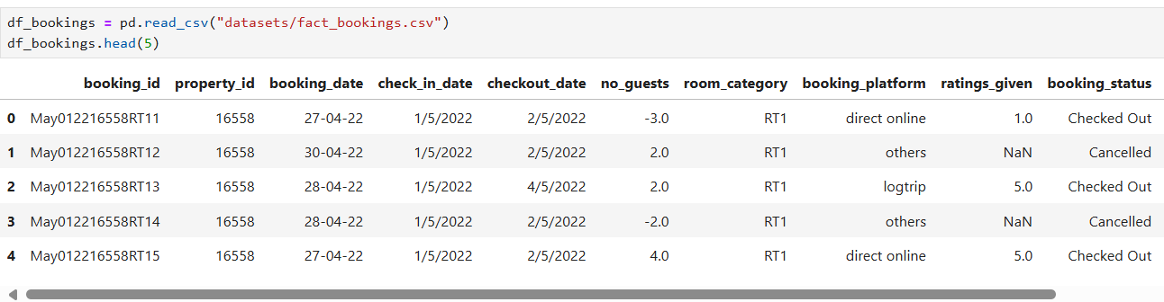
Loading the Datasets in the notebook

Slide 6
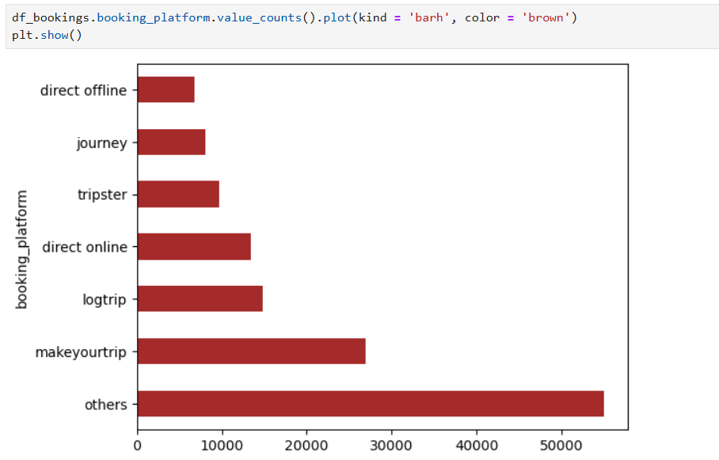
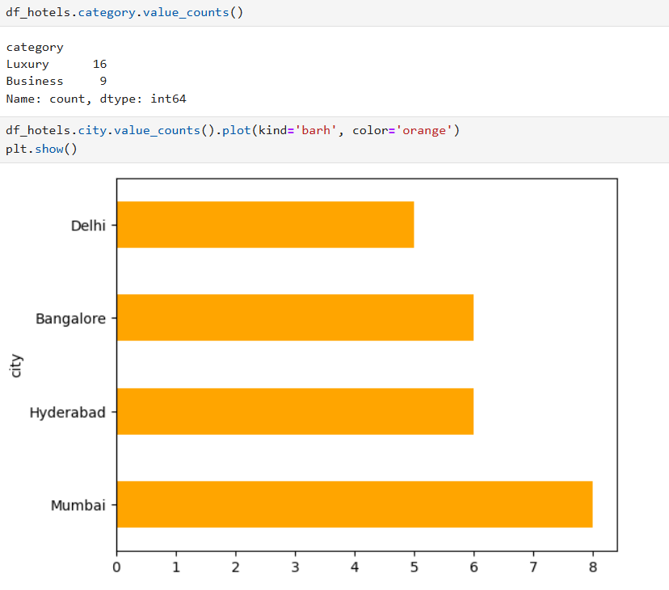
Exploratory Data Analysis
Bookings made through each booking platform
Category and number of hotels in each city

Slide 7
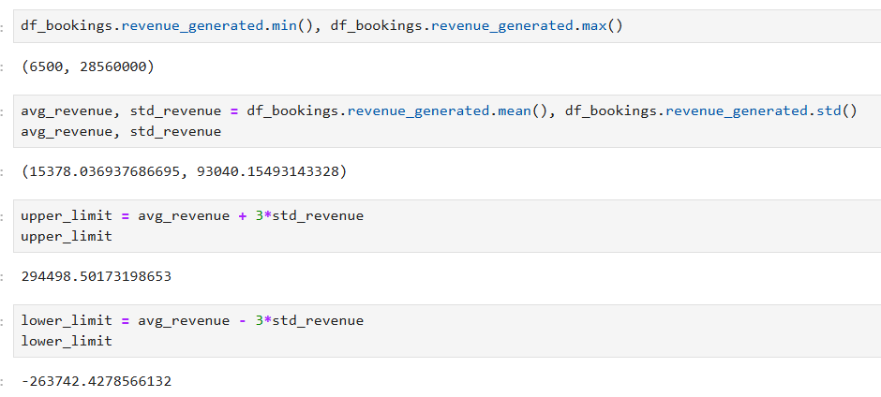
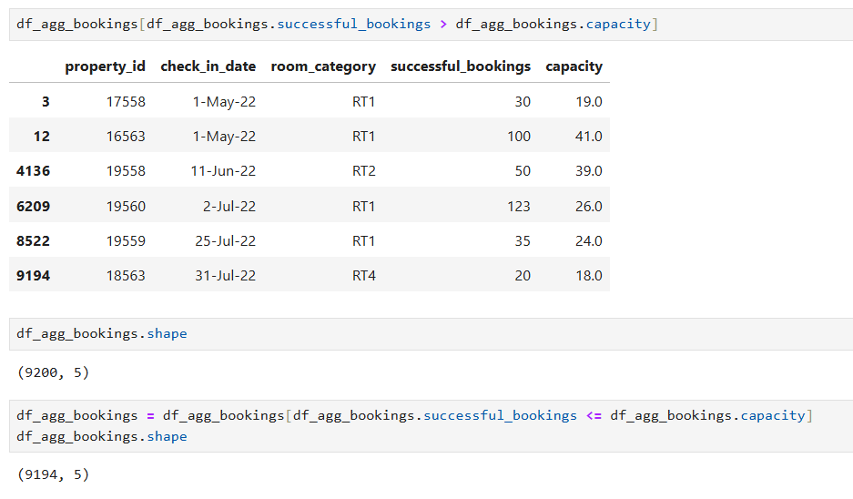
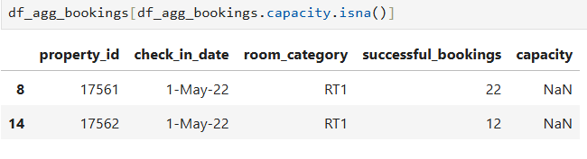
Data Cleaning
Some rows in the bookings dataset had negative values for the guest count, which were removed.
The revenue columns were checked for outliers using mean +/- 3*standard deviation.
The datasets were checked for null values.
The capacity column of the aggregated bookings dataset had 2 null values which were replaced with the median of the column.
Those rows were removed which had a successful booking count greater than the capacity.

Slide 8
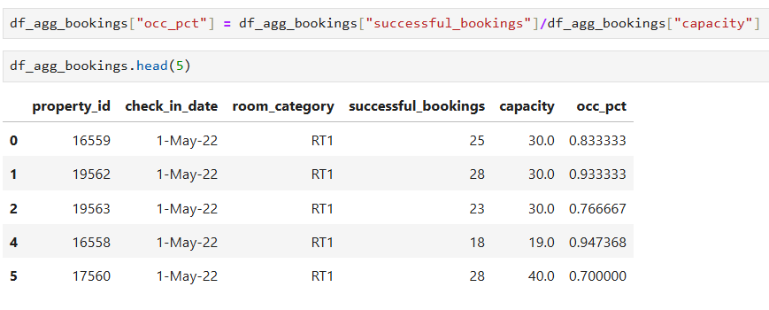
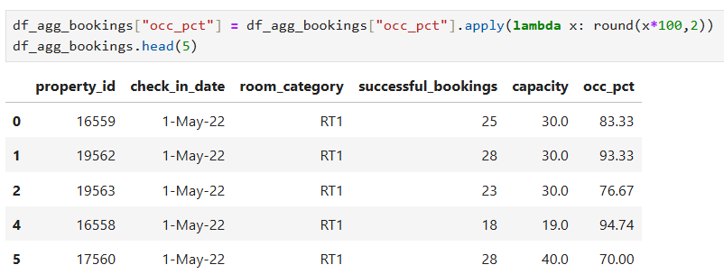
Data Transformation
“Occupancy percentage” column created in the aggregated bookings dataset using the following formula :
Occupancy % = (successful bookings / capacity)*100

Slide 9
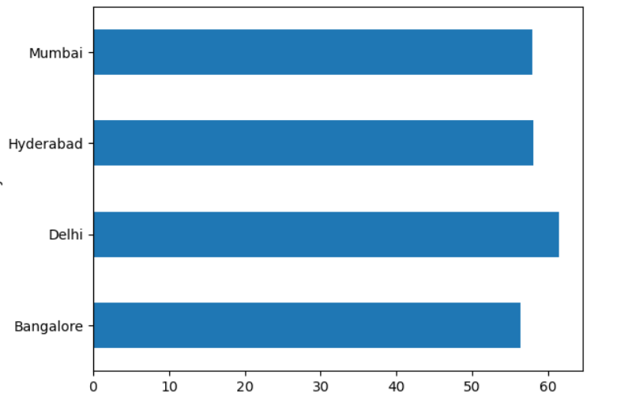
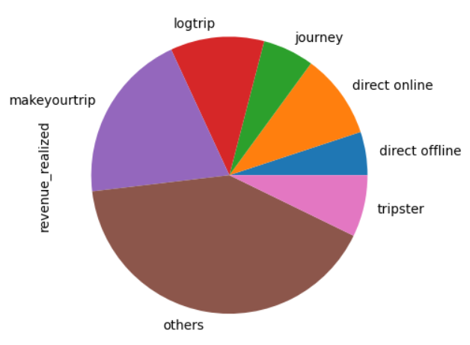
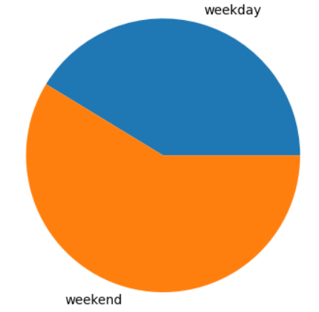
Insights
Occupancy rate per city
Total revenue realized through each booking platform
Occupancy rate on weekends v/s weekdays

Slide 10
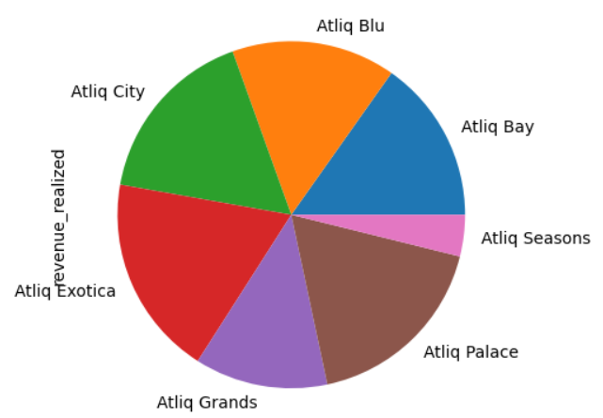
Insights
Total revenue generated from each hotel category

Slide 11

Thank You

