Slide 1
Salifort Motors
IMPROVING EMPLOYEE RETENTION
Ritoja Kundu

Slide 2

PROJECT OVERVIEW
Company Context: Salifort Motors, a French-based alternative energy vehicle manufacturer, aims to address employee retention challenges.
Business Motivation: High employee turnover is costly due to the time and resources required for hiring and onboarding replacements.
Survey Insights: A recent employee survey highlighted potential issues influencing employee departures.

Slide 3
PROJECT OVERVIEW
Project Goal: Develop a predictive model to identify employees likely to leave the company.
Key Predictors Used:
Department
Number of projects
Average monthly working hours
Satisfaction level
Tenure at the company
Promotion status in the past 5 years
Strategic Benefit: Early identification of at-risk employees enables targeted interventions to improve retention and reduce turnover costs.

Slide 4
Exploratory Data analysis performed to check for null values, duplicate rows, outliers and to correct column names to make the dataset uniform.
1
2
Visualizations plotted using Matplotlib library to identify how certain columns are related and the effect of each column on the Target.
The Process
3
Two approaches tried out - Logistic Regression and Tree-based models, namely Decision tree and Random Forest.
4
The best model identified based on precision, recall, accuracy and ROC-AUC scores.

Slide 5
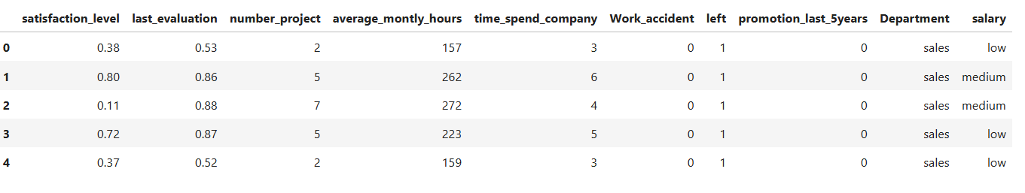
A GLIMPSE OF THE DATASET
Target Variable : ‘Left’ Left(1) - employee left, Left(0) - employee did not leave.
‘Department’ and ‘Salary’ converted to numerical columns.
Logistic Regression - Outliers removed (Mean +- 1.5*IQR)
Decision Tree and Random Forest - Round 1 run with all the independent variables; Round 2 run after excluding ‘Satisfaction level’ and ‘monthly average hours’ while creating a new column ‘Overworked’.
Average monthly hours : Min = 90, Max = 310, average = 166.67
If Average monthly hours > 170 then the employee is overworked (1).

Slide 6
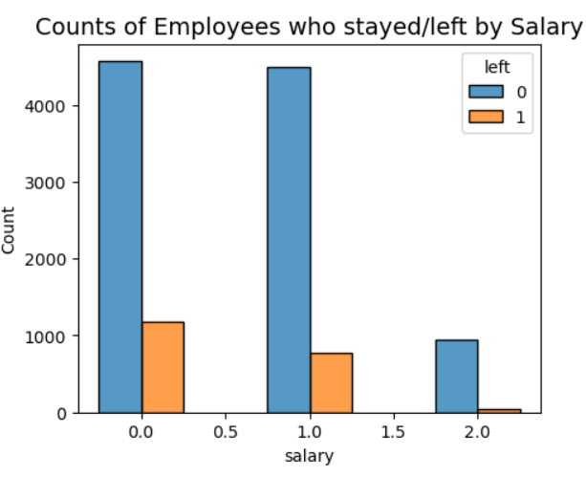
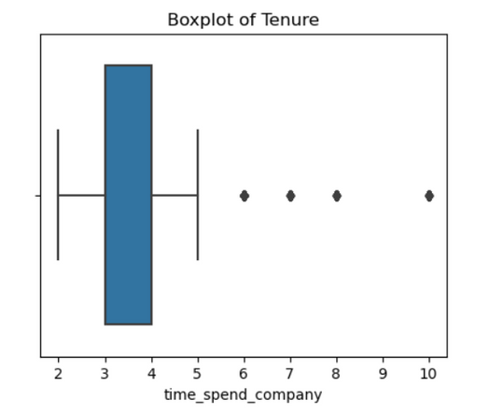
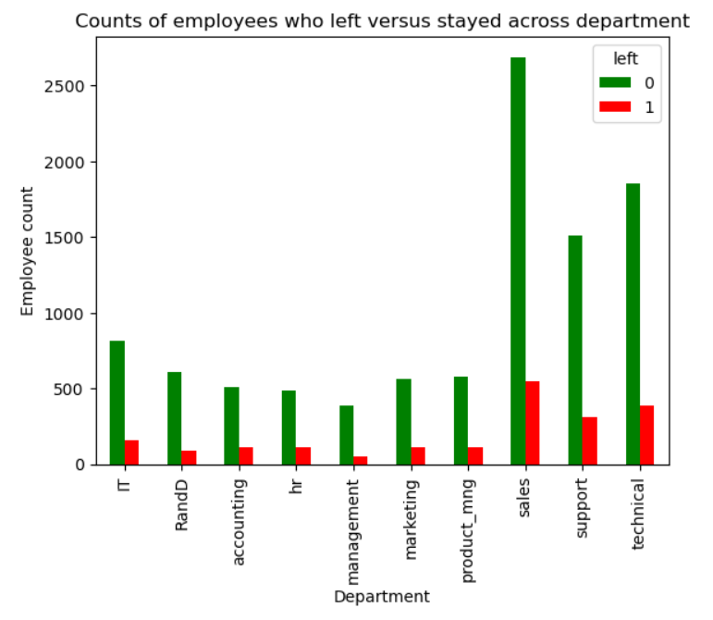
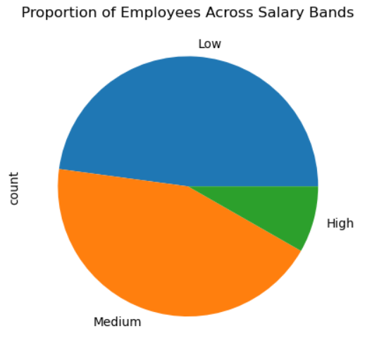
VISUALIZATIONS

Slide 7
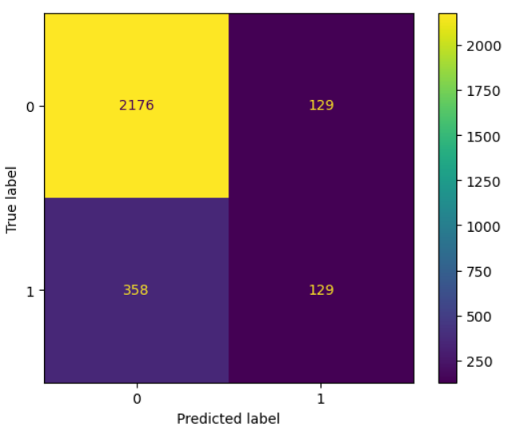
CONFUSION MATRIX FROM LOGISTIC REGRESSION MODEL
Upper-left quadrant : True negatives.
Upper-right quadrant : False positives.
Bottom-left quadrant : False negatives.
Bottom-right quadrant : True positives.
True negatives: The number of people who did not leave that the model accurately predicted did not leave.
False positives: The number of people who did not leave the model inaccurately predicted as leaving.
False negatives: The number of people who left that the model inaccurately predicted did not leave
True positives: The number of people who left the model accurately predicted as leaving
Model predicted more true negatives than true positives.

Slide 8
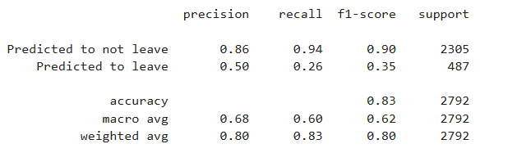
LOGISTIC REGRESSION MODEL - RESULTS
The model achieved a precision score of 80% and a recall score of 83%. Although if it is more important to predict whether an employee would leave the company, then the scores were a bit low.

Slide 9
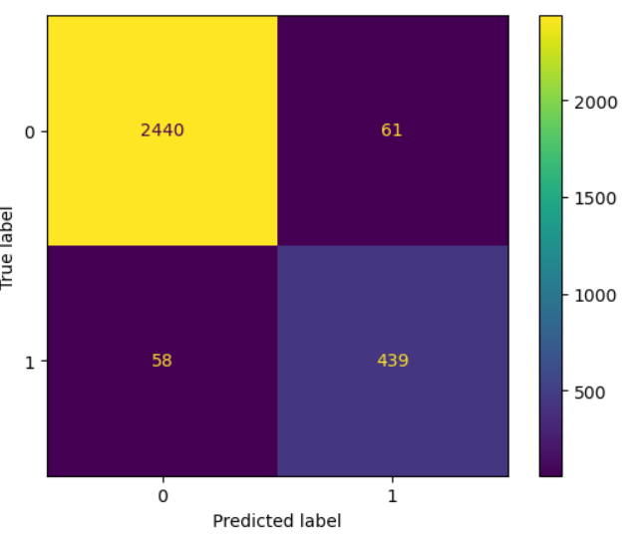
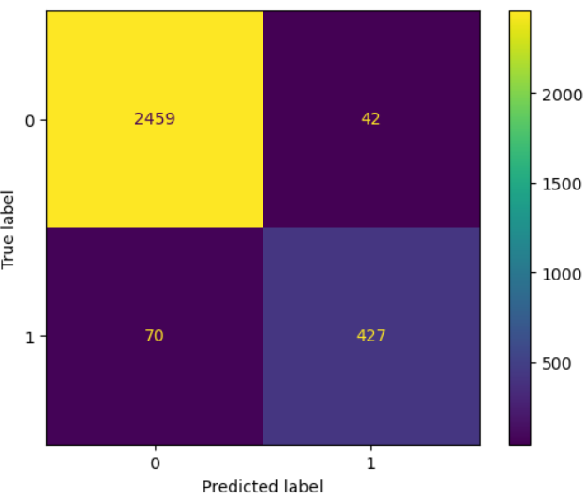
CONFUSION MATRIX FROM TREE-BASED MODELS
Predictions of Decision Tree Classifier
Predictions of Random Forest Classifier

Slide 10

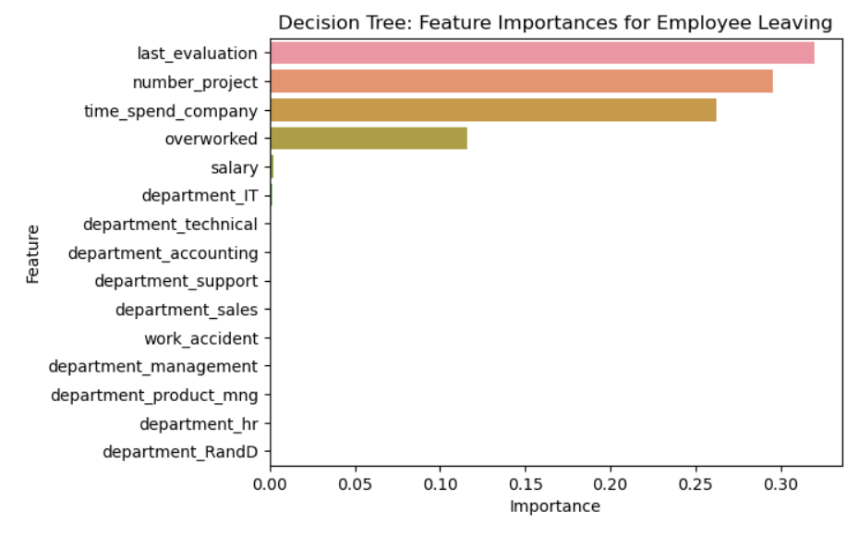
DECISION TREE MODEL - RESULTS

Slide 11

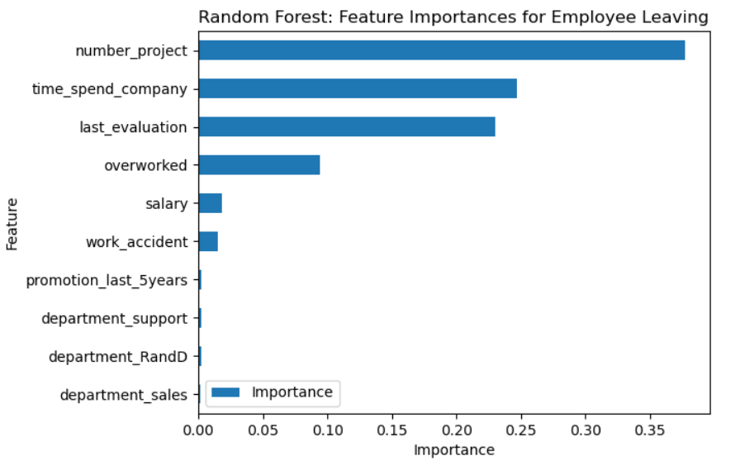
RANDOM FOREST MODEL - RESULTS

Slide 12
OUTCOMES
Random Forest turned out to be the model of choice for the prediction.
The feature importance extracted from the models confirm that employees at the company are overworked.
To retain employees, the following recommendations may be presented to the stakeholders :
The number of projects that employees can work on can be capped.
It may be considered promoting employees who have been with the company for at least four years, or conducting further investigation about why four-year tenured employees are so dissatisfied.
Either employees can be rewarded for working longer hours, or not required to do so.
If employees aren't familiar with the company's overtime pay policies, they should be informed about the same. If the expectations around workload and time off aren't explicit, they can be made clear.
Company-wide and within-team discussions can be held to understand and address the company work culture, across the board and in specific contexts.

