Slide 1
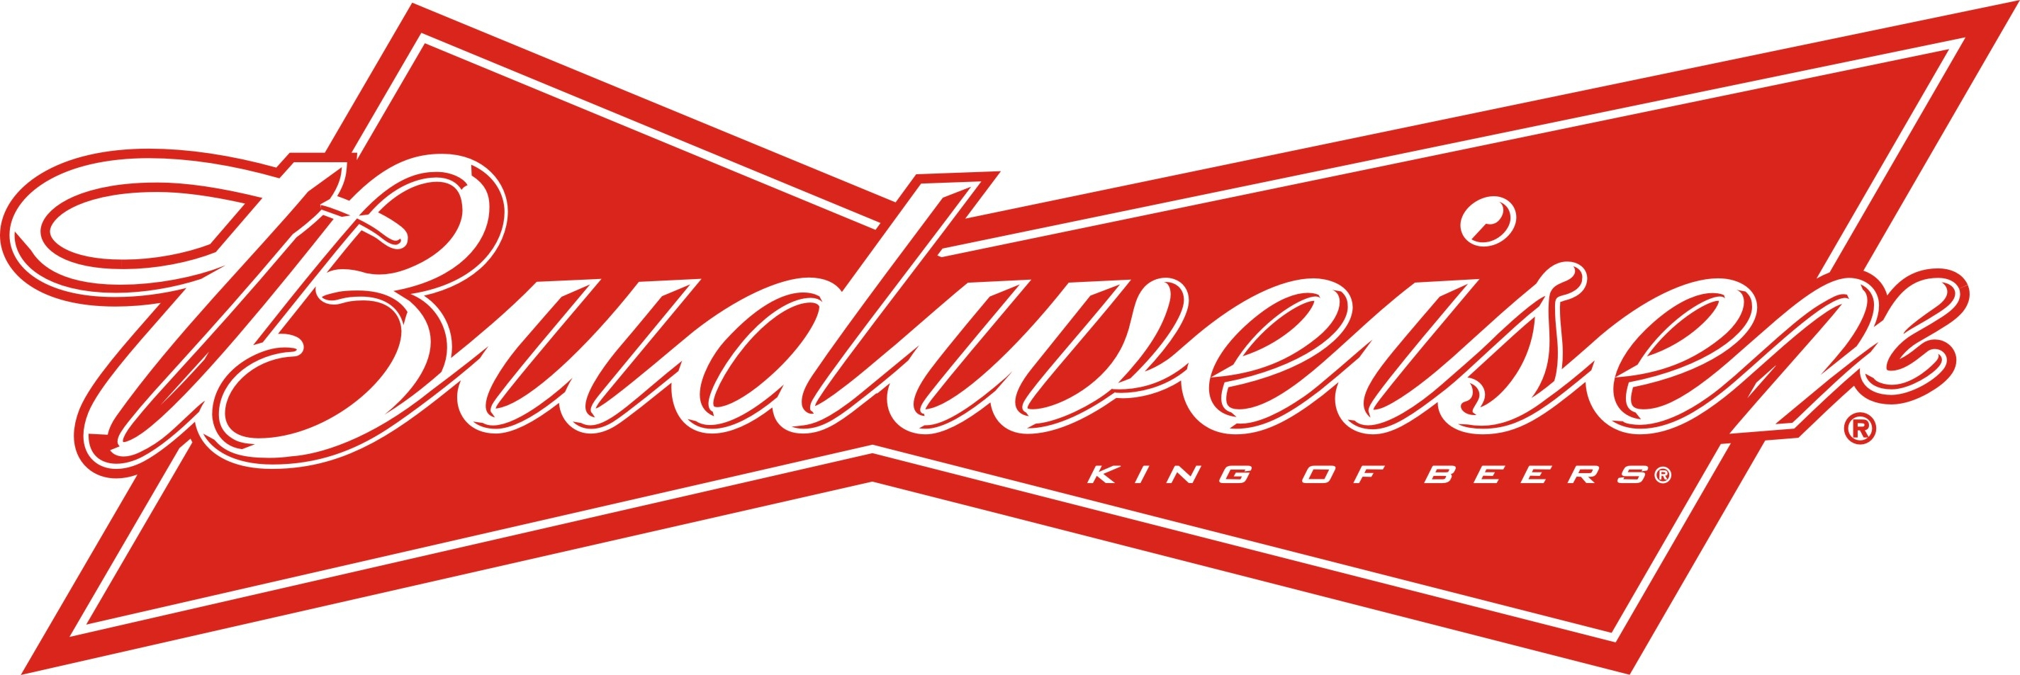
a presentation by Mathias

Slide 2
About
American Brewery - Anheuser–Busch InBev.
Since 1876
one of the highest selling beers in the US
Available in 80 markets worldwide
Rank 35
Brand value: 24,414 $M (2014)

Slide 3
History
Adolphus Busch
Settled 1857 from Germany to St.Lois, Missouri, USA
1864 Busch and Eberhard Anheuser (father in law) funded Anheuser-Busch InBev.
1870 pasteurization
1876 lager beer – called Budweiser
1920 launch of non-alcoholic beverages
1936 Budweiser sales rose
1951-1976 nine breweries opened
2008 InBev (Belgian-Brazilian beer giant) bought majority
Today it's most valueable American beer brand

Slide 4
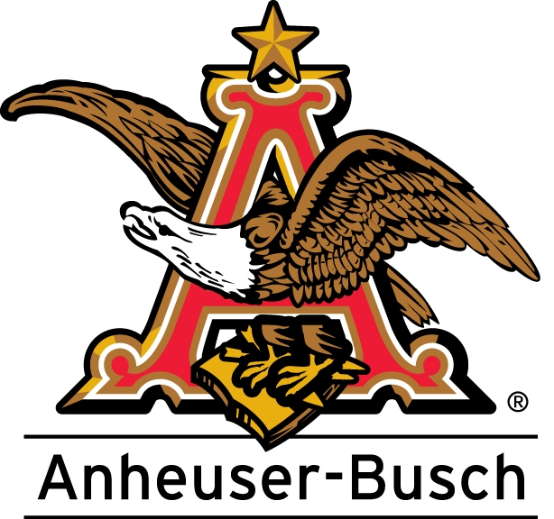
Anheuser-Busch Companies, Inc.
Founded 1852
13 breweries in 2012
Net income:
  US$ 8,578,000,000
Revenue:
  US$ 15,304,000,000

Slide 5
Budweiser trademark dispute
Czech Budweiser Budvar Brewery
a.k.a. Budweiser
American Budweiser labelled as Bud
Exceptations: Sweden, Ireland and the UK
  Both are selled as Budweiser

Slide 6
The beer
Brewed with:
  barley malt, rice, water, hops and yeast
lagered with beechwood chips in the ageing vessel
  Which makes a smoother taste
Taste:
  light-bodied with faint sweet notes and negligible bitterness
Alcohol volume by 5%
Very low rated beer (even Adolphus Busch didn't like it)
Despite these fact it's one of the most sold US beers

