Slide 1
Vizualizáció és képszintézis
Sugárkövetés
Szécsi László

Slide 2

Képalkotás sugárkövetéssel
képernyő
szem

Slide 3
A sugárkövetés alapkoncepciója
Minden képpontra:
találjuk meg a képponton átmenő sugarat,
találjuk meg a képpontban látszó felület, úgy, hogy minden felületre
találjuk meg a sugár—felület metszéspontokat,
és a legközelebbit tartsuk meg.
Találjuk meg a szemirányú sugársűrűséget (árnyaljuk a felületet) így:
ha durva, minden fényforrásra összegezzük a visszavert radianciákat,
ha tükröző, adjuk hozzá az ideálisan visszavert radianciát,
ha törő, adjuk hozzá az ideálisan tört radianciát.
Színezzük ki a képpontot a radianciának megfelelően.

Slide 4









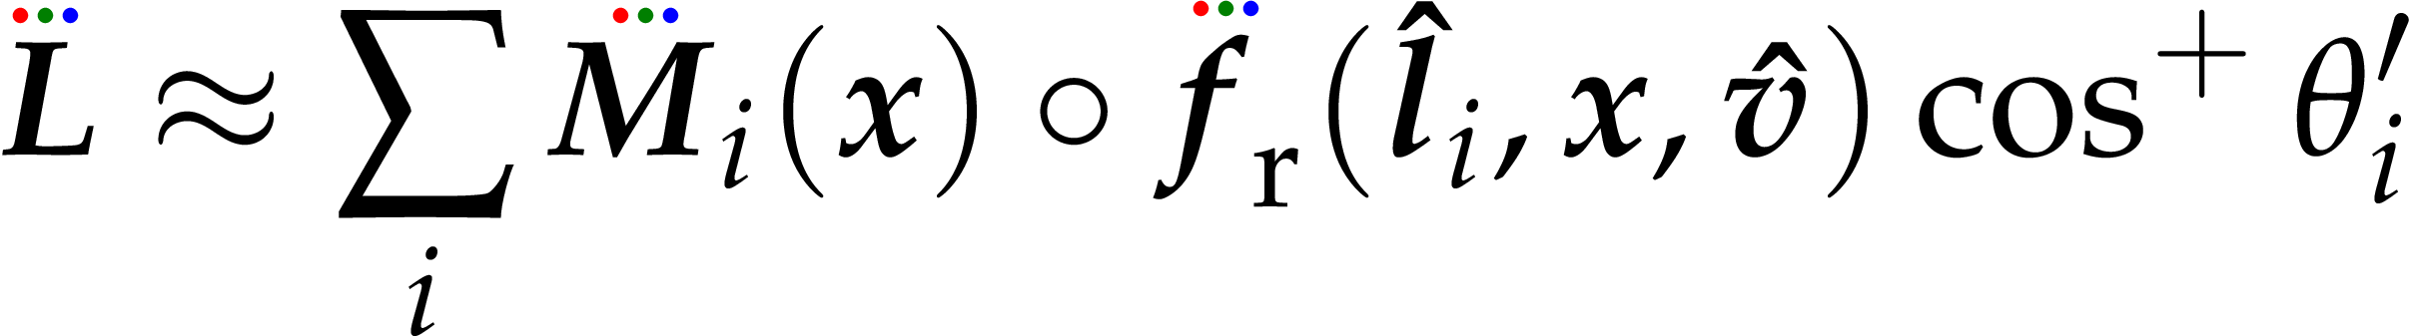
Lokális illumináció absztrakt fényforrásokkal
pixel
absztrakt fényforrások
közvetlen visszavert fénye
anyag-BRDF
absztrakt fényforrás által definiált teljesítménysűrűség
(konstant ha irányfény, 1/r² ha pontfény, 0 ha árnyékban)
Notes:
In local illumination rendering, having identified the surface visible in a pixel, we have to compute the reflected radiance due to only the few abstract light sources. An abstract light source may illuminate a point just from a single direction. The power density provided by the light source at the point is multiplied by the BRDF and the geometry term (cosine of the angle between the surface normal and the illumination direction). The power density provided by the light source is zero if the light source is not visible from the shaded point. For directional sources, the power density and the direction are the same everywhere. For point sources, the direction is from the source to the shaded point and power density decreases with the square of the distance.

Slide 5


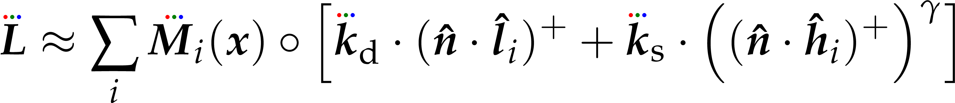
Diffúz + Phong-Blinn
pixel
absztrakt fényforrások
közvetlen visszavert fénye
absztrakt fényforrás által definiált teljesítménysűrűség
(konstant ha irányfény, 1/r² ha pontfény, 0 ha árnyékban)
Notes:
The BRDF times the geometry factor equals to the following expression for diffuse + Phong-Blinn type materials. Here we use different product symbols for different data types; ◦ for the elementwise multiplication of RGB spectra, ⋅ for the dot product of two vectors. Multiplication with a scalar is denoted by the absense of an operator.

Slide 6
Kameramodell
screen
up
eye
fov_{x}
right
ahead
z
eye
y
fov_{y}
x
pin-hole kamera
camera obscura
Notes:
For 3D image synthesis, we would like our screen to act as a window opened on a 3D virtual world. Wherethat window is located in the virtual world, what its size is, and from how far we are looking at it will all influence what we would be seeing on the screen. In order to synthesize the image, these have to be given---we call them the parameters of our camera model.
Indeed, real cameras do the same: create a 2D image from a 3D world. We are not willing to care about lens systems, or sacrifice processing power in order to simulate their intricacies. Thus, we use a very simple camera model, that of the pinhole camera. As light rays pass through a point-like hole, the image of the outside world is projected onto the back wall of the camera chamber, forming an upside-down and left-on-the-right image of it. In order to limit the projected image to a rectangle of certain size, we can apply shades in front of the pinhole in a pyramidal configuration.
It does not matter where the back wall is. Sure, the size of the projected image would be different, but otherwise it would be the same. In computer image display, the dimensions of the image will be scaled to the size of the viewport on-screen eventually, so it is irrelevant what the size in the camera model would be. The angles of the pyramidal shades do make a difference, of course! They control how much of the outside world will be visible in the image.
So, it does not matter where the back wall is. Could it be in front of the pinhole? Certainly not in a real pinhole camera, but in a virtual one, why not? Then our image will not even be flipped in any way. This is the configuration we are going to assume for our camera from now on.
So, what are the parameters of such a camera?
eye – tells where in the virtual world the camera is
ahead – tells at which direction it is looking
right – must be perpendicular to ahead. tells us how the camera is oriented around the ahead axis
up – perpendicular to both ahead and up
fovx – the field of view angle. tells us how the pyramidal shades delimiting the image horizontally are set
fovy – the field of view angle. tells us how the pyramidal shades delimiting the image vertically are set

Slide 7
Camera frame
ahead, right, up egység hosszú
ahead = up × right
right = ahead × up
up = right × ahead
Notes:
ahead, right and up are not independent parameters. This is indeed a chance to go awry when defining our camera, so graphics libraries like OpenGL prefer specifying independent parameters instead, like a lookat point and a general preferred upwards direction, from which ahead, right and up could be computed. This is just a convenience, however, at this point in the discussion what is important for us is that these vectors are provided by the camera specification in one way or another, and the vectors are al unit length and perpendicular to one another.

Slide 8
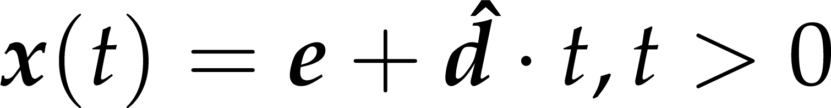
Sugáregyenlet
sugárparaméter
paraméterek
elsődleges sugarak
kezdőpont = szem
irány = ?
pont a sugáron
kezdőpont
irány
Notes:
Now we have calculated the ray direction for a pixel. The ray origin would of course be the eye position--- at least for primary rays.
In general, a ray is a halfline, with the above equation. t is the ray parameter. If dir is normalized (and it should be), then t is also the distance from the origin.

Slide 9


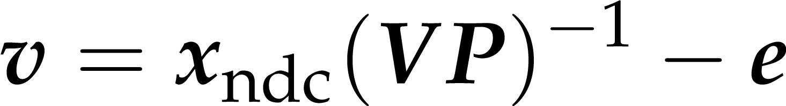
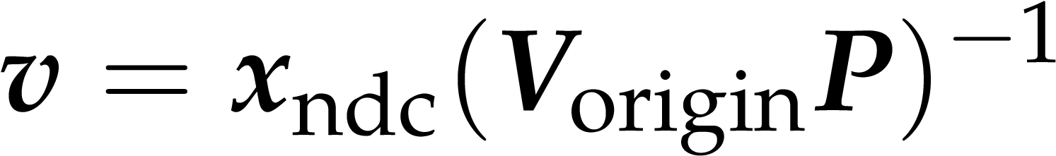
Nézeti irány kiszámítása NDC-ből
(V_{origin}P)⁻¹ -et nevezzük viewDirMatrix-nak
[NEM a view mátrix szorzata valamivel]

Slide 10
Láthatóság sugárkövetéssel
pixel
szem
Hit findBestHit(Ray ray) {
Hit bestHit;
bestHit.t = FLT_MAX;
for(Intersectable* obj : objects)
{
Hit hit = obj->intersect(ray);
if(hit.t > 0 && hit.t < bestHit.t)
bestHit = hit;
}
return hit;
}
Notes:
A fundamental operation of ray tracing is the identification of the surface point hit by a ray. The ray may be a primary ray originating at the eye and passing through the pixel, it can be a shadow ray originating at the shaded point and going towards the light source, or even a secondary ray that also originates in the shaded point but goes into either the reflection or the refraction direction. The intersection with this ray is on the ray, thus it satisfies the ray equation, x(t)=e + vt for some POSITIVE ray parameter t, and at the same time, it is also on the visible object, so point x(t) also satisfies the equation of the surface. A ray may intersect more than one surface, when we need to obtain the intersection of minimal positive ray parameter since this is the closest surface that occludes others.
Function firstIntersect finds this point by trying to intersect every surface with method intersect, always keeping the hit with minimal but positive ray parameter t.

Slide 11




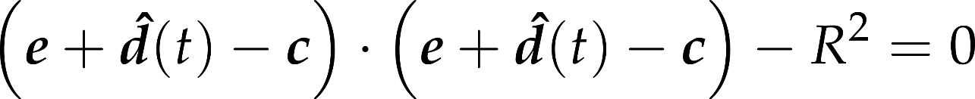
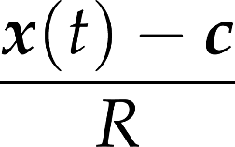
Metszés gömbbel
sugár
középpont
nincs megoldás - egy van - kettő van
felületi normál:
Notes:
The implementation of method intersect depends on the actual type of the surface, since it means the inclusion of the ray equation into the equation of the surface. The first example is the sphere. Substituting the ray equation into the equation of the sphere and taking advantage of the distributivity of the scalar product, we can establish a second order equation for unknown ray parameter t. A second order equation may have zero, one or two real roots (complex roots have no physical meaning here), which corresponds to the cases when the ray does not intersect the sphere, the ray is tangent to the sphere, and when the ray intersects the sphere in two points, entering then leaning it. From the roots, we need the smallest positive one.
Recall that we also need the surface normal at the intersection point. For a sphere, the normal is parallel to the vector pointing from the center to the surface point. It can be normalized, i.e. turned to a unit vector, by dividing by its length, which equals to the radius of the sphere.

Slide 12





Implicit felületek általában
felületi pontok:
pontok a sugáron:
metszet:
nem-lineáris egyenletrendszer, egy ismeretlen:
normál = gradiens
Notes:
The equation of the sphere is an example of a more general category, the implicit surfaces that are defined by an implicit equation of the x,y,z Cartesian coordinates of the place vectors x of surface points. Substituting the ray equation into this equation, we obtain a single, usually non-linear equation for the single unknown, the ray parameter t. Having solved this equation, we can substitute the ray parameter t* into the equation of the ray to find the intersection point.
The normal vector of the surface can be obtained by computing the gradient at the intersection point. To prove it, let us express the surface around the intersection point as a Taylor approximation. f(x*,y*,z*) becomes zero since the intersection point is also on the surface. What we get is a linear equation of form n⋅ (x – x0) = 0, which is the equation of the plane, where n=grad f.
So, the gradient is the normal vector of the plane that approximates the surface locally in the intersection point.

Slide 13
Normál = gradiens
tfelh. lineáris
ez nulla
síkegyenlet
normálvektor

Slide 14


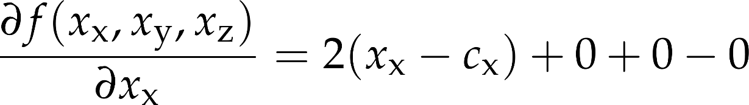
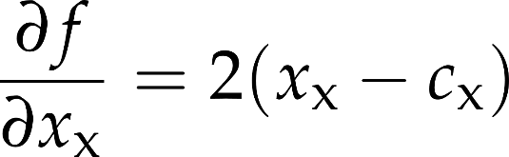
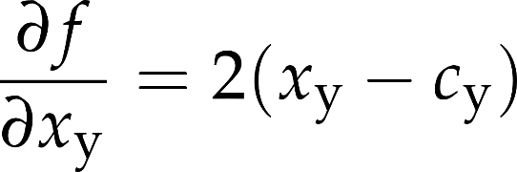
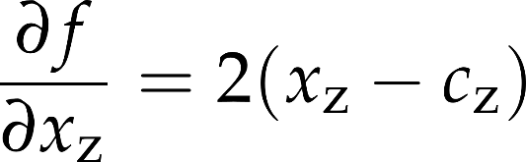
Gömb normálvektora gradienssel
x
c

Slide 15
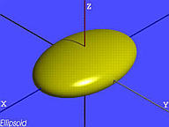
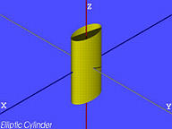
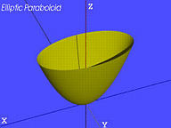
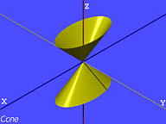
Kvadratikus felületek - quadrics

Slide 16
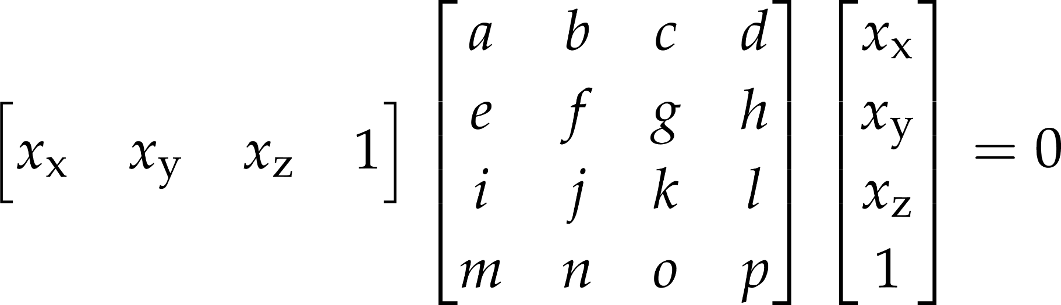
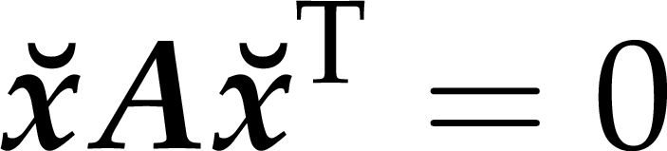
Kvadratikus felületek - quadrics

Slide 17
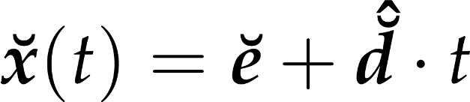
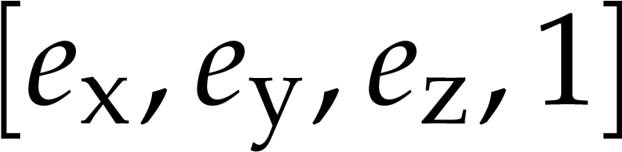
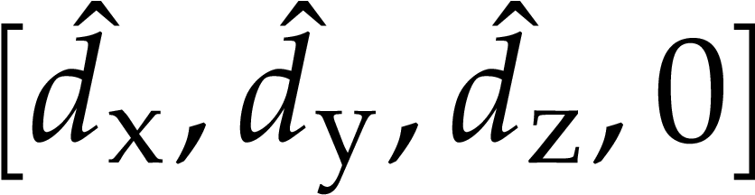
Sugáregyenlet homogén koordinátákkal

Slide 18
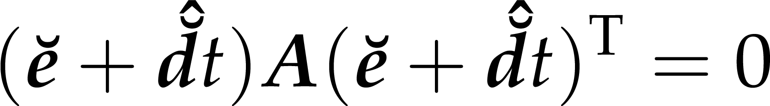
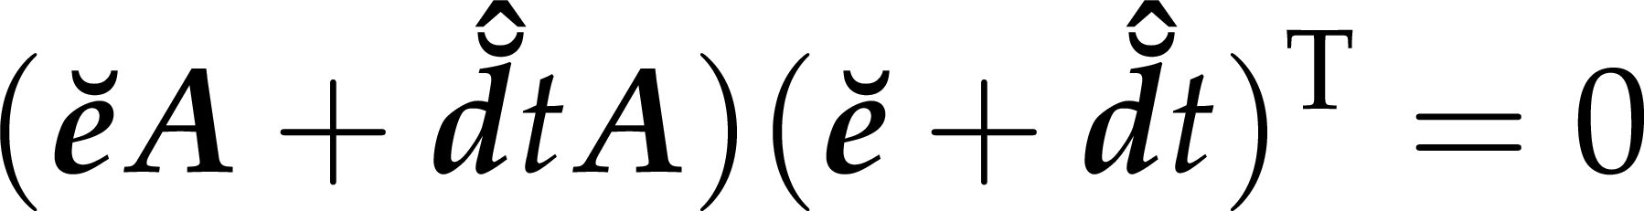
Sugár-quadric metszés

Slide 19
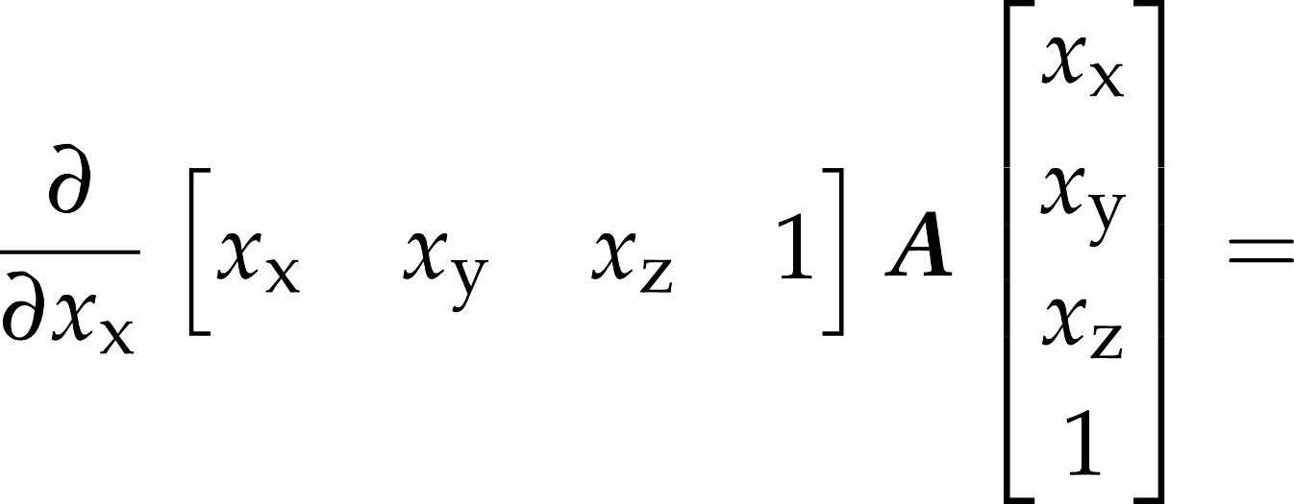
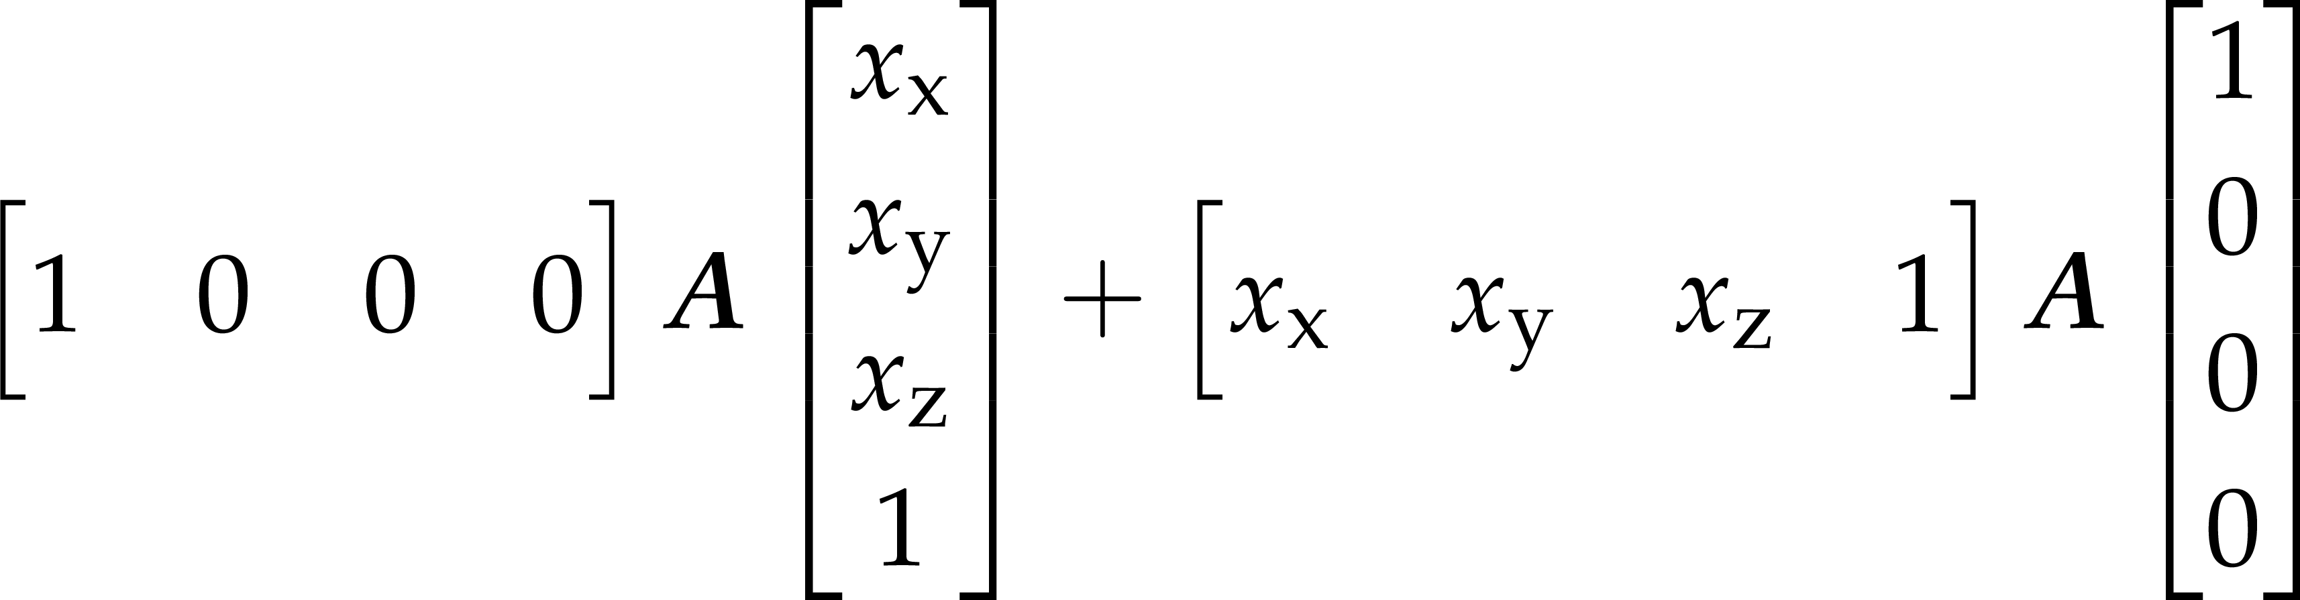
Quadric parciális deriváltak

Slide 20
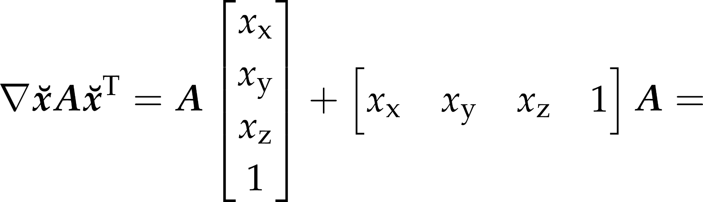

Quadric normál

Slide 21
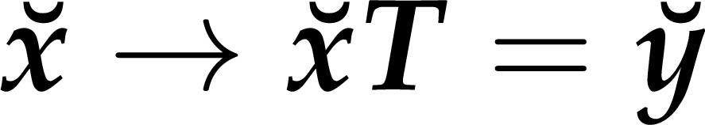
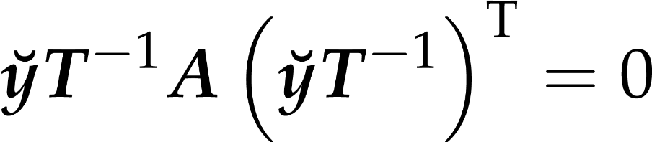
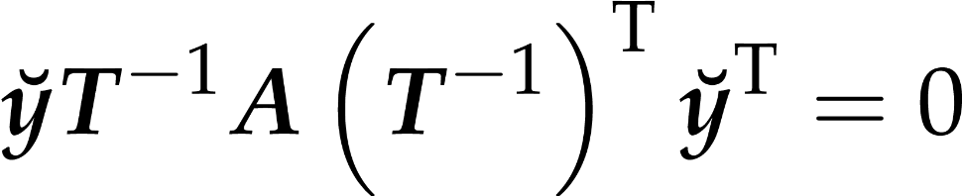
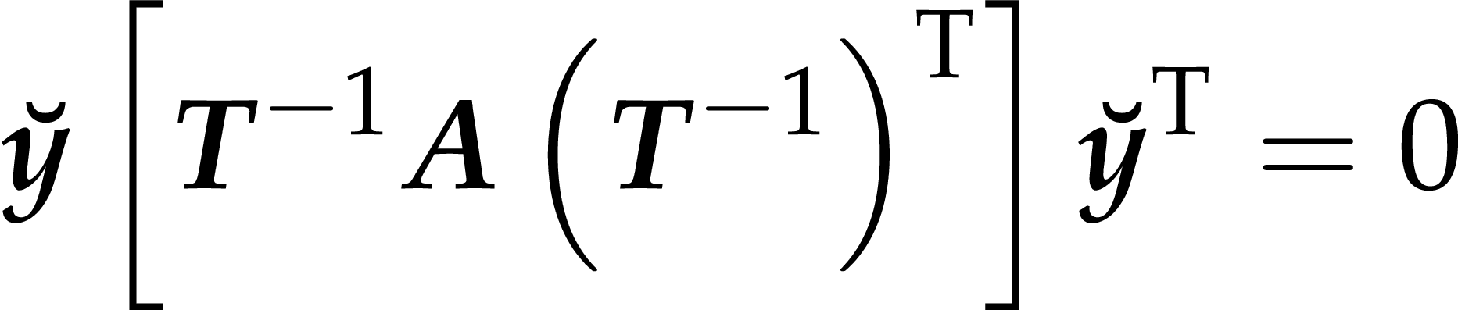
Quadric homogén lineáris transzformálása
eredeti kvadratikus felület
y akkor van a transzformált felületen, ha

