Slide 1
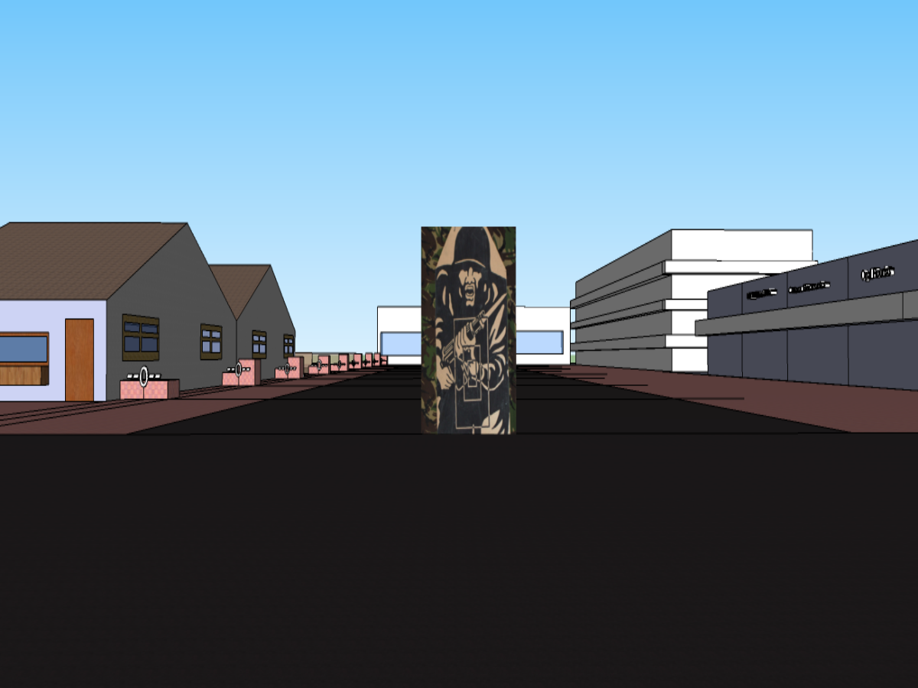
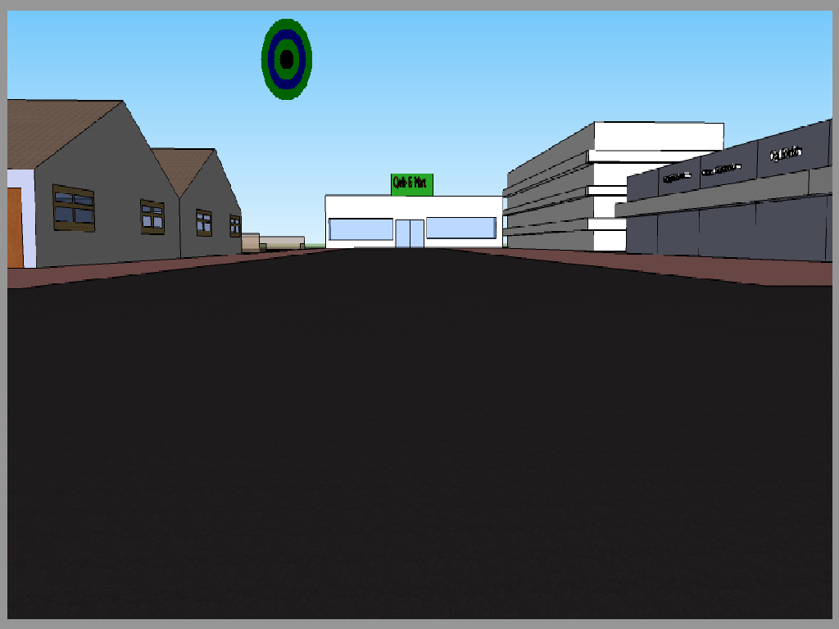
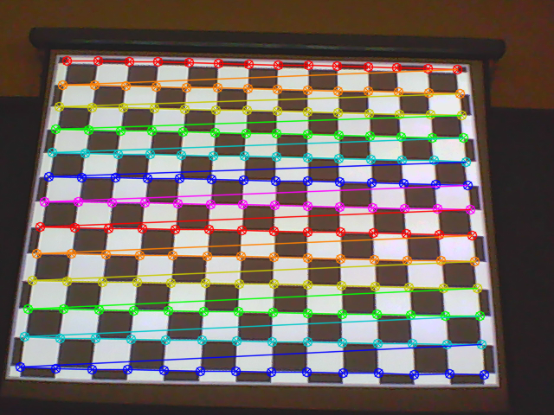
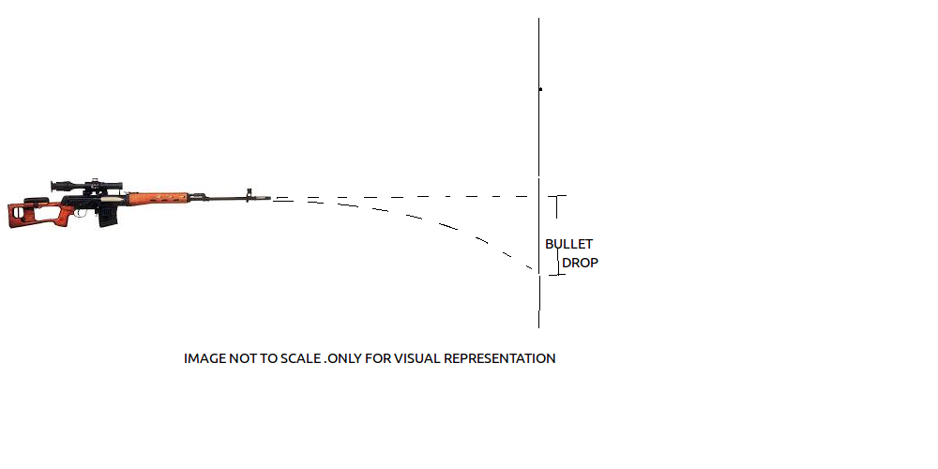
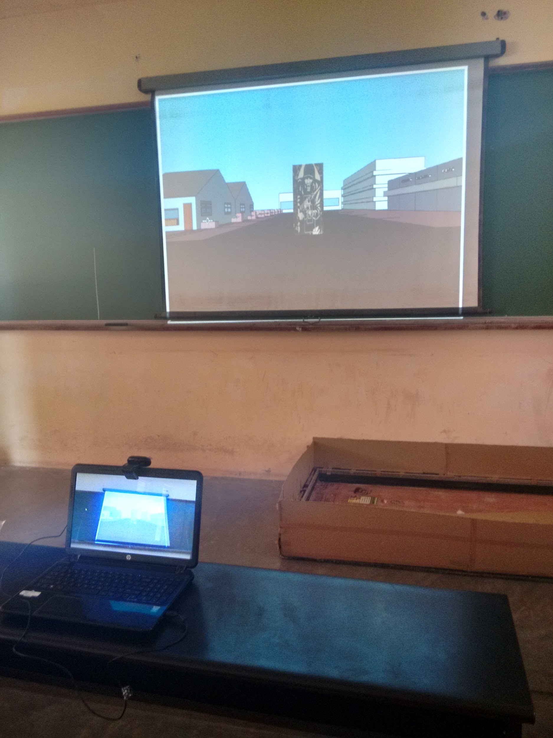
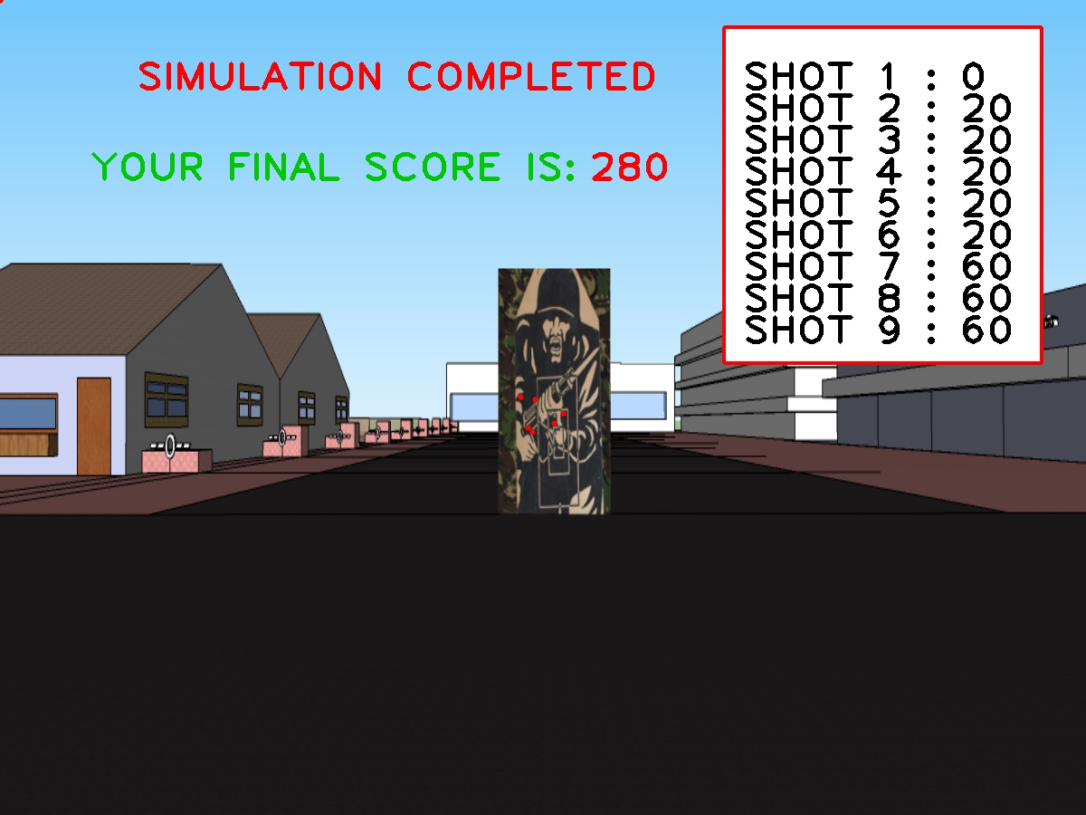
Shooting Range Simulator
Abstract
Stationary target mode
Moving target mode
Calibration
The defence simulation and training market is a growing and increasingly significant sector in the defence industry.Simulated training is the most cost and time effective methodology for training system use and maintenance. This creates a realistic surrounding to generate near real responses to any set of realistic conditions. It also enhances safety levels of handling the weaponaries in practical situations. The Indian defence imports shooting range simulators for prices as high as 50lakh rupees. The main aim of this project is to build a home-grown simulator for low prices and with customizable scenarios.
In the stationary target mode a stationary background with a single target is seen on the screen.
A laser module is used as the pointing device which is fitted onto a gun. the user points the laser gun at the screen and the co-ordinates of the laser dot on the screen is processed and transformed by the system. Audio feedback is included that outputs realistic sounds according to the gun it is emulating.
The laser dot detection is achieved by subtracting the present frame from a reference frame and the red channel thresholded to obtain only the red laser dot location. The obtained laser dot location is then converted to the target co-ordinates and the score card is accordingly updated.
The statistics are then displayed with specifics like shot accuracy and also his proficiency in shooting.
In the moving target mode a video with a moving target is used as a backdrop.
This mode offers two sub-modes -
Double trap mode: A flying disk which imitates a clay disc just as the ones used in double trap shooting.
Ground moving target mode: A single or multiple moving or stationary targets are used.
There are multiple scenarios available especially for the ground moving target mode which can represent real-time scenarios that can arise during counter terror operations and war scenarios.
For the laser dot detection the image is split into three channels and thresholded so as to obtain the red dot location. Erosion morphology is used to obtain the accurate location. The obtained image co-ordinates are then transformed into world co-ordinates and the bullet drop is added. When a hit is performed the scoreboard is updated.
The statistics are then displayed specifying the hit accuracy.
.
Camera calibration is the first and the most important step in the shooting range simulator as it creates a link between the world co-ordinates displayed on the projector and the image co-ordinates as seen by the camera. It also removes the distortion effects of the camera lense thus increasing the accuracy of the hit point detection.
Introduction
With an increase in number of sophisticated systems and their high costs it became imperative to find a way to simulate them in a controlled environment producing near-real experiences. Virtual reality made this possible. It lets you create a virtual world of your own and manipulate it to your liking thus providing a lot of flexibility. OpenCV is a tool to leverage this virtual reality. OpenCV is a library of programming functions for real time computer vision and the shooting range simulator is developed with the same. The primary components of this system being a camera, projector and computer.
Projector camera systems
Projector camera system is a confluence of a camera, projector and a PC aiding in the development of an immersive and interactive virtual reality scenario.
Camera: Role of the camera is that of an eye.It captures the view of the surroundings from a viewpoint and thus enables the system to develop a model of the surroundings.
Projector: The projector is the most important part of the system which is the visual representation of the simulated environment.
Computer: It is the brain of the system. It takes in the feedback from the camera and simulates the requisite responses which are then projected onto the projector screen.
The Projector camera system thus plays the main role in the development of the various scenarios the simulator offers.
There are 2 scenarios in the shooting range simulator -
Stationary target
Moving target
Bullet Drop
The added bullet drop functionality aids in developing a more realistic real-world scenario reproduction. The bullet drop is calculated by considering the muzzle velocity of the weapon being used.
To calculate the offset APIs for bullet drop calculations have been used.
Projector
Camera
Computer
Conclusion
The shooting range simulator has been designed keeping in mind the requirements of the defence to produce .
Future work will include bettering the overall aesthetics, adding more scenarios, improving the laser accuracy, development of sniper mode and developing a 3D model.
Notes:
‹#›

