Slide 1
INTERNATIONAL INSTITUTE OF PROFESSIONAL STUDIES Inventory Control Management System Name :-Ritu Sharma Roll No:-IT-2K19-48 Course:-Integrated Mtech(it) 5th Sem Subject:-System analysis and design Guided By:- Dr. Shaligram prajapat

Slide 2
Content
1 Purpose
2 Concept
2.1 Introduction
2.2 Forms of Demand
2.3 Forms of Inventories
2.4Classification of Inventories Cost
2.5 Scope of Inventory Control
2.6 Process Flow Chart
2.7 Data dictionary
2.8 Data flow diagram
3 Objectives of Inventory Control
4.References

Slide 3
Purpose
1.To maintain independence of operations
2. To meet variation in product demand
3. To allow flexibility in production scheduling
4. To provide a safeguard for variation in raw material delivery time
5. To take advantage of economic purchase-order size.

Slide 4
Introduction
Inventory is material that the firm obtains in advance of need, holds until it is needed, and then used, consumes, incorporates into a product, sells, or otherwise disposes it of. A business inventory is temporary in nature.Inventories are stock of any kind like fuel and lubricants, spare parts and semi-processed materials to be stored for future use mainly in the process of production or it can be known as the ideal resource of any kind having some economic values.

Slide 5
INVENTORY VALUATION INVOLVES TWO PROCESS
❖ Determination of quality of each type of inventory held.
❖ Assignment of the values of the units items of inventory.
TWO FORMS OF DEMAND
1. Dependent
1.Demand for items used to produce final products
2. Tires stored at a Goodyear plant are an example of a dependent demand item
2. Independent
1. Demand for items used by external customers
2. Cars, appliances, computers, and houses are
examples of independent demand inventory

Slide 6
FORMS OF INVENTORIES
There are many types of inventory.
The form of inventories depends upon the type of concern. All types of inventory do not require same treatment and therefore policy with regard to each may also differ.
1.RAW MATERIAL INVENTORIES:
There are raw materials and other supplies, parts and components, which enter into the product during the production process and generally form part of the product.
2.WORK IN PROCESS INVENTORY
These are semi finished, work in progress and partly finished products formed at the various stages of production.

Slide 7
3.M.R.O INVENTORIES/ SPARE PART INVENTORIES
Maintenance, repairs and operating supplies which are consumed during the production process and generally do not form part of the product itself are referred to as spare part inventories.
4.FINISHED INVENTORIES:
These are complete finished products ready for sales. In a manufacturing unit, they are the final output of the production process.
They can also be classified as:-
• Movement inventories
• Lot size inventories
• Anticipation inventories
• Fluctuation inventories

Slide 8
CLASSIFICATION OF INVENTORIES COST
PURCHASE COST:
For items that are purchased from outside the firms, this is usually the unit price that the firm pays to its vendor. As an item moves through the logistics system of the firms, it purchase cost in the inventory analysis should reflect its fully landed cost, by which is meant the cost to acquire and moves the item to that point in the system.
ORDERING COST:
In addition to the per unit purchase cost, there is usually an additional cost which is incurred whenever we order, reorder or replenish the inventory. If we produce items internally then there will be an organization set up cost. This happens because we have to shut down the manufacturing line and change over, reconfigure the line to make a specific item. This is the cost involved with processing the order, involving paying the bill, auditing, and so forth.

Slide 9
HOLDING COST:
The cost that accrue due to the actual holding of the inventory over a time period. Many different kinds of cost can be considered as holding cost. The key characteristics of holding cost varies with the amount of inventory being held and the time that the inventory is held. The holding cost can further be classified as follows:
• Storage cost
• Service cost
• Risk cost
•Capital cost.
SHORTAGE COST:
When a demand arises which cannot be satisfied from available
inventory an inventory shortage occurs. Purchase, ordering and holding
cost can be thought of as the cost of having inventories, while shortage
cost result for not having inventory, or for not having enough inventory
at the right place at the right time

Slide 10
FOUR SPECIFIC CASE WHERE SHORTAGE COST MAY EXIST ARE:
➢ Back orders
➢ Lost sales
➢ Lost customer cost
➢ Disruption cost

Slide 11
INVENTORY CONTROL
Inventory control is the means by which materials of the correct quality and in correct quantity are made available as and when required with due regard to economic in storage and ordering cost. Hear the desired level of inventory can neither be high or low because high level inventory will lead to increase in carrying cost while low level of inventory will lead to increase in
ordering cost.
THE ACTIVITIES
• Determination of the limits of the inventories to be held.
• Determination of inventory policies.
• Selling out of investments pattern and its regulations as
per individual and collective requirements.
• Follow up to examine the work of inventory policy and
effect change as and when needed.OF INVENTORY CONTROL NORMALLY INCLUDE THE FOLLOWING:

Slide 12
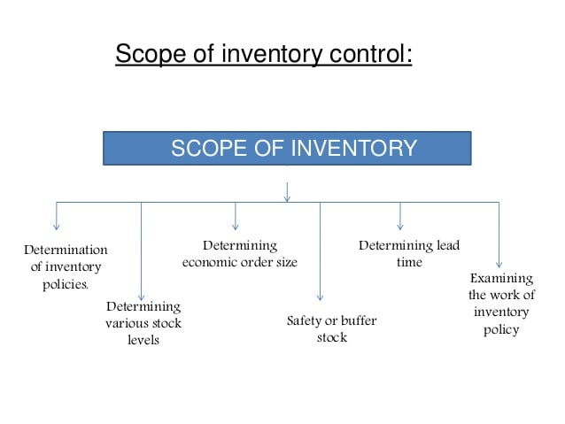

Slide 13
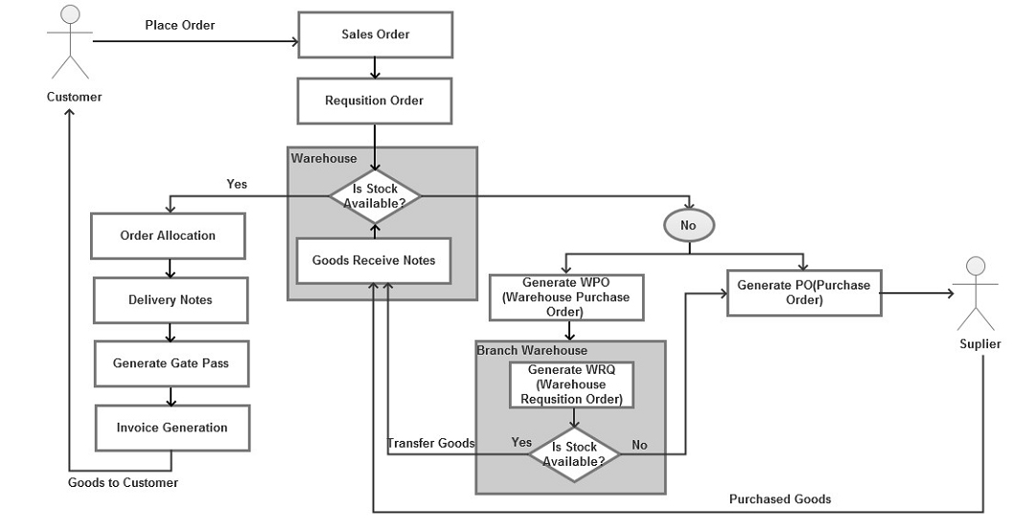
Flow Chart Of Inventory Control Management System

Slide 14
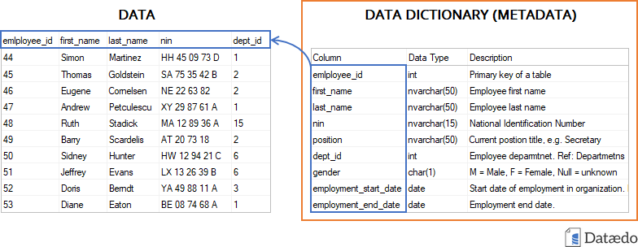
Data Dictionary

Slide 15
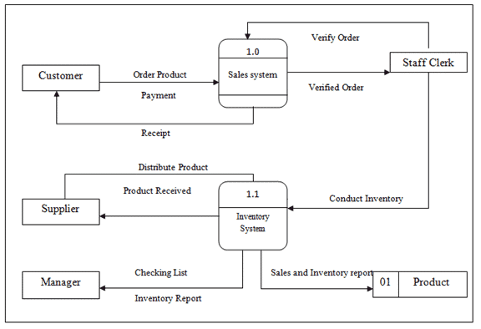
Data Flow Diagram DFD

Slide 16
Objective of inventory control
1. To ensure smooth flow of stock
2. To provide for required quality of material
3. To control investment in stock
4. Protection against fluctuating demand
5. Protection against fluctuating in output
6. Minimization of risk and uncertainty
7.Risk of obsolescence
8.Minimization of material cost.

Slide 17
KEY TERMS
Inventory Control: The act of physically counting and ensuring the stock ledger and physical values match. Site controls and physical asset control fall under this term.
Inventory Planning: The act of consuming a future demand forecast, the current stock ledger, and lead times to determine when and where to buy goods. Processes like S&OP fall into this category of tasks. Terms like Weeks of Supply (WOS), Inventory Turns, and Capital Asset Utilization are often used to manage performance.
Avoid Spoilage: Product that cannot be consumed because it will harm the customer.
Avoid Dead Stock: Product that is no longer demanded and is waiting for a “wild hair” customer to purchase.

Slide 18
Automation: This is the use of technology or computers to control and process data reducing the need for human intervention.
Database: This refers to a large store of related data on a computer that a user can access and modify.
Password: This is a secret code that must be entered into a computer to enable access to its applications. It is made up of numbers, letters, special characters or a combination of any of the above categories.
Inventory Control System: A list of orders to be filled, and prompts workers to pick the necessary items and provides them with packaging and shipping information.
Computerization: This is the conversion of a manually operated system to a controlled, organized and automated system.
Research: A careful study of a subject to discover facts, establish a theory or develop a plan of action based on the facts discovered.
System: A set of computer components functioning together.
Technology: The study of techniques of mobilizing resources such as information for accomplishing objectives that benefit man and his environment.
Software: A computer program or set of instructions that direct a computer to perform processing functions.
Information System: A collection of procedures, people, instructions and equipment to produce information in a useful form.
Processing: This is dealing with something according to an established procedure.

Slide 19
Manage Aging Stock: Product aging provides an indicator when the current pricing is no longer attractive to your customer. By providing an aged based price reduction, you entice customer purchasing where the current price does not get it done.
Reduce Unproductive Cash Usage: Look for creative ways to manage inventory where you do not need to carry the burden of the inventory you are selling. This can be accomplished in several ways.
Drop Shipping: The process where the vendor ships directly to your customer on your behalf.
Consigned Inventory: The process where your suppliers maintains ownership of your goods and does not charge you until they are consumed by your customer.
Cross Dock: The process where inventory arrives at your facility ready for customer delivery and you literally move it from an inbound trailer to an outbound trailer with minimal handling or cost.

Slide 20
References
1. Google
2. Wikipedia
3. Study Mafia
4. PPTlanet

Slide 21
THANKYOU

