Slide 1
international institute of professional studies
NAME :-RITU SHARMA
ROLL NO:- IT-2K19-48
SUBJECT:-System analysis and design
Topic:-user interface design
course:- integrated mtech(it) 5th sem
GUIDED BY:- SHALIGRAM PRJAPAT sir

Slide 2
Contents
1 Purpose
2 Strengths, weaknesses, and limitations .
3 Inputs and related ideas
4 Concepts
4.1 The end user
4.2 Types of user interfaces
4.2.1 Command interfaces
4.2.2 Menu interfaces
4.2.3 Object-oriented interfaces
4.2.4 Expert system interfaces
4.2.5 Web-form interfaces

Slide 3
4.3 User interface design criteria
4.3.1 System type
4.3.2 The mental model
4.3.3 Environmental issues
4.4 The user interface design process
4.4.1 Overview and define
4.4.2 Design and construct
4.4.3 Test and evaluate
4.4.4 Feedback and refine
5. Key terms
6 .Software
7 .Reference

Slide 4
Purpose
The purpose of UI design, above all else, is to deliver content and make visual sense of well planned out UX. The often debated battle between flat versus skeuomorphic design poses us a pivotal style decision in how we allow the content to communicate through our designs.
User interface (UI) design defines how an individual user interacts with a digital information system.In this ppt we can discuss about several interface design process.

Slide 5
Strengths
A good and innovative User interface can attract new clients, but the User interface design which we have crafted should be unique when compared to your competitor.
With the help of UI design, one can retain its existing clients and can increase brand loyalty by means of developing applications based on the requirements of the clients.
As User interface design crafts the relationship between humans and machines, it helps in building the emotional bond among the clients. Thus, it makes sure that the client is visiting these websites and applications frequency

Slide 6
Weakness
Implementing a graphical user interface is not an easy process as it seems while using it.
The programmer should be well aware to design functions rightly so that the users could use this
interface more conveniently. A single mistake that happens from the programmers side can make their efforts
go in vain. All this can take lot of time and effort.
The design of graphical user interface makes it more more difficult and costly to develop. It cannot be
created by ordinary people. Only skilled programmer will be able to develop such an interface. Moreover, a GUI needs to be
connected with extra hardware which could even increase the overall expenses.
Even though a graphical user interface is easy to use, it is not the same when creating them. GUI contain lots of textual interpretations that takes quite a lot of time and
energy to create. The programmer must create, tie and then assign the image with proper functions, all which are going to consume a lot of time. This is even more difficult if there large
number of images each with different functions.

Slide 7
Inputs and related ideas
Before designing a user interface, the analyst or designer must first know the user and understand the task to be performed. Much of the necessary information is collected during the problem definition and information gathering analysis and high-level design stages of the system development life cycle
Input field consists of the following parts:
Container
Leading icon (Optional element)
Label
Placeholder/Input text
Trailing icon (Optional element)
Helper text/Error text (Optional element)

Slide 8
Concepts
User interfaces are the access points where users interact with designs.
A user interface is a point in the system where a human being interacts with a computer. The interface can incorporate hardware, software, procedures, and data. The interaction can be direct; for example, a user might access a computer through a screen and a keyboard.

Slide 9
The end use
In a literal sense, the term end user is used to distinguish the person who purchases and uses the good or service from individuals who are involved in the stages of its design, development, and production.
An end user is a person or other entity that consumes or makes use of the goods or services produced by businesses.
In this way, an end user may differ from a customer—since the entity or person that buys a product or service may not be the one who actually uses it.
Delivery to the end user is often the final step in manufacturing and selling products.
End user experience and support are crucial for the success of user-oriented products and services.
References to "end users" as customers are most common in the technology industry.

Slide 10
Types Of User Interface
There are several different types of direct user interfaces.
Command interfaces :-A Command Line Interface (CLI) is a text-based user interface for interacting with PC on a low abstraction level. Generally, this type of menu is not intended for the average user. It is mostly used when working with cloud services or carrying out system administrators’responsibilities.
Menu interfaces :-The operating system is designed sometimes with a menu based user interface. The user IT skills cannot be assured in menu-based user interface. There will be a limited number of options on the screen to the system users of the menu-based interface. When the user selects the menu, they get a sub-menu, which gives furthermore options. The selection continues to the further sub-menu. This goes on until the user is able to select correctly, what they want from the choice which is displayed on the screen.

Slide 11
4.Object-oriented interfaces :-An OOI is typically created for a general end user through an object-oriented user interface (OOUI), which enables access to and interaction with the underlying system/software. The OOI approach is the same as OOD and OOP, in terms of interface design, where a user interface's (UI) components or interaction points are defined and developed through objects. Each interface object interacts with each other, as well as back end objects, to enable a functional interface.
Most modern applications and operating systems (OS) that are built with an object-oriented programming language (OOPL) create user interfaces on OOI or object-oriented concepts.
5. Expert system interfaces:-Expert system interfaces utilize natural language processing (NLP) . Key elements include the ability to parse and comprehend human sentences and paragraphs, voice recognition, and voice data entry. Such hardware as keyboards, pointing devices, and microphones might be used for input. Speakers provide audio output. Natural language processing requires a very powerful computer with a great deal of memory and a fast processor.

Slide 12
6. Web-form interfaces:-Form-fill interfaces consist of onscreen forms or Web-based forms displaying fields containing data items or parameters that need to be communicated to the user. The form often is a facsimile of a paper form already familiar to the user. This interface technique is also known as a form-based method and input/output forms.

Slide 13
User interface design criteria
The following are the golden rules stated by Theo Mandel that must be followed during the design of the interface.
Place the user in control:
Define the interaction modes in such a way that does not force the user into unnecessary or undesired actions: The user should be able to easily enter and exit the mode with little or no effort.
Provide for flexible interaction: Different people will use different interaction mechanisms, some might use keyboard commands, some might use mouse, some might use touch screen, etc, Hence all interaction mechanisms should be provided.
Allow user interaction to be interruptable and undoable: When a user is doing a sequence of actions the user must be able to interrupt the sequence to do some other work without losing the work that had been done. The user should also be able to do undo operation.

Slide 14
Streamline interaction as skill level advances and allow the interaction to be customized: Advanced or highly skilled user should be provided a chance to customize the interface as user wants which allows different interaction mechanisms so that user doesn’t feel bored while using the same interaction mechanism.
Hide technical internals from casual users: The user should not be aware of the internal technical details of the system. He should interact with the interface just to do his work.
Design for direct interaction with objects that appear on screen: The user should be able to use the objects and manipulate the objects that are present on the screen to perform a necessary task. By this, the user feels easy to control over the screen.

Slide 15
The user interface design process
The analysis and design process of a user interface is iterative and can be represented by a spiral model. The analysis and design process of user interface consists of four framework activities.
User, task, environmental analysis, and modeling: Initially, the focus is based on the profile of users who will interact with the system, i.e. understanding, skill and knowledge, type of user, etc, based on the user’s profile users are made into categories. From each category requirements are gathered. Based on the requirements developer understand how to develop the interface. Once all the requirements are gathered a detailed analysis is conducted. In the analysis part, the tasks that the user performs to establish the goals of the system are identified, described and elaborated. The analysis of the user environment focuses on the physical work environment. Among the questions to be asked are:
Where will the interface be located physically?
Will the user be sitting, standing, or performing other tasks unrelated to the interface?
Does the interface hardware accommodate space, light, or noise constraints?
Are there special human factors considerations driven by environmental factors?

Slide 16
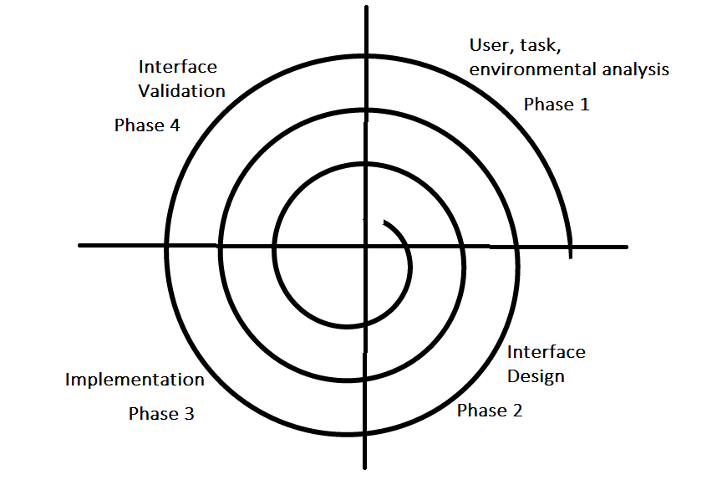

Slide 17
2.Interface Design: The goal of this phase is to define the set of interface objects and actions i.e. Control mechanisms that enable the user to perform desired tasks. Indicate how these control mechanisms affect the system. Specify the action sequence of tasks and subtasks, also called a user scenario. Indicate the state of the system when the user performs a particular task. Always follow the three golden rules stated by Theo Mandel. Design issues such as response time, command and action structure, error handling, and help facilities are considered as the design model is refined. This phase serves as the foundation for the implementation phase.
3.Interface construction and implementation: The implementation activity begins with the creation of prototype (model) that enables usage scenarios to be evaluated. As iterative design process continues a User Interface toolkit that allows the creation of windows, menus, device interaction, error messages, commands, and many other elements of an interactive environment can be used for completing the construction of an interface.
4.Interface Validation: This phase focuses on testing the interface. The interface should be in such a way that it should be able to perform tasks correctly and it should be able to handle a variety of tasks. It should achieve all the user’s requirements. It should be easy to use and easy to learn. Users should accept the interface as a useful one in their work.

Slide 18
Key terms
Command-based interface — CLI is a command line program that accepts text input to execute operating system functions. In the 1960s, using only computer terminals, this was the only way to interact with computers.
Direct user interface — A user interface through which a user directly accesses a computer (for example, via a screen and a keyboard).
End user — Any person who needs the output generated by the computer and/or who interacts with the computer at an operational level.
Ergonomics — The study of the relationship between human beings and their workplaces.
Expert system interface — A user interface that utilizes natural language processing.

Slide 19
Graphic user interface (GUI) — A user interface that features windows, icons, menus, and pointers; generally, the user points to the desired element and clicks a mouse button to trigger the associated action. The Apple Macintosh and Microsoft Windows interfaces are common examples.
Icon — A graphic symbol that represents a processing option, a file, or an executable routine.
Indirect user interface — A user interface that does not involve direct computer access; for example, a printed report or a form designed to capture data for subsequent input.
Menu interface — A user interface in which the list of the options available to the user is displayed in a table or menu.
Natural language processing — Hardware and/or software that allows people to communicate with a computer in much the same way they communicate with each other; voice recognition is an example.

Slide 20
Object-oriented interface — A user interface that features windows, icons, menus, and pointers; generally, the user points to the desired element and clicks a mouse button to trigger the associated action; also called an icon-based interface, a graphic user interface, or a WIMP interface.
Prototype — A working physical model of a system or a subsystem.
User interface — A point in the system where a human being interacts with a computer.
Web-form interface — A user interface that follows the metaphor established by the Internet and the World Wide Web.

Slide 21
Software
Adobe XD - Perfect design tools
Sketch - Reusable adaptive components
Figma - Unique design instruments
Balsamiq - Fast wireframe design
InVision Studio - Automatic design adaptation
Axure - Highly precise prototyping
Framer - Well-structured documentation
Principle - Autonomous design capabilities
Marvel - High-quality layouts
Pencil Project - Built-in collections of various shapes
Origami - Bonding layers in the prototype
WireframeSketcher - Extensive template library

Slide 22
REFERENCE
Lectures and notes by Shaligram prajapat sir
System analysis and design book
https://www.geeksforgeeks.org/

Slide 23


