Slide 1



Operational Analysis of Packaging & Raw Material Handling at
Carewell Steuart Pharma Pvt Ltd
Presented by:
Ritu Nandhan D S
24f1001952

Slide 2


Organizational Background
Carewell Steuart Pharma Private Limited is a medium-scale pharmaceutical manufacturing company located in Kakkalur Industrial Estate, Thiruvallur, Tamil Nadu. The company specializes in producing tablets and capsules, primarily supplying to the Tamil Nadu Government healthcare sector.
All major departments such as Production, QA, QC, Purchase, and Distribution, work closely to ensure smooth operations. The company follows strict internal standards and regulatory protocols to maintain quality, safety, and efficiency throughout the manufacturing and supply process.
Proof of Originality

Slide 3


Problem Statement
Problem Statement 1: Delays in dispatch after packaging completion, causing finished goods to accumulate in storage, increasing inventory holding time and slowing delivery to government depots.
Problem Statement 2: Inefficiencies in raw material handling due to delayed usage after QA approval and minor mismatches during dispensing, leading to stockpile issues and process slowdowns.
Impact: Operational bottlenecks, storage congestion, and material wastage.

Slide 4

Primary Data Collection
Data Captured:
• Batch details: Dates, Size, Yield
• Raw material tracking: Indent, Approval, Usage
• Packaging material consumption
• Dispatch timelines and delays
Process:
• Manual digitization from physical BMR files
• Structured into Excel datasets for analysis
Source: Physical Batch Manufacturing Records (BMR)
Product: 11 batches of Frusemide Tablets IP 40 mg (Year 2024)
Access: Official permission from Carewell Steuart Pharma Pvt Ltd

Slide 5
Methodology - Analysis Approach
Tools Used
Analysis Techniques
Microsoft Excel (Primary Tool):
Manual data entry from physical BMRs
Basic formulas for:
Delay calculation
Yield %
Material aggregation
Charts: Bar, Pie, Scatter (for visual insights)
Python:
Used to visualize Top 5 Raw Materials
(Required vs Dispensed)
Descriptive Statistics:
→ Average, Min, Max, Std. Dev.
Time Gap Calculations:
→ Dispatch Delay = Dispatch Date – Packing Date
→ RM Usage Delay = Usage Date – QA Approval Date
Material Usage Comparison:
→ Required vs Dispensed (for both RM and Packaging)
Yield & Loss Analysis:
→ Yield % = (Actual / Theoretical) × 100
→ Compression & Packing Loss tracked (kg)
Trend Observation:
→ Scatter Plot for Compression Loss vs Yield %

Slide 6
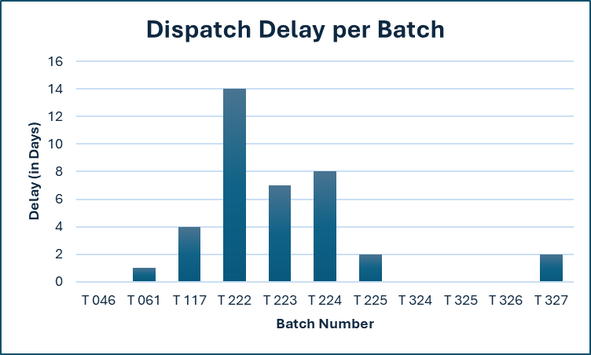
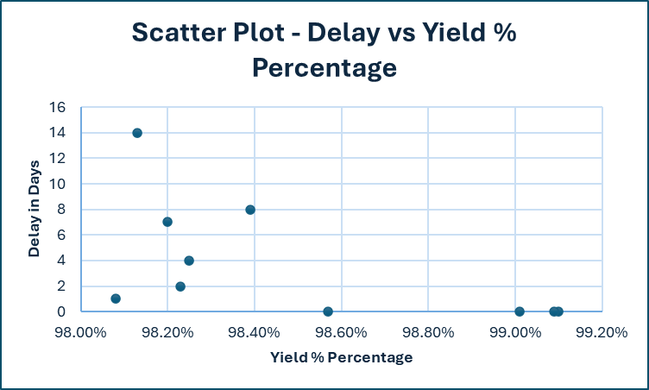
Results and Findings - PS 1
Delays after packaging completion vary across batches.
Most batches faced 2–4 days of delay.
Delays cause storage congestion and idle time.
Average yield remains around 98% across all batches.
Batches with 0-day dispatch delay show slightly higher yields.
Indicates a weak but visible link between faster dispatch and better output efficiency.

Slide 7
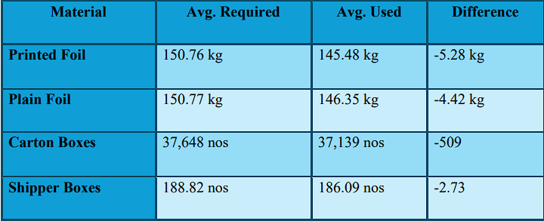
Results and Findings - PS 1
Packing Material Reqd vs Usage
Consistent under-usage across all packing materials observed.
This indicate over-ordering, conservative planning, or excess buffer.
Impacts: Higher holding costs and potential material wastage.
📦 "Packaging materials are consistently used less than required — pointing to overestimation or inefficiencies in planning. Monitoring usage more closely can save a small % in material cost and space."

Slide 8
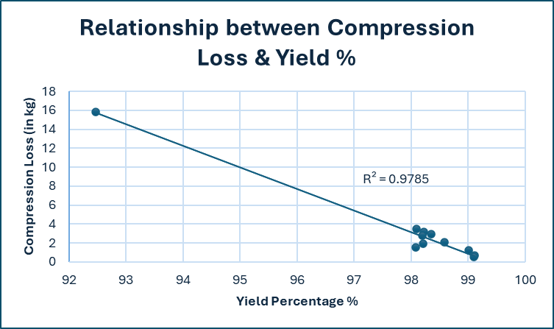
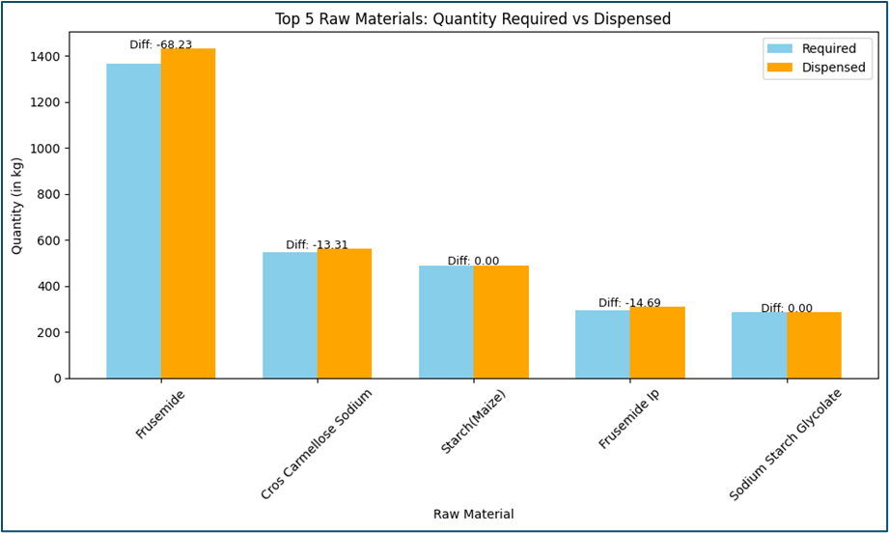
Results and Findings - PS 2
Compression Stage Insight
Higher compression loss → Lower yield %
Indicates inefficiencies in compression stage
Strong trend despite fewer data points (high R²)
Affects batch output and raw material efficiency
Raw Material Handling
Python used to group and visualize RM quantities
Slight over-dispensing seen in key raw materials
Could be due to buffer, rounding, or manual entry
May cause compression loss and reduce yield

Slide 9
Interpretation & Recommendations
Interpretation
Recommendations
Yield tends to drop slightly when dispatch after packaging is delayed
Packing materials are consistently underused, hinting at overestimation
Higher compression loss strongly correlates with lower yield
Minor raw material over-dispensing may increase processing inefficiency
Prioritize batches stored longest post-packaging to reduce dispatch delay
Recalibrate packaging plans using actual vs. planned usage data
Monitor compression stage closely to reduce yield-impacting loss
Flag RM dispensing mismatches using predefined deviation thresholds

Slide 10
Conclusion
Identified process inefficiencies in dispatch, packing, and raw material usage through batch-wise analysis
Insights derived purely from primary operational data
Data-driven recommendations target delay reduction, accurate inventory planning, and improved yield
Future work can involve integrating financial data to quantify business impact more directly
Thank You
Project completed as part of the BDM Capstone – IITM Online BS Program
Recommendations are based on data analytics and should be reviewed by pharmaceutical experts for implementation

