Slide 1
FINAL PROJECT PRESENTATION
Interactive Dashboard for Analyzing the Impact of COVID-19 on Tourist Arrivals to India
(2019–2021)
An interactive analysis of international tourist arrivals to India from 2019 to 2021, visualizing the pandemic's impact on global travel.
Presented By: Rojalin Pradhan | St. Claret College Autonomous Bengaluru

Slide 2



OVERVIEW
The Problem & Purpose
The COVID-19 pandemic caused a sharp decline in international travel. Tourism data is often buried in large tables — this dashboard transforms that data into clear, interactive visuals for trend analysis and decision-making.
The Challenge
The Solution
The Scope
Large data tables make it difficult to identify trends and compare year-over-year changes in tourist arrivals.
An interactive Tableau dashboard with filters, maps, and charts to visualize the pandemic's impact on India's tourism.
Covers 2019–2021 data, classified by country and region of nationality, sourced from the Ministry of Tourism.

Slide 3

Project Objectives
This dashboard is designed to support tourism researchers, policymakers, students, and analysts in understanding how a global event reshaped India's international tourism landscape.
Key Goals
Target Audience
This dashboard is designed to work for:
Analyse Arrival Trends
Tourism researchers & analysts
Government policymakers
Students & academics
Travel industry planners
Examine international tourist arrivals to India across 2019, 2020, and 2021 to identify pandemic-driven patterns.
Compare by Country & Region
All visualizations update simultaneously when a filter is applied, enabling truly dynamic data exploration.
Enable side-by-side comparison of tourist arrivals across different countries and global regions.
Enable Interactive Exploration
Allow users to filter and explore data dynamically by year and geography for self-driven analysis.

Slide 4
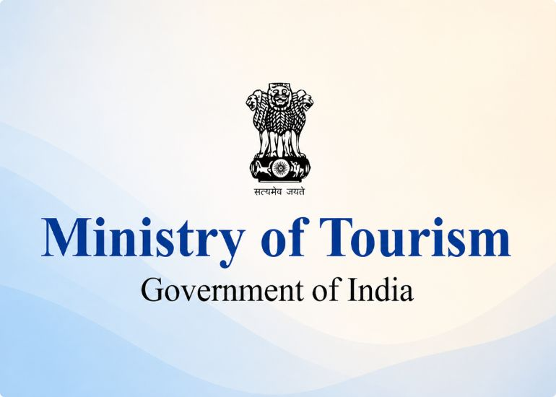
Dataset Description
The dataset is published by the Ministry of Tourism on the Open Government Data (OGD) Platform India, sourced from the Bureau of Immigration, Government of India.
Analysis Dimensions
Year-wise · Country-wise · Region-wise
Dataset Name
Nationality-wise Foreign Tourist Arrivals in India (2017–2021)

Slide 5

DASHBOARD FEATURES
What the Dashboard Shows
Six integrated visualizations work together — when any filter is applied, all charts update simultaneously for a seamless analytical experience.
Trend Line
Interactive Map
Bar & Pie Charts
Displays yearly international tourist arrival trends, clearly highlighting the dramatic decline during the COVID-19 pandemic years.
Visualizes tourist arrivals by country of origin with region-based filtering for geographic exploration.
Country-wise bar chart for arrival comparisons; region-wise pie chart showing the global distribution of visitors to India.
A Year Filter lets users switch between 2019, 2020, and 2021 - all visualizations respond instantly, enabling dynamic comparative analysis.

Slide 6
Expected Outcomes
The dashboard is designed to deliver clear, actionable insights into how COVID-19 reshaped India's international tourism
sector across three critical years.
| Key Insight Enabled
| Decision Support For
Visualise the scale of pandemic impact
Compare arrivals across all three years
Spot top source countries & regions
Tourism recovery planning
Policy & resource allocation
Academic research & reporting

Slide 7








Dashboard Visualizations at a Glance
Each visualization in the dashboard serves a specific analytical purpose, together forming a comprehensive picture of India's tourism from 2019 to 2021.
Trend Line
Interactive Map
Year-over-year arrival trend showing the pandemic dip clearly across 2019–2021.
Country-level geographic view of arrivals with region-based filter controls.
Country Bar Chart
Region Pie Chart
Ranks countries by tourist arrivals for quick identification of top contributors.
Shows proportional distribution of tourists across Asia, Europe, Americas, and other regions.

Slide 8
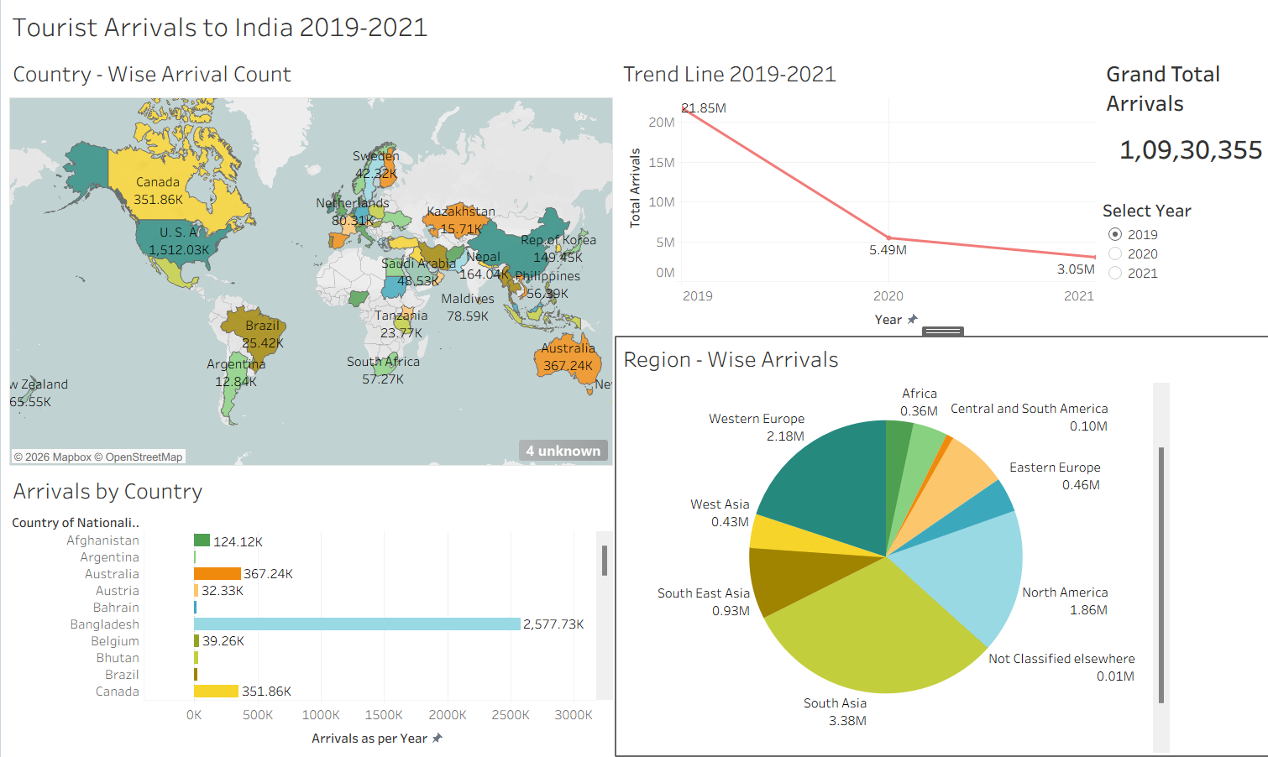
CONCLUSION
Explore the Live Dashboard
🔗 Link
https://public.tableau.com/app/profile/rojalin.pradhan/viz/Tourist_Arrivals_to_India_2019_2021/TouristArrivalstoIndia2019-2021?publish=yes

