Slide 1
[Presentation Title Goes Here]
[Your Name Here]
Walden University

Slide 2
[Heading Goes Here]
Go to the Home tab at the top and click the New Slide or Layout button to access different formatting for your slides.
Choose formatting that presents your information in the most logical way.
Use consistent, grammatically parallel format for bulleted lists (for example, on this slide, each element begins with an imperative verb).

Slide 3
[Heading Goes Here]
Keep font of text consistent.
Be sure headings are consistent in their spacing, placement, size, etc.
Consider using the slide after the title slide to summarize your presentation’s points (like an abstract for a paper).

Slide 4
[Heading Goes Here]
Your slides can also contain entire paragraphs, like this one does. Citation rules apply to presentations just as they do to papers—when using or referencing another author’s ideas, you must cite that source. When incorporating a citation in a slide, do so just as you would in a traditional paper (Smith, 2010). According to Jones (2007), presentations aren’t very different from papers!

Slide 5
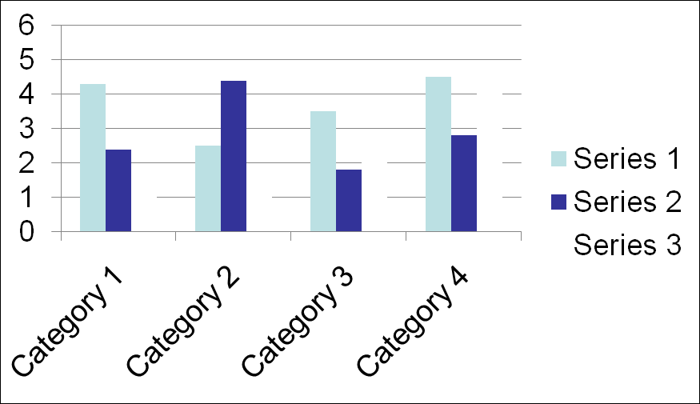
[Heading Goes Here]
Use APA style rules to format any tables and figures in your presentation:
Figure 1. Bar graph showing useful information. From “Utilizing bar graphs,” by A. Jones, 2011, Journal of Handy Graphs, 76(2), p. 3. Reprinted with permission.

Slide 6
[Heading Goes Here]
Remember to adhere to any assignment guidelines regarding presentation format. This template contains suggestions only.
Keep in mind that there is no such thing as an “APA standard PowerPoint.” Review http://blog.apastyle.org/apastyle/2010/09/dear-professor.html for more information!

Slide 7
References
Always include a reference list at the end of your presentation, just like you would in a paper. Reference list entries take the same format they would in a paper:
Jones, P. (2004). This great book. New York, NY: Publisher.
Smith, W., & Cat, D. (2010). How to make a good presentation
great. Presentations Quarterly, 45(4), 56-59.
doi:10.123.45/abc

