Slide 1


Customer Churn Prediction Analysis
HEPro -Business Analytics Internship
Duration – 2 Month (November- December 2025)
Presented by : Ritu Paul

Slide 2
Table of Contents
Cover Page
Table of Contents
Executive Summary
Introduction
  What is Customer Churn?
  Importance of Churn Prediction
  Business Impact
  Problem Statement
Project Goals & Objectives
Daily Work Log
Project Development Phase
  Dataset Description
  Data Preprocessing
  Exploratory Data Analysis (EDA)
  Model Development
  Model Evaluation
Final Insights & Recommendations
Project Conclusion
Challenges & Solutions
Learnings & Key Takeaways
References

Slide 3
Executive Summary
Analyzed telecom customer churn to understand why customers leave the service.
Objective: Identify churn drivers and predict high-risk customers.
Approach: Data cleaning, preprocessing, EDA, and ML model building. Tested multiple models like Logistic Regression, Random Forest, and Gradient Boosting.
Outcome: Selected the best model and provided insights to reduce churn and improve retention.

Slide 4
Introduction
Customer churn is the rate at which customers discontinue or stop using a company’s services.
Predicting churn enables businesses to proactively identify at-risk customers and take targeted retention actions.
Reducing churn strengthens revenue stability, decreases new customer acquisition costs, and enhances long-term customer loyalty.
Problem Statement: The telecom company is facing a high churn rate, particularly among short-tenure and high-billing customers. A data-driven analytical approach is required to understand churn drivers and build an accurate churn prediction model.

Slide 5
Project Goals and Objectives
Identify key factors influencing customer churn in the telecom dataset.
Clean, preprocess, and structure the data for accurate analysis.
Perform Exploratory Data Analysis (EDA) to uncover patterns and insights.
Build and compare machine learning models to predict churn.
Select the best-performing model based on evaluation metrics.
Provide actionable recommendations to reduce churn and improve retention strategies.

Slide 6
Daily Work Log
Week Number Details | Details of Work Log
Week-1(03Nov-07Nov) | 03 Nov: Project kickoff, understanding churn problem, reviewing dataset. 04 Nov: Defined project scope, goals, and initial plan. 05 Nov: Explored dataset structure, checked data types. 06 Nov: Identified missing values, duplicates, and inconsistencies. 07 Nov: Performed initial data cleaning and documented progress.
Week-2(10Nov-14Nov) | 10 Nov: Descriptive statistics and summary-level analysis. 11 Nov: Visualized churn distribution and customer demographics. 12 Nov: Analyzed contract types, tenure, internet service, and billing patterns. 13 Nov: Created correlation heatmap and identified key influencing factors. 14 Nov: Finalized EDA charts and summarized insights.
Week-3(17Nov-21Nov) | 17 Nov: Train-test split and baseline Logistic Regression model. 18 Nov: Built Random Forest model and checked feature importance. 19 Nov: Developed Gradient Boosting model for comparison. 20 Nov: Hyperparameter tuning using GridSearchCV. 21 Nov: Evaluated all models and selected the best one based on performance metrics.
Week-4(24Nov-28Nov) | 24 Nov: Interpreted model outputs and identified churn drivers. 25 Nov: Prepared business insights and retention recommendations. 26 Nov: Created PPT slides for EDA, models, and insights. 27 Nov: Added introduction, objectives, summary, and formatted slides. 28 Nov: Final review, proofreading, and submission of project & PPT.

Slide 7
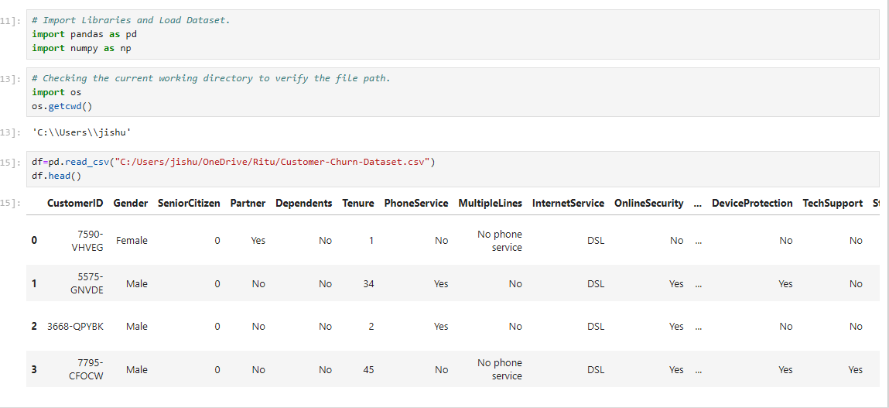
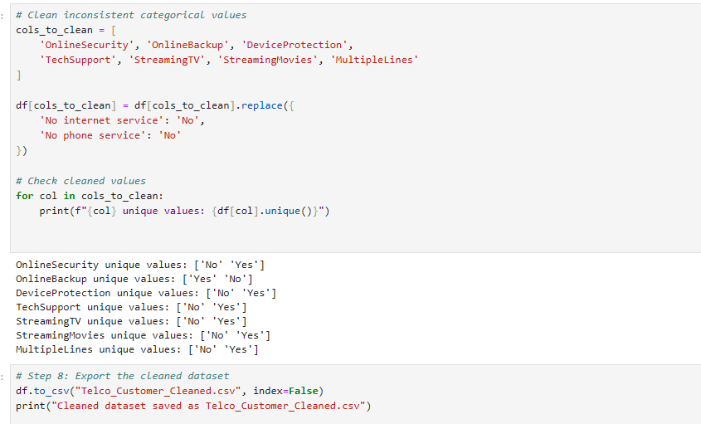
Dataset Description
Telecom customer dataset with demographic, service usage, and billing details.
Key features include: tenure, contract type, internet service, payment method, charges, dependents, senior citizen.
Target variable: Churn (Yes/No).
Project Development Phase

Slide 8
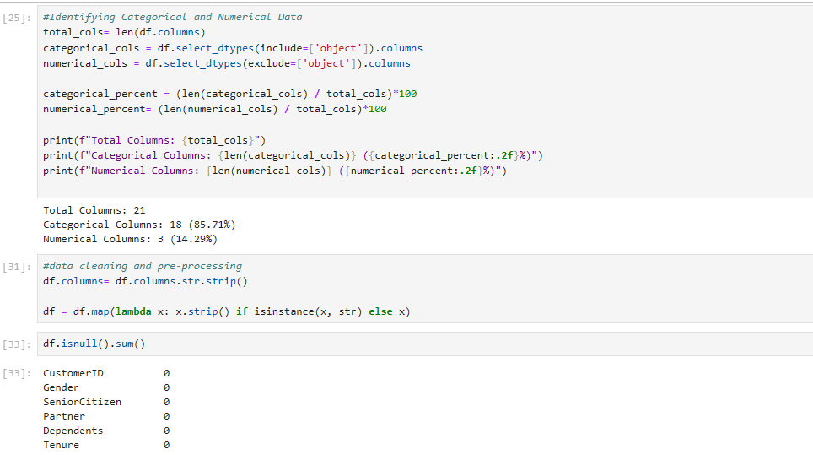
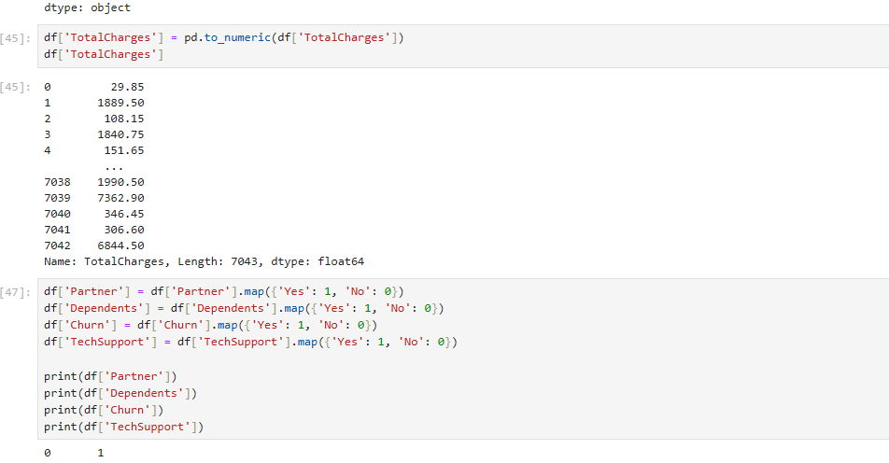
Project Development Phase
Data Preprocessing
Handled missing values and removed duplicate records.
Converted Yes/No fields into 0/1 format.
Applied label encoding and one-hot encoding for categorical variables.
Standardized numeric columns such as MonthlyCharges and TotalCharges.
Created new features like Tenure Groups and Contract Type Simplified.

Slide 9
Exploratory Data Analysis (EDA)
Highest Churn Segment:
Customers with Month-to-Month contracts show the maximum churn rate.
Interpretation: These customers lack commitment and switch providers easily.
Monthly Charges vs Churn:
Customers with higher monthly bills churn more.
Interpretation: High cost is a major reason for dissatisfaction.
Tenure vs Churn:
Low-tenure customers (0–12 months) churn the most
.
Interpretation: New customers leave early if expectations are not met.
Internet Service Impact:
Fiber Optic users show higher churn than DSL users.
Interpretation: Possible issues with service quality or pricing.

Slide 10
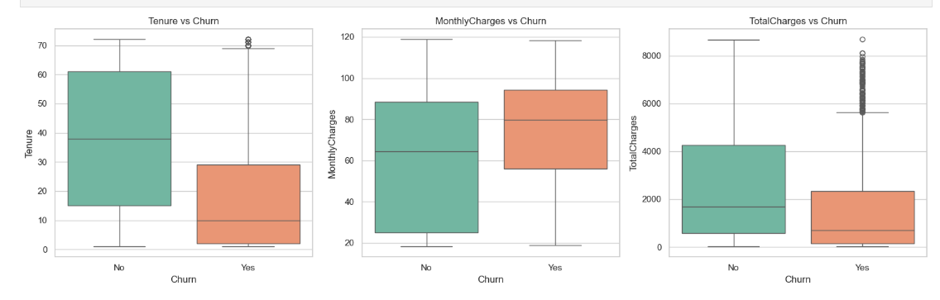
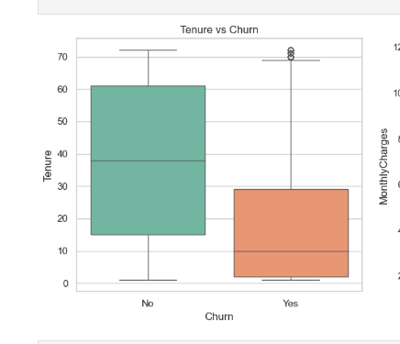
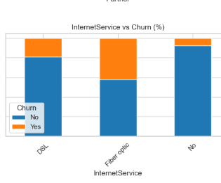
Show Insights
Monthly Charges vs Churn
Tenure vs Churn
Internet Service Impact

Slide 11
Model Development
Train–Test Split: Dataset split into 80% Training and 20% Testing to ensure balanced learning and evaluation.
Algorithms Used : Logistic Regression, Decision Tree ,Random Forest , Gradient Boosting.
Why These Models Were Chosen ?
Logistic Regression –
Provides a simple, interpretable baseline for binary classification.
Decision Tree –
Captures non-linear patterns and is easy to visualize and understand.
Random Forest –
Reduces overfitting, improves accuracy, and handles mixed data types effectively.
Gradient Boosting –
Offers high predictive performance by sequentially improving weak learners.

Slide 12
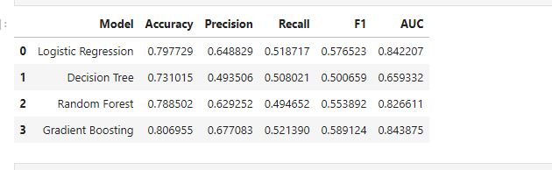
Model Evaluation
Performance Metrics Used
Accuracy- Overall correctness
Precision- Correct churn predictions
Recall-Ability to detect actual churners
F1 - Balance of Precision and Recall
AUC - Ability to separate churn vs non-churn

Slide 13
Best Model Selected: Gradient Boosting
Justification :
Achieved the highest Accuracy, Precision, Recall, F1-Score, and AUC among all models.
Best at detecting churn customers (highest recall).
Handles complex, non-linear patterns effectively.
Produces stable and reliable predictions, suitable for business decision-making.

Slide 14
Final Insights
Contract Type, Monthly Charges, and Tenure strongly influence churn.
Month-to-Month customers churn the most.
High-billing customers show higher churn probability.
Fiber Optic users have higher churn rates than DSL users.
Low-tenure customers leave early due to dissatisfaction or poor onboarding.
Recommendations
Promote long-term contracts with discounts.
Reduce billing stress using flexible payment plans
Improve customer support for Fiber Optic users.
Introduce early-engagement campaigns for new customers.
Use the ML model to predict churn early and trigger retention actions.

Slide 15
References
The Telecom Customer Churn dataset was provided by HEProAI for analysis.
Python Libraries: Pandas, NumPy, Scikit-Learn, Matplotlib, Seaborn.
Research papers on customer churn prediction and retention models.

Slide 16
Project Conclusion
The project successfully identified the key drivers behind customer churn.
Gradient Boosting emerged as the best-performing model based on all evaluation metrics.
Insights from the analysis highlight the importance of contract type, tenure, and monthly charges in churn behavior.
The model can help the business predict churn early and take proactive retention measures.
Overall, the project provides a data-driven foundation for reducing churn and improving customer retention strategies.

Slide 17
Challenges and Solutions
Data Quality Issues : Missing values, inconsistent entries, and non-numeric fields.
Solution: Cleaned the dataset, handled missing values, converted TotalCharges to numeric, and performed encoding.
Imbalanced Target (Churn) : Churn cases were fewer than non-churn, affecting model learning.
Solution: Used proper evaluation metrics (Precision, Recall, F1, AUC) and applied model tuning to improve performance.
Selecting the Best Model : Different models performed differently across metrics.
Solution: Compared Accuracy, Precision, Recall, F1, and AUC → Selected Gradient Boosting as the best performer.
Understanding Key Drivers of Churn : Many correlated variables made interpretation difficult.
Solution: Used feature importance from ML models and EDA insights to identify top churn factors.

Slide 18
Learnings and Key Takeaways
1. Improved Data Handling Skills
Learned to clean, preprocess, encode, and transform real-world datasets effectively.
2. Strong Understanding of EDA
Gained experience in uncovering patterns, trends, and churn drivers using visualizations and statistics.
3. Hands-on Machine Learning Experience
Learned how to build, compare, and tune ML models such as Logistic Regression, Decision Tree, Random Forest, and Gradient Boosting.
4. Model Evaluation Expertise
Understood the importance of metrics like Accuracy, Precision, Recall, F1 Score, and ROC-AUC for classification tasks.
5. Ability to Draw Business Insights
Translated data findings into actionable recommendations for reducing churn and improving customer retention.
6. Enhanced Problem-Solving Skills
Developed solutions to challenges related to data quality, model selection, and interpretation.

Slide 19
Thank You

