Slide 1


Customer Churn Prediction Analysis
HEPro -Business Analytics Internship
Duration – 2 Month (November- December 2025)
Presented by : Ritu Paul

Slide 2
Table of Contents
Cover Page
Table of Contents
Executive Summary
Introduction
  What is Customer Churn?
  Importance of Churn Prediction
  Business Impact
  Problem Statement
Project Goals & Objectives
Daily Work Log
Project Development Phase
  Dataset Description
  Data Preprocessing
  Exploratory Data Analysis (EDA)
  Model Development
  Model Evaluation
Final Insights & Recommendations
Project Conclusion
Challenges & Solutions
Learnings & Key Takeaways
References

Slide 3

Purpose of analysis: Understand why employees leave DETE.
Data: Exit survey responses from multiple employee segments.
Tools used: Power BI, Excel.

Slide 4
Key Objectives
Analyze resignation patterns across roles & departments.
Evaluate workplace satisfaction & morale.
Identify trends in tenure, age, and separation types.
Suggest actions to improve retention.

Slide 5
Parameters used for the Survey
Personal & Employment Information: ID, Separation Type, Cease Date, Start Date, Position, Region, Employment Status.
Reasons for Leaving: Career moves, dissatisfaction, work-life balance, workload, maternity, health issues, etc.
Workplace Experience Ratings: Professional development, opportunities, staff morale, workplace issues, stress, support from peers and supervisors, etc.
Demographics: Gender, Age, Region, Issue etc.

Slide 6
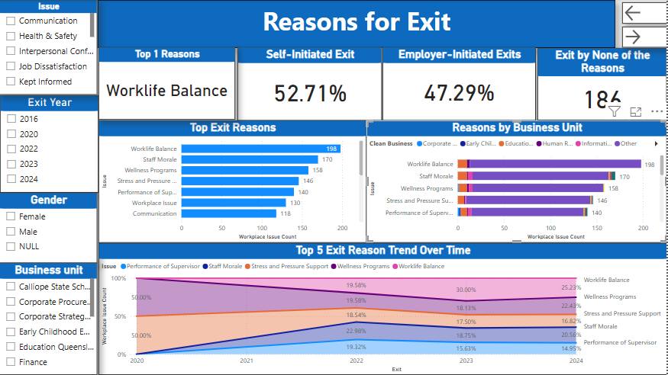
Reasons for Leaving:
Career moves, dissatisfaction, work-life balance, workload, maternity, health issues, etc.
Insight:
Employees resigning have lower satisfaction vs others
Key Point:
Morale is consistently low among those who resigned

Slide 7
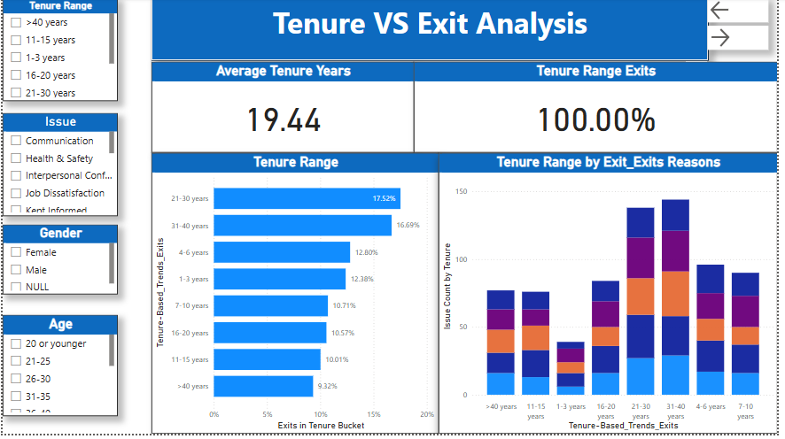
Visual:
Stacked bar or line chart
Insight:
People with short duration between 0-3 years are having high chances of resignation
Key point:
Employee experience may affect satisfaction & decision to leave

Slide 8
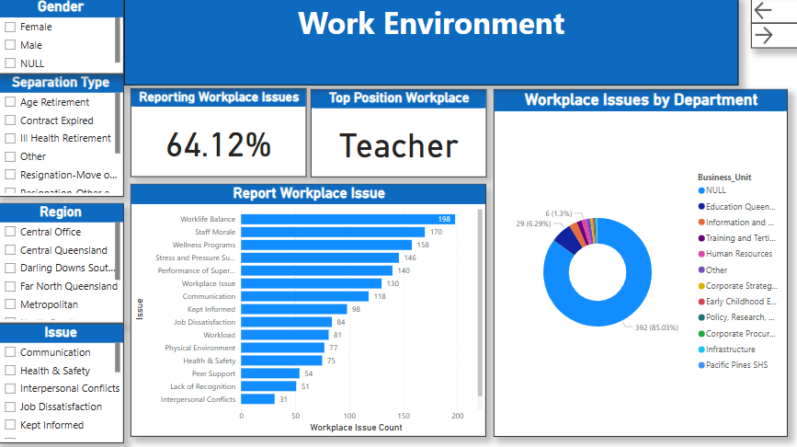
Visual:
Average scores of Professional Development, Morale, Supervisor, Work-Life Balance
Insight:
Lowest satisfaction in staff morale and career progression

Slide 9
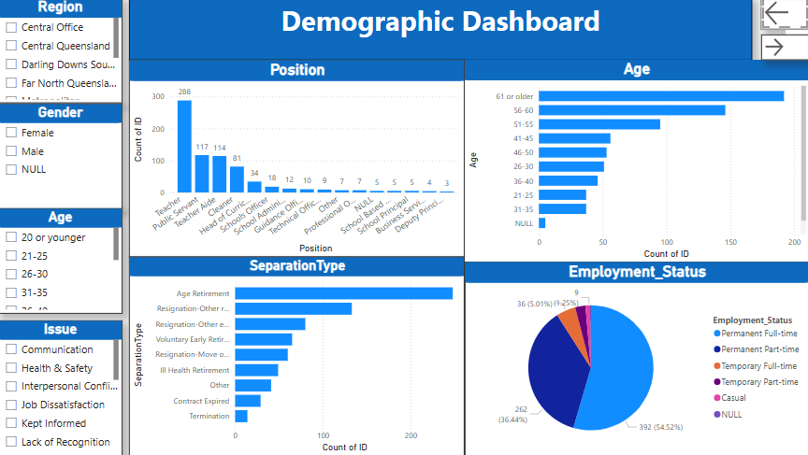
Visual:
Stacked Bar Chart / Pie Chart
Most resignations come from Age 61–or older group in Corporate Services
Recommendations:
Improve onboarding and support in early tenure
Focus on morale –building and supervisor engagement
Target high-turnover departments with action plans

Slide 10
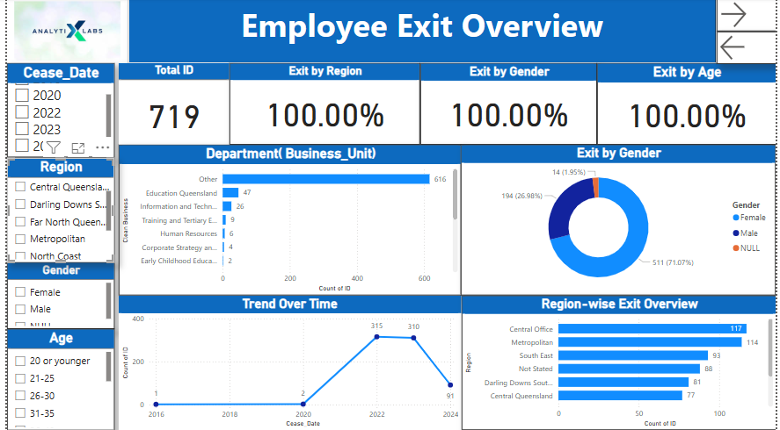

Slide 11
Conclusion
Survey reveals actionable trends
Focus on satisfaction = Retention
Next Step: Implement strategic HR interventions

Slide 12
Thank You

