Slide 1



Evaluating Impact of an Online Self-Service Learning Platform for Application-Inspired Cloud DevOps Curriculum
Roshan L Neupane (Presenter), Kiran Neupane, Hemanth Sai Yeddulapalli, Prof. Prasad Calyam
Department of Electrical Engineering and Computer Science
University of Missouri-Columbia
Metrics 2023

Slide 2

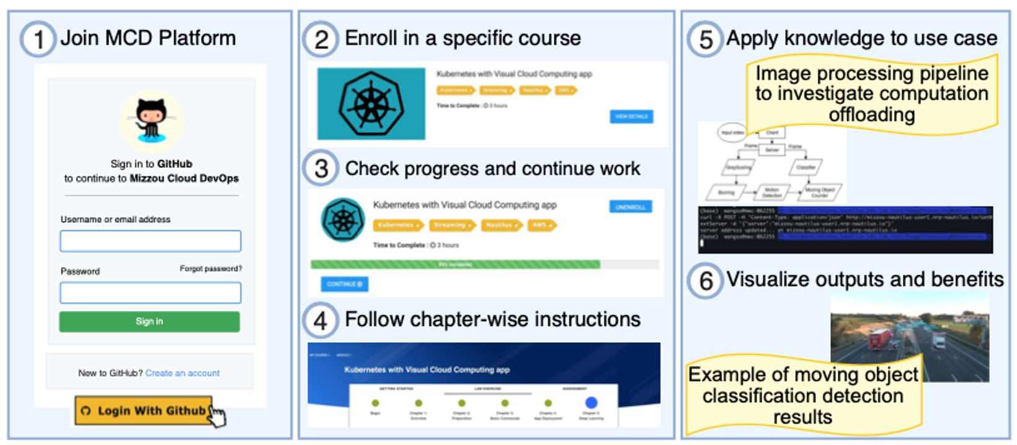
Mizzou Cloud DevOps Platform Overview
Join the platform through your GitHub account
Learners can choose from a set of courses
Learners can check progress of their work and return to their last progress
The modules follow a progression of starting from introductions and basics for these technologies to performing more technical contents
Learners are able to implement a research-inspired use case scenario
The platform is accessible from https://www.mizzouclouddevops.net

Slide 3
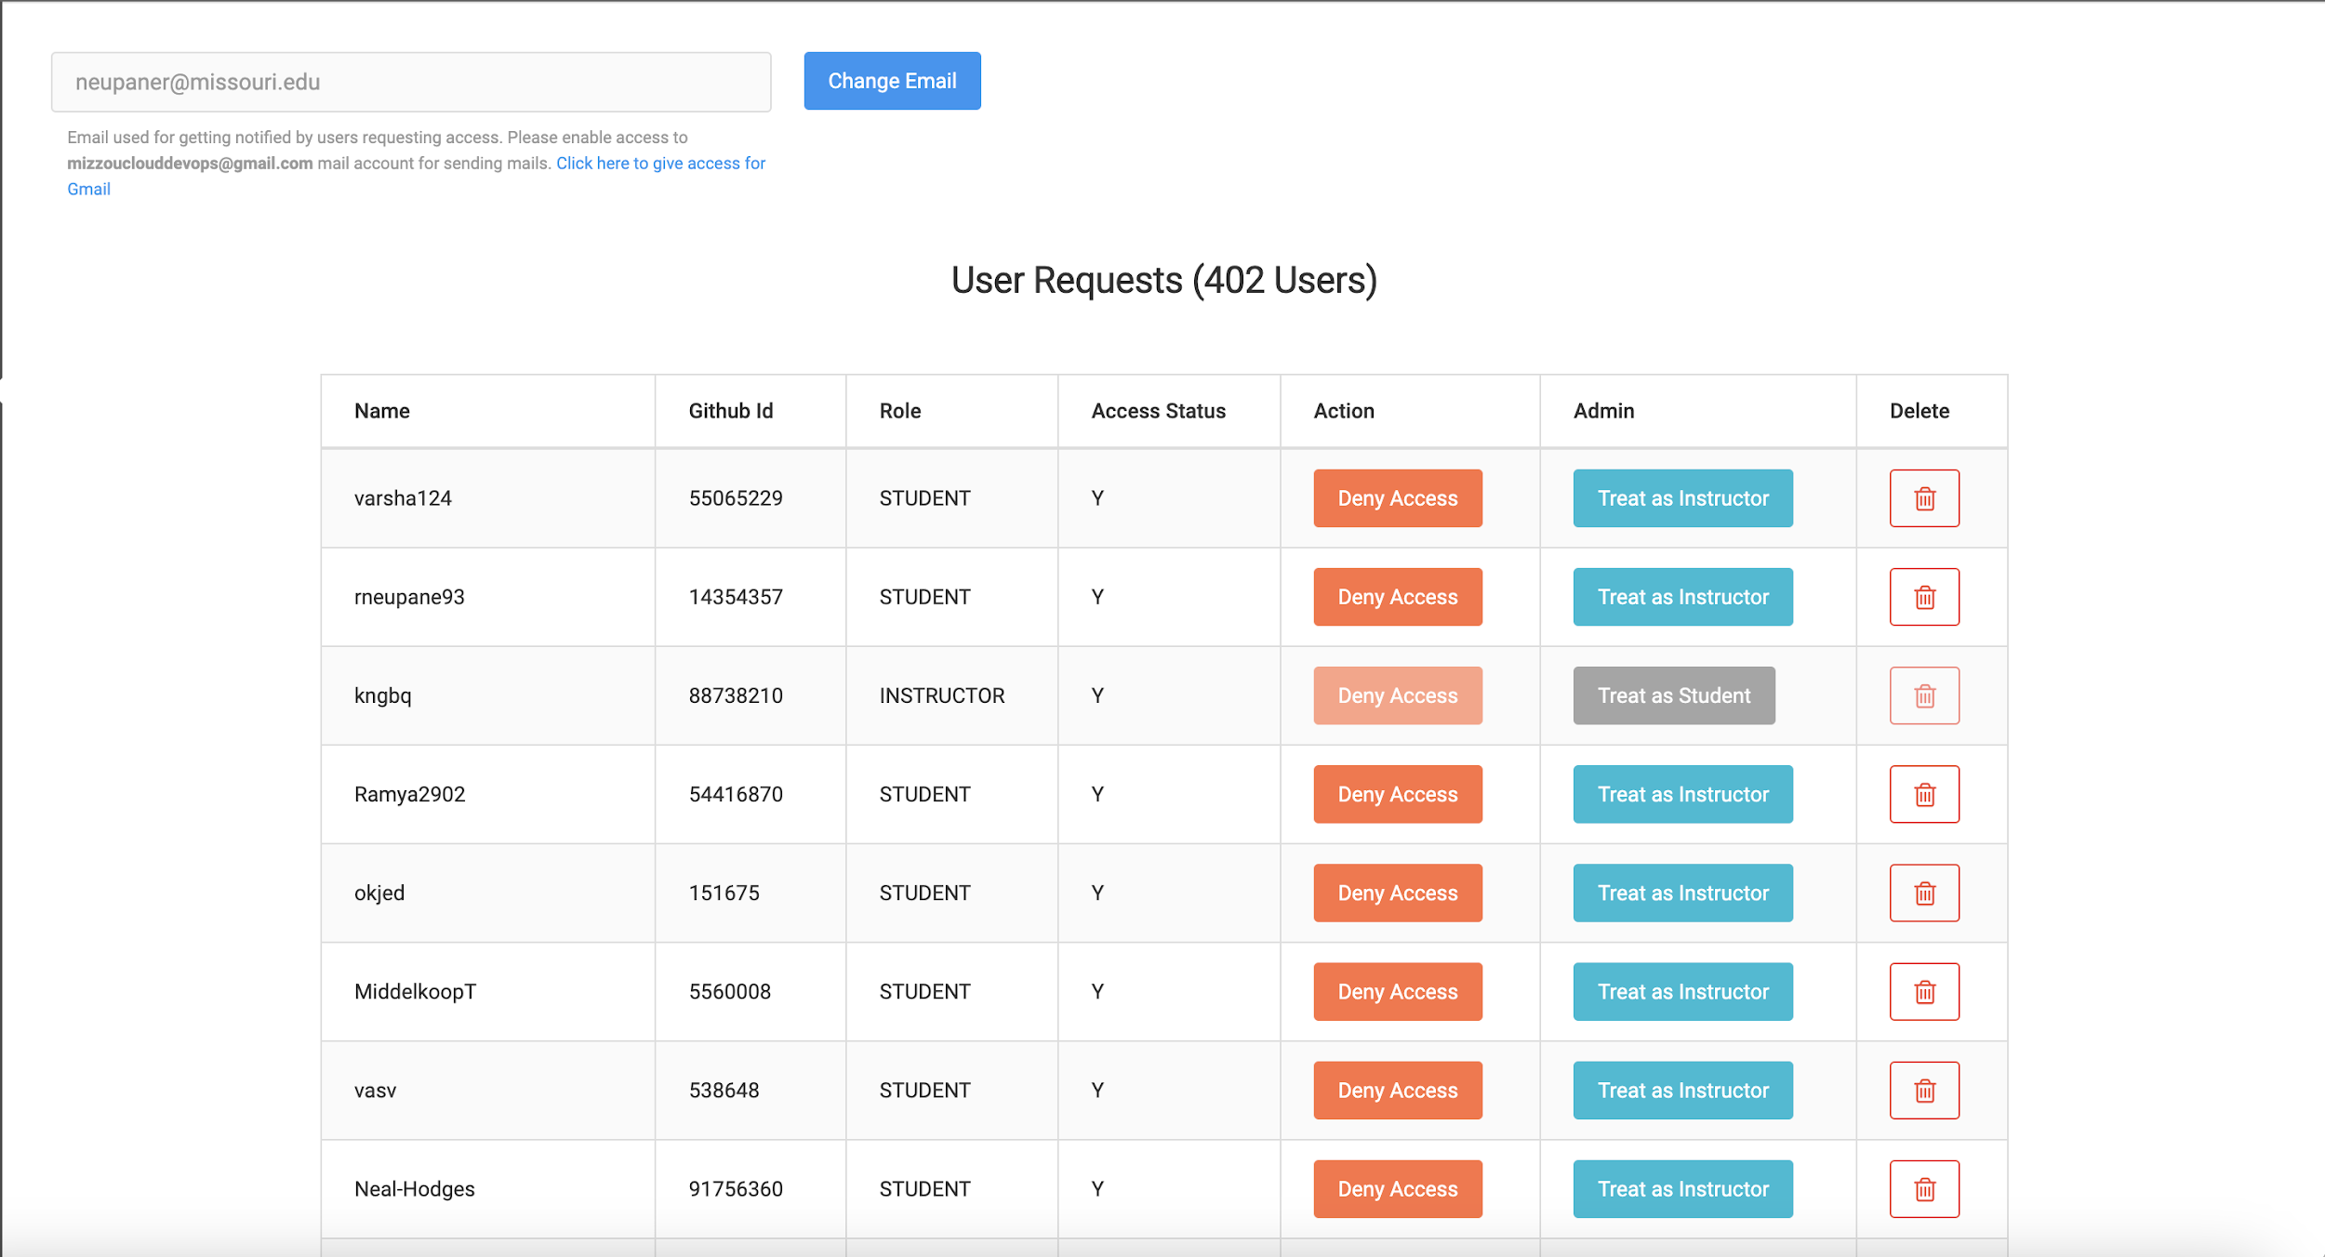
Instructors view of user access request
The instructors are able to view the list of students that are requesting access and grant them
Description about the users are shown in the user requests panel
There are options for admin privileges or assigning roles
Instructors can view the students accessing a course and have the option to remove a request

Slide 4
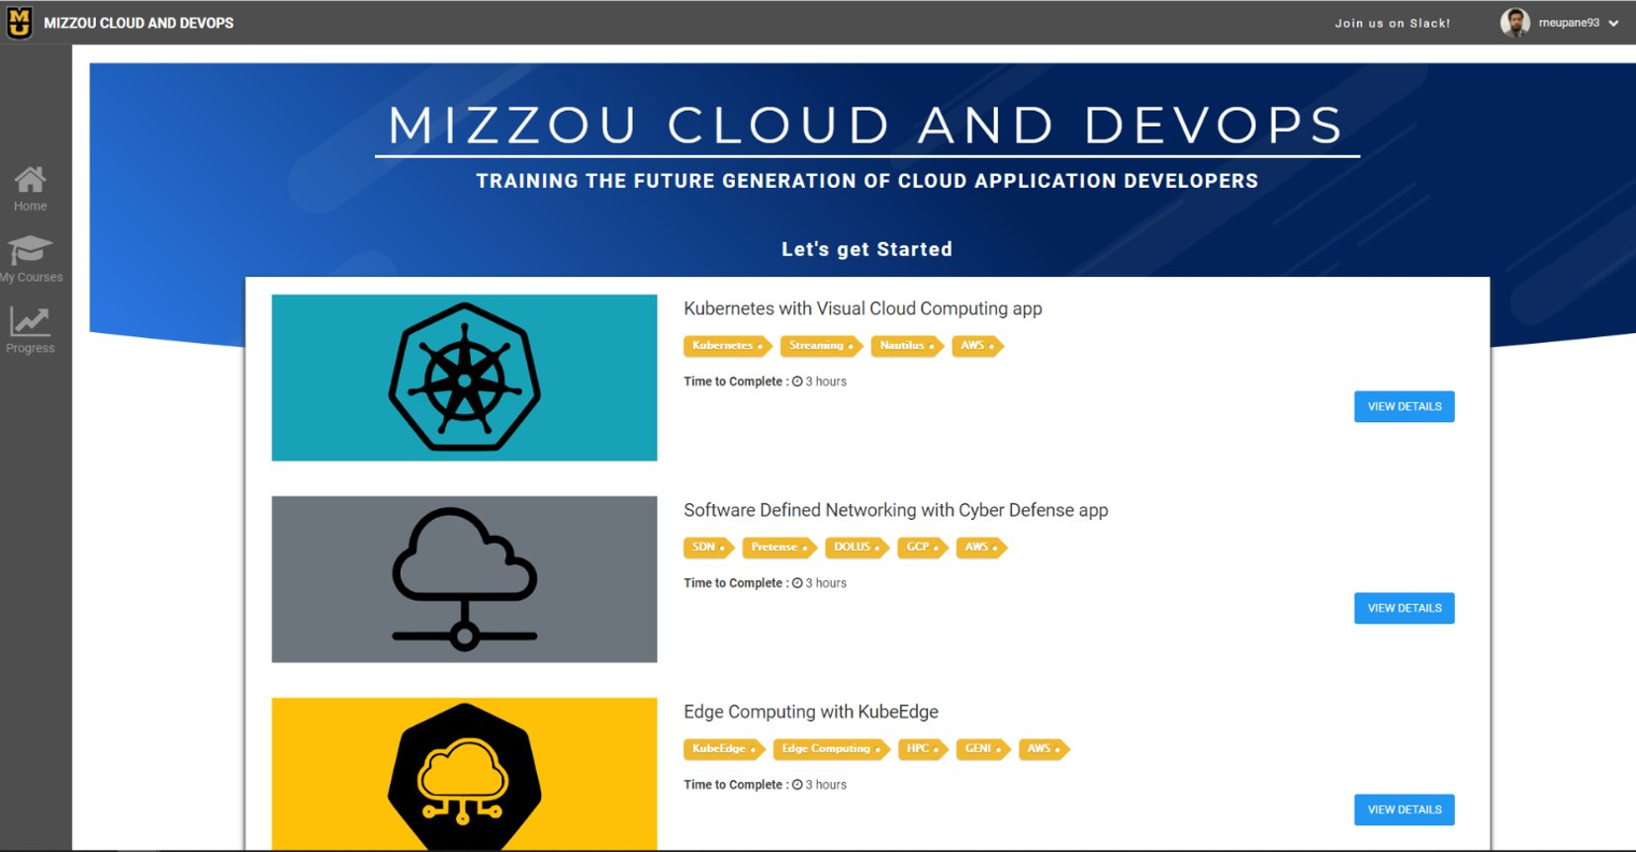
Student Home Page
Students land into the home page for the courses available in the LMS system
There are diverse cloud and devops tools listed with Keywords that emphasize the learning outcomes
Student can view details of the course that lands them in the upcoming page

Slide 5
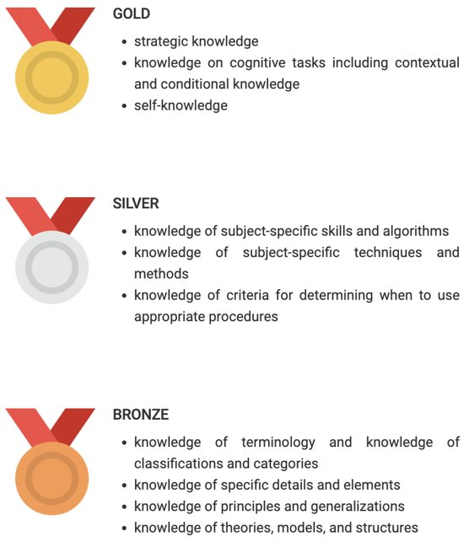
Knowledge Levels
The gold standard mentions strategic knowledge about the course with contextual and conditional knowledge
The silver standard mentions subject-specific skills and algorithms knowledge and ability to determine when to use appropriate procedures
The bronze acknowledges the terminology, details and elements, principles and generalizations of theories, models, structures

Slide 6
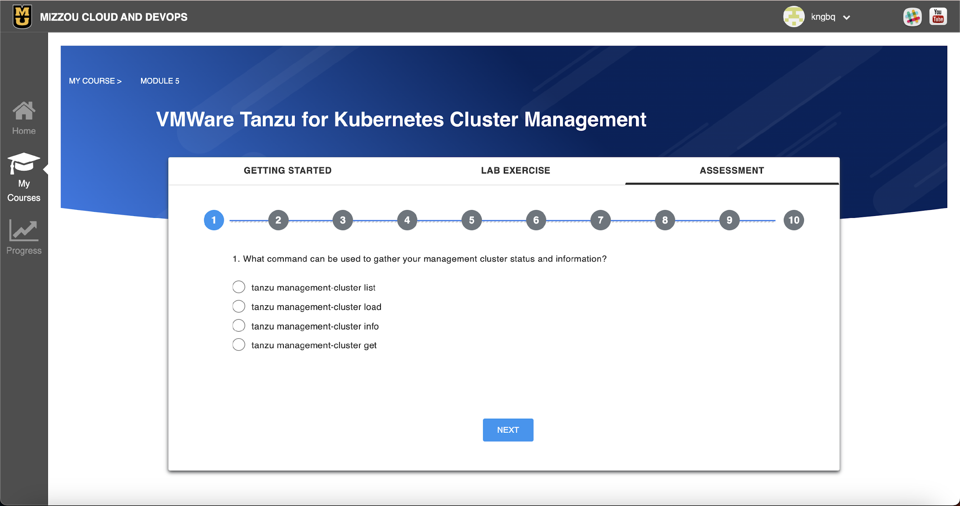
Student assessment via Auto-grading API
Students initially are assessed via pre-survey questions before course begins
Students complete the course and are directed to technical assessment page
The assessment consists of 3 pre-survey questions and 10 post-completion technical assessment questions for determining the knowledge levels and eventually the knowledge growth

Slide 7
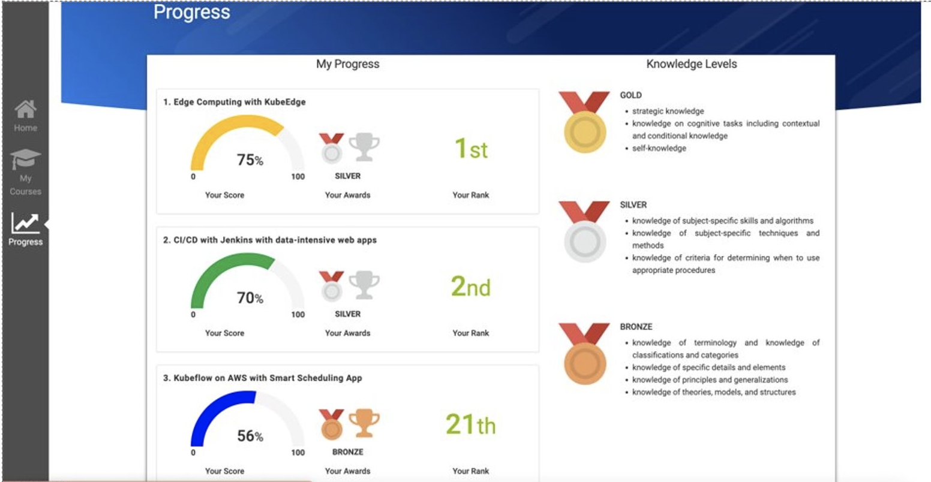
Student Progress
Description about the Progress is shown in all the courses
Learners can also assess their Knowledge Levels looking at the tiers that they are assigned
These help assess the Knowledge Growth in students and provides directives for improvement

Slide 8
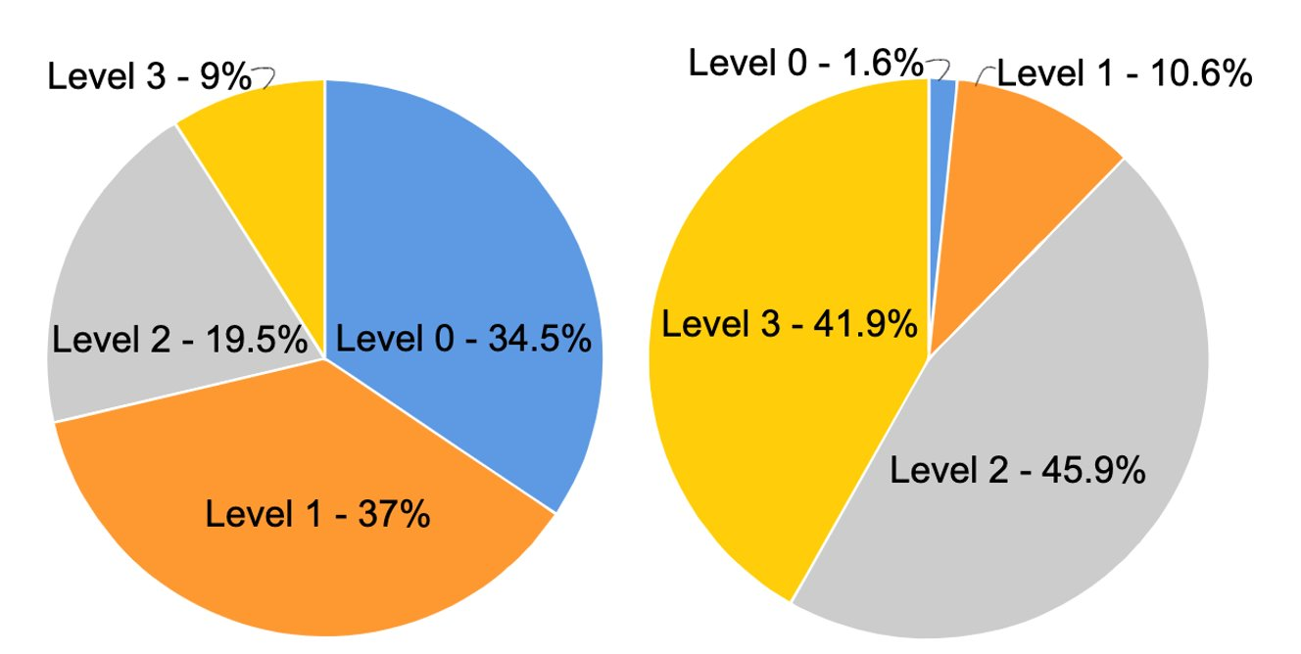
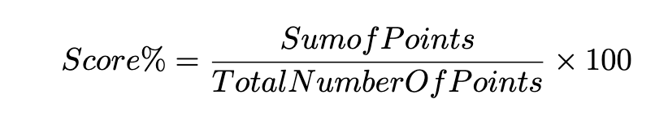
Knowledge Growth Evaluation
Workshops were conducted totaling 122 students for the first module relating to Kubernetes
Knowledge growth is evaluated by comparing knowledge level after a post pre-survey with the post technical assessment
It can be noticed that there have been significant improvement from the students
Gold medal 🥇 - 90% and above
Silver medal 🥈 - 70% and above
Bronze medal 🥉 - 50% and above

Slide 9
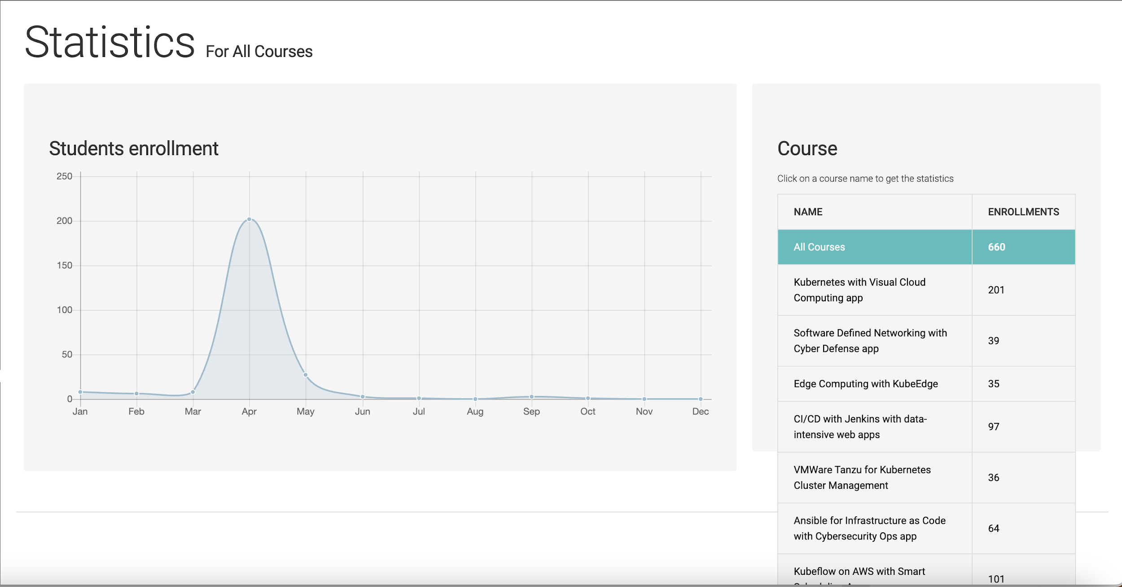
Descriptive telemetry on the student enrollments – Instructor view
The status of student enrollment is shown
Instructors can filter the visualization with the courses available and check the enrollment status

Slide 10
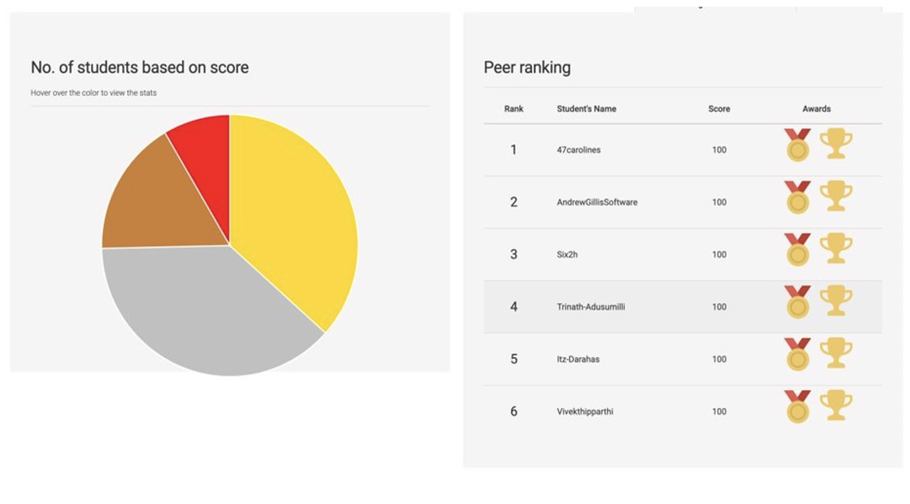
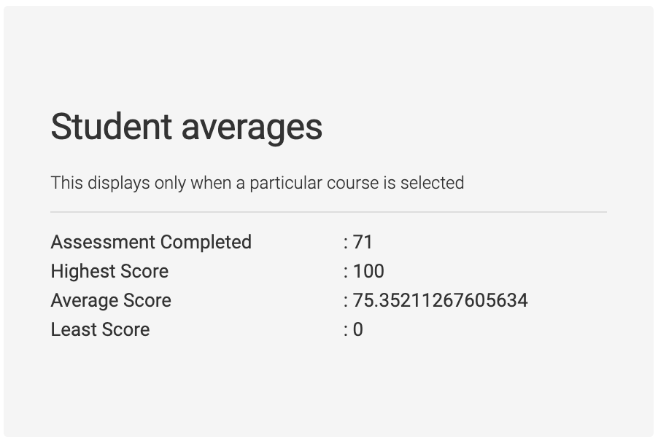
Knowledge Levels and Peer Ranking – Instructor view
Assessments are shown based on the class scores, student rankings
Student averages for the assessments, their min-max and average
Student rankings are sorted through scores and there are awards assigned based on the Knowledge Growth Study

Slide 11
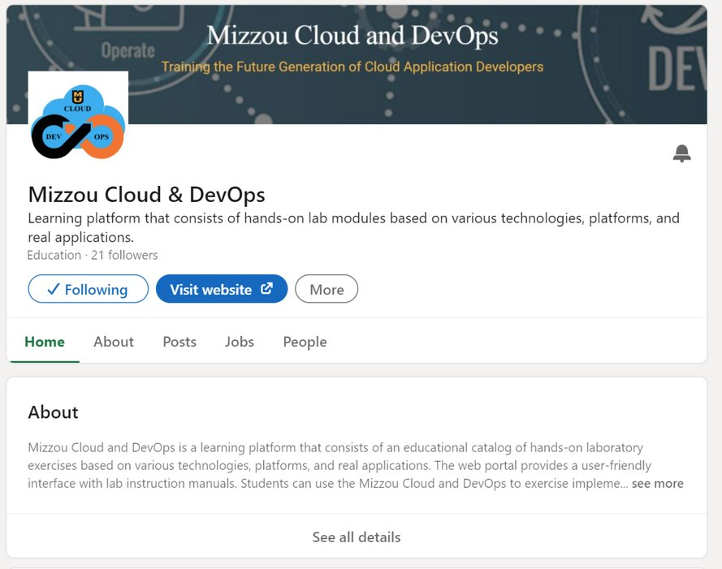
LinkedIn Integrations
We have newly created a dedicated LinkedIn site for Mizzou Cloud & DevOps for improving the learner outreach​
We have integrated with LinkedIn for providing students credentials (certificates/badges) based on their lab completion using the portal​
Student can directly share the credentials to LinkedIn from the portal using the link given to post the credentials in 2 ways: (a) Open credential without verification id, and (b) Credential with verification id​

Slide 12
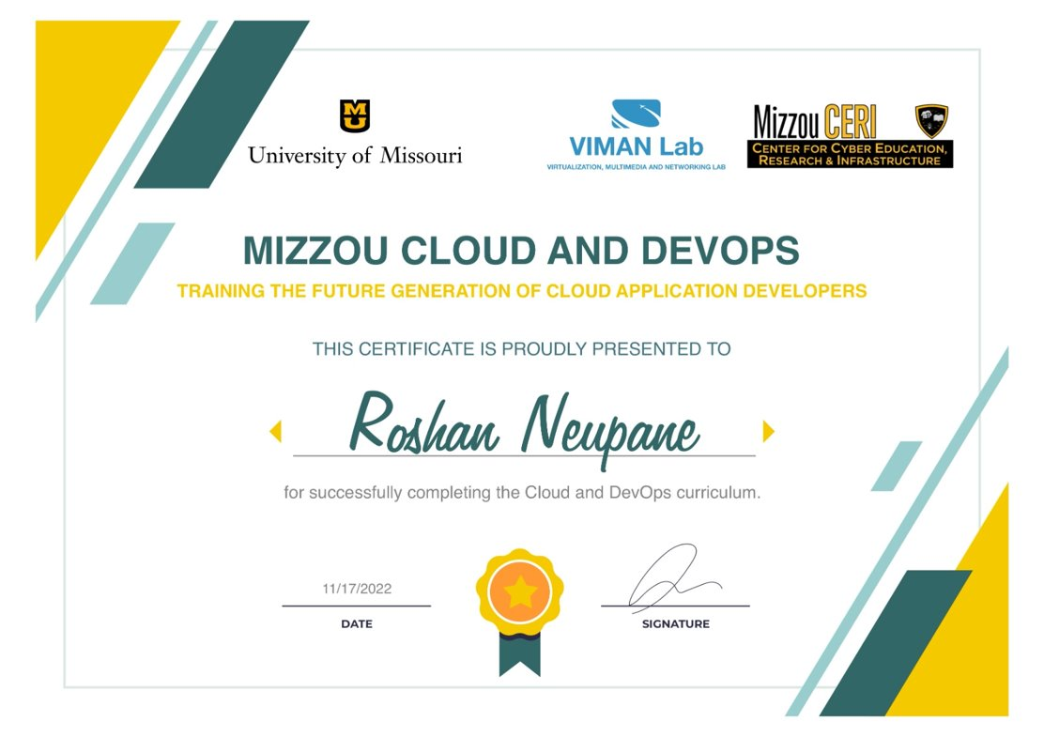
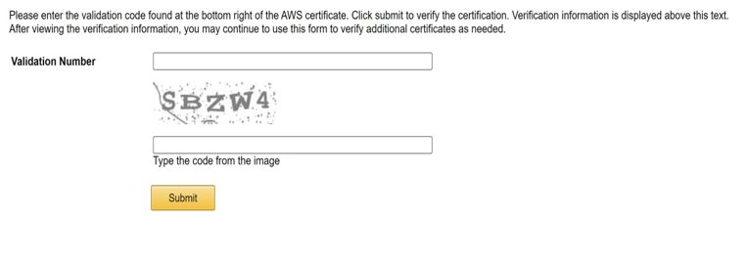
Digitally Verifiable Credentials
Certificate Validation by CERI Center at Mizzou (similar to how AWS does)

Slide 13
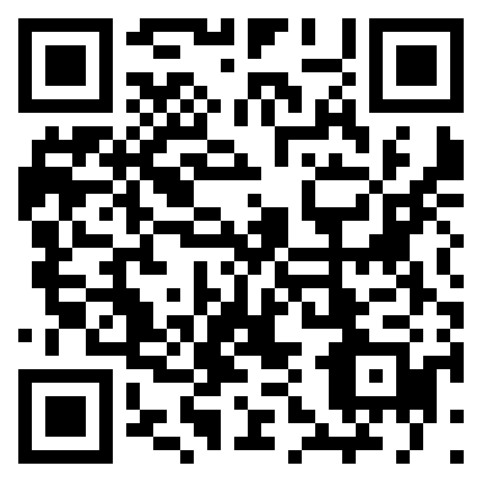
THANK YOU!
ANY QUESTIONS?

