Slide 1
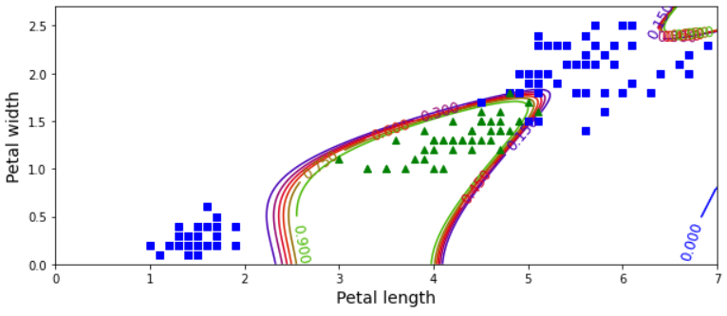
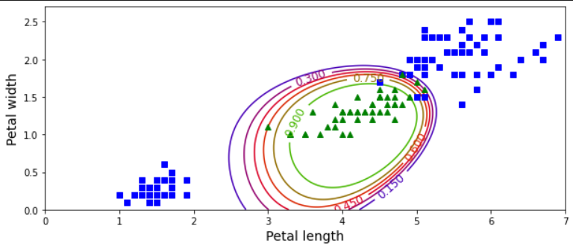
No Regularization
Over complex decision boundary
Narrow uncertainty range
L2 Regularization
Simple decision boundary
Wider uncertainty range
Degree 5 Polynomial Log Regression (with/out regularization)

Slide 2
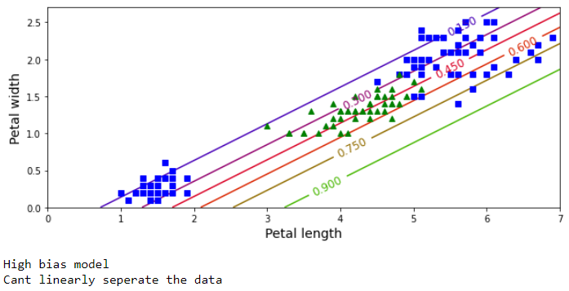
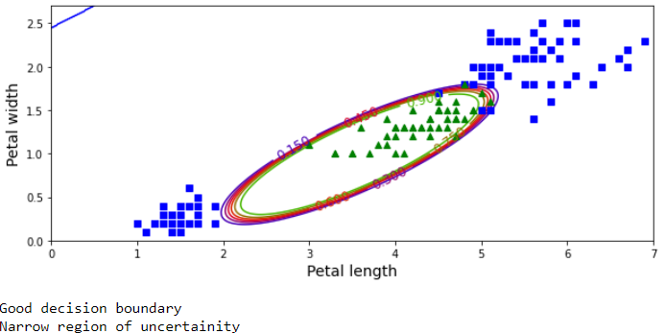
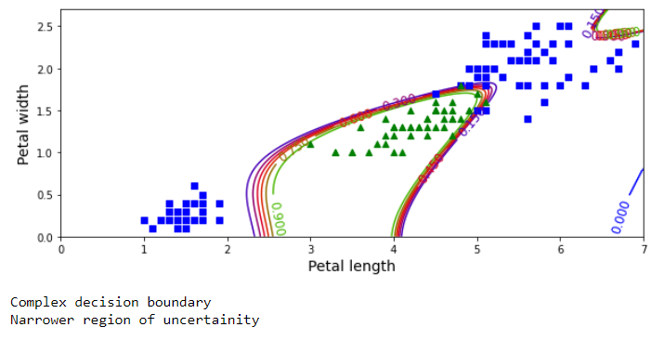
Degree 1
Degree 2
Degree 5

Slide 3
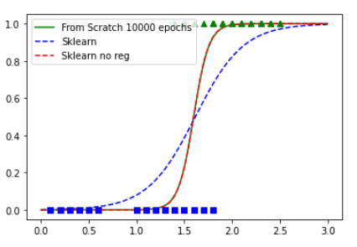
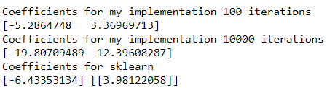
(default regularization)
No regularization: Coefficient magnitude grows
No regularization: Small Uncertainty Region

