Slide 1
Cross-country analysis & Emigration
Ritu Bhamrah
015324478

Slide 2
introduction
Various people move from one region to another.
Research by Hayes et. al(2013) - “Economic, demographic and sociological factors hold dominant positions in most accounts of the intention to emigrate.”
This project focuses on analysis of different factors responsible for migration to different regions.

Slide 3
Project objective
Collect the data for the project requirement from various online resources.
Merge the data using tableau prep builder.
Visualize the emigration trends among various regions using tableau.
Analyze the causes of emigration.

Slide 4
Project Phases
Project Proposal
26
27
28
29
30
31
1
2
3
4
5
6
7
Initial study
Data preparation & Planning
9
10
11
12
13
14
15
Execute visualization
9
10
11
12
13
14
15 Oct 2021
presentation
9
10
11
12
13
14
23 Nov 2021

Slide 5
DATA Preparation
Data collection is done from 3 different Kaggle sources.
Demographic Data – Country name, country code, birth rate, internet users, income group.
Happiness Report – Country, region, happiness rank, happiness score, standard Error, GDP, family, life expectancy, freedom, government trust, generosity, dystopia residual.
Emigration Data – Emigration, country, region.

Slide 6
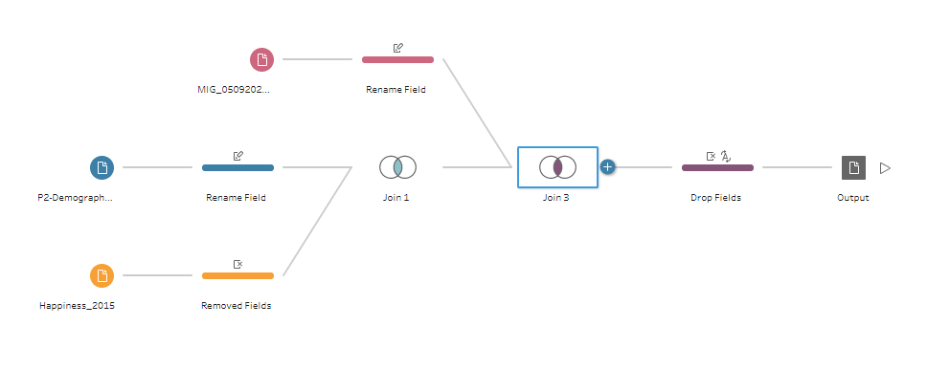
DATA Preparation Continue…

Slide 7
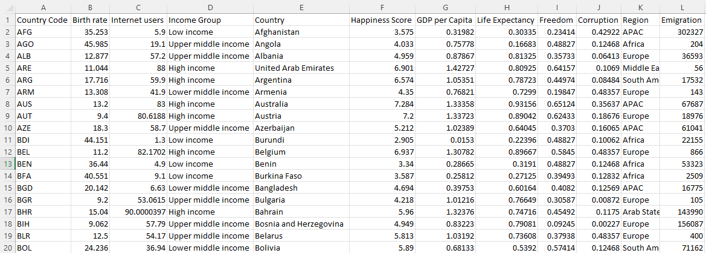
Data after preparation

Slide 8
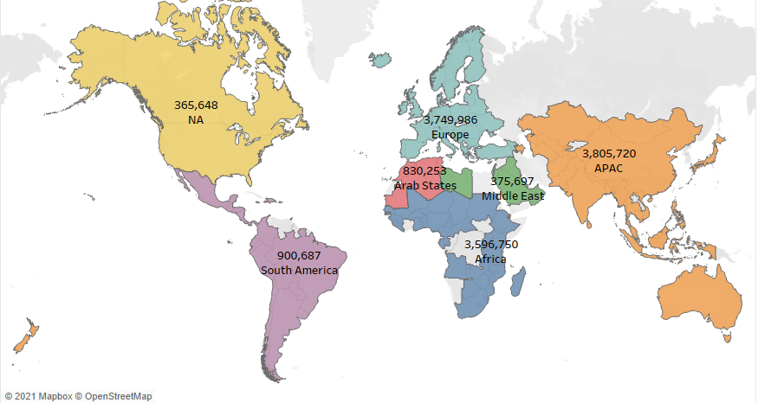
Emigration by region
Problem - Understand how factors like freedom, birthrate, happiness, corruption, etc. influence people’s life and their decision-making in emigration.
Benefits – Conclusions can be drawn & measures for improvements can be made.

Slide 9
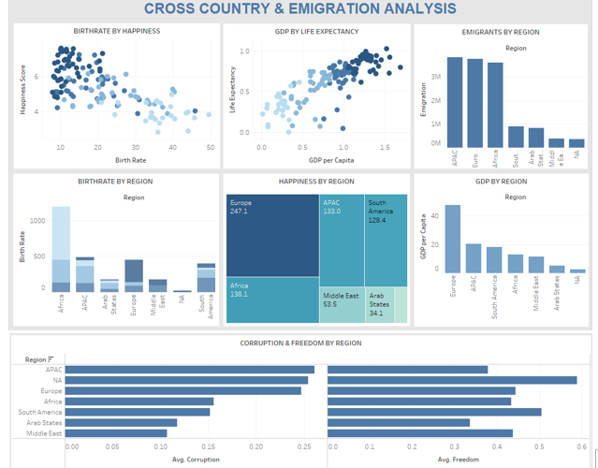
Dashboard

Slide 10
conclusion
Emigration order from highest to lowest –
APAC, Europe , Africa, South America, Arab states, Middle East, North America
Corruption order from highest to lowest -
APAC, North America, Europe , Africa, South America, Arab states, Middle East
Freedom Order –
North America, South America, Europe, Middle East, Africa, APAC, Arab states
Corruption is a major factor for emigration.
Freedom is also another contributing factor for emigration.
E.g.: Though North America has higher corruption, since it has the highest freedom emigration is lower than other regions.
Combination of corruption and freedom is a great factor for emigration.

Slide 11
RESOURCES
Demographic Data
https://www.kaggle.com/hbao12/world-demographics?select=P2-Demographic-Data.csv
Happiness Report
https://www.kaggle.com/mathurinache/world-happiness-report
Emigration Data
https://stats.oecd.org/Index.aspx?DataSetCode=MIG#
Damarys Canache, Matthew Hayes, Jeffery J. Mondak, Sergio C., 2013 Reference: https://doi.org/10.1016/j.jrp.2013.02.008

Slide 12
Thank you!!

