Slide 1
Applied Data Science Specialization
Week 5 Capstone Project

Slide 2
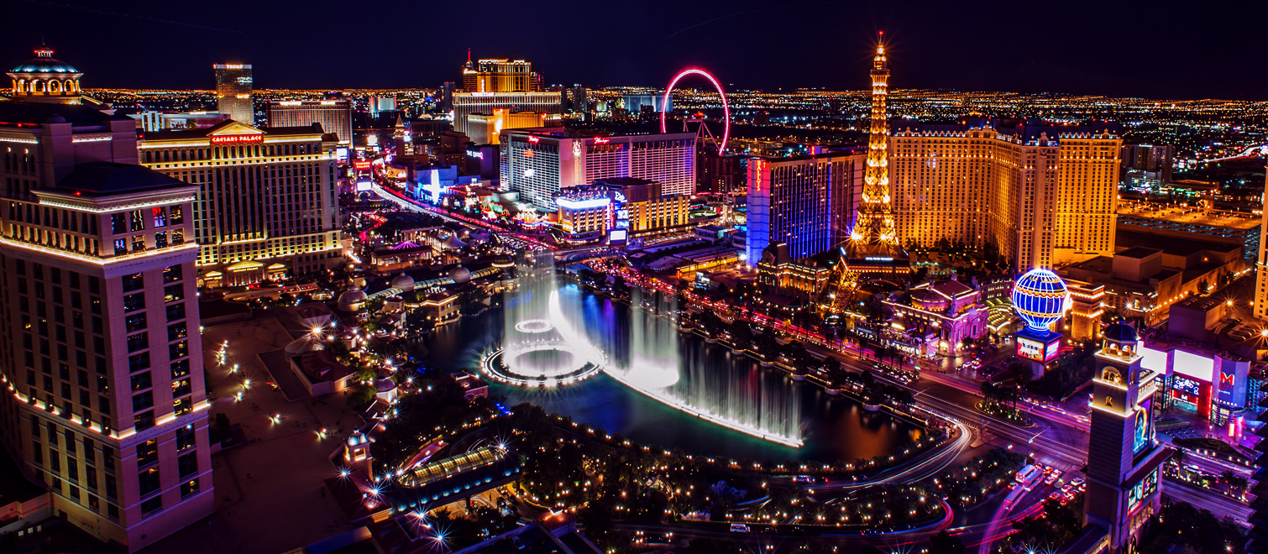
Aim
This project is aimed to make your travel experience to Las Vegas Simple by Providing all nearby locations of nightlife fun spots with help of Foursquare datasets.

Slide 3
Problem Statement
Many people come to Las Vegas each day and experience difficulty in choosing between the best and the not so known night out places. Here I and other foursquare users would try and help them with their tips and ratings for each place and help people enjoy most of their time rather fear losing something in the fake casinos

Slide 4
Objectives
1] The geojson data for Las Vegas's neighborhood is required.
2] Then, analyzing the data using the Foursquare API.
3] Use clustering to identify each area and its category.
Data Source we are going to use is from Foursquare. Foursquare is a technology company that uses location intelligence to build meaningful consumer experiences and business solutions. So We are going to build a project with the help of Foursquare location data, Foursquare API provides great amount of quality data’s about locations.(cafe, restaurant etc) Using this data will allow tourists to easily decide where to go when they are in a specific city.

Slide 5
Objectives(contd…)
Using techniques such as K-means clustering, I was able to get results about common venues in city. This information can be really helpful to tourists since they can focus on what they are trying to experience most during their Travel .(Food, culture, sport etc)
These techniques also provides the visualization of clustering of city. k-means clustering is a method of vector quantization, originally from signal processing, that is popular for cluster analysis in data mining. k-means clustering aims to partition n observations into k clusters in which each observation belongs to the cluster with the nearest mean, serving as a prototype of the cluster.
This results in a partitioning of the data space into Voronoi cells

Slide 6
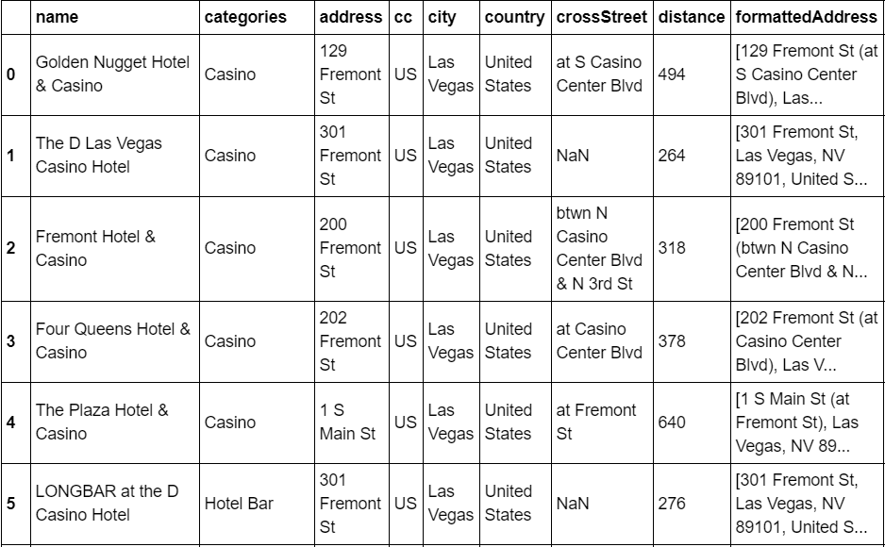
Data Set

Slide 7
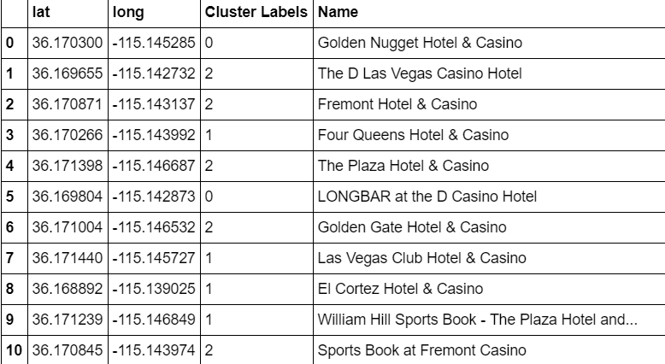
Data set processed for clustering

Slide 8
Conclusion
So using Foursqaure data set I have successfully created a way to know all the location information handy, information such as casinos,cafes and hotels, venues are easily accessible using data science methodology.

