Slide 1
CI/CD
Velocity training institute
Shantanu Mahajan (sr engg devops)

Slide 2
What is CI/CD?
CI/CD is an important DevOps practice and an Agile methodology best practice.
This practice allows development teams to frequently deliver and deploy applications and accelerate the application development process.
Introducing a CI/CD pipeline into our software development lifecycle allows us to efficiently implement automation and monitor code changes, new features, potential bug fixes, and more.

Slide 3
What is CI/CD?
CI/CD typically refers to continuous integration and continuous delivery, but the “CD” can also stand for continuous deployment.
Continuous delivery and continuous deployment both refer to automating stages of the CI/CD pipeline, but continuous deployment goes a step further.
The purpose of continuous delivery is to make it easy to deploy new code.
The purpose of continuous deployment is to allow teams to be “hands-off” in the process by automating the deployment stage.

Slide 4
Benefits of CI/CD
Increased Speed of delivery
Real time feedback
Easy maintenance
Reliable
Improved collaboration
High quality code

Slide 5
CI
Continuous integration refers to the build / integration stage of the software release process.
It’s a stage where developers consistently merge their changes into the main repository of a version control system (like Git).
After these changes are merged into the main repository, automated builds and tests are run.
If you don’t run the tests yourself, the CI service performs automated tests and builds on any new code changes.
Continuous integration is a coding philosophy and set of practices that drive development teams to implement small changes and check in code to version control repositories frequently.

Slide 6
With CI vs Without CI
Development without CI | Development with CI
Lots of Bugs | Fewer bugs
Infrequent commits | Regular commits
Infrequent and slow releases | Regular working releases
Difficult integration | Easy and Effective Integration
Testing happens late | Continuous Integration testing happens early and often.
Issue raised are harder to fix | Find and fix problems faster and more efficiently.
Poor project visibility | Better project visibility

Slide 7
CD
Continuous delivery picks up where continuous integration ends.
CD automates the delivery of applications to selected infrastructure environments.
Most teams work with multiple environments other than the production, such as development and testing environments, and CD ensures there is an automated way to push code changes to them.

Slide 8
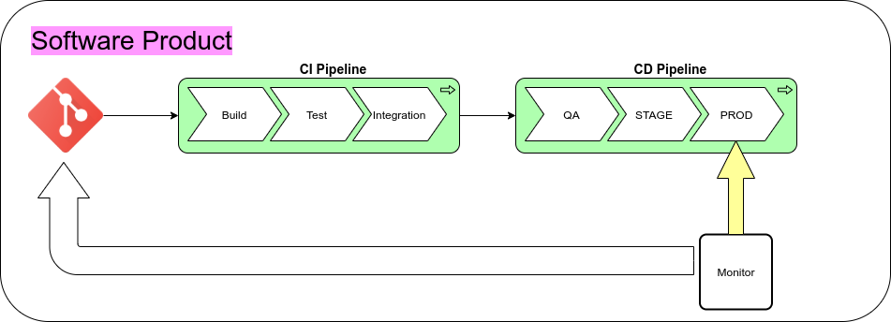
CI-CD

Slide 9
One of the most Popular CI/CD tool is Jenkins

Slide 10
What is Jenkins?
Jenkins is a self-contained, open source automation server which can be used to automate all sorts of tasks related to building, testing, and delivering or deploying software.
Jenkins can be installed through native system packages, Docker, or even run standalone by any machine with a Java Runtime Environment (JRE) installed.
Jenkins is a powerful application that allows continuous integration and continuous delivery of projects, regardless of the platform you are working on.

Slide 11
history
In 2004, Kohsuke Kawaguchi, the developer of Jenkins, was working with Sun Microsystems as a Java developer.
At that time, Kawaguchi was involved in several development projects. He didn’t like breaking the builds due to code failure.
This made him look for something that could help him know whether the code will work or not before it is committed to the repository.
This curiosity led the way to the development of an automation server named Hudson.
In 2011, there was an infamous dispute between the independent Hudson open source community and Oracle, which now has Sun Microsystems under its umbrella.
This dispute led to a fork, which was named Jenkins. Both Jenkins and Hudson continued to exist for a long time; however, Jenkins was the more preferred choice. The Hudson project was shut down in January 2020. Jenkins is still active.

Slide 12
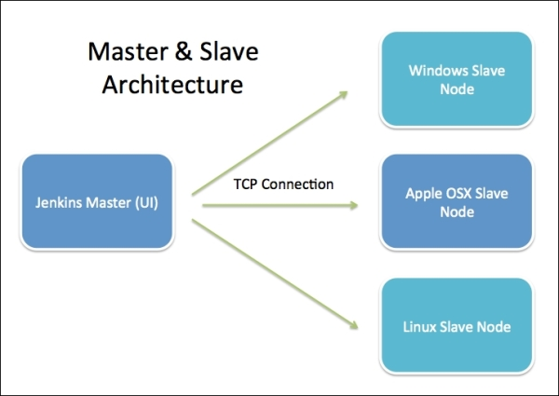
Jenkins Architecture

Slide 13
Jenkins Distributed Architecture
Jenkins manages the builds with the help of master-slave architecture. Master and slave units communicate with each other using IP/TCP protocol. Here is a little download on how it all works
Jenkins master
This is the primary server of Jenkins.
It handles a number of tasks that include but are not limited to scheduling build jobs, recording and presenting build results, dispatching builds to slaves for execution, monitoring all the slaves offline as well as online, and others.
Master Jenkins is capable of directly executing build jobs.

Slide 14
Jenkins Distributed Architecture
Jenkins slave
It runs on the remote server.
The Jenkins slave follows the requests of the Jenkins master and is compatible with all operating systems.
Building jobs dispatched by the master are executed by the slave.
The project can be suitably configured to choose a specific slave machine.

Slide 15
Jenkins Master-agent Connectivity
Using the SSH method: Uses the ssh protocol to connect to the agent. The connection gets initiated from the Jenkins master. There should be connectivity over port 22 between master and agent.
Using the JNLP method: Uses java JNLP protocol (Java Network Launch Protocol).

Slide 16
Features of Jenkins
Easy installation and configuration
Available plugins :- There are hundreds of plugins available in the Update Center, integrating with every tool in the CI and CD toolchain.
Extensible :- Jenkins can be extended by means of its plugin architecture, providing nearly endless possibilities for what it can do.
Easy distribution :- Jenkins can easily distribute work across multiple machines for faster builds, tests, and deployments across multiple platforms.
Free Open Source :- Jenkins is an open-source resource backed by heavy community support.

Slide 17
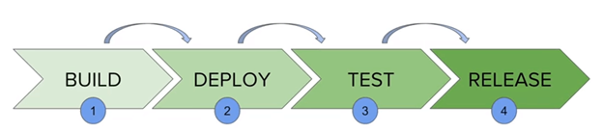
Jenkins Pipeline
In Jenkins, a pipeline is a collection of events or jobs which are interlinked with one another in a sequence.
The above diagram represents a pipeline in Jenkins. It contains a collection of states such as build, deploy, test and release.
These jobs or events are interlinked with each other. Every state has its jobs, which work in a sequence called a continuous delivery pipeline.

Slide 18
Installing Jenkins
https://www.jenkins.io/doc/book/installing/

