Slide 1
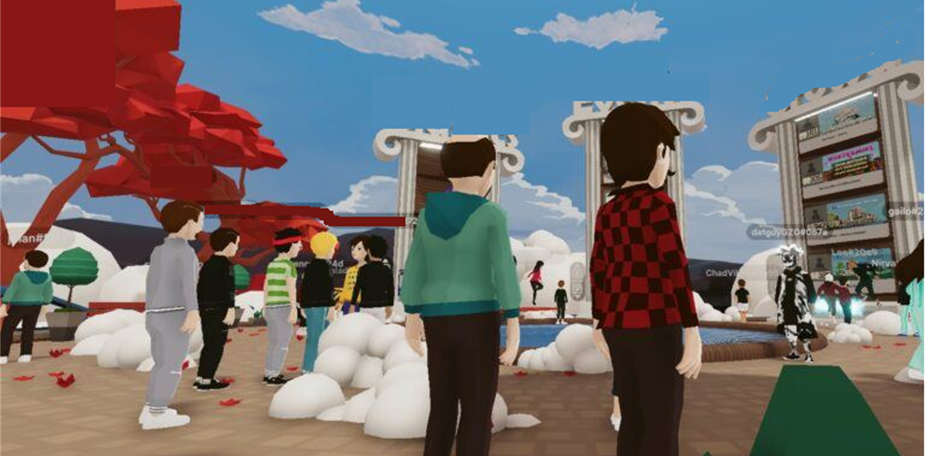
Developer’s
अड्डा
One stop shop for all the developers..

Slide 2
Are you a developer?
Players
Education providers
Developers
Protocol owners-founders
Hackers
Are you tired of going to several communication channels like telegram, whatsapp, discord to get the information?
There is no one stop shop for developers
Currently we don’t have any single one stop shop for the developers. Mentors, blogs, relaxing lounge,
Key features of the application –
The SwagBag – Your digital Collectible Bag
Implemented features –
Features –
The SwagBag – Your digital Collectible Bag
Collect your digital swags – own your swag, claim your ownership
Airdrops
Enter with a digital ID your own identity in the अड्डा
Buy the Dip – Concessional courses
Udemy, Coursera, Skillshare, Pluralsight, edX
Personal zero cost infra and network.

Slide 3




Implemented Features & Tech Stack
What? | Description | How? (Tech components) | Used | Logos
Enter the अड्डा – Your unique identity | Mint your claim ticket to enter the अड्डा Ticket changes colors based on the traits & coins you accumulate | Implementation of dynamic NFT | Gasless transactions of Biconomy through the new SDK
Earn your ethindia coins by answering questions, help the community | Answer questions, get rewarded based on likes, fires & other emojis Use these rewards to avail discounts, get free NFTs to participate in hacks, events, claim swags, airdrops etc. Leaderboard Become a Techguru(1250 beyond), Tech genius(800-1250), TechStar(450-800), Rising star(100-450), Newbie (<100) etc. | Rewarding system through – ERC-20 Tokens to all the contributors Ranges - Fire – 5 points Like – 2 points | Solidity Polygon, Ethereum
Developer Lounge – Chill out zone - Fun activities | Play games and earn tokens. | Phaser framework, Valist
Promote Regional education | Create regional content and earn based on likes, comments, share Listen to podcasts, live streams in your own language. | YET TO IMPLEMENT | Livepeer
Backend/Hosting platform – Solidity, Phaser Framework, Valist
Blockchains used – Ethereum, Polygon
Front end – React JS, HTML, Javascript

Slide 4
Implemented Features & Tech Stack
What? | Description | How? (Tech components) | Used | Logos
SwagBag | Wallet to airdrop swags by the founders, VCs and
Earn your karma coins by answering questions, help the community | Answer questions, get rewarded based on likes, fires & other emojis Use these rewards to avail discounts, get free NFTs to participate in hacks, events, claim swags, airdrops etc. Leaderboard Become a Techguru(1250 beyond), Tech genius(800-1250), TechStar(450-800), Rising star(100-450), Newbie (<100) etc. | Rewarding system through – ERC-20 Tokens to all the contributors Ranges - Fire – 5 points Like – 2 points | Solidity Polygon, Ethereum
Promote Regional education | Create regional content and earn based on likes, comments, share Listen to podcasts, live streams in your own language. | YET TO IMPLEMENT | Livepeer
Backend – Solidity
Blockchains used – Ethereum, Polygon
Front end – React JS, HTML, Javascript

Slide 5

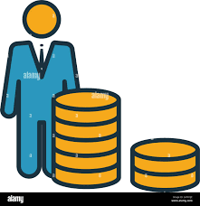



Airdrop swags
Developer’s wallet

Slide 6
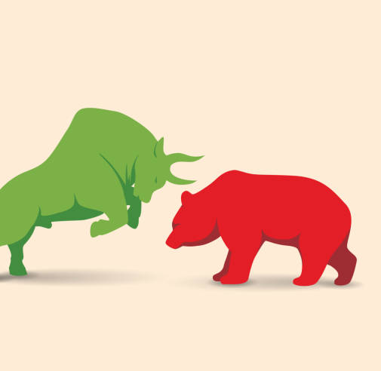

The Vibe Meter – Bear or Bull?
General vibe or health of the workplace – High on buidling – BULL or low on buidling BEAR

