Slide 1

Detection of freshness of fish using mobile camera
International Institute of Information Technology
Internship Presentation
Name: Mahajan Ritu Yuvaraj
Roll No: TI39
Under the mentorship of Dr. Ajitkumar Shitole.
Mentor Name Prof. Bhawana K.

Slide 2
Company Background Information
Kshiti CleanTech Pvt. Ltd.
Mr Sharad Pustake,
President , Foundation for Interdisciplinary Research, India; www.fir-india.com
Mentor & Advisor, Kshiti CleanTech Pvt. Ltd., India; www.kshiti.com
Executive Director , Shikhar Outward Bound Institute, India; www.shikhar.org
I²IT IEEE Agriculture Lab.

Slide 3
Introduction to domain
CNN
Machine Learning
Fish Data Set for Surmai.
Data Science
Web App
Android

Slide 4
Details of your work responsibilities during the internship
Collected Images Of Fishes.
Created the data set.
Collected research Papers .
Developed Machine Learning Model.
Developing Android App.

Slide 5
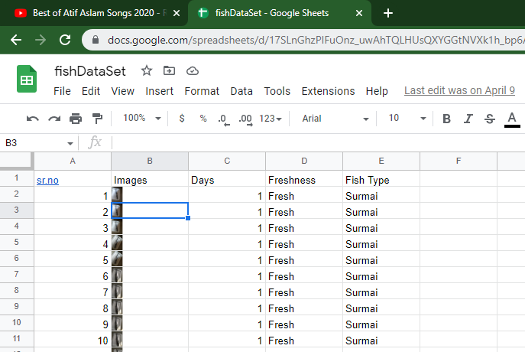
Dataset:

Slide 6
Research Papers:
• Fish Identification and freshness classification through Image Processing using Artificial Neural Network.
• A low-cost imaging framework for freshness evaluation from multifocal fish tissues.
• Design and implementation of fish freshness detection algorithm using deep learning

Slide 7
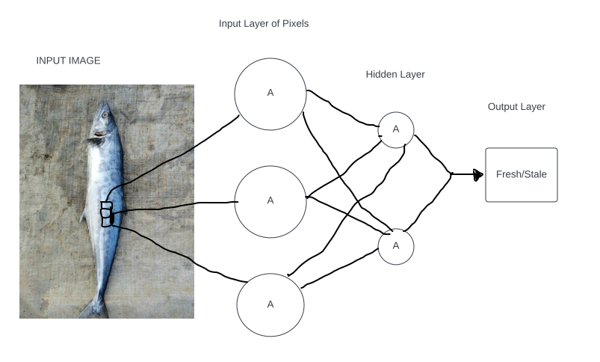
Machine Learning Model:

Slide 8
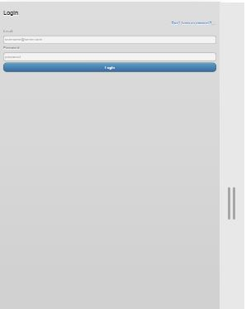
Mobile App:

Slide 9
Skills acquired and the experiences:
Python.
Research Paper Selection.
Dataset Creation.
Machine Learning.
Android.

Slide 10
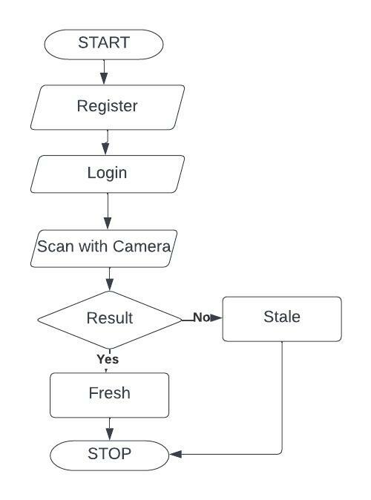
Outcomes:

Slide 11
Future Scope:
Currently, Result is in form of Fresh Or Stale. But in future we will try to show as fish is fresh with 1day,
2day stale like.
Currently, We are processing Dataset of only one Fish Species (Surmai) in future we will add other Species.
Predicting remaining shelf life of Fish.

Slide 12
Conclusion:
Fish is consumed as a source of food in many regions of the world. It is rich in nutrients, vitamins, minerals, and proteins. Multiple tissues of fish such as gill, eye and skin decompose with time, which causes a drop in its freshness quality. Image processing of the application used for identify fish is fresh or stale .

Slide 13
Thank You!!!...

Slide 14
Open for Questions ?

