Slide 1
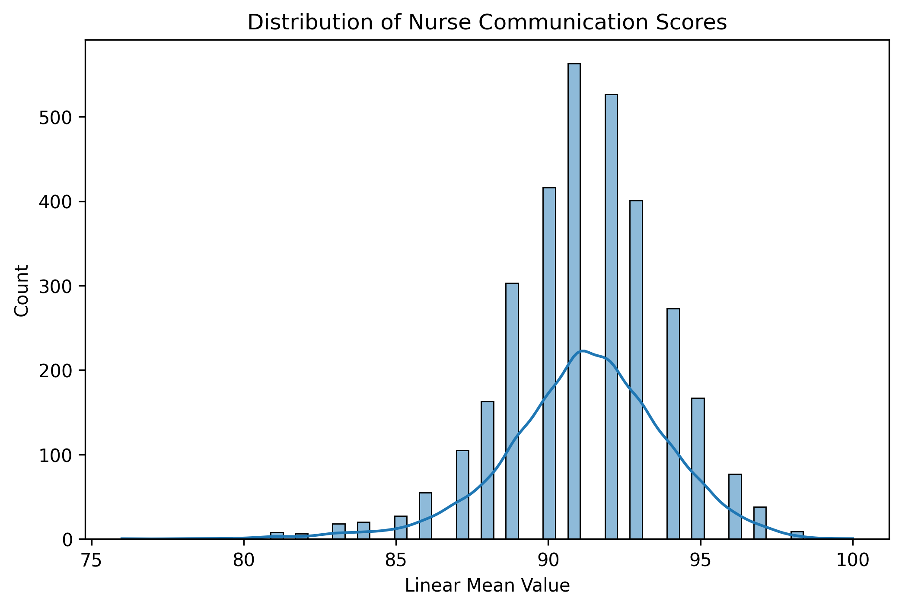
Distribution of Nurse Communication Scores

Slide 2
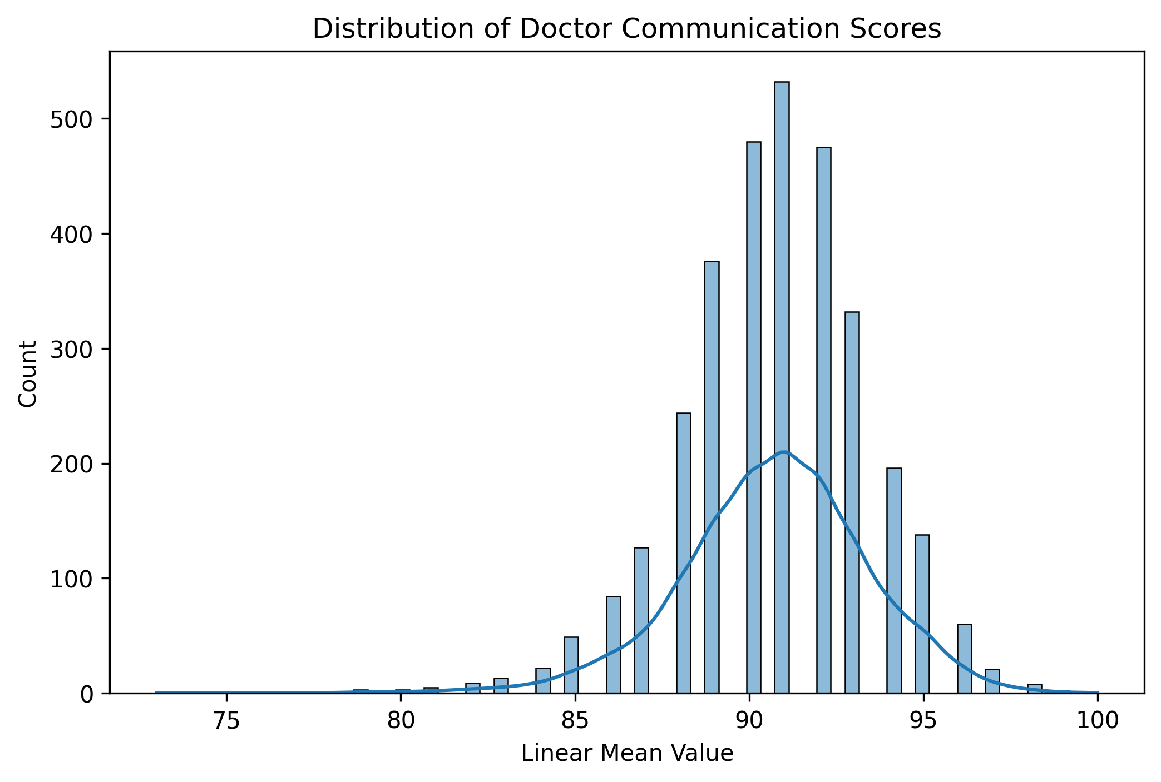
Distribution of Doctor Communication Scores

Slide 3
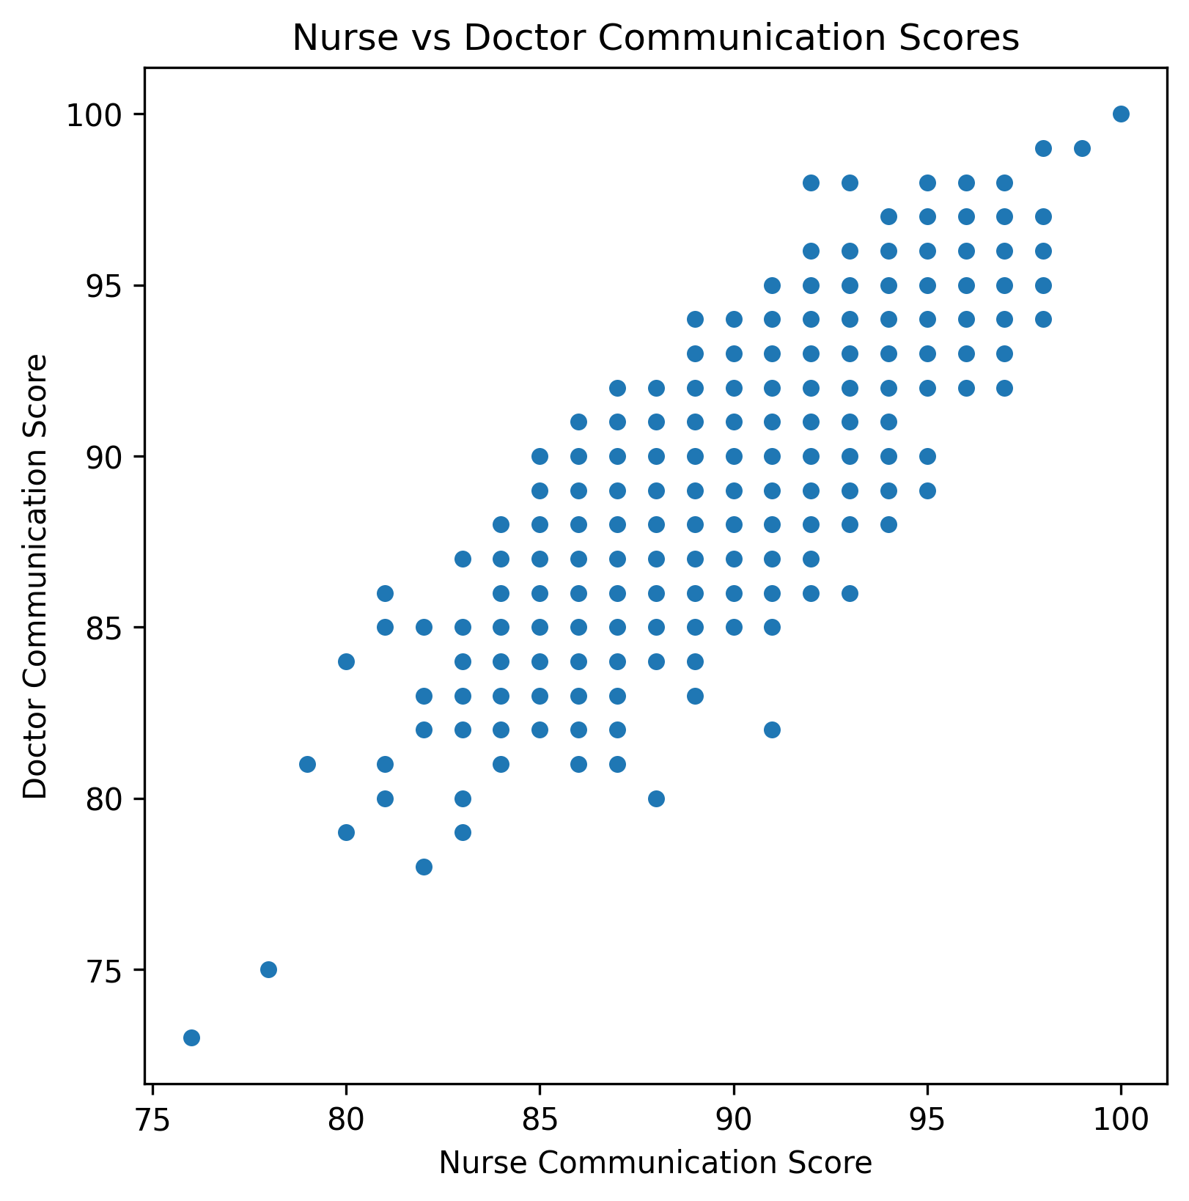
Nurse vs Doctor Communication Comparison

