Slide 1

NATIONAL INSTITUTE OF TECHNOLOGY HAMIRPUR (H.P.)
Structural Protein Sequences
Submitted To: Dr. Robin Singh Badhoria
Submitted By: Ritu Mehta

Slide 2
CONTENTS:
Introduction
Tools And Technologies
Data Description
Evaluation Metrics
Models
Conclusions and References

Slide 3
INTRODUCTION:
The Protein Data Bank (PDB) is a repository for atomic coordinates and other information about proteins and biological macromolecules.
Dataset year=2018.
Structural biologists use techniques like X-ray crystallography, NMR spectroscopy, and cryo-electron microscopy to determine atomic locations in molecules.
The archive includes diverse structures such as ribosomes, oncogenes, drug targets, and viruses.

Slide 4
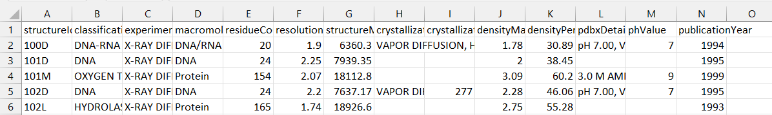
DATA DESCRIPTION:
Data size:
27.29MB data
Structure:
140911 rows
14 columns

Slide 5
TOOLS AND TECHNOLOGIES:
Python: Primary programming language for data analysis, model development, and processing.
Pandas and NumPy: Libraries for data manipulation, preprocessing, and handling large datasets efficiently.
Sci-kit Learn: Used for implementing classical machine learning models like Logistic Regression and SVM.
TensorFlow and Keras: Frameworks for building, training, and evaluating deep learning models, Used for developing the sequential neural network model with layers optimized for high-dimensional genetic data.

Slide 6
Matplotlib and Seaborn: Visualization libraries used to graphically represent model accuracy, loss, and performance comparisons across different diseases.
StandardScaler (from Sci-kit Learn): Standardizes features by removing the mean and scaling to unit variance, which improves model convergence.
CSV File Handling: Exported processed and transformed datasets to CSV format for ease of re-use in model training and testing.

Slide 7
EVALUATION METRICS:
1. Accuracy: The percentage of correctly predicted instances (both true positives and true negatives) out of all instances.
2. Precision: The ratio of true positives to the sum of true positives and false positives. Measures the model's ability to correctly identify positive instances. It's important when false positives have significant consequences.
3. Recall (Sensitivity): The ratio of true positives to the sum of true positives and false negatives. Measures the model’s ability to correctly identify all positive instances. It is crucial when false negatives are costly.
4. F1-Score: The harmonic mean of precision and recall, calculated as 2 * (Precision * Recall) / (Precision + Recall). A balanced metric that is particularly useful when the class distribution is imbalanced. It provides a single value that captures both precision and recall.

Slide 8
MODELS:
KNN Algorithm
Decision Trees
Random Forests Algorithm
Naive Bayes
Logistic Regression
SVM

Slide 9
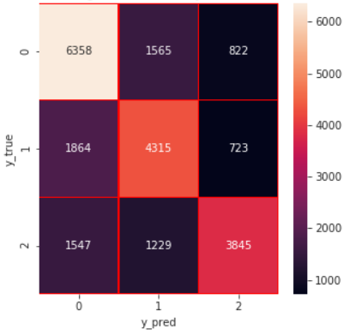
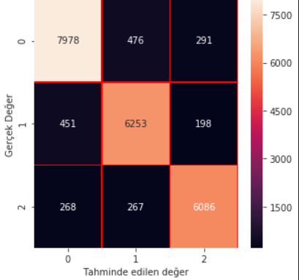
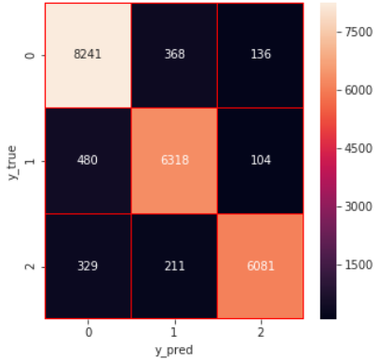
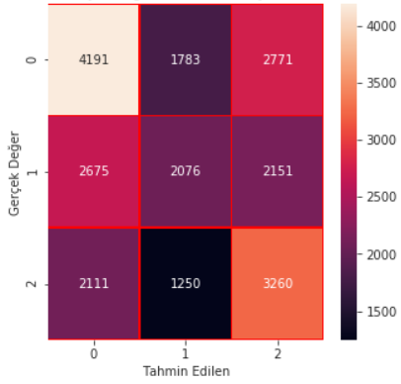
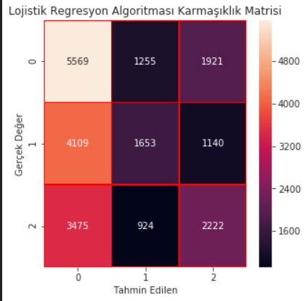
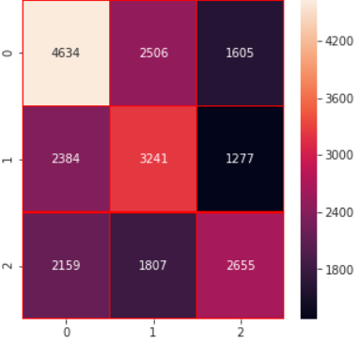
KNN
Decision Tree
Random Forests
Naive Bayes
Logistic Regression
SVM

Slide 10
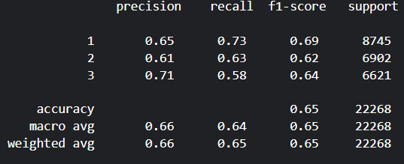
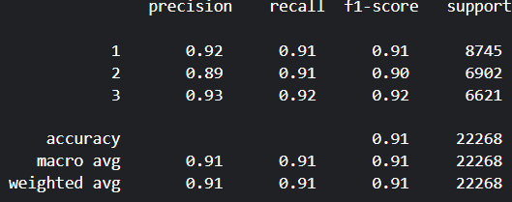
RESULTS:
KNN
Decision Tree

Slide 11
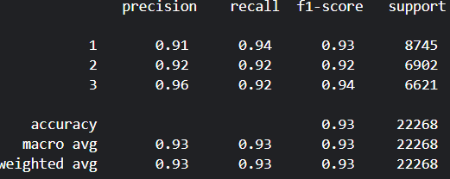
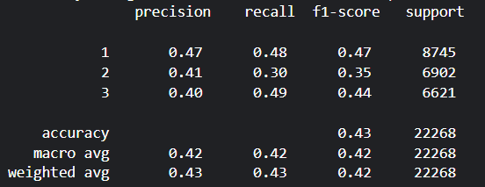
3) Random Forests
4) Naive Bayes

Slide 12
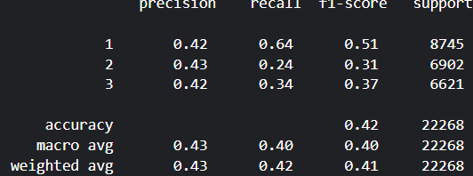
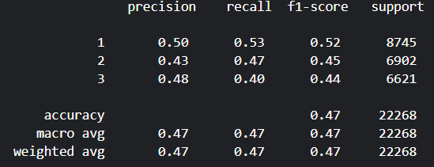
5) Logistic Regression
6) SVM

Slide 13
CONCLUSIONS:
Random Forest: Accuracy of 93%, with high precision, recall, and f1-scores across all classes, particularly excelling in class 3. This model consistently shows strong performance with balanced results across the metrics.
Decision Trees: Accuracy of 91%, also performing very well with high precision and recall for all classes, though slightly lower than Random Forest.
KNN: Accuracy of 65%, with balanced precision and recall, but the performance is lower compared to both Decision Trees and Random Forest.

Slide 14
Naive Bayes: Accuracy of 43%, with poor performance overall, especially for class 2, indicating that it is not well-suited for this particular dataset.
Logistic Regression: Accuracy of 42%, with low f1-scores and recall, indicating that this model is also not effective.
SVM: Accuracy of 47%, with average performance and poor recall for class 3, making it less competitive compared to the other models.

Slide 15
REFERENCES:
A novel protein structural classes prediction method based on predicted secondary structure
Prediction of structural classes for protein sequences and domains—Impact of prediction algorithms, sequence representation and homology, and test procedures on accuracy
Classifier ensembles for protein structural class prediction with varying homology
Support Vector Machines for Prediction of Protein Domain Structural Class

Slide 16
THANK YOU!

