Slide 1
Ethereum
Prepared By:
Dr. Tejas M. Modi
Department of CSE
IIIT Surat

Slide 2
Advantages of Ethereum
Ethereum has been on the market since July 2015; it’s the oldest player here.
You can find a huge development network with Ethereum.
There are plenty of tools and frameworks built on top of Ethereum such as Quorum, Truffle, MetaMask, and Embark.
There are enough developers available with Ethereum skill sets.
Most major cloud enablers as Amazon Web Service, Azure, Google Cloud, and so on, either have started providing Ethereum templates as part of the service or are planning to do so.
Ethereum is open source.

Slide 3
Limitations of Ethereum
Public blockchains are not suitable for all.
At the time of writing, Ethereum is slow. It takes 12 seconds for miners to validate and add a block to an Ethereum blockchain network.

Slide 4
Ethereum Projects
uPort: This is a digital identity platform recently launched in Zug, a city in Switzerland where the city government can issue a Zug ID to its citizens, which is a digital verification of their citizenship.
Rentberry: Rentberry is the first rental platform that aims to solve all the major issues found in renting property today. Powered by a blockchain, Rentberry certainly is a fascinating concept on offer that has prompted even Forbes to pick Rentberry as one of its top ten real estate startups for 2018.
Coinlancer: Coinlancer is a decentralized job market built on the Ethereum platform that empowers burgeoning freelancers and clients from across the globe.
Status: Status is an Ethereum light client targeting Android and iOS that gives users options to browse, chat, and make payments securely on the decentralized Web.

Slide 5
Ethereum Introduction
By contrast, Ethereum was developed as a platform that facilitates peer-to-peer contracts and applications via its own native currency called ether.
The primary purpose of ether is to facilitate and monetize the working of Ethereum to enable developers to build and run distributed applications.
Ethereum also introduced a revolutionary new concept called a smart contract, which is a “Turing complete” language.

Slide 6
Ethereum Virtual Machine
Ethereum is a Turing complete blockchain framework, as it gives a foundation to programming languages using which you can write contracts that can solve any reasonable computational problem.
Ethereum is controlled by the Ethereum Virtual Machine (EVM), a consensus-based virtual machine that decodes the compiled contracts in bytecodes and executes them on the Ethereum network nodes.
It also uses algorithms to prevent denial-of-service attacks that are widely observed in cryptocurrency markets.
Ethereum blockchain network is a group of EVMs, or nodes, connected to every other node in a peer-to-peer mechanism.
Each node consists of a copy of the entire blockchain data store and competes with other nodes to mine the next block by validating transactions.
If a new block is added, the blockchain gets updated and is propagated to the entire network so that every node is in sync.

Slide 7
Data Storage in Ethereum
Ethereum is used to build decentralized applications using smart contracts.
A contract is a combination of data (such as state variables) and functions to store that data to a specific address on the Ethereum blockchain.
At a later point of time and as needed, data can be retrieved and used further.

Slide 8
Ethereum Accounts
Every account has an owner and a balance. But some of these accounts are special; they own themselves.
At creation time, we give them a piece of code and memory. That’s a smart contract.
A smart contract is like a smart bank account that executes some code when it receives transactions. This transaction happens within the blockchain, which is public, replicated, and validated by the network.
A smart contract has a balance, some code, and some storage that is persistent.
Also, a smart contract won’t fail because of a power outage in a data center.

Slide 9
Storage Cost
Note that the more data or larger the amount of storage, the higher the transaction cost in terms of fuel.
However, storage in an Ethereum network is not time bound; it’s a one-time payment, and data could be there forever.
Also, reading data from the network is free. In later chapters, you will learn how reading and writing to the network work.
The cost of each instruction in a smart contract will limit the amount of storage it uses.
Ethereum allows for a theoretically infinite storage space, yet you have to provide gas for every read/write operation carefully.
Learning how to build a smart contract in Solidity is easy, but knowing which architecture to adopt and programming using best practices will really help you to create contracts in the most efficient way so you can make the entire ecosystem profitable.

Slide 10
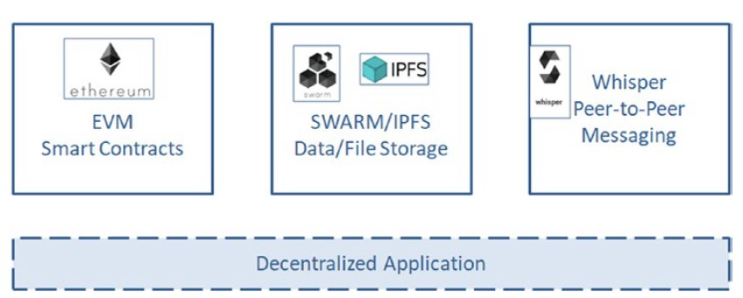
Ethereum Ecosystem
The data stored in smart contracts is safe and easy to access, yet the cost and the structure of the store make it relevant mostly for metadata-related uses because saving real data would be too expensive.
Ethereum has its own messaging protocol called Whisper.
The EVM is mostly for running the smart contracts and also for getting a consensus between all participants.

Slide 11
Interplanetary File System
Ethereum is too heavy as well as expensive to store large blobs like images, video, and so on.
Hence, some external storage is necessary to store bigger objects. This is where the Interplanetary File System (IPFS) comes into the picture.
The Ethereum Dapp can hold a small amount of data, whereas for saving anything more or bigger such as images, word, PDF files, and so on, we can rely on IPFS.
IPFS is a protocol and network designed to create a peer-to-peer method of storing and sharing data.
It was initially designed by Juan Benet and is now an open source project developed with help from the community.

Slide 12
If you have heard of the BitTorrent protocol, then IPFS will not be new to you. BitTorrent enables the fast download of large files using minimum Internet bandwidth.
IPFS does not entirely
follow the BitTorrent protocol but rather takes several good ideas from many other protocols such as Git, SFS, Bitcoin, and the Web, and gathers them all into one package.
IPFS connects all computing devices with the same system of files. In some ways, IPFS is similar to the Web.
IPFS is a protocol and network designed to create a peer-to-peer method of storing and sharing data.
It was initially designed by Juan Benet and is now an open source project developed with help from the community.

Slide 13
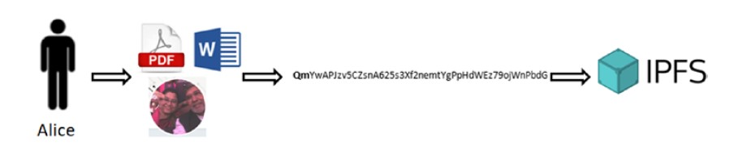
Storing Data on IPFS
Alice wants to upload a PDF, Word, or image file to IPFS.
She puts this PDF, Word, or image file in her working directory.
She informs IPFS to add this file, which generates a hash of the file. Note an IPFS hash always starts with “Qm.…”
Her file is available on the IPFS network.

Slide 14
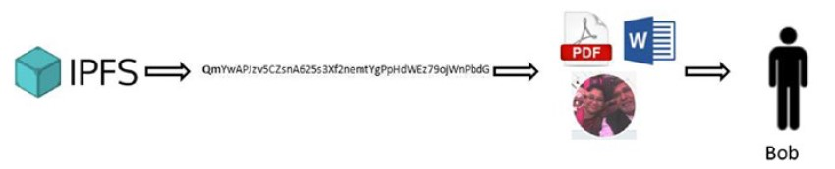
Sharing Data on IPFS
Alice provides the hash of the file to Bob.
Bob uses the hash and calls IPFS for the file.
The file is now downloaded at Bob’s end.

