Slide 1
Blockchain Technology
Prepared by: Dr. Reema patel

Slide 2
Cryptography for Blockchain
Crypto basics that are essential for blockchain technology
Hash functions and their properties
Public key cryptosystems
Digital signature
Hash puzzles
Hash pointers
Merkle data structures

Slide 3
Identifying and Protecting User Accounts
Besides hash functions, the blockchain uses another base technology extensively: asymmetric cryptography.
It is the foundation for identifying users in the blockchain and protecting their property.
Goal:
identify owners and property uniquely and to ensure that only the lawful owner can access his or her property.

Slide 4
Identifying and Protecting User Accounts
Challenge:
The blockchain is a peer-to-peer system that is open to everyone.
Everyone can connect and contribute computational resources or submit new transaction data to the system.
However, it is not desirable for everyone to access the property assigned to the accounts managed by the blockchain.
The right to transfer ownership to another account is restricted to the owner of the account who hands off ownership.
Hence, the challenge of the blockchain is to protect the property assigned to the accounts without restricting the open architecture of the distributed system.

Slide 5
Identifying and Protecting User Accounts
Idea:
treat accounts like mailboxes: everyone can transfer property to it, but only the owner of the account can access the things that are collected inside.
The major characteristic of a mailbox is that its location is known and hence anyone can put something in but only the owner can open it with a key.

Slide 6
Idea of Cryptography
cryptography is to protect data from being accessed by unauthorized people.
It is the digital equivalent to door locks or bank safes, which also protect their content from being accessed by unauthorized people.
Similar to locks and keys in the physical world, cryptography also uses keys to protect data.

Slide 7
Terminology
Encryption: The digital equivalent to closing a lock is encryption,
Encrypted data are called cipher text.
Encryption: Protecting data by turning them into cipher text by utilizing a cryptographic key
Cipher text: looks like a useless pile of letters and figures to everyone who does not know how to decrypt it.
Cipher text is indeed useful but only for those who possess the key necessary to decrypt it.
Decryption: digital equivalent to opening a lock is decryption.
Decryption: Turning cypher text back into useful data by utilizing a matching cryptographic key
Decrypted cipher text : identical to the original data that have been encrypted.

Slide 8
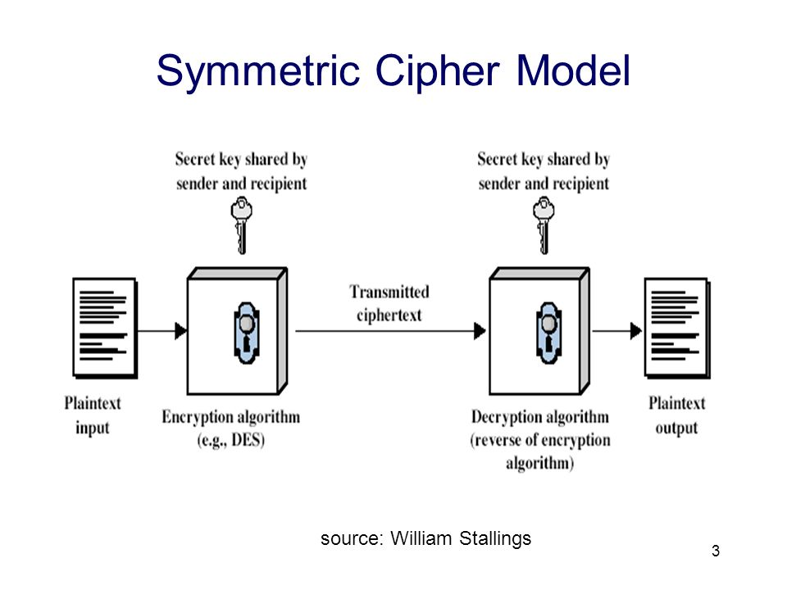
Symmetric Key Cryptography

Slide 9
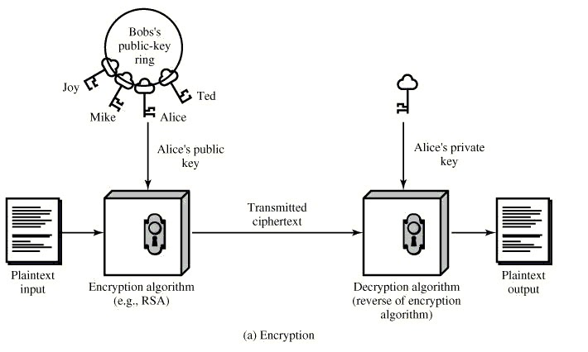
Asymmetric Key Cryptography

Slide 10
Asymmetric Cryptography in the Real World
Creating and distributing the keys:
When using asymmetric cryptography in real life, you would give the two keys specific names in order to highlight each one’s role.
Typically these keys are called the private key and public key.
For that reason, asymmetric cryptography is called public-private-key cryptography
The public key is given to everyone, regardless of their trustworthiness
private key is kept safe and private.

Slide 11
Asymmetric Cryptography in the Real World
first steps to be performed in any application of asymmetric cryptography are:
Create a pair of complementary keys by using cryptographic software
Give one key the name public key
Give the other key the name private key
Keep the private key for yourself
Give your public key to everyone else

Slide 12
Asymmetric Cryptography in the Real World
Using the keys:
Public to private
this way of using asymmetric cryptography is all about sending information in a secured fashion to the owner of the private key.
It works because everyone can create cipher text with the public key,
but only the owner of the private key can decrypt the cipher text and read the message

Slide 13
Asymmetric Cryptography in the Real World
Using the keys:
Private to public
this way of using asymmetric cryptography is all about proving authorship.
It works because everyone can use the public key to decrypt cypher text that was created with the corresponding private key.
The fact that cipher text created with the private key can only be decrypted with the corresponding public key serves as proof that the owner of the corresponding private key has encrypted the message.

Slide 14
Asymmetric Cryptography in the Blockchain
Identifying accounts
Authorizing transactions

Slide 15
Asymmetric Cryptography in the Blockchain
Identifying Accounts
The blockchain needs to identify users or user accounts, respectively, in order to maintain the mapping between owner and property.
The blockchain uses the public-to-private approach of asymmetric cryptography for identifying user accounts and transferring ownership between them.
Account numbers in the blockchain are actually public cryptographic keys.
Hence, transaction data use the public cryptographic keys for identifying the accounts involved in the transfer of ownership.
In this regard, the blockchain treats user accounts similar to mailboxes: They have a publicly known address and everyone is able to send messages to them.

Slide 16
Asymmetric Cryptography in the Blockchain
Authorizing Transactions
Transaction data always have to include a piece of data that serves as proof that the owner of the account who hands off ownership indeed agrees with the described transfer of ownership.
This kind of information flow is similar to that implied by the private-to-public use case of asymmetric cryptography.
The owner of the account who hands off ownership creates some cipher text with his or her private key.
All others can verify this proof of agreement by using the public cryptographic key, which happens to be the number of the account that hands off ownership.
The details of this procedure, which is called digital signature

Slide 17
Authorizing Transactions
Signature:
Handwritten signatures serve an important purpose: they state agreement with the content of a document and agree with its execution.
The reason why we accept handwritten signatures as evidence for agreement is the uniqueness of each person’s handwriting.
Every human being has his or her own characteristic way of writing his or her name

Slide 18
Authorizing Transactions
Goal:
It is important to ensure that only the owner of an account can transfer the property associated with it to other accounts.
Every attempt to access an account and its associated property by any person other than the lawful owner should be identified as unauthorized and should be rejected.

Slide 19
Digital Signature
Digital signatures are the equivalent of handwritten signatures.
They utilize cryptographic hashing and the private-to-public information flow of asymmetric cryptography.
Three major elements of digital signatures:
Creating a signature
Verifying data by using the signature
Identifying fraud by using the signature

Slide 20
Digital Signature

Slide 21
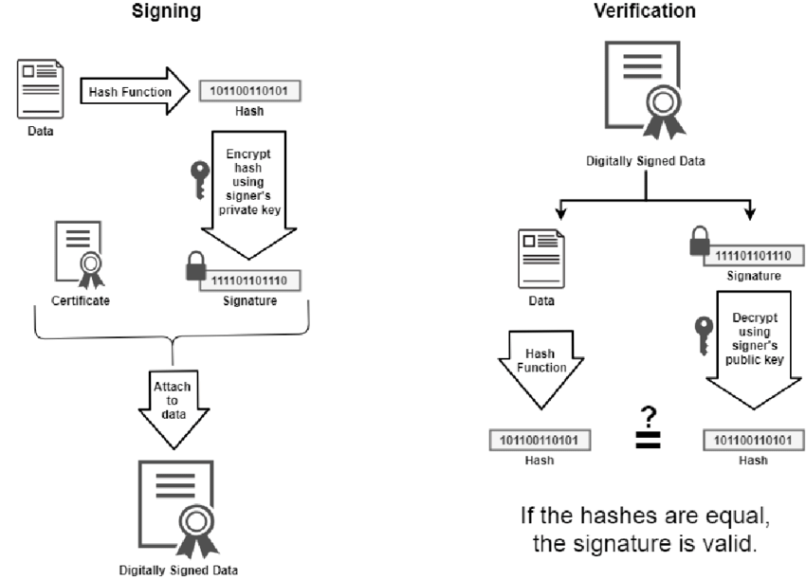

Slide 22

Digital Signature

Slide 23
Digital Signature
Verifying Data by Using the Signature

Slide 24
Identifying Fraud by Using the Digital Signature

Slide 25
Digital Signature in Blockchain
Digital signatures in the blockchain fulfill the following requirements:
They state agreement of the owner of the account who hands off ownership with specific transaction data.
They are unique for the whole content of transaction data in order to prevent it from being used to authorize other transactions without the agreement of its author.
Only the owner of the account who hands off ownership can create such a signature.
They are easy to verify by everyone.
There are two use cases of digital signatures in the blockchain:
Signing a transaction
Verifying a transaction

Slide 26
Signing a Transaction
Create a digital signature for a transaction, the owner of the account who hands off ownership performs the following steps:
Describes the transaction with all necessary information such as the involved account numbers, amount being transferred, and so on except the signature itself as it is not yet available.
Create the cryptographic hash value of the transaction data.
Encrypt the hash value of the transaction with the private key of the account that hands off ownership.
Add the cipher text created in point 3 to the transaction as its digital signature.

Slide 27
Verifying a Transaction
Create the hash value of the transaction data to be verified except the signature itself.
Decrypt the digital signature of the transaction under consideration with the account number that hands off ownership.
Compare the hash value of step 1 with the value gained in step 2.
If both are identical, the transaction is authorized by the owner of the private key that corresponds to the account that hands off ownership, otherwise it is not.

