Slide 1
Blockchain Technology
Prepared by: Dr. Reema patel

Slide 2
Cryptography for Blockchain
Crypto basics that are essential for blockchain technology
Hash functions and their properties
Public key cryptosystems
Digital signature
Hash puzzles
Hash pointers
Merkle data structures

Slide 3
Hashing Data - Identifying data from their digital fingerprint
Fingerprints are impressions of the friction ridges of all or any part of the fingers of the human hand.
They are considered to be able to identify humans uniquely.
They have been used to investigate crimes, identify offenders, and to exonerate the innocent.
Concept for identifying data - digital equivalent to fingerprints.
The concept is called cryptographic hash value
the blockchain makes extensive use of it

Slide 4
Hashing Data
In the distributed peer-to-peer system,
deal with a huge number of transaction data.
need to identify data uniquely and compare them as quickly and as easily as possible
Goal: identify transaction data and possibly any kind of data uniquely by their digital fingerprints

Slide 5
Hashing Data
Hash Function: Takes Message as input and produces a fixed length output.
Hash functions are functions that compress an input of arbitrary length to a result with a fixed length.
h = H(M) :- M - Arbitrary length message, h- Fixed length hash code
An n–bit hash is a map from arbitrary length message to n-bit hash value.
n-bit hash value referred as a hash-value, hash-code, hash-result, message digest, digital fingerprint or simply hash.
Hash Functions are used for data integrity and authentication.
Hash Function
Fixed Length
Hash Code h
Message M

Slide 6
Hash Function
Easy to compute
Almost impossible to reverse
Security properties:
Collision-resistant
Hides the original string
Almost impossible to get the original string from the output
Puzzle friendly

Slide 7
Requirements of Cryptographic Hash Function
Cryptographic hash functions have the following properties:
Providing hash values for any kind of data quickly
Being deterministic
Being pseudorandom
Being one-way functions (preimage resistant)
Being collision resistant

Slide 8
Requirements of Cryptographic Hash Function
Deterministic
hash function yields identical hash values for identical input data.
Pseudorandom
Being pseudorandom means that the hash value returned by a hash function changes unpredictably when the input data are changed.
Even if the input data were changed only a little bit, the resulting hash value will differ unpredictably.
It should not be possible to predict the hash value based on the input data

Slide 9
Requirements of Cryptographic Hash Function
One-Way Function
it is impossible to recover the original input data based on the hash value.
Collision Resistant
A hash function is called collision resistant if it is very hard to find two or more distinct pieces of input data for which it yields the identical hash value.
Hash Value Output : Hexadecimal Number
Trying It Out Hash Value:
http://www.blockchain-basics.com/HashFunctions.html

Slide 10
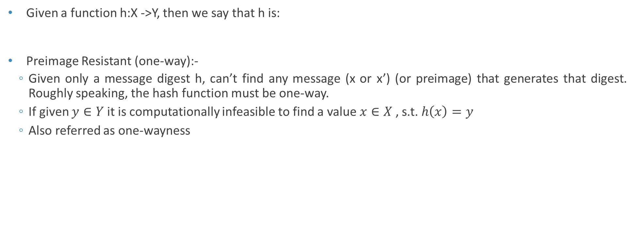
Requirements of Cryptographic Hash Function
Given a function h:X ->Y, then we say that h is:
Preimage Resistant (one-way):-
Given only a message digest h, can’t find any message (x or x’) (or preimage) that generates that digest. Roughly speaking, the hash function must be one-way.
If given $y∈Y$ it is computationally infeasible to find a value $x∈X$ , s.t. $h\left(x\right)=y$
Also referred as one-wayness

Slide 11

Requirements of Cryptographic Hash Function
Second preimage resistant
Given one message, can’t find another message that has the same message digest.
It is computationally infeasible to find any second input which has the same output as any specified input.
An attack that finds a second message with the same message digest is a second pre-image attack.
If given x$∈X$ it is computationally infeasible to find a value $x′∈X$ , $x^{′}≠x$ and h$\left(x^{′}\right)=h(x)$
Also referred as weak-collision resistance

Slide 12
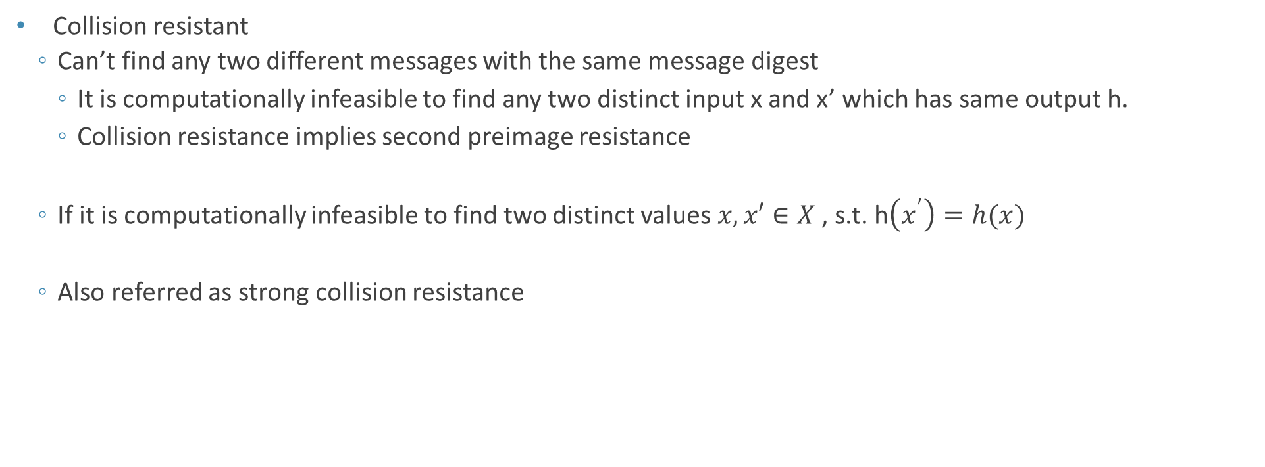
Requirements of Cryptographic Hash Function
Collision resistant
Can’t find any two different messages with the same message digest
It is computationally infeasible to find any two distinct input x and x’ which has same output h.
Collision resistance implies second preimage resistance
If it is computationally infeasible to find two distinct values $x,x′∈X$ , s.t. h$\left(x^{′}\right)=h(x)$
Also referred as strong collision resistance

Slide 13
How It Works

Slide 14
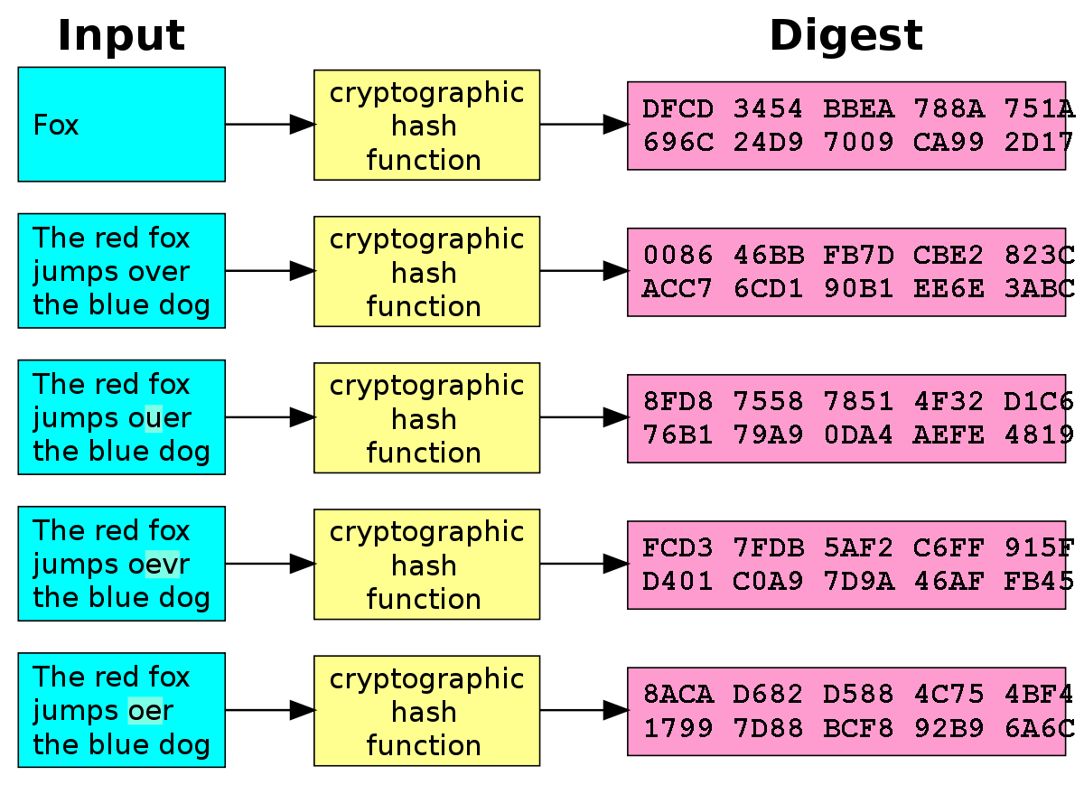
A small change in the data results in a significant change in the output – called avalanche effect

Slide 15
Patterns of Hashing Data
Independent Hashing:

Slide 16
Patterns of Hashing Data
Repeated Hashing Combined Hashing

Slide 17
Patterns of Hashing Data
Sequential Hashing Hierarchical Hashing

Slide 18
Uses of hash functions
Timestamping
Message authentication
Software integrity
One-time Passwords
Digital signature
Certificate revocation management

Slide 19
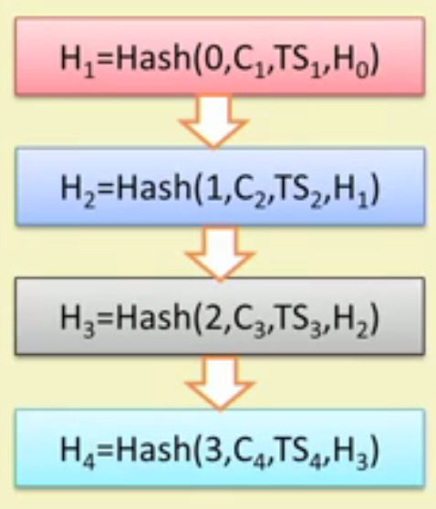
Uses of hash functions
The first use – time stamp a digital document

Slide 20
Hashing in the Real World - Comparing Data
Comparing Data:
Compare data (e.g., files or transaction data) without comparing their content piece by piece and to make comparing any kind of data, regardless of their size and content,
as easy as comparing two numbers
calculate and compare the cryptographic hash value of all data under consideration.
If all of the cryptographic hash values differ, all the data under consideration differ as well.
If two or more of the cryptographic hash values are identical, their corresponding input data are also identical.

Slide 21
Hashing in the Real World - Referring to Data in a Change-Sensitive Manner
Referring to Data in a Change-Sensitive Manner:
Comparing data and detecting changes based on their hash values can be considered basic use cases of hash values.
A slightly more advanced application case of hash values is hash references
The goal is to store a large amount of data e.g., transaction data that are supposed to stay unchanged.
Any changes to these data are to be detected quickly and easily.

Slide 22
Hashing in the Real World - Referring to Data in a Change-Sensitive Manner
There are two classical patterns of using hash references in order to store data in a change-sensitive manner:
The Chain
The Tree

Slide 23
Hashing in the Real World - Referring to Data in a Change-Sensitive Manner
The Chain:
A chain of linked data, also called a linked list
is formed when each piece of data also contains a hash reference to another piece of data
Such a structure is useful for storing and linking data together that are not fully available at one given point in time but instead arrive step by step in an ongoing fashion
Figure: Data linked together in a chain-like fashion

Slide 24
Hashing in the Real World - Referring to Data in a Change-Sensitive Manner
The Tree:
Data linked together in a tree-like fashion

Slide 25
Hashing in the Real World - Causing Time-Consuming Computations
Hash values are not only useful for making basic file operations such as comparing, referring and storing data secure and efficient.
Hash values can also be used to allow computers to challenge other computers with elaborate puzzles.
This usage of hash values is one of the most important concept of the blockchain.

Slide 26
Hashing in the Real World - Causing Time-Consuming Computations
You may need to create puzzles that require computational resources in order to be solved.
It should not be possible to solve these puzzles based on knowledge or data stored somewhere or by means of thinking, like an IQ test or a knowledge test.
The only way to solve these puzzle is by sheer computational power and hard computational work.

Slide 27
Hashing in the Real World - Causing Time-Consuming Computations
Elements of a hash puzzle are:
Given data that have to be kept unchanged
Data that can be freely changed, the so-called nonce
The hash function to be applied
Restrictions on the hash value of the combined hashing, also called the difficulty level

Slide 28
Hashing in the Real World - Causing Time-Consuming Computations
Combined hashing is applied to the data and the nonce.
The resulting hash value has to fulfill the given restrictions.

Slide 29
Hashing in the Real World - Causing Time-Consuming Computations
Hash puzzles can only be solved by trial and error.
This requires guessing a nonce, calculating the hash value of the combined data with the required hash function, and evaluating the resulting hash value based on the restrictions.
If the hash value satisfies the restrictions, you will have solved the hash puzzle;
otherwise, you would continue with another nonce until you eventually solve the puzzle.
The nonce that, when combined with the given data, yields a hash value that satisfies the restrictions is called the solution.

Slide 30
Hashing in the Real World - Causing Time-Consuming Computations
Example

Slide 31
Hashing in the Real World - Causing Time-Consuming Computations
Difficulty Level:
Requiring the hash value to fulfill a certain restriction is the core of the hash puzzle.
In the context of hash puzzles, the restrictions are often called difficulty or difficulty level,
The difficulty is expressed as a natural number and refers to the number of leading zeros the hash value has to have.
a difficulty of 1 means that the hash value has to have (at least) one leading zero,
while a difficulty of 10 means that the hash value has to have at least 10 leading zeros.
The higher the difficulty level, the more leading zeros are required and the more complicated the hash puzzle is.
The more complicated the hash puzzle is, the more computational power or time are needed to solve it.

Slide 32
Hashing in the Real World - Causing Time-Consuming Computations
The functioning of hash puzzles critically depends on the fact that hash functions are one-way functions.
Hash puzzles can only be solved by trial and error, which consumes a lot of computing power and hence a lot of time and energy.
The level of difficulty directly influences the number of trials needed on average for finding the solution, which in turn influences the computational resources or the time needed to find the solution.

Slide 33
Hashing in Blockchain
In the context of the blockchain, hash puzzles are often called proof of work, as their solution proves that someone has done the work necessary to solve it.
Usage of Hashing in the Blockchain:
Storing transaction data in a change-sensitive manner
As a digital fingerprint of transaction data
As a way to incur computational costs for changing the blockchain-data-structure

Slide 34
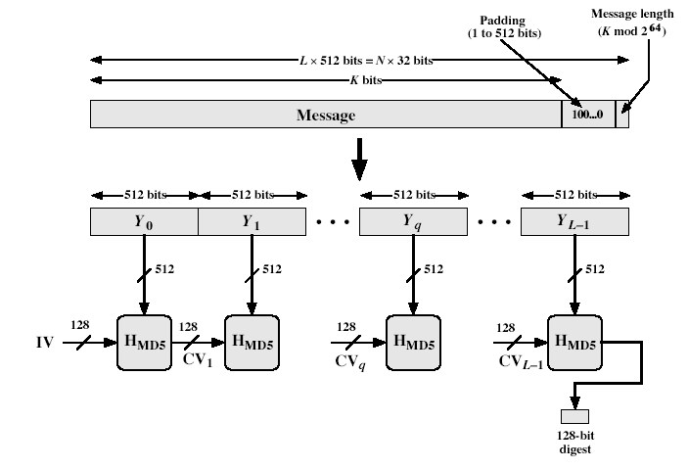
MD5 Hash Algorithm

Slide 35
MD5
Preparing the input
The MD5 algorithm first divides the input in blocks of 512 bits each.
64 Bits are appended at the end of the last block. These 64 bits represent the length of the original input.
If the last block is less than 512 bits, the message is padded (1 followed by 0s) such that its length ≡ 448 mod 512
Next, each block is divided into 16 words of 32 bits each. These are denoted as M₀ ... M₁₅.

Slide 36
MD5
MD5 helper functions
MD5 uses a buffer that is made up of four words that are each 32 bits long. These words are called A, B, C and D. They are initialized as
A = 01 23 45 67
B = 89 AB CD EF
C = FE DC BA 98
D = 76 54 32 10
These words are called chaining variables
Ki = Constant Value derived from sin function
abs(sin(i)) * 2³²

Slide 37
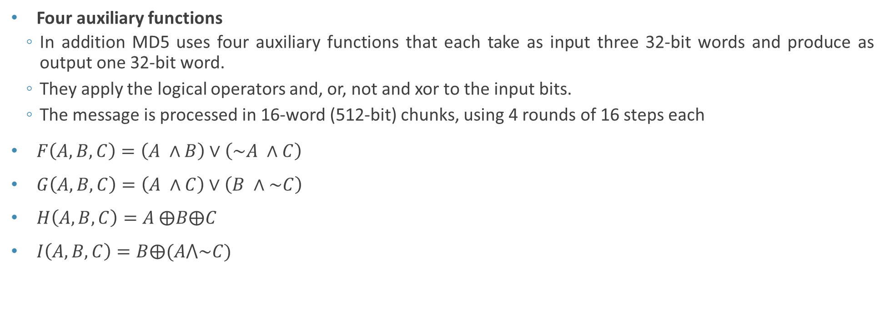
MD5
Four auxiliary functions
In addition MD5 uses four auxiliary functions that each take as input three 32-bit words and produce as output one 32-bit word.
They apply the logical operators and, or, not and xor to the input bits.
The message is processed in 16-word (512-bit) chunks, using 4 rounds of 16 steps each
$F\left(A,B,C\right)=\left(A ∧B\right)∨\left(\sim A ∧C\right)$
$G\left(A, B, C\right)=\left(A ∧C\right)∨\left(B ∧\sim C\right)$
$H\left(A,B,C\right)=A ⨁B⨁C$
$I\left(A,B,C\right)=B⨁(A⋀\sim C)$

Slide 38
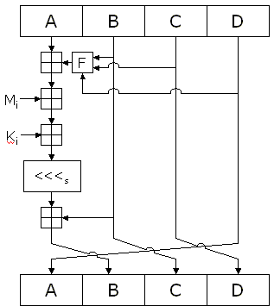
MD5

Slide 39
MD5
Round 1
FF(a,b,c,d,M_{j},s,t_{i}) denotes a = b + ((a + F(b,c,d ) + M_{j} + t_{i}) <<< s)
16steps:
FF (a, b, c, d, M₀, 7, 0xd76aa478)
FF (d, a, b, c, M₁, 12, 0xe8c7b756)
....
FF (b, c, d, a, M₁₅, 22, 0x49b40821)
Round2
GG(a,b,c,d,M_{j},s,t_{i}) denotes a = b + ((a + G(b,c,d ) + M_{j} + t_{i}) <<< s)
GG (a, b, c, d, M₁, 5, 0xf61e2562) ..... Upto 16steps
Round3
HH(a,b,c,d,M_{j},s,t_{i}) denotes a = b + ((a + H(b,c,d) + M_{j} + t_{i}) <<< s)
HH (a, b, c, d, M₅, 4, 0xfffa3942) ….16steps
Round4
II(a,b,c,d,M_{j},s,t_{i}) denotes a = b + ((a + I(b,c,d ) + M_{j} + t_{i}) <<< s)
II (a, b, c, d, M₀, 6, 0xf4292244) .....16 steps

Slide 40
MD5
After all of this, a, b, c, and d are added to A, B, C, D, respectively, and the algorithm continues with the next block of data.
The final output is the concatenation of A, B, C, and D.

Slide 41
MD5
Berson (1992): for a single-round MD5, he used differential cryptanalysis to find two messages producing the same hash. Attack does not work for 4-round MD5.
Boer & Bosselaers(1993): found a pseudo collision (same message, two different IV’s)
Dobbertin (1996) created collisions on MD5 compression function with a chosen IV
Wang, Feng, Lai, Yu found collisions of MD5
works on any IV
easy to find multiple collisions
Collisions for the compression function of MD5 have been demonstrated

Slide 42
Secure Hash Algorithm (SHA)
SHA originally designed by NIST (National Institute of standards and technology) and published as a Federal Information Processing Standard (FIPS 180) in 1993.
Was revised in 1995 as FIPS 180-1 and referred to as SHA-1, also Internet RFC3174
The algorithm is SHA, the standard is SHS
Three generations of Secure Hash Algorithm

Slide 43
Revised Secure Hash Standard
SHA-Generation | SHA-1 | SHA-2 |  |  | SHA-3
 | SHA-1 | SHA-256 | SHA-384 | SHA-512 | future hash function standard still in development
Message digest size | 160 | 256 | 384 | 512
Message size | < 2⁶⁴ | < 2⁶⁴ | < 2¹²⁸ | < 2¹²⁸
Block size | 512 | 512 | 1024 | 1024
Word Size | 32 | 32 | 64 | 64
Number of Steps | 80 | 64 | 80 | 80

Slide 44
SHA-1
SHA-1 produces a 160-bit digest from a message with a maximum length of (2⁶⁴ − 1) bits.
SHA-1 is based on principles similar to those used by Ronald L. Rivest of MIT in the design of the MD4 and MD5 message digest algorithms.
Preprocessing : exactly same as MD5

Slide 45
Description of SHA-1

Slide 46
SHA-1
Five chaining variables
A = 67452301
B = efcdab89
C = 98badcfe
D = 10325476
E = c3d2e1f0
Main loop : Four rounds of 20 operations each
ft(X,Y,Z) = (X Λ Y) ν ((¬ X) Λ Z), for t=0 to 19
ft(X,Y,Z) = X + Y + Z, for t = 20 to 39
ft(X,Y,Z) = (X Λ Y) ν (X Λ Z) ν (Y Λ Z), for t=40 to 59
ft(X,Y,Z) = X + Y+ Z, for t = 60 to 79
+ = XOR

Slide 47
SHA-1
Four constants are used :
K_{t} = 0x5a827999, for t = 0 to 19
K_{t} = 0x6ed9eba1, for t = 20 to 39
K_{t} = 0x8f1bbcdc, for t = 40 to 59
K_{t} = 0xca62c1d6, for t = 60 to 79
Message block is transferred from 16 blocks to 80 blocks:
W_{t} = M_{t}, for t=0 to 15
W_{t} = (W_{t-3} + W_{t-8} + W_{t-14} + W_{t-16})<<<1, for t=16 to 79

Slide 48
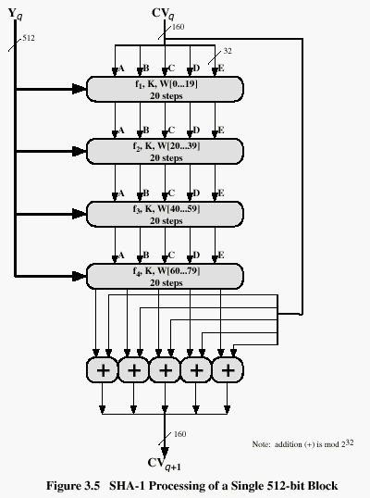
SHA-1
Current buffer (five 32-bit registers A,B,C,D,E)
Current message block
Four rounds, 20 steps in each
Let’s look at each step
in more detail…
Very similar to a block cipher,
with message itself used
as the key for each round
Fifth round adds the original
buffer to the result of 4 rounds
Buffer contains final hash value

Slide 49
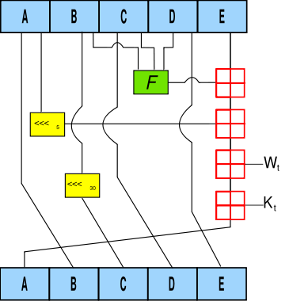
One SHA-1 operation
If t is the operation number (from 0 to 79), W_{t} represents the t th sub-block of the expanded message, and <<< s represents a left circular shift of s bits, then the main loop looks like:
For t=0 to 79
TEMP = (a <<< 5) + f_{t}(b,c,d) + e + W_{t} + K_{t}
e = d
d=c
c=b <<< 30
b = a
a = TEMP

Slide 50
Security of SHA-1
“a fourth round is added “ SHA does this too. However in SHA, the fourth round uses the same f function as the second round.
“Each step now has unique additive constant” True for SHA where it reuses the constants for each group of 20 rounds
“ G is less symmetric”. SHA uses the MD4 version of G
“Faster avalanche effect” True for SHA. Addition of fifth variable to make Boer-Bosselaers attack against MD5 impossible against SHA.

Slide 51
Security of SHA-1
“The order in which message sub-blocks are accessed in rounds 2 and 3 is changed “. SHA is completely different.
“The left circular shift… to yield faster avalanche effect.” SHA uses a constant shift amount in each round. This amount is relatively prime to the word size, as in MD4
SHA is MD4 with the addition of an expand transformation, an extra round, and better avalanche effect; MD5 is MD4 with improved bit hashing, an extra round, and better avalanche effect

