Slide 1
Blockchain Technology
Prepared by: Dr. Reema patel

Slide 2
How the Blockchain Works?
Planning the Blockchain
The basic concepts of managing ownership with the blockchain
The Goal:
Understand the concepts that make up the blockchain.
Present the challenge of designing your own system for managing ownership.
Will face the same challenges that the inventor of the blockchain once faced and successfully solved:
designing a piece of software that manages ownership in a purely distributed peer-to-peer system of ledgers that operates in a completely open and untrustworthy environment.

Slide 3
The Path to Follow
Describing ownership
Protecting ownership
Storing transaction data
Preparing ledgers to be distributed in an untrustworthy environment
Distributing the ledgers
Adding new transaction to the ledgers
Deciding which ledgers represents the truth

Slide 4
The Path to Follow
Describing Ownership
Decide how to describe ownership first. It turns out that transactions are a good way to describe any transfer of ownership, and the complete history of transactions is the key to identifying the current owners.
Protecting Ownership
In real life, you can easily prevent people from using your car or from entering your house by using doors with locks.
It turns out that cryptography provides a way to protect transactions on an individual level
Protecting ownership has three major elements: identifying and authenticating owners as well as restricting access to the property to its owners.

Slide 5
The Path to Follow
Storing Transaction Data
Since the transaction history is the core element in clarifying ownership, it must be stored in a secure way.
It turns out that the blockchain-data-structure is the digital equivalent to a ledger.
Preparing Ledgers to Be Distributed in an Untrustworthy Environment
blockchain-data-structure that is append-only: it is possible to add new transactions, but it is nearly impossible to change data that were added in the past.

Slide 6
Transaction data provide the following information for describing a transfer of ownership:
An identifier of the account who initiates the transaction and is to transfer ownership to another account
An identifier of that account that is to receive ownership
The amount of the goods to be transferred
The time the transaction is to be done
A fee to be paid to the system for executing the transaction
A proof that the owner of the account who hands off ownership agrees with that transfer

Slide 7
Transaction data
In order to maintain integrity, only those transaction data are added to the blockchain-data-structure that fulfill the following three criteria:
Formal correctness
Semantic correctness
Ensuring that an account does not hand off more than it currently owns
Preventing double spending
Limiting the amount of items that can be transferred in a single transaction
Limiting the number of transactions per user
Limiting the total amount of items spent in a given time period
Enforcing that an account keeps an item for a minimum time period before it can be transferred further
Authorization

Slide 8
Storing Transaction Data
Goal: blockchain should maintain the whole history of transaction data in an ordered fashion
Example:
Transforming a Book into a Blockchain-Data-Structure
turn a book into a small library with an ordering catalog, which turns out to be a simplified version of the blockchain-data-structure.

Slide 9
Blockchain Data Structure
The blockchain-data-structure is a specific kind of data structure that is made up of ordered units called blocks.
Each block of the blockchain-data-structure consists of a block header and a Merkle tree that contains transaction data.
The blockchain-data-structure consists of two major data structures: an ordered chain of block headers and Merkle trees.

Slide 10
Blockchain Data Structure
Having each block header referencing its preceding block header preserves the order of the individual block headers and blocks.
Each block header in the blockchain-data-structure is identified by its cryptographic hash value and contains a hash reference to its preceding block header and a hash reference to the application-specific data whose order it maintains.
The hash reference to the application-specific data is typically the root of a Merkle tree that maintains hash references to the application-specific data.

Slide 11
Blockchain Data Structure

Slide 12
Blockchain Data Structure
BLOCK 1 is the very first block in this data structure, hence, it does not have a preceding block, and, consequently, Block Header 1 does not contain any reference to a preceding block header.
Since BLOCK 2 has a predecessor, Block Header 2 maintains a hash reference to its preceding block header labeled as B1.
Blockchain-data-structure maintains hash reference to two distinct Merkle trees whose roots are labeled R12 and R34, respectively.
the reference to the most currently added block header is called the head of the blockchain-data-structure because it is the place where the next block will be added. (e.g., B2)

Slide 13
Blockchain Data Structure
If you joined a distributed peer-to-peer system that maintained a blockchain data structure,
you would receive all transaction data, all hash reference values, and all block headers.
Based on these data, your local computer would create the blockchain-data-structure including the hash references that point to data stored on your local computer.

Slide 14
Adding New Transactions
Initial situation: Two new transactions (Transaction 3 and Transaction 4) should be added to the existing blockchain-data-structure

Slide 15
Adding New Transactions
Step 1: Creating a new Merkle tree that contains the new transactions

Slide 16
Adding New Transactions
Step 2: Create a new block header that contains both the hash reference to its preceding header and the root of the Merkle tree that contains the new transaction data

Slide 17
Adding New Transactions
Step 3: Create a new hash reference that points to the new block header,
which is now the new head of the whole updated blockchain-data-structure

Slide 18
Detecting Changes in Blockchain Data Structure
Changing the content of transaction data
Changing the details of a transaction invalidates the hash reference that pointed to the original data, which invalidates the whole data structure

Slide 19
Detecting Changes in Blockchain Data Structure
Changing a Reference in the Merkle Tree
Changing a transaction and its hash reference in the Merkle tree invalidates the root of the Merkle tree, which invalidates the whole data structure

Slide 20
Detecting Changes in Blockchain Data Structure
Replacing a Transaction
Replacing a transaction and its hash reference in the Merkle tree invalidates the root of the Merkle tree, which invalidates the whole data structure

Slide 21
Detecting Changes in Blockchain Data Structure
Changing the Merkle Root
Changing a Merkle tree invalidates the hash reference that points to the block header that contains it, which in turn invalidates the whole data structure

Slide 22
Detecting Changes in Blockchain Data Structure
Changing a Block Header Reference
Changing a hash reference within a block header invalidates the hash reference that points to the manipulated block header, which in turn invalidates the whole data structure

Slide 23
Immutability
Immutability means that something cannot be changed.
Data that are immutable cannot be changed once they have been created or written.
For that reason, these data are also called read-only data.
Their whole benefit is solely presenting information for reading or presentation purposes.
Handing over immutable data is an effective way of preventing changes or manipulation of data.
Driver’s licenses, passports, and educational certificates are examples of immutable objects in real life.

Slide 24
Immutability
Making the history of transaction data immutable has three elements:
Storing the history of transaction data in a way that even the smallest manipulation of its content stands out and becomes noticeable.
Enforcing that embedding a manipulation in the transaction history requires rewriting a huge part of it.
Making adding, writing, or rewriting of data to the history computationally expensive.

Slide 25
Immutability - Blockchain
Making Manipulations Stand Out
The blockchain-data-structure that stores data in a change-sensitive manner
Any change will stand out with a huge “noise” caused by breaking hash references that become invalid as a result of changing the data they refer to.
Enforcing Rewriting the History for Embedding Changes:
One either changes the blockchain data structure starting from the point that causes the change until the head of the whole chain or one better leave it unchanged in the first place

Slide 26
Immutability - Blockchain
Making Adding Data Computationally Expensive:
The blockchain-technology-suite makes the content of the blockchain-datastructure immutable by incurring significant computational costs for every block being written, rewritten, or added to the blockchain-data-structure.
The computational costs are incurred by hash puzzles that are unique for each block header

Slide 27
Making Adding Data Computationally Expensive
The challenge of making the blockchain-data-structure immutable is to make adding a new block a computationally expensive task.
The following aspects need to be considered in the course of achieving this:
Compulsory data of block headers
The process of creating a new block header
Validation rules for block headers

Slide 28
Making Adding Data Computationally Expensive
Compulsory Data
Every block header of the blockchain-data-structure has to carry at least the following data:
The root of a Merkle tree containing transaction data
A hash reference to the header of the preceding block
The difficulty level of the hash puzzle
The time when solving the hash puzzle started
The nonce that solves the hash puzzle

Slide 29
Making Adding Data Computationally Expensive
The Process of Creating A New Block:
Get the root of the Merkle tree that contains the transaction data to be added.
Create a hash reference to the header of that block that will be the predecessor from the new block header’s point of view.
Obtain the required difficulty level
Get the current time.
Create a preliminary block header that contains the data mentioned in points 1 to 4.
Solve the hash puzzle for the preliminary block header.
Finish the new block by adding the nonce that solves the hash puzzle to the preliminary header.

Slide 30
Making Adding Data Computationally Expensive
Schematic illustration of the hash puzzle required to be solved when adding a new block to the blockchain-data-structure

Slide 31
Making Adding Data Computationally Expensive
Validation Rules:
It must contain a valid hash reference to a previous block.
It must contain a valid root of a Merkle tree containing transaction data.
It must contain a correct difficulty level.
Its time stamp is after the time stamp of its preceding block header.
It must contain a nonce.
The hash value of all the five pieces of data combined together fulfills the difficulty level.

Slide 32
Making Adding Data Computationally Expensive
The activity of adding a new block to the blockchain-data-structure by solving a hash puzzle is also called mining or block mining.

Slide 33
The Immutable Data Store in the Real World
The immutability of the blockchain data-structure depends on the computational costs induced by the hash puzzle.
The difficulty of the hash puzzles determines how much computational effort and hence how much time is needed to solve them, which in turn determines the immutability of the blockchain datastructure.
If the difficulty is too low, the computational costs of changing the blockchain data-structure will decline and may no longer be regarded as prohibitively high, which in turn may encourage nodes to manipulate the history of transaction data.

Slide 34
The Immutable Data Store in the Real World
if the difficulty is too high, even the computational costs of adding a new block may be regarded as prohibitively high, which in turn discourages nodes from adding new transaction data.
Hence, a challenge in designing a blockchain is to determine the appropriate level of difficulty for the hash puzzles. This challenge is even more demanding as computational power of computers changes due to technical advances. As a result, the difficulty level may need to be determined dynamically.
Blockchain applications in the real world rarely utilize a constant difficulty level for all blocks.
Instead they typically utilize a dynamic difficulty level based on the speed at which new blocks are added.

Slide 35
Distributing the Data Store Among Peers
In a distributed peer-to-peer system, the individual nodes connect via the Internet

Slide 36
Distributing the Data Store Among Peers
A peer-to-peer system that uses the Internet as a medium of communication is characterized by the following facts:
The computers are connected with one another via the Internet.
Each computer is identified by a unique address.
Each computer can disconnect and reconnect to the system at any given time.
Each computer independently maintains a list of peers with which it communicates.
Communication between nodes is based on messages.
Messages are sent from one node to another over the Internet by using their unique addresses.

Slide 37
Distributing the Data Store Among Peers
Due to the adversaries of networks, the communication among the nodes is characterized by the following facts:
Messages are not guaranteed to arrive at the addressees, but they may get lost instead.
Messages may arrive more than once.
Messages may arrive in a different order than they were sent.

Slide 38
Distributing the Data Store Among Peers
The blockchain counteracts the adversaries of communicating over an unreliable network in the following ways:
Messages are sent in a gossip style - Every node that receives a message will forward it to the peers it communicates with, which in turn will handle the message in the same way.
This ensures that eventually every node receives the news, even if some individual messages get lost.
Duplicates of transactions or blocks are identified and filtered out based on their cryptographic hash values.
Each node can order the received information because transaction data and block headers contain time stamps.

Slide 39
Distributing the Data Store Among Peers
The communication among the computers that make up the peer-to-peer system serves the following three purposes:
Keeping existing connections alive
Establishing new connections
Distributing new information

Slide 40
Distributing the Data Store Among Peers
Keeping Existing Connections Alive:
Each computer in the network independently maintains a list of peers it communicates with.
This list contains only a subset of all nodes that make up the whole system.
On a regular basis, each computer verifies that these peers are still available by sending a small like ping message.
Peers that repeatedly do not answer these messages are removed from the list of peers.

Slide 41
Distributing the Data Store Among Peers
Establishing New Connections:
Every computer can request to join the peer-to-peer system by sending a corresponding request message to any of the nodes that make up the system.
The requested node adds the address of the inquirer to its list of peers and sends a confirmation as reply.
When receiving the reply the node will add the address of the sender to its own list of peers as well
when joining a peer-to-peer system, a computer typically establishes connections to many different nodes that are already part of the system.
This ensures that the connection to the system as a whole is maintained, even if individual nodes disconnect or shut down

Slide 42
Distributing the Data Store Among Peers
Distributing New Information:
In an ongoing fashion: new information (e.g., new transaction data and new blocks) are distributed as they occur.
As an update: nodes that reconnect to the system after they were disconnected for a while will receive all transaction data and blocks they have missed out in the meantime.
As part of the on-boarding procedure: Transferring a copy of the whole up-to-date version of the blockchain data structure to the newbie node ensures that it becomes a full-fledged node after joining the system

Slide 43
Verifying and Adding Transactions
Goal: allow everyone to add new transaction data to the history of transaction data while preserving its integrity.
The blockchain-algorithm is based on the following concepts:
Validation rules for transaction data and block headers
Reward for submitting valid blocks
Punishment for counteracting the integrity of the system
Competition among peers for earning reward based on processing speed and quality
Peer control

Slide 44
Verifying and Adding Transactions
Validation Rules for Transaction Data:
define which data are required for describing a transaction.
These rules encompass formal correctness, semantic correctness, and authorization.
These rules are specific to the application goal of the blockchain.
Hence, a blockchain for managing ownership in digital bonus points may have different validation rules than a blockchain that manages ownership of real estate

Slide 45
Verifying and Adding Transactions
Validation Rules for Block Headers:
Only blocks whose headers contains a correct solution of its individual hash puzzle are processed further.

Slide 46
Verifying and Adding Transactions
Reward:
Creating valid blocks costs energy, time, and money because it requires solving the computationally expensive hash puzzle that is unique for every block.
convince peers to carry the burden of solving the hash puzzle is to offer them a reward as compensation for their work

Slide 47
Verifying and Adding Transactions
Punishment:
punishment are reclaiming the reward for blocks that were accepted in the past but were identified as invalid or useless later on.
Another form of punishment is the absence of reward.
Letting nodes do the proof of work but not rewarding them because of identifying the block as duplicate, being too old, or being useless is a punishment in its own right.

Slide 48
Verifying and Adding Transactions
Competition:
Speed competition
Quality competition
Only the node that wins both competitions receives the reward for submitting a new block

Slide 49
Verifying and Adding Transactions
Peer Control:
the blockchain-algorithm makes all nodes of the system the supervisors of all other nodes
The work of each node contributes to the creation of new valid blocks as well as to the detection, refusal, or removal of invalid transaction data or invalid blocks.

Slide 50
Verifying and Adding Transactions
At any given point in time, all nodes of the system are in either of the two phases:
Evaluating a new block that was created by others
Trying hard to be the next node that creates a new block that has to be evaluated by all others
The majority of honest nodes and their striving for reward will outweigh the attempts of dishonest nodes to counteract the integrity of the system

Slide 51
Verifying and Adding Transactions
New transaction data as well as new blocks are forwarded to all nodes in a gossip fashion
Each node collects new transaction data in an inbox and selects them for processing
Each node processes new blocks immediately with highest priority
Each node processes new transaction data by validating them for authorization and formal and semantic correctness
Each node collects only valid transaction data into a Merkle tree and starts creating a new block by solving its hash puzzle
As soon as a node finishes the hash puzzle, it sends the newly created block to all other nodes.

Slide 52
Verifying and Adding Transactions
Each node processes new blocks by verifying the solution of its hash puzzle and by verifying all its containing transaction data for formal correctness, semantic correctness, and authorization.
Each node adds valid blocks to its own copy of the blockchain-data-structure
If a newly arrived block has been identified as invalid, it will be discarded and the nodes continue with processing transaction data or with finishing the hash puzzle of a new block.
If a newly arrived block has been identified as valid, the node removes those transactions that are contained in the new block from its own inbox and starts with processing transaction data and the creation of a new block

Slide 53
Verifying and Adding Transactions
If a block that was added to the blockchain-data-structure is identified as invalid or useless later on, that block as well as all its subsequent blocks will be removed from the blockchain-data-structure and their transactions will be added to the inbox to be processed again.
The node whose block was accepted will receive the fees for all transactions contained in the block as reward.
If a block is removed from the blockchain-data-structure, then the reward for adding it is withdrawn from the node that initially received it.

Slide 54
Choosing a Transaction History
Goal: maintain one unambiguous history of transaction data among all nodes in the network that as a result yields identical outcomes when clarifying ownership requests, regardless of the specific node being contacted or requested.

Slide 55
Choosing a Transaction History
the arrival of new blocks at the inboxes of the individual nodes is highly influenced by the message delivery capabilities of the network, which has its own adversities.
Messages may get lost, may be delivered with time delay, or may arrive in any order.
As a result, the nodes of the network do not have the identical information at their disposal at the same time.
Furthermore, the switch between the two working phases does not take place at the identical time for all the nodes.
Instead, each node switches between the two working phases at its own individual time governed by the arrival of messages in its inbox.

Slide 56
Choosing a Transaction History
Challenge:
find a way to identify one unambiguous history of transaction data in the face of all message delivery adversities and without falling back to a centralized solution.
Idea:
Consensus is a synonym for an agreement among independent individuals.
Distributed consensus is an agreement among the members of a purely distributed peer-to-peer system

Slide 57
Choosing a Transaction History
The blockchain as we know, it fulfills the first four conditions of collective decision making:
All nodes operate in the identical environment consisting of the network, nodes that maintain their individual copies of the blockchain-data-structure, and the blockchain algorithm that governs the behavior of the nodes.
The decision-making e problem is to select one transaction history collectively.
All nodes strive to maximize their individual income earned as reward for adding new valid blocks to the blockchain-data-structure
In order to achieve their goals, all nodes send their new blocks to all their peers to have them examined and accepted. As a result, each node leaves its individual footprint in the environment that is the collectively maintained blockchain-data-structure.

Slide 58
Choosing a Transaction History
Selecting a transaction history based on the computational effort that was spent for creating it has led to the following two criteria:
The longest-chain-criterion
The heaviest-chain-criterion

Slide 59
The longest-chain-criterion
The longest-chain-criterion
Figure: Initial blockchain-data-structure in a distributed system

Slide 60
The longest-chain-criterion
Result of adding a new block to the existing blockchain-data-structure

Slide 61
The longest-chain-criterion
The blockchain-data-structure after a delayed block was delivered

Slide 62
The longest-chain-criterion
A blockchain-data-structure after two nodes finish the proof of work at nearly the same time

Slide 63
The longest-chain-criterion
blockchain-data-structure that contains one longest chain after a new block arrived

Slide 64
The longest-chain-criterion
Due to its shape, the blockchain-data-structure is often referred to as a tree-datastructure.
The very first and therefore oldest block in the blockchain-data-structure is the one that has no predecessor, and it is often called the root of the tree-shaped structure.
A block without a successor is called the leaf. A straight sequence of blocks from the root to a leaf is called the path.

Slide 65
The Heaviest-Chain-Criterion
blockchain applications rarely utilize a constant difficulty level for the hash puzzle to be solved for adding a new block to the blockchain-data-structure.
Instead, they typically determine the difficulty level dynamically, which causes the blocks to differ with respect to the computational effort that was spent for adding them to the blockchain-datastructure.
the longest-chain-criterion is based on the idea that the path that contains the most blocks is the one that represents the most computational effort.
in the case of heterogeneous difficulty levels, the longest path is not necessarily the one that represents the most computational effort.

Slide 66
The Heaviest-Chain-Criterion

Slide 67
Consequences of Selecting One Chain
Orphan blocks
Reclaimed reward
Clarifying ownership
Reprocessing of transactions
A growing common trunk
Eventual consistency
Robustness against manipulations

Slide 68
Consequences of Selecting One Chain
The deeper down the authoritative chain a block is located:
The further in the past it was added
The more time has passed since its inclusion in the blockchain-data-structure
The more common effort has been spent on adding subsequent blocks
The less it is affected by random changes of the blocks that belong to the longest chain
The less likely it will be abandoned
The more accepted it is by the nodes of the system
The more anchored it is in the common history of the nodes

Slide 69
Paying for Integrity
Neither integrity nor the creation of trust is without costs
Competition for reward and threat of punishment are the two forces that keep peers of the system verifying transactions orderly and selecting that transaction history that unites the most collective effort
Reward and punishment are implemented with rewards based on transaction fees and proof of work
This effect is universal in all blockchain applications regardless of their concrete application goal.
the choice of a concrete instrument of payment used to compensate the maintainers of the system is not identical in all blockchain applications.

Slide 70
The Role of Fees Within the Blockchain
consequences of choosing an instrument of payment have to be considered:
The impact on the integrity of the system
The impact on the openness of the system
The impact on the distributed nature of the system
The impact on the philosophy of the system

Slide 71
The Role of Fees Within the Blockchain
The impact on the integrity of the system:
Which instrument of payment is considered valuable and worthwhile for doing the work of maintaining the system?
What happens if this instrument of payment is known to lose its value or is not trustworthy?
Can we expect that the peers who maintain the blockchain will continue doing so when they are compensated with an untrustworthy and worthless instrument of payment?
The instrument of payment used for compensating the supporters of the system directly impacts the trustworthiness of the blockchain itself.

Slide 72
The Role of Fees Within the Blockchain
Impact on the Openness of the System:
The blockchain is supposed to be an open peer-to-peer system.
But what happens if the instrument of payment used to compensate peers is not as open as the blockchain itself?
What if the compensation is done by using an instrument of payment that is available or accepted only in specific countries or is subject to capital movement restrictions?
In this case, the instrument of payment counteracts the technical openness of the system by inducing economic constraints

Slide 73
The Role of Fees Within the Blockchain
Impact on the Distributed Nature of the System:
The blockchain is a purely distributed peer-to-peer system without any element of central control or coordination.
But what happens if the instrument of payment used to compensate peers is controlled and governed by one central institution?
This means allowing centrality to enter the system through the back door.
It would counteract the distributed nature of the system.

Slide 74
The Role of Fees Within the Blockchain
Impact on the Philosophy of the System:
How can a purely distributed peer-to-peer system that is designed to stay free of centralized control be considered credible if it uses an instrument of payment to compensate its peers that counteracts its major values?
Every blockchain that claims to be completely open and purely distributed has to find a satisfying answer to this question.

Slide 75
Desirable Properties of an Instrument of Payment for Compensating Peers
Be available in digital form; otherwise it cannot be included in the blockchain.
Be accepted as an instrument of payment in the real world;
Be accepted as an instrument of payment in all countries;
Not be subject to capital movement restrictions; otherwise its transfer to peers is restricted.
Have a stable value; otherwise the peers have an economic risk of losing purchasing power.
Be trustworthy; otherwise it undermines the ability of the blockchain to create trust.
Not be controlled by one single central organization or state;

Slide 76
Emergence of Cryptographic Currencies
The first and most prominent blockchain application was formed to solve this problem
The Bitcoin system not only manages ownership of the new digital money in a purely distributed peer-to-peer system but it also compensates its peers with the money to whose integrity they contribute.

Slide 77
Digital Currencies
With the present growth and developments in mobile technology and software, there have been extensions in the meaning of money.
Digital currencies are an innovation in payment systems.
Money has been seen to not only be a form of physical tender,
but has now included digital currencies and mobile form of payment
Before the emergence of digital currencies as a payment technological innovation, there have been several other innovations.
One of such innovation is mobile money,
which converts money as mobile credit and is hugely dependent on national currency.

Slide 78
Digital Currencies
The digital currencies mainly those that make use of the distributed ledger
in which their mechanism of payment is decentralized
Examples of digital currencies.
Bitcoin, Altcoin, Ethereum, Feathercoin, Ripple, Namecoin, Litecoin, Chinacoin, PPcoin, Groupcoin and Zen.

Slide 79
Digital Currencies
There are basically two categories of digital currency as highlighted by the European Central Bank.
Electronic Money (E-money)
Virtual Currency
E-money is characterized by the use of traditional currency such as Euros, US Dollars, Pounds, Yen, Australian Dollar, Dirham, Rupee and a host of other traditional currencies
Virtual currency is characterized by the use of invented currencies such as AltCoin, Bitcoins, Ripple and other invented currencies.

Slide 80
European central bank categorization of digital currency

Slide 81
Advantages of Digital Currencies
Faster Payment Alternative:
The payment system of digital currencies such as Bitcoin does not require entering a lot of payment information (such as card numbers, card issue dates, card expiry dates and so on) and as such it saves transaction time.
Independence:
Digital currencies such as Bitcoin are designed not to be dependent on government, banks or any other institution.

Slide 82
Advantages of Digital Currencies
Global Nature:
Payments can be made from one country to another without putting the traditional currencies (dollar, euro, pounds and so on) of such countries into consideration.
Cost-effectiveness:
With traditional currencies – transfer of funds from one traditional currency to another.
During the transfer of funds, the conversion rate is considered and service charges are incurred but this is not the case for digital currencies.

Slide 83
Advantages of Digital Currencies
Ease of Use:
The digital currency system is easy to use and there are few steps required for transactions to be completed.

Slide 84
Limitations and Risks of Digital Currencies
Vulnerability:
The consumers and merchants that make use of digital currencies are vulnerable to possible hacking, money laundering and fraud.
Volatility:
Digital currencies are highly volatile.
This high volatility in the rate of exchange gives room for loss of currency value. As a result of the loss of currency value, funds are lost by users.

Slide 85
Limitations and Risks of Digital Currencies
Anonymity:
Transactions via digital currencies are prone to criminal activities such as fraud as a result of the level of anonymity during transactions.
Crime:
The use of digital currencies gives room for criminal activities such as money laundering, fraud, purchase of illegal goods and services; financing terrorism and extortion.
Lack of Measures:
lack of measures put in place for users to recover funds, lots of users loose funds and such funds are irrecoverable
This could hinder potential users from making use of digital currencies.

Slide 86
Factors Determining the Development of Digital Currencies
digital currencies that operate on the basis of distributed ledger have some factors that initiated its development.
This new development in payment technology offers reduction in cost of transactions and increase in the transaction speed.
one of the core factor for the changes in services of payment, with a significant influence on the demand and the supply of these services

Slide 87
Factors Determining the Development of Digital Currencies
Various factors that influence the demand for digital currencies:
Cost
Ease of Use
Security
Irrevocability – payments are irrevocable due to distributed ledger concept
Volatility
Transaction Speed
Privacy of Data
Global Reach

Slide 88
Factors Determining the Development of Digital Currencies
The supply of digital currencies is also influenced by various factors:
Technical Factor
There has to be an agreement among the participants of the network in order for a single version of the ledger to be used
Sustainability:
Extending over a relatively long period of time, the sustenance of the model for some of the ‘distributed ledger-based’ digital currencies could be a difficult task.
Anonymity:
The level of anonymity that mechanisms employed by digital currencies provide could be discouraging to financial institutions

Slide 89
Factors Determining the Development of Digital Currencies
Fragmentation:
At present, there are over 600 digital currencies in circulation having distinct transacting and confirmation protocols.
The distinction in the transacting and confirmation protocols of the digital currencies may serve as a stumbling block to the approval and use of the mechanisms employed by digital currencies.
Efficiency:
As a result of the faster speed of completing transactions as well as the advancements in processing power, digital currencies may be more widely used and accepted.

Slide 90
Possible Regulatory Role
two main regulatory influences that are associated with the use and acceptance of digital currencies.
limitation of crime (as the use of digital currencies gives room for criminal activities such as money laundering, fraud, purchase of illegal goods and services; financing terrorism and extortion and this has hindered the growth of digital currencies)
consumer protection laws (as the lack of protection for consumers have hindered investment from such consumers).
It is envisioned that for consumers to be motivated to accept and consistently use digital currencies schemes, regulatory measures have to be put in place as such regulatory measures could assure consumers that their monies are safe.

Slide 91
Regulatory categories and potential actions required

Slide 92
Limitations
Technical Limitations of the Blockchain:
Lack of privacy
The security model
Limited scalability
High costs
Hidden centrality
Lack of flexibility
Critical size

Slide 93
Technical Limitations of the Blockchain
Lack of privacy:
All transaction details such as the goods and the amount being transferred, the involved accounts, and the time of transfer are accessible to everyone

Slide 94
Technical Limitations of the Blockchain
The Security Model:
Only the one who possesses the corresponding private key can access the property that is associated with an account.
Only transaction data that contain a digital signature that was created with the corresponding private key are valid and can transfer property from one account to another one.
The private key is the only security instrument that authorizes the lawful owner.
As soon as the private key of an account is given to some else, either on purpose, by accident, by mistake, or due to data robbery, the security for that individual account is broken.

Slide 95
Technical Limitations of the Blockchain
Limited Scalability:
require high processing speed, high scalability, and high throughput.
High Costs:
Solving the hash puzzle or providing the proof of work is computationally expensive on purpose.
It is the security measure that makes the history of transaction data immutable.
The proof of work is expensive. Hence, the whole blockchain incurs costs.

Slide 96
Technical Limitations of the Blockchain
Hidden Centrality:
Suppose a large and diverse group of peers, each of them owns huge computational power in the form of specialist hardware, eventually becomes a very small group of entities that collectively maintains the integrity of the system
From a technical point of view, such a system is still a distributed system, but it is a system whose integrity is maintained by only a small number of entities.

Slide 97
Technical Limitations of the Blockchain
Lack of Flexibility:
Critical Size:
any blockchain will require a critical mass of honest nodes to support it and make it resistant to attackers with a lot of computational power.
Reaching a critical size that makes 51 percent attacks impossible is a challenge that every new blockchain has to face.

Slide 98
Reinventing the Blockchain
The emergence of four different kinds of blockchain
Conflicting Goals of the Blockchain:
Transparency vs. privacy
Security vs. speed

Slide 99
Deciding on Transparency vs. Privacy
Making a decision on the transparency vs. privacy conflict actually means deciding on whom to grant reading access.
Types of blockchains based on granting reading and creating new transactions access:
Public blockchains: grant read access and the right to create new transactions to all users or nodes.
Private blockchains: limit read access and the right to create new transactions to a preselected group of users or nodes.

Slide 100
Deciding on Security vs. Speed
Making a decision for the security vs. speed conflict actually means to decide to whom you will grant writing access.
Types of blockchains based on granting write access:
Permissionless blockchains: grant write access to everyone. Every user or node can verify transactions and create and add new blocks to the blockchain-data-structure.
Permissioned blockchains: grant write access only to a limited group of preselected nodes or users that are identified as trustworthiness through an on-boarding process. As a result, only the group of nodes that have write access are allowed to verify transactions and take part in the distributed consensus procedure.

Slide 101
Four Versions of the Blockchain
Four Versions of the Blockchain as a Result of Combining Reading and Writing Restrictions

Slide 102
Public Blockchain
completely open blockchain, similar to Bitcoin,
enables anyone and everyone to join and contribute to the network
anyone is free to join and participate in the core activities of the blockchain network.
Anyone can read, write, and audit the ongoing activities on the public blockchain network,
which helps a public blockchain maintain its self-governed nature.
The public network operates on an incentivizing scheme that encourages new participants to join and keep the network agile.
Public blockchains offer a particularly valuable solution from the point of view of a truly decentralized, democratized, and authority-free operation.

Slide 103
Private Blockchain
allows only selected entry of verified participants,
like those for a private business, one can opt for a private blockchain implementation.
A participant can join such a private network only through an authentic and verified invitation.
A validation is also necessary either by the network operator(s) or by a clearly defined set protocol implemented by the network.
In the truest sense, a private blockchain is not decentralized and is a distributed ledger that operates as a closed, secure database based on cryptography concepts.
not everyone can run a full node on the private blockchain, make transactions, or validate/authenticate the blockchain changes.

Slide 104
Permissioned Blockchain
allow for a mixed bag between the public and private blockchains and support many customization options.
allowing anyone to join the permissioned network after suitable verification of their identity, and allocation of select and designated permissions to perform only certain activities on the network.
Such blockchains are built so that they grant special permissions to each participant.
This allows participants the ability to perform specific functions such as read, access, and write information on the blockchains.
Businesses are increasingly opting for permissioned blockchain networks, as this allows them to selectively place restrictions while configuring the networks, and control the activities of the various participants in the desired roles.

Slide 105
Permissioned Blockchain
Example: if a blockchain network is used for managing dealings in farm produce from its origin (the farm) to the end customer (the market),
the process involves multiple entities.
Say a farmer cultivates a medicinal plant that he ships to multiple markets across the globe.
In this case, multiple parties—the customs authorities who clear the produce to enter their respective nation, the shipping companies who move the product, and the warehouse operators who need to maintain the product within a specified temperature range—
all serve a specific function in the farmer's transaction. In this case, permissioned networks may offer the best fit

Slide 106
Permissioned Blockchain
The farmer may finalize a particular price and quantity for selling his produce to a buyer in America and another price and quantity to another buyer in Europe.
The other involved entities such as the warehouse operator may not necessarily need information about the agreed prices between the farmer and his various buyers.
They may simply need access to limited information—like quantity and quality specifications—to perform their function in supporting such deals.

Slide 107
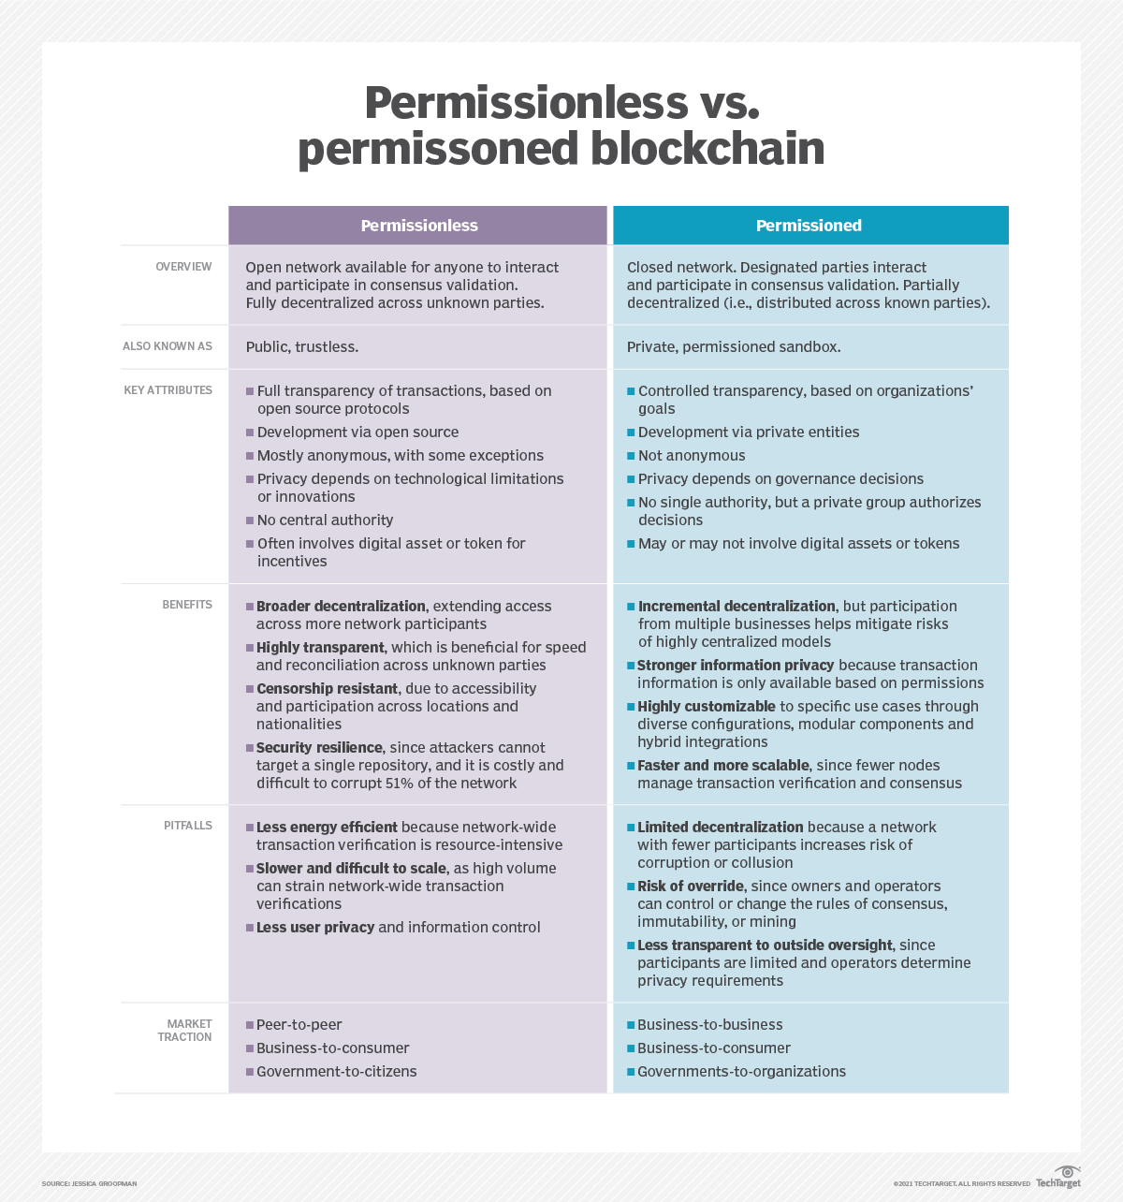

Slide 108
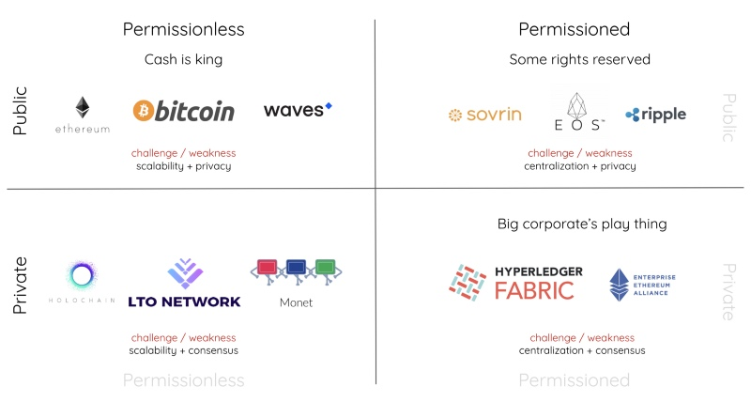

Slide 109
Restricted Environment
The blockchain-technology-suite causes value even in restricted environments for the following reasons:
The number of nodes can vary due to technical failures or downtime.
Every distributed system faces the adversaries of networks that make communication on the level of individual messages unreliable.
Even an on-boarding process may not guarantee the trustworthiness of nodes at a 100 percent level.
Even trustworthy nodes may yield wrong results due to technical failures.

Slide 110
Applications
small selection of concrete blockchain application areas in which the blockchain is already used or may be used soon:
Payments: Managing ownership and transfer of digital fiat currencies.
Cryptocurrencies: Managing ownership and creation of digital instruments of payment that exist independently from any government, central bank, or other central institution.
Micropayments: Transfer of small amounts of money that would be too costly by using traditional means of transfer.
Digital assets: Managing creation, ownership, and transfer of digital items that have value in their own right or represent valuable goods in the real world.
Digital identity: Proving identity and authentication based on unique digital items.

Slide 111
Applications
Notary services: Digitizing, storing, and verifying documents or contracts and proof of ownership or transfer.
Compliance and audit: Auditing business activities of people or organizations in regulated industries in an audit track.
Tax: Calculating and collecting taxes based on transactions or on sole ownership, reducing tax avoidance, or double taxation.
Voting: Creating, distributing, and counting digital ballot papers.
Record management: Creation and storing of medical records.

Slide 112
Characteristics of the Blockchain
The blockchain is a purely distributed peer-to-peer data store with the following properties:
Immutable
Append-only
Ordered
Time-stamped
Open and transparent
Secure (identification, authentication, and authorization)
Eventually consistent

