Slide 1

EDA OF FAST FOOD RESTAURANTS IN US

Slide 2
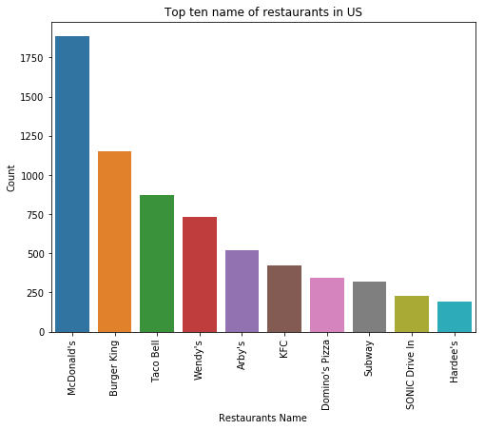
What is the most popular Fast Food Restaurants in US?
Presence of McDonald’s is the highest in US. So it can be said McDonald’s is the most popular restaurant in US followed by Burger King and Taco Bell

Slide 3
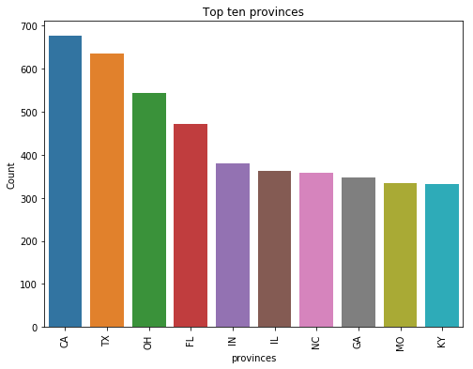
In which province count of the Fast Food Restaurants is highest?
‘CA’ is in the highest position followed by ‘TX’ and ‘OH’.

Slide 4
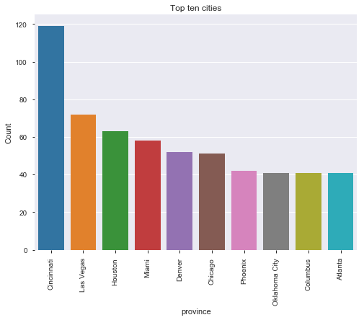
In which city count of the Fast Food Restaurants is highest?
‘Cincinnati’ is in the highest position followed by ‘Las Vegas’ and ‘Houston’.

Slide 5
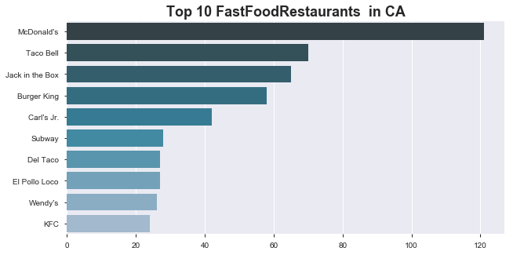
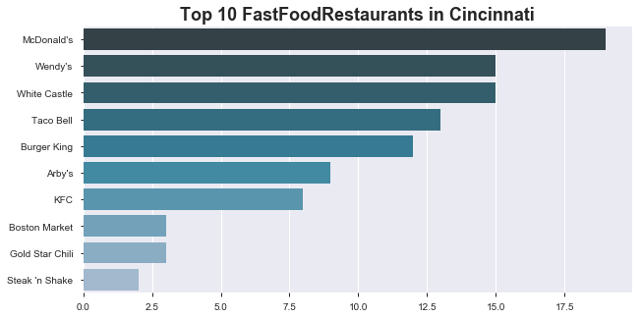
In the below charts we are trying to highlight the top 10 Fast Food restaurants in ‘CA’ and ‘Cincinnati’
In both the cases we can see McDonald’s is in the leading position.

Slide 6
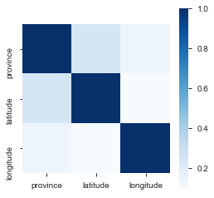
What is the Impact of geographical location in Fast Food Restaurant business?
So from the above graph we can see there is some relation between province and latitude.
In particular latitude Fast Food restaurants are more.

Slide 7
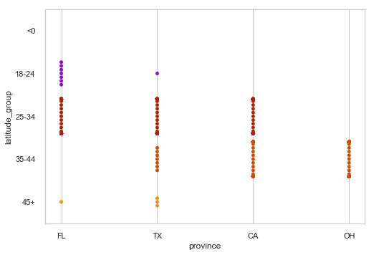
In which Latitude Number of Fast Food Restaurants are more?
We have Selected top 4 provinces in US (‘CA’,’TX’,’OH’ and ‘FL’)
In the latitude between 30 to 43 (approximately) the Fast Food restaurants are more in US.

