Slide 1

Problem Statement : Predict the grade of Portuguese high school students

Slide 2
Approaches I have followed:
Linear Regression | Decision Tree
Predict the grade of the students based on other parameters(independent variables). As the name suggests the relation can be described as linear equation format. | Based on the grade of the students introduced a categorical variable as a column, The newly introduced column is divided into ‘A’,’B’ and ‘C’ category. Then calculate the accuracy.

Slide 3
LINEAR REGRESSION

Slide 4
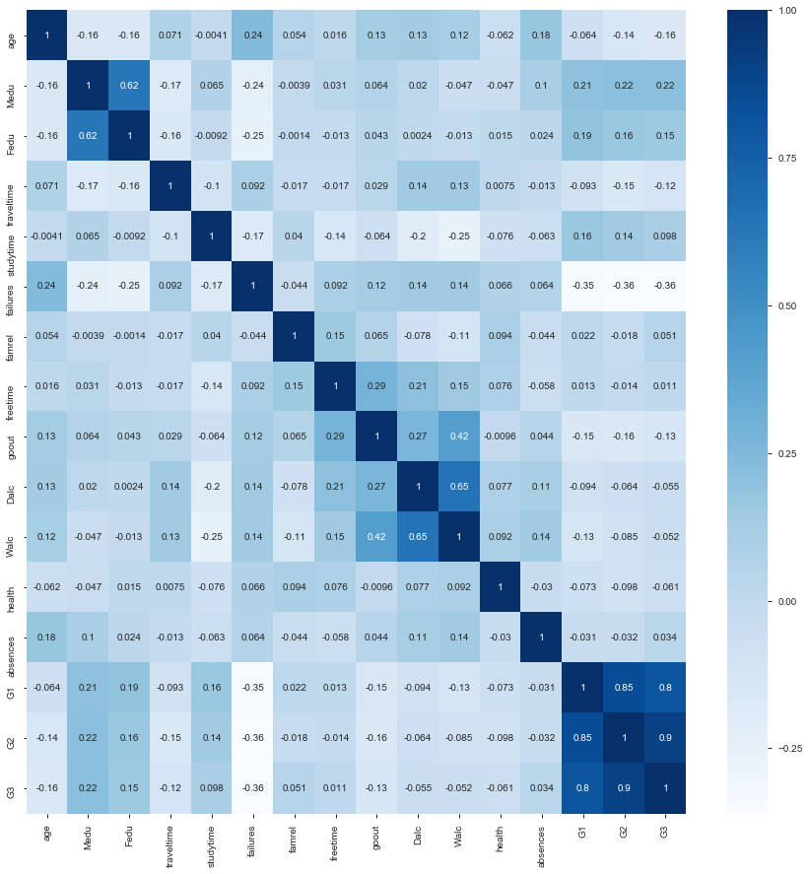
What are the relations between the given data?
So From the above diagram(heatmap) it is clear that there is a strong correlation between Medu(Mother’s education) and Fedu(Father’s education). According to linear regression assumption we need to choose any one of them. I am considering Medu for this model.
Correlation exists between G1,G2,G3. So I have introduced a new column(AvgGrade) taking the average of G1,G2 and G3. Then these three columns has been dropped.
Correlation is also there between gout and, Walc, and Dalc and Walc.So dropped Walc.
Some of the other independent variables has been also dropped later after checking the relation among them.

Slide 5
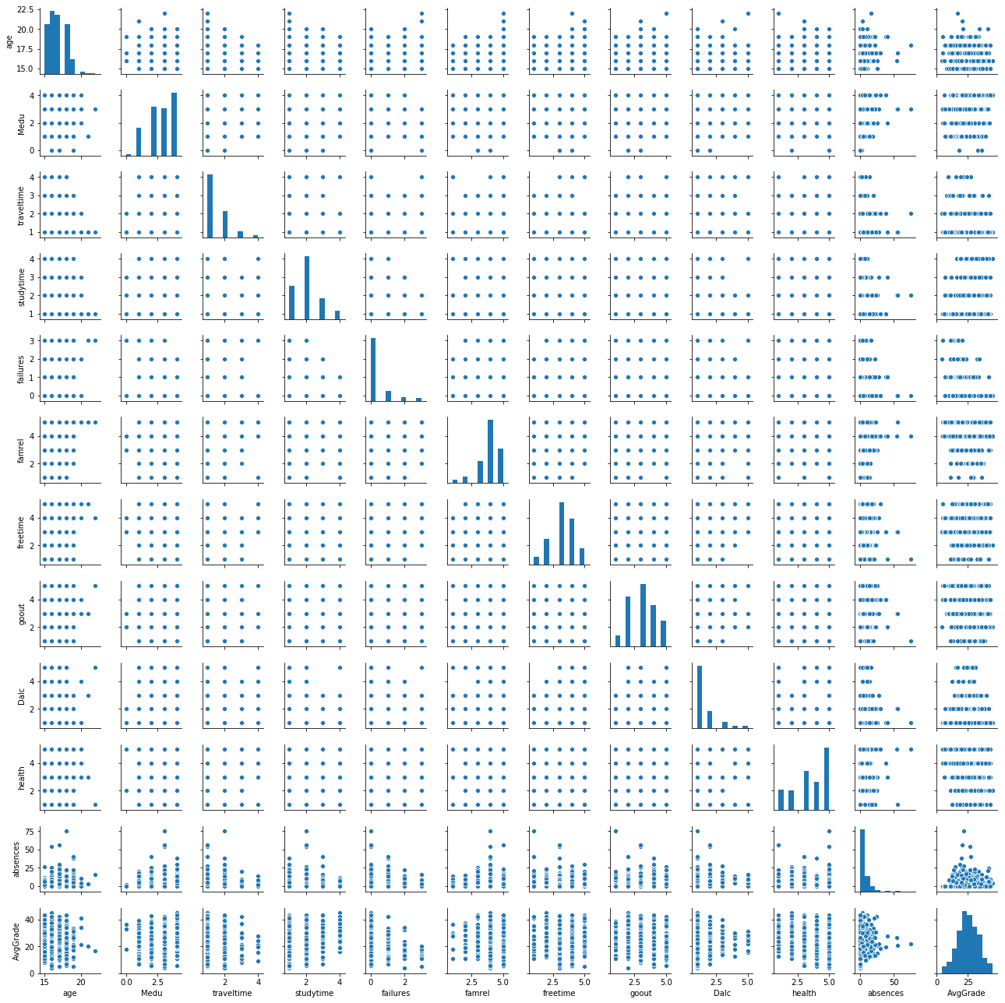
Pairwise plot to see the type of correlation exists in the given data
From the above plot it is clear that the relation is almost linear.

Slide 6
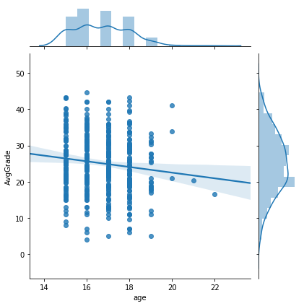
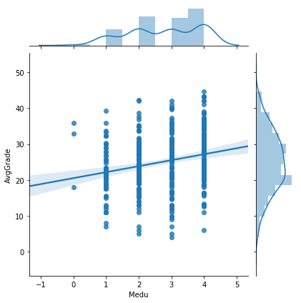
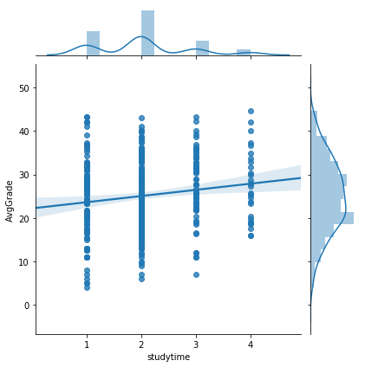
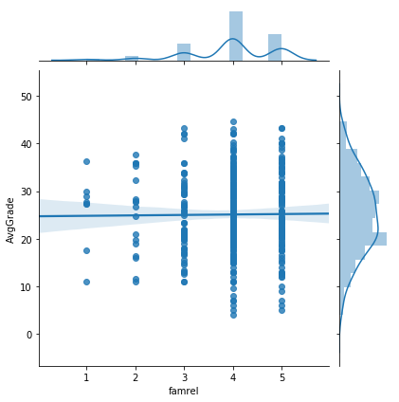
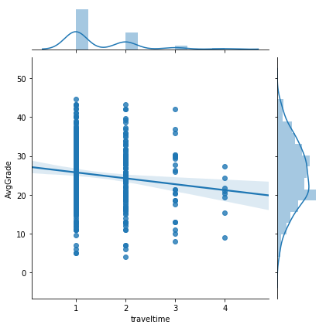
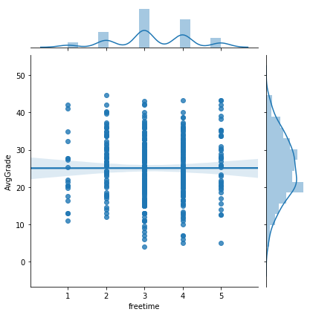
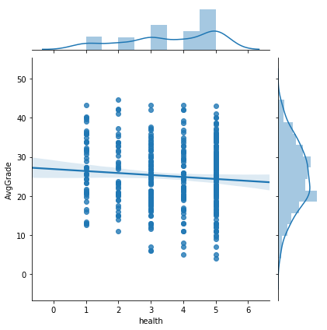
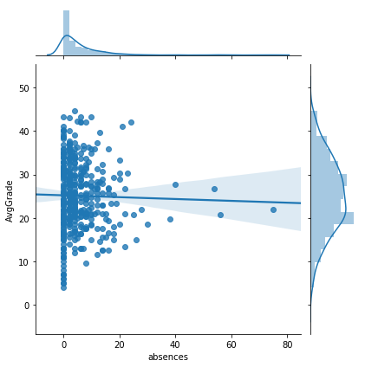
The below diagrams shows the relationship of the dependent variable(AvgGrade) and other independent variables. Till now we have considered the numerical variables present in the given data. So from the diagram we can see the relationship is linear and distribution is almost normal.

Slide 7
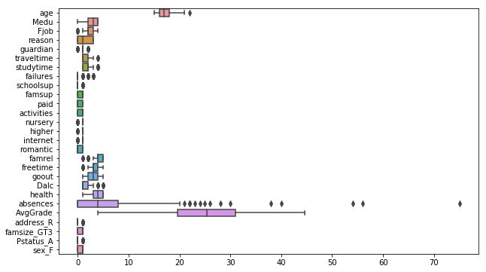
Check for outliners in the data So from the below diagram we can see outliners exist in the given data. To overcome this values between 5 to 95 percentile range has been considered for the model.

Slide 8
Standardization of data:
Before running the linear regression algorithm it is important to standardize the data.
The data contains both continuous and categorical values. There is no point of standardize the categorical values.
So first the continuous values has been separated and the standardization has been done.
Then a new dataset has been formed by concatenating the standardize values and the categorical values.
The data has been divided in Train and Test set to run the algorithm.
Then Linear Regression algorithm has been run and model evaluation has been done.

Slide 9
Model Evaluation
 | Without Grid Search | Grid Search
Test Data | RMSE:0.79 | RMSE:0.74
Train Data | RMSE:0.90 | RMSE:0.91
Linear relationship can be expressed as:
y = 0.027949704637808968 -0.035041653508167105 * absences -0.03319616296127453 * age + 0.004429088967017304 * famrel+........

Slide 10
Decision Tree

Slide 11
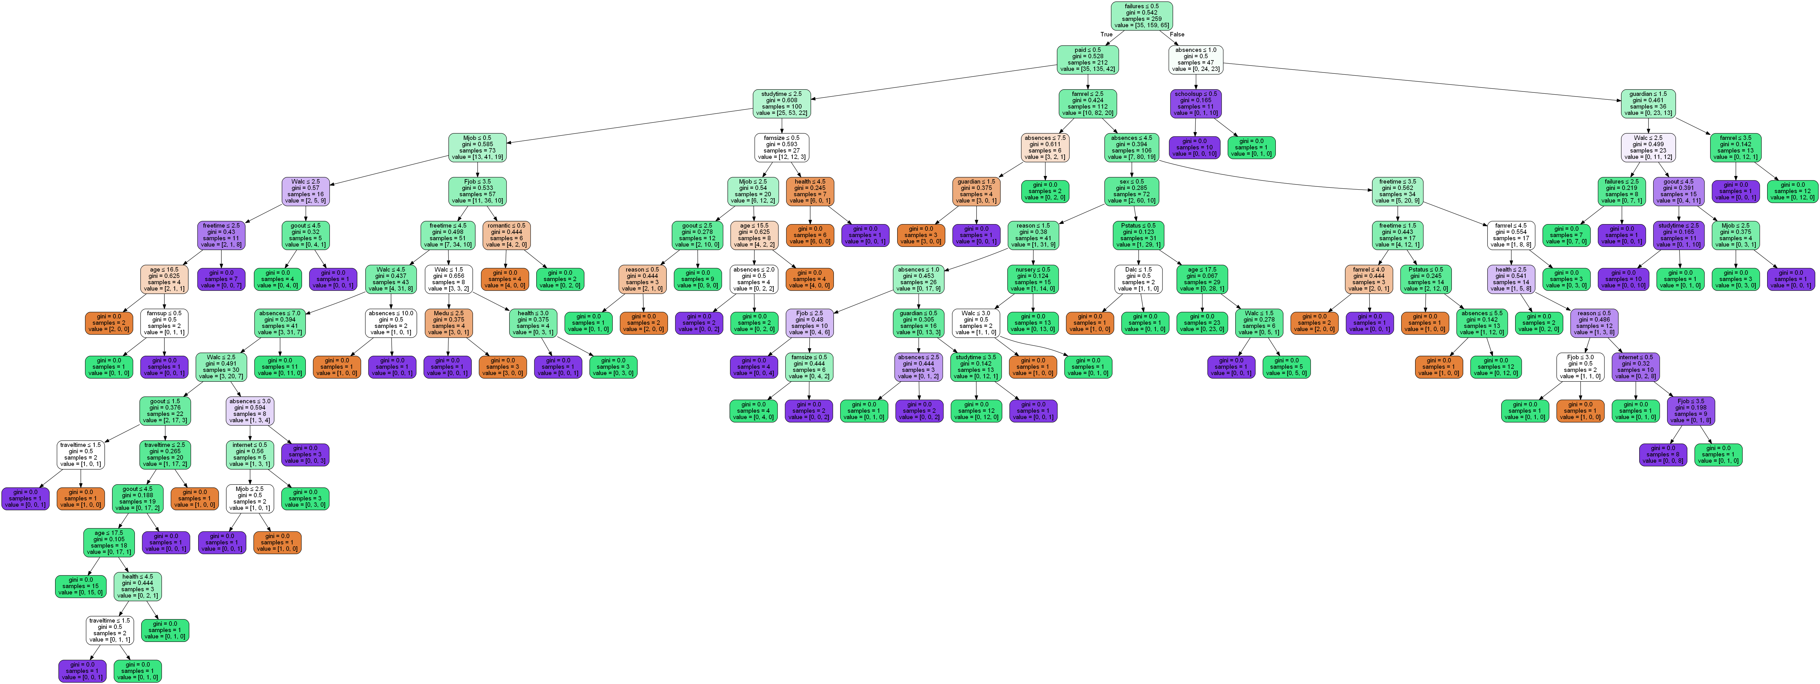
The EDA is almost similar to linear regression
Followed Label Encoding for all categorical variables
Did not drop so many independent variables as linear regression.
Introduced a new categorical variable “grades”
Based on the average grade divided it in “A”,”B” and “C” category.
Finally the GraphViz presentation looks like below:

Slide 12
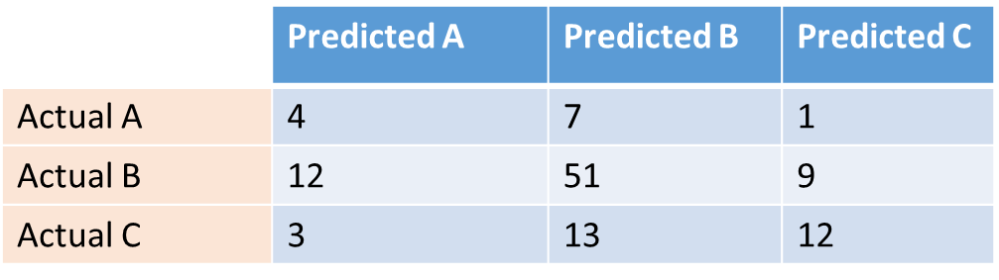
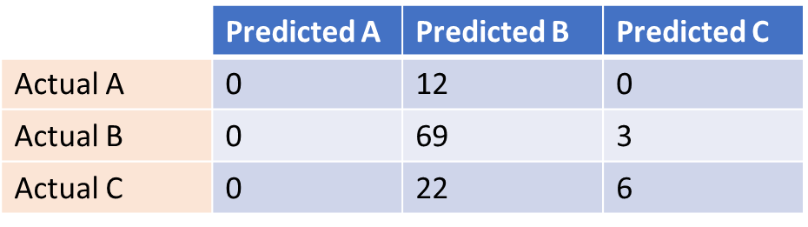
Model Evaluation
Grid Search:
Confusion Matrix
Without Grid Search:
Confusion Matrix
Accuracy score: 0.598
Correct prediction: 67
Wrong Prediction: 35
Accuracy score: 0.669
Correct prediction: 75
Wrong Prediction: 37

