Slide 1

Problem Statement : Old Trafford Museum Tour Experience Team Members Name : Abhishek Kumar Soni, Alokik Pathak Rama Krishna Padhi, Ritu Parno Behera

Slide 2
AIM : To develop a user friendly Android application that provides best visiting experience of museum tour by various means.
INTRODUCTION:
Museum e-Guide opens a multilingual path with many features. With support for many national and international languages. The galleries contain details about different players achievements, voice narrator, 3D model of the same & related videos. Low powered Bluetooth beacon and QR enables smarter interaction. It also houses a Navigator which contains a graphical overview of the entire museum. The visitor can have mesmerizing and immersive experience of virtual reality tour of the entire museum. The app features a real time commentary, where a guide can sit at any place and guide a group of people around the museum. With such introduction to new era of technology it gives a human touch that will bring us all together. The applications sends push-notifications post visit to engage the user by informing the presence of similar kinds of museum on the basis of his visiting record.

Slide 3
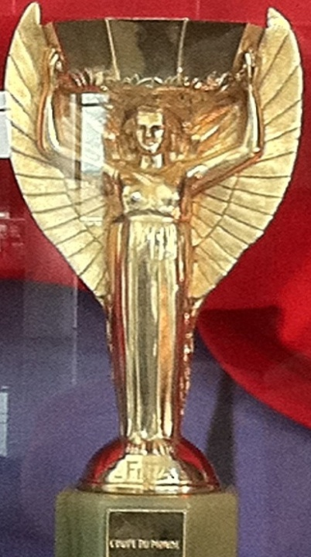

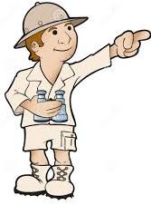
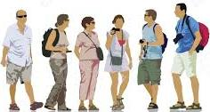
MAIN IDEA :
Title of the technology /innovation: “Museum E-Guide”.
The museum e-guide minimizes many well-known problems that visitors face like (communication, improper guidance, unsatisfactory etc.).
e-Guide has the ability to provide commentary in user selected language.
Focuses on both standalone tourists and those in groups irrespective of their origin, nationality and mode of communication.
I’m German
I’m French
This is World Cup Trophy
Visitors
Tourist Guide
Group
Single

Slide 4
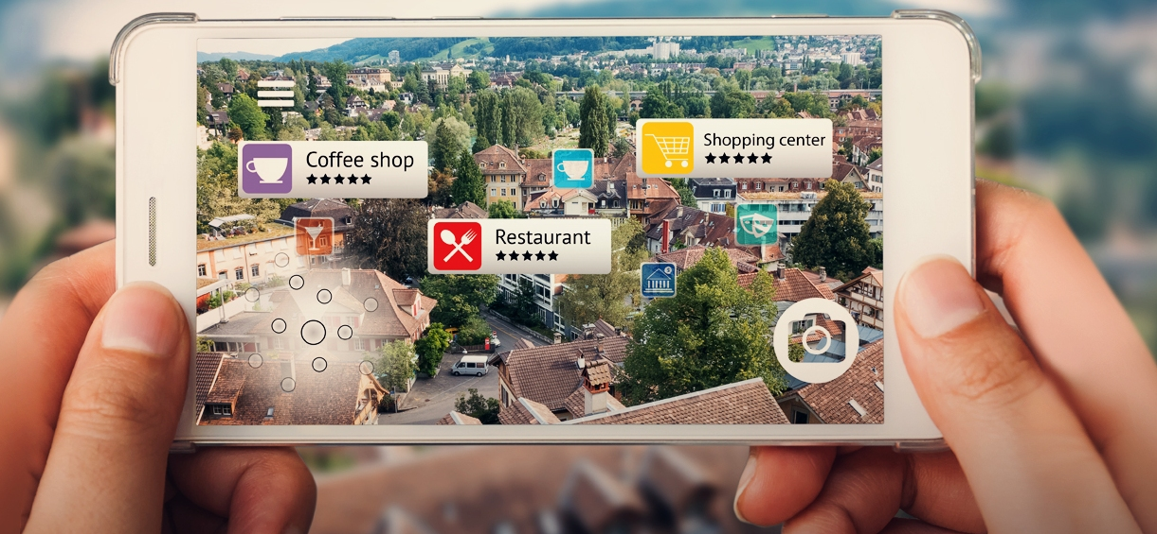
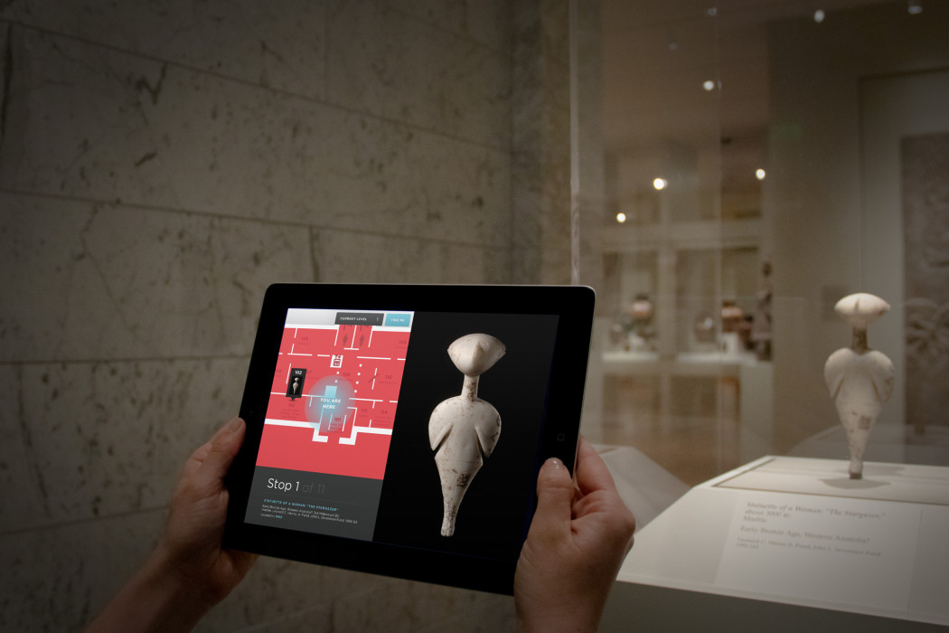
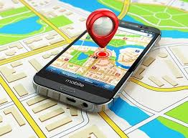
Other features like object look-alike augmented reality videos, relevant audio & text based on
artefacts.
If we will scan any object through our App like Trophy, jersey, shoes the its interactive 3-D model will be superimposed in App through Mixed Reality which will show that object with all its details like for Trophy it will show its history like in which tournament it was won, what was the score of the match and all the related information about the Trophy will be displayed with its interactive models.
Data analytics are incorporated to support features such as automatic time scheduling based on user’s interest and real time tracking of other group mates, thus helping kids find their parents if they are lost.
Augmented Reality
Real time tracking

Slide 5
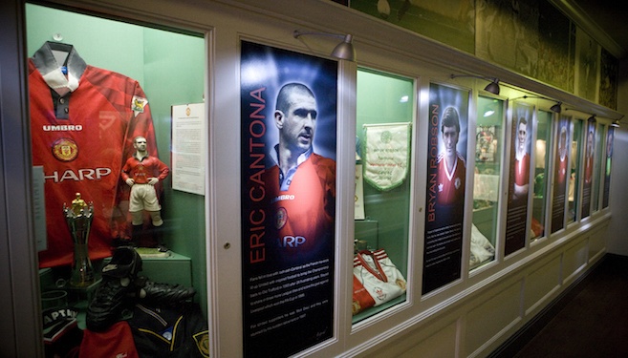
APPROACH DETAILS :
Old Trafford museum attracts a good number of football lovers across the globe every year. 130 years of football in the Museum with a varied heritage, the museum possesses many iconic players with trophies from pre-historic to modern age revealing royalty, culture and the remarkable history.
Our App “Museum E-Guide” will be solving major problems faced by visitors visiting the museum.
The App will ask for brief introduction about the user like name, country, age, languages known etc. which will be used for keeping record of the visitors later used for providing better facilities & monitoring.
App is designed in such a way it will fetch data according to user language in app.
Data about the players are in text, image, 3D model and in video formats.
The App will able to read the text (audio) in their respective language and video too is fetched according to the user language.
They will able to have a mesmerizing experience through immersive and interactive Mixed Reality features.

Slide 6
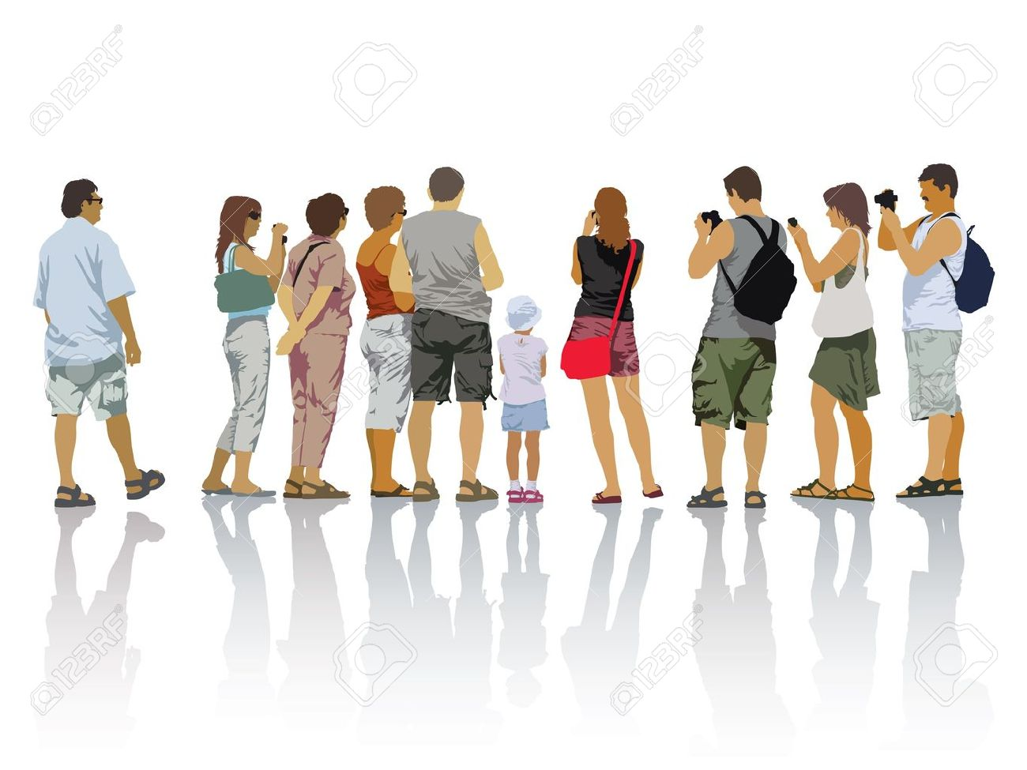

There will be two modes of operations
1. Standalone Mode 2. Group Mode
In Standalone mode, single user will operate according to his choice.
In Group Mode, all app is connected with Wi-Fi with every other app and view the same content in all App belongs to a particular group in real time.
SINGLE TOURIST
GROUP OF TOURIST

Slide 7
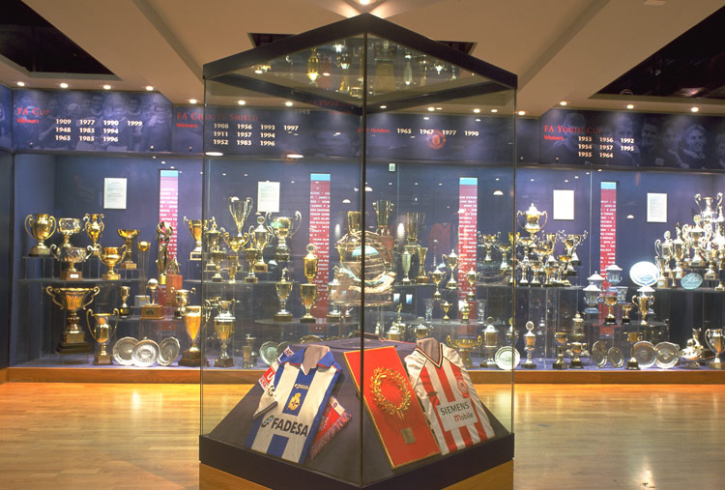
Every artefact of museums consists of Beacon and QR Code integrated with them. A single Beacon can also be integrated for a group of artefacts present in a particular area in museums.
Every Beacon and QR-Code integrated with artefacts have Unique Identification Number.
Tourist visiting the museums having App in their Smartphone when passes from nearby artefacts they will get push notification (from Beacon) in their phone with the brief introduction of artefact.
Or user can also manually scan the QR-Code and App will fetch related data from the server.
App is powered with Augmented & Virtual Reality feature which gives a 3D interactive visual of artefacts to which it focuses on. It gives best visiting experience to visitors'.
Our App also act as a virtual live guide which help to single visitor or group of visitors to roam around the museum using Web-RTC.
App has unique feature of Time Scheduling which will make a plan for the visitor and act as a virtual guide for visitor.

Slide 8
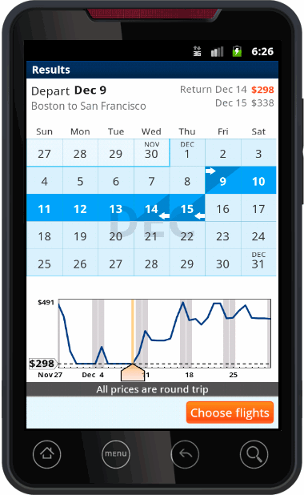
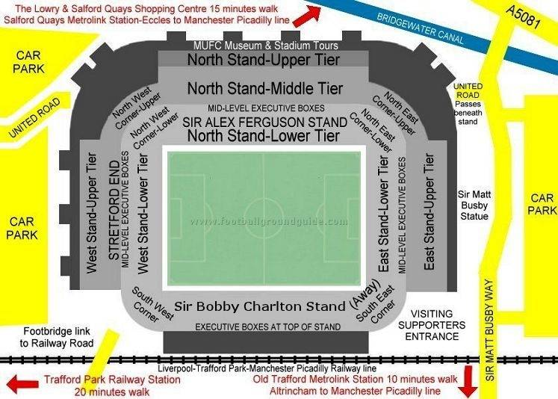
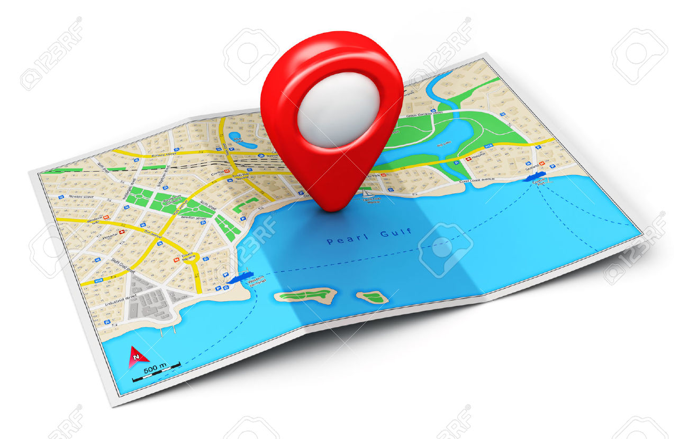
The App will have brief record of the visitor & sends it to the server.
The visitor record in server will helps in Monitoring & improvising the facilities
for future visitors.
The GPS in app will helps in real time tracking of visitors in museums.
Google map is integrated in the App so that visitors can see all the
museums and monuments around there location.
There is also ticket verification & feedback system in App.

Slide 9

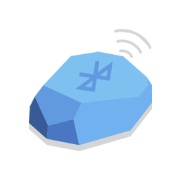

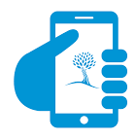
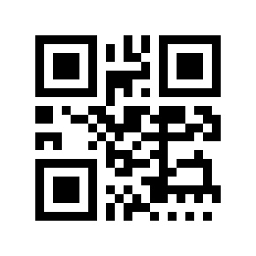
TECHNOLOGY STACK
The System is divided into two parts:
Server Side
Client Side

Slide 10
SERVER SIDE
The real-time synchronization server is a pair
of two servers the Local and Auxiliary server.
Both Local and Auxiliary server
replicates the data from the National server
in real time, maintaining measures for hardware
failures.
The Primary server is always active
while the Auxiliary one is at standby till
either the visitor number crosses a given
threshold or the primary server crashes.
National
Server
Local
Server
Auxiliary
Server

Slide 11
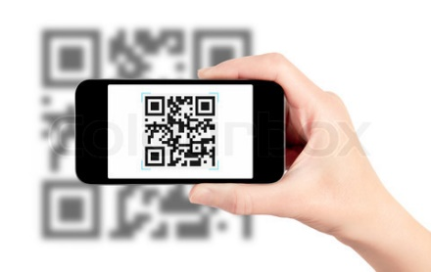
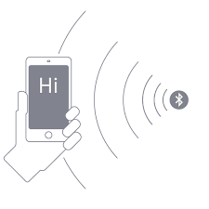
CLIENT SIDE
It consist of various components such as
Beacon
QR-Code
Smartphone
Beacon
Beacon
QR Code

Slide 12
BEACON
Beacon technology allows Mobile Apps to
understand their position on a micro-local scale
and deliver hyper-contextual content to users
based on location.
The underlying communication technology
is Bluetooth Low Energy.
It’s designed for low energy consumption
and cost.
It’s maintaining a communication range
of 70-450 meters.
It’s with all major platform such as Android
and iOS.
It’s IP65 whether proof rated (Protected from
total dust ingress & low pressure water jets
from any direction, limited ingress protection).
Beacon

Slide 13
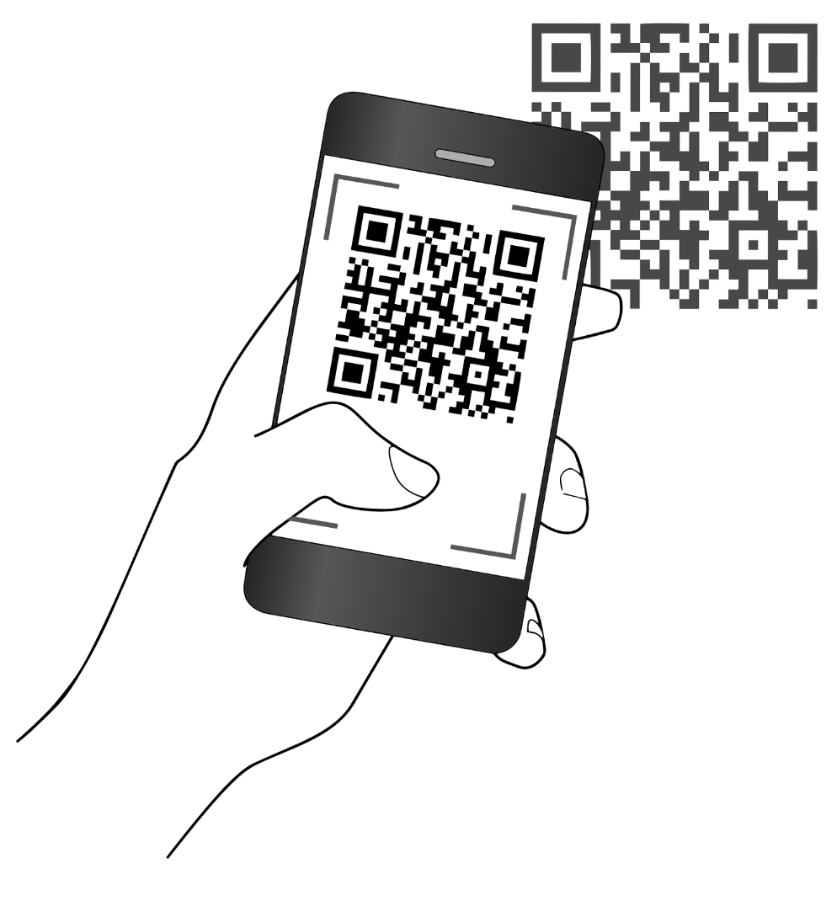
QR CODE
QR or Quick Response Codes are
a type of two-dimensional barcode that
can be read using smart phones and
dedicated QR reading devices, that link
directly to text, emails, websites, phone
numbers and more! You may have even
got to this site by scanning a QR code.
Creation of QR Code can use different
file formats such as HTML Code, PNG file,
Tiff file, SVG, EPS.

Slide 14
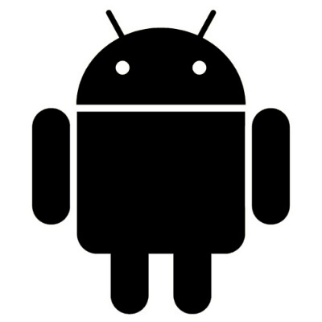



SMARTPHONE
Phone should be operating on
OS such as Android, iOS etc.
Bluetooth must be turned ON for
getting the push notification from
nearby Beacon.
GPS must be turned ON for real
time tracking.

Slide 15
SOFTWARE AND LIBRARIES
Unity 3d
Autodesk Maya
Adobe Photoshop
Vuforia
Google Cardboard Sdk
Google Web RTC
Android Studio

Slide 16
THANK YOU.

