Slide 1
Excel Internal Assesment
LVADSUSR181-rituraj-anand

Slide 2
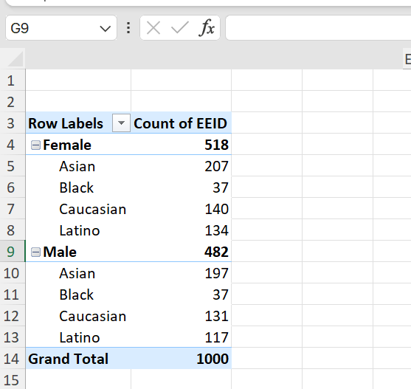
Solution:
A summary for gender and ethnicity of the employees can be seen in the solution.
A pivot is used for the same.

Slide 3

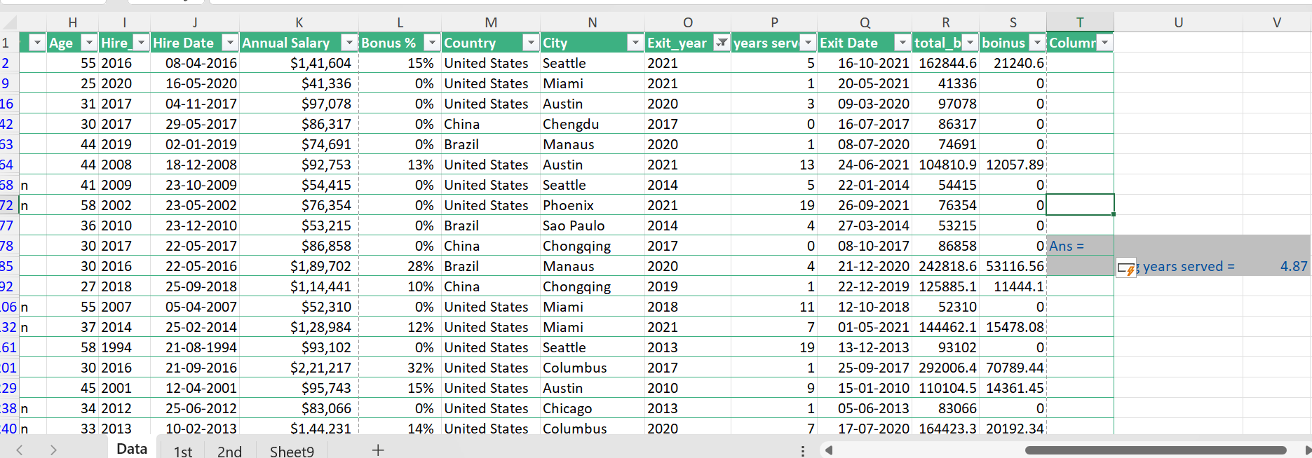
Solution:
Average years served =
Avg(Exit Year- Hire Year)=4.87

Slide 4

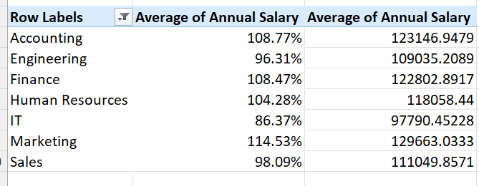
Solution:
A significant difference can be seen in the % of grand total for these average salaries in different departments.

Slide 5
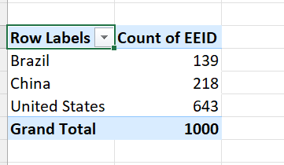
Solution:
We can see United States has the highest count of EEID and hence highest number of employees.

Slide 6
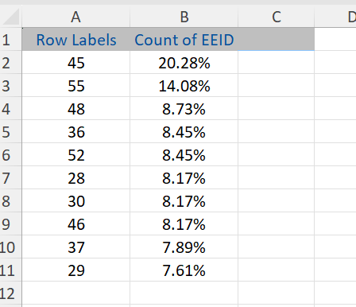
Solution:
An age of 45 is the most common range of age in employees.

Slide 7
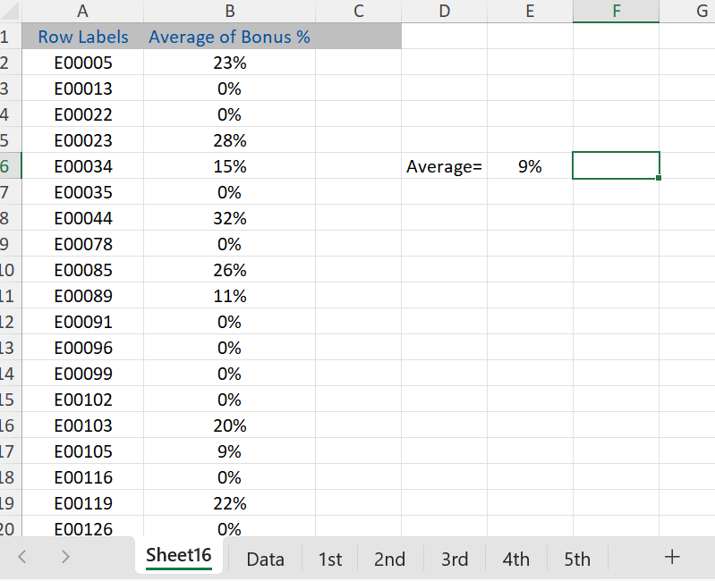
Solution:
An average of 9% can be seen for the bonus.

Slide 8
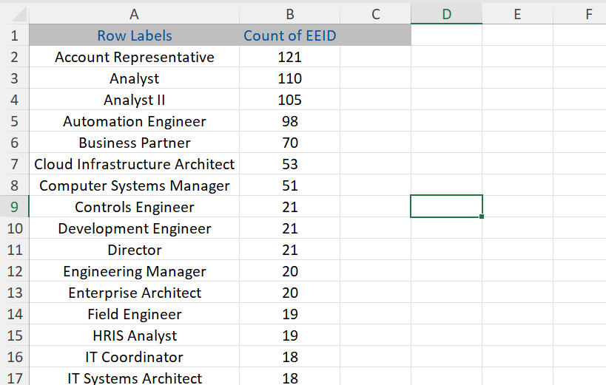
Solution:
Account Representative title occurs the most.

Slide 9
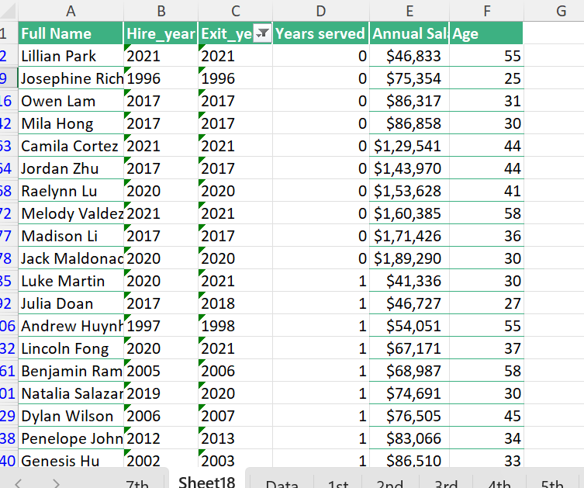
Solution:
Age being the primary reason for the exits.

Slide 10
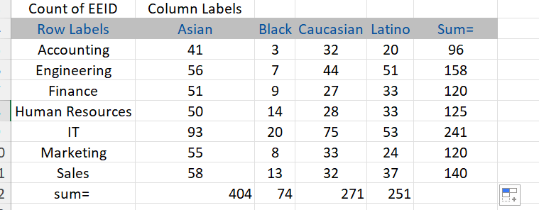
Solution:
IT being the diversified group.

Slide 11
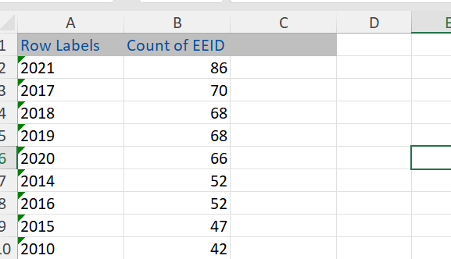
Solution:
We can see the hiring has increased in past years.

