Slide 1

Vision Care Insurance :
Key Factors to design policies

Slide 2





Team : Section 001(Group 2)
I
Ikram
Patel
Rituraj
Borah
Tirthak
Bhingaradiya
LinkedIn
Github
LinkedIn
Github
LinkedIn
Github

Slide 3
OBJECTIVE
1
Background Motivation
2
Problem Statement
3
Project Proposal
4
Analysis Questions
4
Dataset Description
5
6
Data Cleaning & Transformation
7
Analysis Results

Slide 4
BACKGROUND MOTIVATION
Vision is critical for daily tasks, but due to screen time, diabetes, and aging, vision problems are common nowadays.
The World Health Organization estimates that approximately 2.2 billion people globally have some form of vision impairment, with the majority being easily preventable or treatable ("Vision impairment and blindness," 2021).
As per future projections made by most recent census data, the number of people with visual impairment or blindness in the United States is expected to double to more than 8 million by 2050.("Visual impairment, blindness cases in U.S. expected to double by 2050," n.d.)

Slide 5
BACKGROUND MOTIVATION…
Health insurance providers offer coverage plans to assist customers in dealing with the financial burden associated with critical illnesses
It offers coverage for critical illnesses, including vision care. Vision insurance typically covers routine eye exams, glasses, contacts, and other related services.
Since there are risk factors such as Race/ethnicity, age, high blood pressure, heart disease, smoking, and physical inactivity which can increase the risk of vision loss.
Insurance companies aim to provide the most superior eye-care insurance plans in the market to motivate their customers to try out new or enhanced products.
Nevertheless, the development of these new offerings demands comprehensive research and analysis of the previous health-related challenges experienced by their intended customers, considering various factors.

Slide 6
PROBLEM STATEMENT
Risk factors
Better insights
Pre-existing disease
Current trends
Effective Insurance plans
In order to create vision insurance policies that are more tailored to the needs of their consumers and generate revenue, insurance companies in North America, particularly the US, require a more comprehensive understanding of current trends and risk factors in eye care specific to different age groups and pre-existing medical conditions of the population.

Slide 7
PROJECT PROPOSAL
Our team will present an analysis of patterns and fluctuations observed in the data obtained from the Centre for Disease Control and Prevention.
The study will support the claims made regarding different geographical areas, age groups, and types of eye ailments.
This data comprises a summarized table of prevalence rates for various indicators related to vision and eye health, extracted from the year 2016.
Our research will provide valuable insights to insurance companies, assisting them in designing and recommending suitable products to customers.
It will also aid in making financial decisions such as insurance amount and premiums based on various factors, enabling them to make a profit.

Slide 8

ANALYSIS QUESTIONS
What are discrete Eye disorders under 52 geographic locations(US states)?
What are the different Eye disorders as per age brackets?
What are different Eye disorders as per gender ?
What are the Risk Factors associated with the population ?
What is the relationship between the most prevalent eye disorders and the type of services utilized for their treatment?

Slide 9
DATASET DESCRIPTION
This dataset contains a summary table of prevalence rates for vision and eye health data indicators from the year 2016.
Data source: Commercial Claims and Encounters Data (CCAE) is produced by Truven Health Analytics, a division of IBM Watson Health.
The dataset is collected by doing a survey for an equal number of people across each Gender and Age category for various types of diseases across the states in the US. Thus, the data can be considered unbiased and a uniform representation of the population.
The data contain a convenience sample of insurance claims, and the data is arranged by all available combinations of age group, gender, and state.
As per our initial assessment, there are enough variables/columns to perform a detailed analysis and share insight from the dataset.
The data preparation will undergo a few minor transformations before projecting it for analysis.

Slide 10
DATASET DETAILS
Column Name | Description | Type
YearStart | Starting year for year range | Number
YearEnd | Ending year for year range. Same as starting year if single year used in evaluation | Number
LocationAbbr | Location (National or state) abbreviation | Text
LocationDesc | Location (National or state) full name | Text
DataSource | Abbreviation of Data Source | Text
Topic | Topic description | Text
Category | Category description | Text
Question | Question description (e.g., Percentage of adults with diabetic retinopathy) | Text
Response | Optional column to hold the response value that was evaluated | Text
Age | Stratification value for age group (e.g., 0-17 years) | Text
Gender | Stratification value for gender (e.g., Total, Male, Female, or Unknown) | Text
RaceEthnicity | Stratification value for race (e.g., All races, Asian, Black, non-hispanic, Hispanic, any race, North American Native, White, non-hispanic, or Other) | Text
RiskFactor | Stratification value for major risk factor (e.g., All participants, Diabetes) | Text
RiskFactorResponse | Column holding the response for the risk factor that was evaluated (e.g., All participants, Yes, No, or Unknown) | Text
Data_Value_Unit | The unit, such as "%" for percent | Text
Data_Value_Type | The data value type, such as age-adjusted prevalence or crude prevalence | Text
Data_Value | A numeric data value greater than or equal to 0, or no value when footnote symbol and text are present | Number

Slide 11
DATASET DETAILS
Column Name | Description | Type
Data_Value_Footnote_Symbol | Footnote symbol | Text
Data_Value_Footnote | Footnote text | Text
Low_Confidence_Limit | 95% confidence interval lower bound | Number
High_Confidence_Limit | 95% confidence interval higher bound | Number
Numerator | The actual number of patients with the condition (n) | Number
Sample_Size | Sample size used to calculate the data value | Number
LocationId | Lookup identifier value for the location | Text
TopicId | Lookup identifier for the Topic | Text
CategoryId | Lookup identifier for the Category | Text
QuestionId | Lookup identifier for the Question | Text
ResponseId | Lookup identifier for the Response | Text
DataValueTypeId | Lookup identifier for the data value type | Text
AgeId | Lookup identifier for the Age stratification | Text
GenderId | Lookup identifier for the Gender stratification | Text
RaceEthnicityId | Lookup identifier for the Race/Ethnicity stratification | Text
RiskFactorId | Lookup identifier for the Major Risk Factor | Text
RiskFactorResponseId | Lookup identifier for the Major Risk Factor Response | Text
Geolocation | Latitude & Longitude to be provided for formatting GeoLocation in the format (latitude, longitude) | Point

Slide 12

VARIABLES IN DATASET
YearStart
YearEnd
RaceEthnicity
RiskFactorResponse
Data_Value_Type
Low_Confidence_Limit
High_Confidence_Limit
Numerator
Sample_Size
LocationId
TopicId
CategoryId
QuestionId
ResponseId
DataValueTypeId
AgeId
GenderId
RaceEthnicityId
RiskFactorId
RiskFactorResponseId
Geolocation
LocationAbbr
LocationDesc
Topic
Category
Response
Age
Gender
RiskFactor
Additional Variables
Categorical Variables

Slide 13
EXPLORATORY DATA ANALYSIS
Locating a trustworthy source for the dataset.
Examining the data frame information to comprehend the number of rows and columns, data types, and non-null values.
Removing irrelevant data values, such as filtering out two incorrect location values.
Saving the dataset on Google Drive to commence working on Google colaboratory.
Managing failures and errors, if any occur.

Slide 14
DATA CLEANING & TRANSFORMATION
We utilized Python along with the Pandas library to import and merge data from two source files, and to facilitate the exploration of the data.
We have cleaned the data in Location column by removing irrelevant or inaccurate values.
Values in Category column has been transformed to make them more concise and visually appealing for better data visualization.
As there were 52 discrete locations, it was challenging to showcase them in plots. Therefore, we categorized the locations into four different regions to improve data visualization.

Slide 15
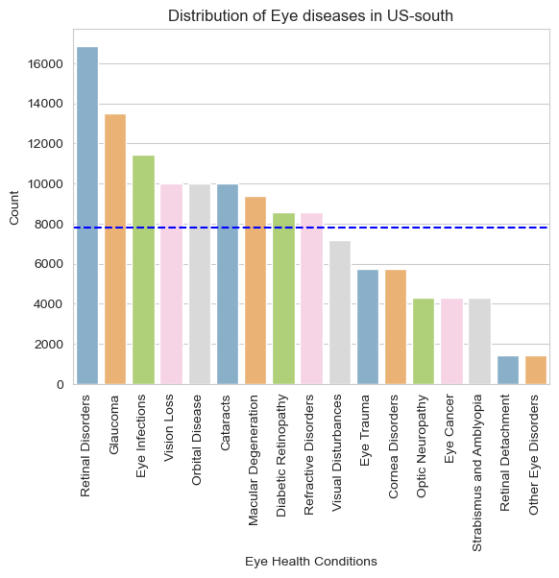
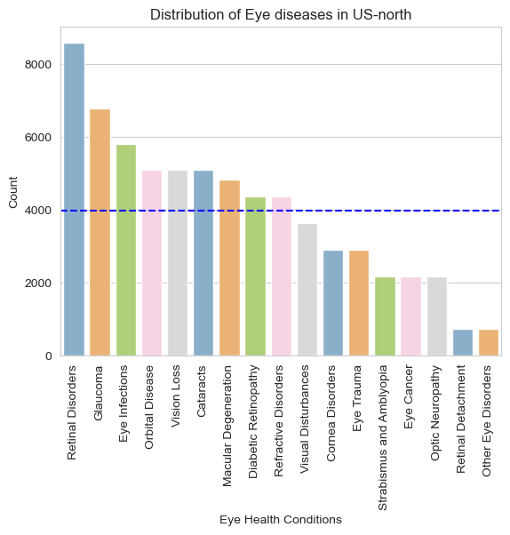
ANALYSIS 1 : Distribution of Eye disorders across Locations

Slide 16


ANALYSIS 1 : Distribution of Eye disorders across Locations…

Slide 17
ANALYSIS 1 : Distribution of Eye disorders across Locations…
The graph provides a clear overview of the common vision-related issues across various regions in the US.
Retinal Disorders and Glaucoma are the most common vision-related issues in all of them.
Several other eye diseases such as Eye infections, Vision Loss, Orbital Diseases, Cataracts, Macular Degeneration, Refractive Disorders, and Diabetic Retinopathy are prevalent among the population and affect more than the average population in all regions.
The population in US-north has the lowest prevalence of vision-related issues compared to other regions.

Slide 18
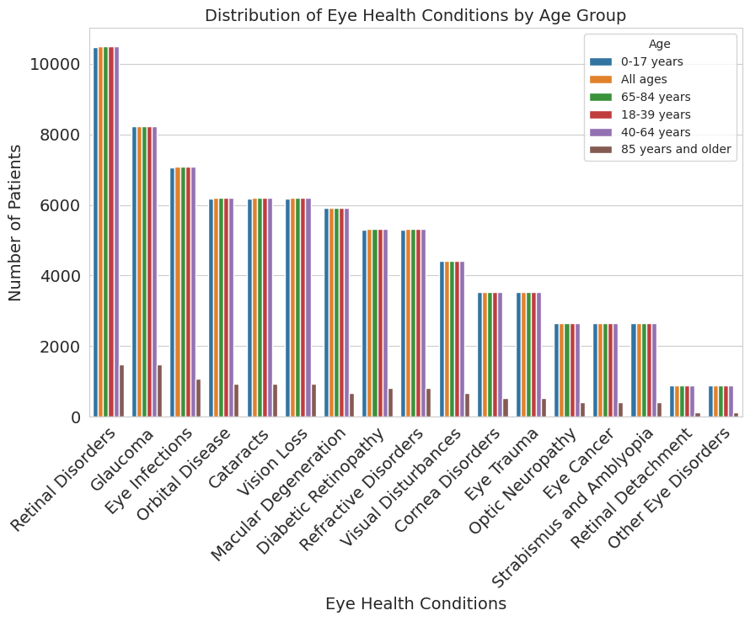
ANALYSIS 2 : Distribution of Eye disorders by Age Groups
The graph shows the relationship between different Age Groups and different Eye Health conditions.
Except for the "85 years and older" age group, the distribution of eye disorders is constant across all age groups.
Therefore, Age is not a significant factor in determining eye disorders for the selected population under review.

Slide 19
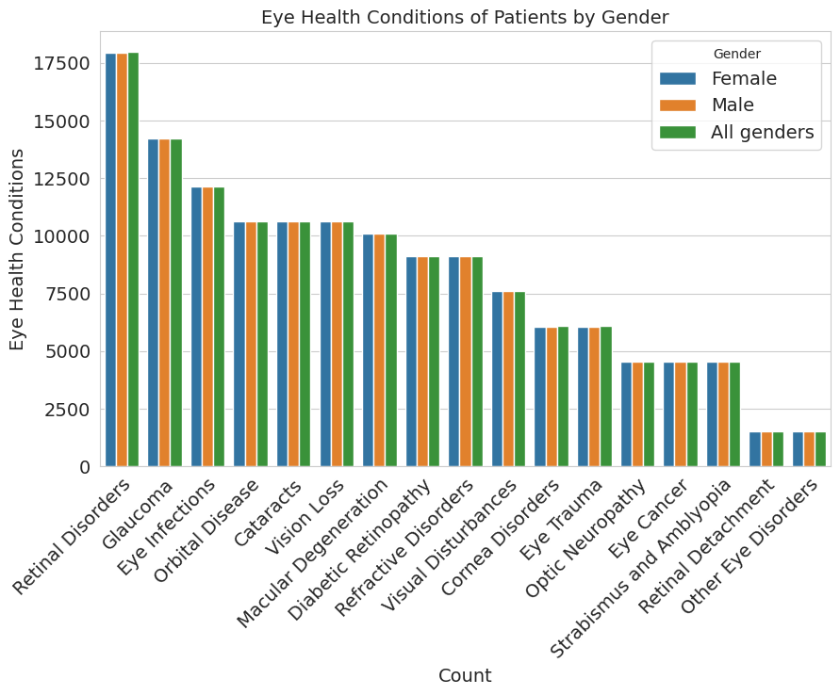
ANALYSIS 3 : Distribution of Eye disorders by Gender
The graph shows the relationship between different Gender and Eye Health conditions.
The Gender distribution is the same across various Vision disorders, where Retinal Disorders contribute to the major number of people.
Therefore, Gender is not a significant factor in determining eye disorders for the selected population under review.
The data granularity is at the disease level rather than the individual person level, and therefore, the category "All genders" is present as part of the Gender column.

Slide 20
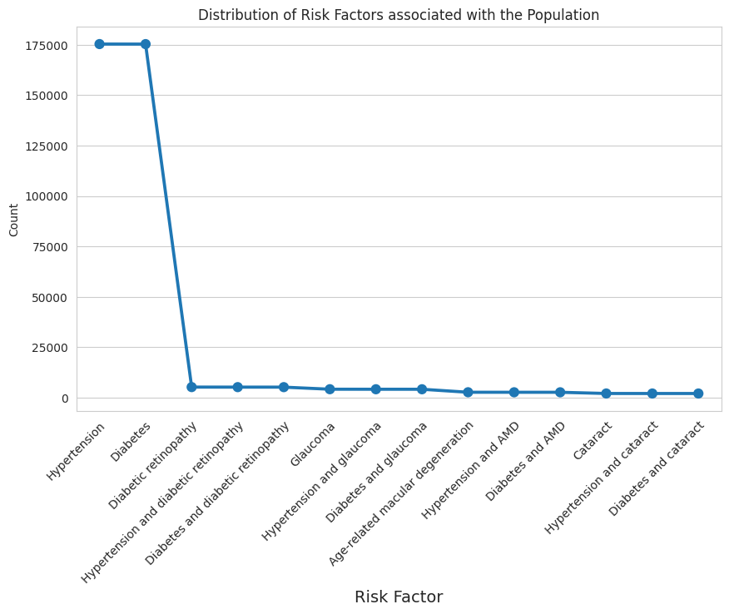
ANALYSIS 4 : Distribution of Risk Factors
The graph presents the Risk Factors associated with the population in the US.
The two major factors that stand out are Hypertension and Diabetes, with values of around 17.5K each.
The other Risk Factors associated with the population are not that significant and can be ignored for analysis.

Slide 21
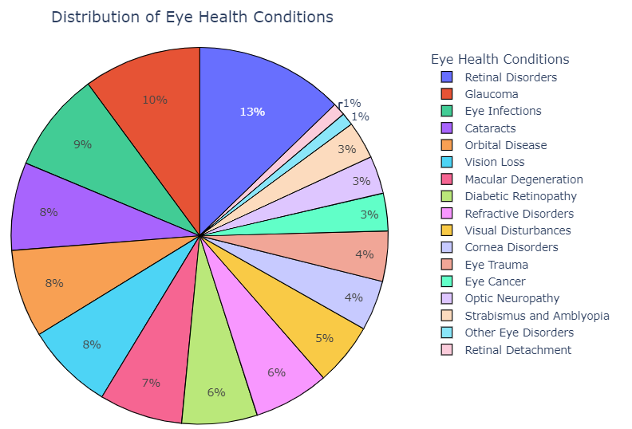
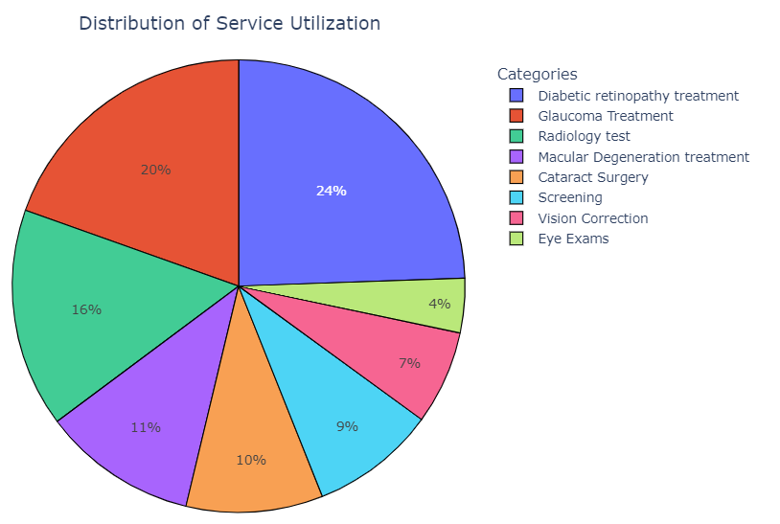
ANALYSIS 5 : Eye Disorder vs Service Utilization
Retinal Disorders and Glaucoma together affect about 23% of the population suffering from vision-related issues in the US.
Diabetic Retinopathy, Glaucoma treatment, and Radiology are the most sought-after Medical Services for eye health in the US.
Among the Medical Services, Diabetic Retinopathy accounted for 24%, Glaucoma treatment for 20%, and Radiology for 16% of the services.
The figures indicate that eye health is a significant concern in the US and that Retinal Disorders and Glaucoma are prevalent among the population.

Slide 22
ANALYSIS & RECOMMENDATIONS
Since, Retinal Disorders and Glaucoma are prevalent among the population. Insurance companies should prioritize eye health coverage plans considering these two major issues.
Among the medical services, Diabetic Retinopathy accounted for 24%, Glaucoma treatment for 20%, and Radiology for 16% of the services. Insurance companies can use this data to determine the most critical services and provide coverage accordingly to ensure that their customers receive adequate medical attention.
Insurance companies should focus on providing comprehensive coverage to all age groups and genders as Age and Gender do not seem to be significant factors in determining eye disorders.
Based on Risk factors, companies may consider higher premiums for individuals with Diabetes and Hypertension due to the increased risk of eye health conditions.
Thus, to be competitive in the US eye insurance market, it is imperative for insurance companies to concentrate on prevalent eye disorder categories and the most sought-after medical services.
The above insights can help them design new products or enhance existing policies to drive profitability and gain an edge over their competitors.

Slide 23
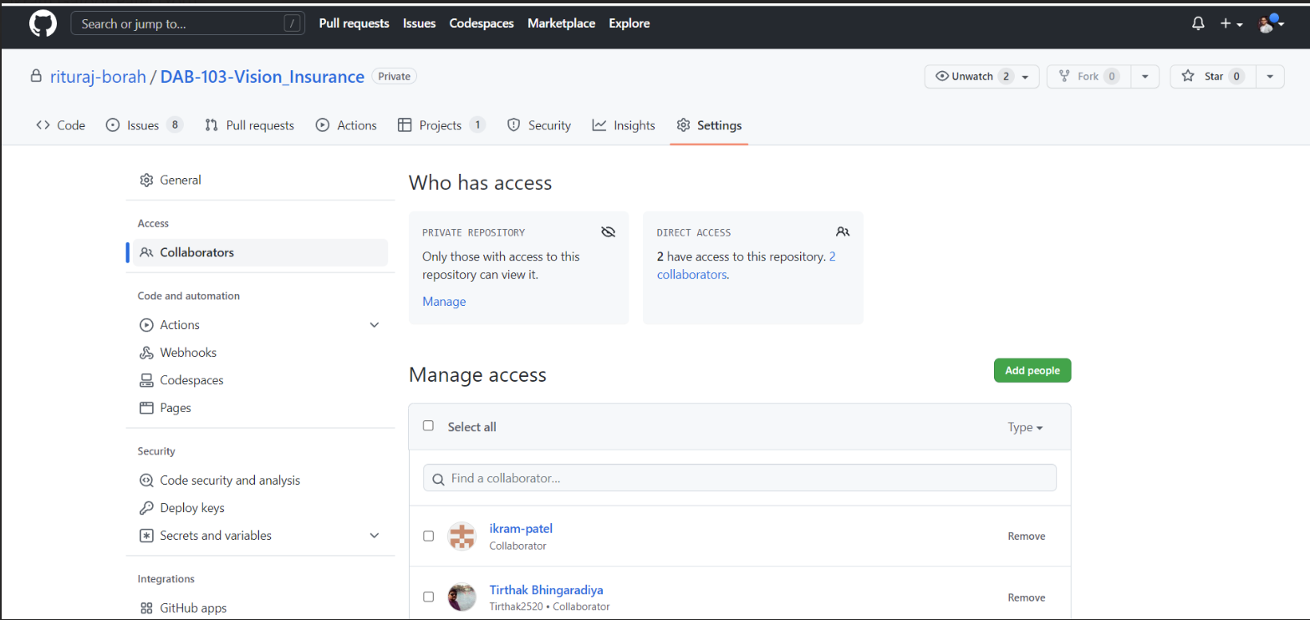
GITHUB PROJECT REPOSITORY
https://github.com/users/rituraj-borah/projects/2/views/1

Slide 24
REFERENCES
Vision impairment and blindness. (2021, October 14). WHO | World Health Organization. https://www.who.int/news-room/fact-sheets/detail/blindness-and-visual-impairment
Visual impairment, blindness cases in U.S. expected to double by 2050. (n.d.). National Eye Institute | National Eye Institute. https://www.nei.nih.gov/about/news-and-events/news/visual-impairment-blindness-cases-us-expected-double-2050
Open Data | Centers for Disease Control and Prevention | Chronic Disease and Health Promotion Data & Indicators. https://chronicdata.cdc.gov/Vision-Eye-Health/Commercial-Medical-Insurance-MSCANCC-Vision-and-Ey/a35h-9yn4
User guide and tutorial — Seaborn 0.12.2 documentation. https://seaborn.pydata.org/tutorial.html
Pandas isin() explained with examples. https://sparkbyexamples.com/pandas/pandas-isin-explained-with-examples/

Slide 25
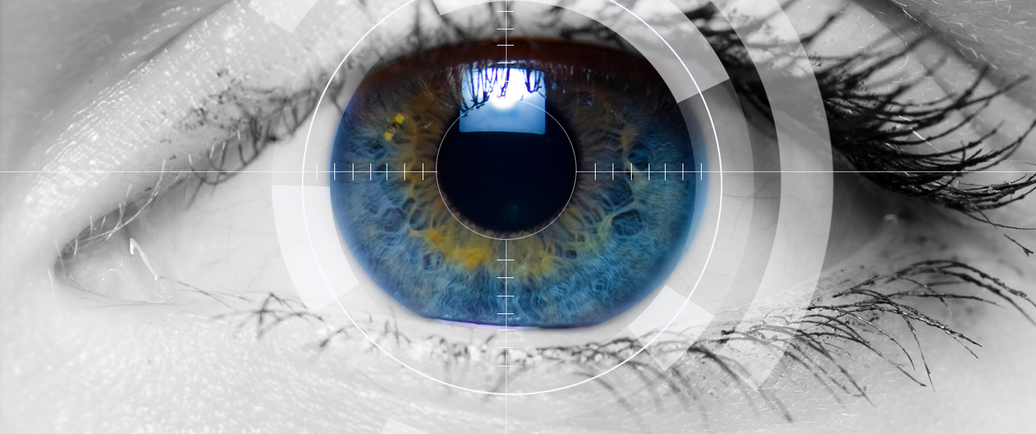
Thank you

