Slide 1
DHTs and their Application to the Design of Peer-to-Peer Systems
Krishna Gummadi

Slide 2
DHTs today
Active area of research for over 2 years now
Ongoing work at almost every major university and lab.
  over 20 DHT proposals; as many for DHT applications
  IRIS : DHT-based, robust infrastructure for Internet-scale systems. 5 year, $12M, NSF-funded project
Large, and growing, research community
  theoreticians, networks and systems researchers

Slide 3
Today’s Discussion
What are DHTs? How do they work?
Why are DHTs interesting?
What are P2P systems? Why are DHTs appealing to P2P system designers?
When should we use DHTs? What apps require DHTs?
  do some current DHT based applications make sense?

Slide 4
What is a DHT?
Hash Table
  data structure that maps “keys” to “values”
  essential building block in software systems
Distributed Hash Table (DHT)
  similar, but spread across many hosts
Interface
  insert(key, value)
  lookup(key)

Slide 5
How do DHTs work?
Every DHT node supports a single operation:
  Given key as input; route messages to node holding key
    DHTs are content-addressable

Slide 6

DHT: basic idea
K V
K V
K V
K V
K V
K V
K V
K V
K V
K V
K V

Slide 7
DHT: basic idea
K V
K V
K V
K V
K V
K V
K V
K V
K V
K V
K V
Neighboring nodes are “connected” at the application-level

Slide 8
DHT: basic idea
K V
K V
K V
K V
K V
K V
K V
K V
K V
K V
K V
Operation: take key as input; route messages to node holding key

Slide 9
DHT: basic idea
K V
K V
K V
K V
K V
K V
K V
K V
K V
K V
insert(K₁,V₁)
K V
Operation: take key as input; route messages to node holding key

Slide 10
DHT: basic idea
K V
K V
K V
K V
K V
K V
K V
K V
K V
K V
insert(K₁,V₁)
K V
Operation: take key as input; route messages to node holding key

Slide 11
DHT: basic idea
(K₁,V₁)
K V
K V
K V
K V
K V
K V
K V
K V
K V
K V
K V
Operation: take key as input; route messages to node holding key

Slide 12
DHT: basic idea
K V
K V
K V
K V
K V
K V
K V
K V
K V
K V
K V
retrieve (K₁)
Operation: take key as input; route messages to node holding key

Slide 13
How to design a DHT?
State Assignment:
  what “(key, value) tables” does a node store?
Network Topology:
  how does a node select its neighbors?
Routing Algorithm:
  which neighbor to pick while routing to a destination?
Various DHT algorithms make different choices
  CAN, Chord, Pastry, Tapestry, Plaxton, Viceroy, Kademlia, Skipnet, Symphony, Koorde, Apocrypha, Land, ORDI …

Slide 14
State Assignment in Chord DHT
000
111
001
110
010
101
011
d(100, 111) = 3
100
Nodes are randomly chosen points on a clock-wise Ring of values
Each node stores the id space (values) between itself and its predecessor

Slide 15
Chord Topology and Route Selection
000
111
110
001
d(000, 001) = 1
110
010
d(000, 010) = 2
101
011
100
d(000, 001) = 4
Neighbor selection: i^{th} neighbor at 2^{i} distance
Route selection: pick neighbor closest to destination
Notes:
Flow is broken

Slide 16
State Assignment in CAN
1
Key space is a virtual d-dimensional Cartesian space

Slide 17
State Assignment in CAN
1
2
Key space is a virtual d-dimensional Cartesian space

Slide 18
State Assignment in CAN
3
1
2
Key space is a virtual d-dimensional Cartesian space

Slide 19
State Assignment in CAN
3
1
2
4
Key space is a virtual d-dimensional Cartesian space

Slide 20
State Assignment in CAN
Key space is a virtual d-dimensional Cartesian space

Slide 21
CAN Topology and Route Selection
(a,b)
S
Route by forwarding to the neighbor “closest” to the destination

Slide 22
State and Neighbor Assignment in Pastry DHT
h = 3
h = 2
h = 1
000
001
010
011
100
101
110
111
Nodes are leaves in a tree
logN neighbors in sub-trees of varying heights

Slide 23
Routing in Pastry DHT
h = 3
h = 2
000
001
010
011
100
101
110
111
111
Route to the sub-tree with the destination

Slide 24
Today’s Discussion
What are DHTs? How do they work?
Why are DHTs interesting?
What are P2P systems? Why are DHTs appealing to P2P system designers?
When should we use DHTs? What apps require DHTs?
  do some current DHT based applications make sense?

Slide 25
Interesting properties of DHTs
Scalable
  each node has O(logN) neighbors
  hence highly robust to churn in nodes and data
Efficient
  lookup takes O(logN) time
Completely decentralized and self-organizing
  hence highly available
Load balanced
  all nodes are equal
  Are DHTs panacea for building
  Scalable Distributed Systems?

Slide 26
Domain Name System Today
13 Root Name Servers (.)
net.
edu.
com.
us.
info.
arpa.
washington,edu.
mobile345.washington,edu.
“Hierarchy is a fundamental way to
accommodating growth and isolating faults “
-- Butler Lampson on Grapevine

Slide 27
Hierarchical DNS vs. DHT based DNS
Contrast 3 hypothetical DHT based DNS systems with existing DNS
  DNS1: all DNS servers (~100,000)
  DNS2: all end hosts (~100,000,000)
  DNS3: only few first level name servers (~1,000)
Points of comparison
Scalability: Number of neighbors per node
Efficiency: Time taken per query
Load Balancing: Per node state and lookup load
Self-organization and Decentralization
Fault isolation and Security

Slide 28
Hierarchy vs. DHT: Scalability
Scalability: # neighbors per node
Very skewed distribution in current DNS
  root-servers store few tens of children (.com, .net)
  Verizon’s .com server has hundreds of 1000’s of children,
  .washington.edu has few hundred department name servers
  cs.washington.edu. has 0 children
O(logN) per node for all DHTs
  DNS1: O(log 100,000) < 20 children
  DNS2: O(log 100,000,000) < 30 children
  DNS3: O(log 1000) < 10 children
  Ignoring other factors,
  DHTs are better for scalability

Slide 29
Hierarchy vs. DHT: Efficiency
Efficiency: Time per query = #lookups * time/lookup
Current DNS: small #(<5) of lookups per query
  primarily due to large branching at .com, .net name servers
  cat.cs.washington.edu. requires at most 4 lookups
  but due to caching most queries need 1 lookup
  nyt.com lookup time = RTT to NYTimes server
DHT based DNS: O(logN) lookups per query
  DNS1: 20 lookups, DNS2: 30 lookups, DNS3: 10 lookups
  with more efficient DHTs it can be O(logN/loglogN) < 5
  can we do caching in DHTs?
  avg. lookup time per query is horrible.
    one-way trip round the world ~1 sec !!

Slide 30
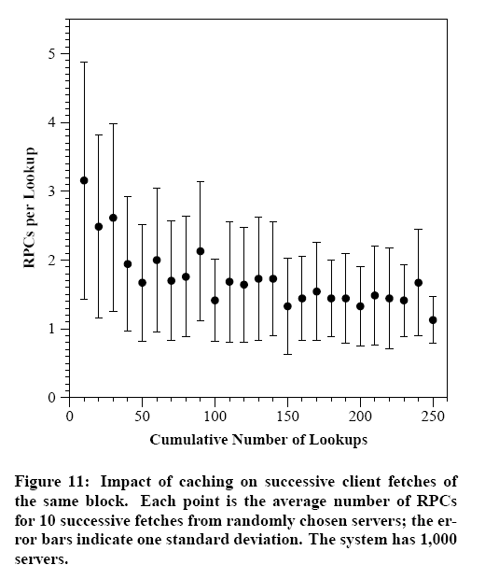
Caching in DHTs
Basic idea: Cache along the lookup path
  1 lookup for repeated queries from same host
But, what about repeated queries from different host in the same domain?
  not equally effective !!
  CFS still requires 3 lookups
Can we make DHTs topologically sensitive?
  this will solve lookup time per query problem too !

Slide 31
Topologically Sensitive DHTs
Idea: Pick close-by nodes while selecting neighbors and routes
Heuristics: Past, CFS
  even a small set of node choices helps
Hierarchical DHTs: SkipNet, Canon
  nodes are organized in a well-defined hierarchy
  Recursive DHTs: nodes at each level of the hierarchy form a DHT

Slide 32
Topological Sensitivity in CAN DHT
WA
MA
PO
CA
FL
Key space is a virtual d-dimensional Cartesian space

Slide 33
Topological Sensitivity in Pastry DHT
h = 3
h = 2
h = 1
000
001
010
011
100
101
110
111
Nodes are leaves in a tree
logN neighbors in sub-trees of varying heights
Select the closest node from various sub-trees

Slide 34
Topological Sensitivity in Chord DHT
000
111
001
110
010
101
011
100
Chord algorithm picks i^{th} neighbor at 2^{i} distance
A different algorithm picks i^{th} neighbor from [2^{i} , 2^{i+1})

Slide 35
Topological Sensitivity in Chord DHT
000
111
110
001
110
010
101
011
100
Chord algorithm picks neighbor closest to destination
CFS algorithm picks the best of alternate paths

Slide 36
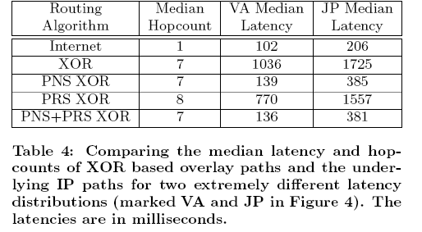
How well do heuristics for topologically sensitive DHTs work?

Slide 37
Topologically Sensitive DHTs
Idea: Pick close-by nodes while selecting neighbors and routes
Heuristics: Past, CFS
  even a small set of node choices helps
Hierarchical DHTs: SkipNet, Canon
  Each node has a well defined positioned in a hierarchy
  Recursive DHTs: nodes at each level of the hierarchy form a DHT

Slide 38
Hierarchy vs. DHT: Efficiency
Efficiency: Time per query = #lookups * time/lookup
Current DNS: small #(<5) of lookups per query
  primarily due to large branching at .com, .net name servers
  cat.cs.washington.edu. requires at most 4 lookups
  but due to caching most queries need 1 lookup
  nyt.com lookup time = RTT to NYTimes server
DHT based DNS: O(logN) lookups per query
  DNS1: 20 lookups, DNS2: 30 lookups, DNS3: 10 lookups
  with more efficient DHTs it can be O(logN/loglogN) < 5
  can we do caching in DHTs? Yes, but we need topological proximity
  avg. lookup time per query is horrible. Need topological proximity
    one-way trip round the world ~1 sec
  Ignoring other factors,
  Hierarchy is better for efficiency,
  if the queries are cacheable

Slide 39
Hierarchy vs. DHT: Load Balancing
Load Balancing: amount of state, # routes per nodes
Current DNS: Huge skew in load per node
  more routes through servers higher in hierarchy
  depends heavily on caching to ease load
  root server stores only a few 10 entries
  verizon’s .com server stores tens of millions of entries
  cs.washington.edu a few 100
  my home NAT box has 4
DHT based DNS: uniform across nodes
  DNS1: 1000/node, DNS2: 1/node, DNS3:100,000/node
  highly resistant to a DOS attack
  but, topological sensitivity upsets uniform state, routes distribution
  some servers more well connected and more powerful than others. should we balance routes, state proportional to capacity?

Slide 40
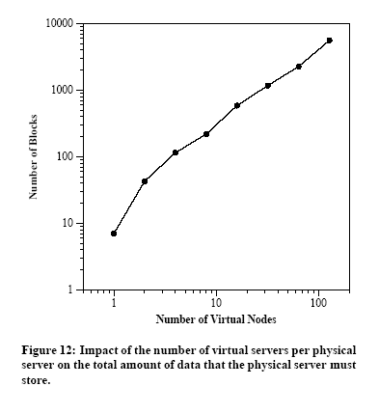
Load Balancing in DHTs with Heterogeneous nodes
Idea: a powerful node can act as multiple less powerful virtual nodes
  but, what if a 10GB machine has 1Mbps connection and 1GB machine has 10 Mbps?
  but, a powerful node’s departure can severely damage the DHT
  but, do we really want every node in DHT to forward/reply queries at the speed of 56Kbps modems?
This might NOT be such a good idea

Slide 41
Hierarchy vs. DHT: Load Balancing
Load Balancing: amount of state, # routes per nodes
Current DNS: Huge skew in load per node
  more routes through servers higher in hierarchy
  depends heavily on caching to ease load
  root server stores only a few 10 entries
  verizon’s .com server stores tens of millions of entries
  cs.washington.edu a few 100
  my home NAT has 4
DHT based DNS: uniform across nodes
  DNS1: 1000/node, DNS2: 1/node, DNS3:100,000/node
  very difficult to launch a DOS attack
  but, topological sensitivity upsets uniform state, routes distribution
  Ignoring other factors,
  DNS3 > DNS1 > DNS > DNS2

Slide 42
Hierarchy vs. DHT:
Decentralization and Self-organization
Current DNS: Clearly defined administrative domains, replication of primary servers to secondary servers is a manual process
DHT based DNS: no way to enforce domain names !! replication automatic
  system maintains some constant “K” replicas based on the rate at which nodes fail
  but, how do we determine “K”, if the failure rates vary massively between clients (the problem of heterogeneity)
  Ignoring other factors,
  DNS3 > DNS > DNS1 > DNS2

Slide 43
Hierarchy vs. DHT:
Fault Isolation and Security
Current DNS: Failures in one domain do not affect another; security model is trust your higher-ups in hierarchy
  microsoft DNS server crashes do not affect rest of world
  Verizon spends millions of dollars to ensure its .com server does not crash, cs.washington.edu spends a few 100 dollars for its server
DHT based DNS: provides no fault isolation; security model is trust everyone
  if I turn off my sever, someone else’s data is lost
  what if the server my data is on is malicious?
  why would verizon’s million dollar server serve someone else’s data?
  Ignoring other factors,
  DNS > DNS3 > DNS1 > DNS2

Slide 44
Hierarchy vs. DHT: Summary
Scalability
  DHT > Hierarchy
Efficiency
  Hierarchy > DHT
  DHTs troubled by hosts located in different areas
Load Balancing
  DNS3 > DNS1 > DNS > DNS2
  DHTs troubled by hosts with different capacities
Self-organization and Decentralization
  DNS3 > DNS > DNS1 > DNS2
  DHTs troubled by enforcing uniform policy over peers with different goals
Fault isolation and Security
  DNS > DNS3 > DNS1 > DNS2
  DHTs troubled by hosts with different reliabilities and trust policies

Slide 45
DHT’s Achilles Heel: Heterogeneity
DHTs are fantastic for building large scale homogeneous distributed systems
  so, if we ever want to deploy a DHT based DNS it should be DNS3 (i.e., DNS over 1000 first level name servers)
We are not claiming heterogeneous systems cannot be built over DHTs
  building heterogeneous systems often requires careful engineering of the DHT

Slide 46
Today’s Discussion
What are DHTs? How do they work?
Why are DHTs interesting?
What are P2P systems? Why are DHTs appealing to P2P system designers?
When should we use DHTs? What apps require DHTs?
  do some current DHT based applications make sense?

Slide 47
What are P2P systems?
Peer-to-Peer as opposed to Client-Server
All participants in a system have uniform roles
  they act as clients, servers and routers
  popular P2P apps: Seti@home, Kazaa, Napster
Technological trends favoring P2P
  client desktops have increasingly larger storage, computation power and bandwidth
  millions of clients connected to the Internet
P2P systems leverage the power of these clients
  Seti@home leverage computation power
  Kazaa, Napster leverage bandwidth
  CFS, PAST leverage storage

Slide 48
Why are DHTs appealing to
P2P System Designers?
They are Scalable, Load-balanced and Decentralized, Self-organizing
They are Content-Addressable
  in CFS, a query for content does not specify host
  in NFS, a query specifies content on a particular host
  Internet is by and large host-addressable
  DNS started as an Arpanet host naming scheme

Slide 49

Content Addressability in a DHT
♫♫♫
A
HASH(xyz.mp3) = K₁

Slide 50
Content Addressability in a DHT
K₁
(xyz.mp3, A)
insert
♫♫♫
A
HASH(xyz.mp3) = K₁

Slide 51
Content Addressability in a DHT
K₁
(xyz.mp3, A)
lookup
♫♫♫
A
B
HASH(xyz.mp3) = K₁

Slide 52
Content Addressability in a DHT
K₁
(xyz.mp3, A)
♫♫♫
A
B
♫♫♫

Slide 53
Why are DHTs appealing to
P2P System Designers?
They are Scalable, Decentralized, Self-organizing
They are Content-Addressable
  in CFS, a query for content does not specify host
  in NFS, a query specifies content on a particular host
  Internet is by and large host-addressable
  DNS started as an Arpanet host naming scheme
DHTs provide flat-application independent naming, many apps/services can co-exist on one DHT

Slide 54
One DHT, many uses
K₁
(xyz.mp3, A)
♫♫♫
A
B
♫♫♫
♫♫♫
“♫♫♫” could as easily have been a web page, disk block, service, DNS name, …

Slide 55
Content-addressability: key insight
Content-addressability provides a level of indirection between consumers and providers of content/service
  “Any computer systems problem can be solved by adding a level of indirection”
Eliminates need for consumers to know providers & vice-versa
  allows a new raft of applications like anycast, multicast, service composition etc.,
  anycast: single consumer, multiple providers
    fetch content X from the best server
    client should know only a few servers
  multicast: single provider, multiple consumers
    supply content X to a large number of clients
    server should know only a few clients

Slide 56
Applications of Content Addressability:
Anycast (find closest server with xyz.mp3)
C
B
K₁
(xyz.mp3, A)
(xyz.mp3, B)
(xyz.mp3, C)
insert
A

Slide 57
A Topologically Sensitive DHT
can support Anycast
C
B
K₁
(xyz.mp3, A)
(xyz.mp3, C)
(xyz.mp3, B)
(xyz.mp3, C)
(xyz.mp3, A)
A
“anycast” lookup could be based any metric.
Here, we consider latency

Slide 58
Anycast today
Chat
Blogs
Web
(Client/Server)
Applications
Hierarchical name
and service structure
Indirection
services
DNS
(by hostname)
IP
Connectivity

Slide 59
Anycast today
Chat
Blogs
Web
(Client/Server)
Applications
Hierarchical name
and service structure
Google
(by keyword)
CDNs
(by name)
manual
Indirection
services
Ad hoc hacks
DNS
(by hostname)
IP
Connectivity
Notes:
But…
1) Google not application?

Slide 60

Applications of Content Addressability:
Multicast (find all clients needing xyz.mp3)
D
B
E
(xyz.mp3, D)
(xyz.mp3, E)
(xyz.mp3, F)
F
(xyz.mp3, K₂ )
K₃
(xyz.mp3, B)
K₁
K₂
(xyz.mp3, K₃ )
(xyz.mp3, C)
C
A
HASH(xyz.mp3) = K₁
Scalable multicast dissemination

Slide 61
Indirection today
Chat
Blogs
Web
(Client/Server)
Non client-server
applications
Applications
Hierarchical name
and service structure
EndSystem
Mcast
KaZaa
Napster
Google
(by keyword)
CDNs
(by name)
manual
Mobile IP
(by home IP
address)
Indirection
services
Ad hoc hacks
DNS
(by host names)
Application specific
Home agent
IP
Connectivity
Notes:
But…
1) Google not application?

Slide 62
Can we retrofit content addressability over DNS through creative hacks?
Possible, but very unattractive
DNS based anycast (Akamai) reduces effectiveness of caching
  huge stress on the DNS servers higher up in the hierarchy
DNS based multicast, mobileip require constant updates to DNS databases
  once again, effectiveness of caching is reduced
Content addressability fits naturally in DHTs

Slide 63
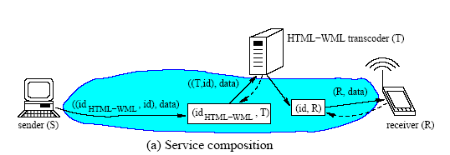
Applications of Content Addressability:
Service Composition

Slide 64
A vision for DHT based
Content Addressable Internet
A ubiquitous, generic DHT infrastructure that provides an explicit indirection service
  over which a rich assortment of services are layered
  opening up a new generation of large-scale distributed applications

Slide 65
A DHT-enabled Internet
P2P
Client/Server
Web
dChat
File
Systems
(Casper, Past
CFS, OStore)
PIER
Wb
dEmail
blogs
content publishing/distribution
collaborative apps
Internet distr. systems
dGoogle
(by keyword)
SFR
(content)
DNS
(by location)
CDN-like
(by name)
pSearch
(by interest)
i3
mcast
rv
dhash
CASLIB
PHT
commn. services
storage services
ReHash
directory services
compute
services
DHT
Indirection service
IP
Connectivity

Slide 66
Why are DHTs appealing to
P2P System Designers?
They are Scalable, Load-balanced and Decentralized, Self-organizing
They are Content-Addressable
  mask server churn from clients and vice-versa

Slide 67
Today’s Discussion
What are DHTs? How do they work?
Why are DHTs interesting?
What are P2P systems? Why are DHTs appealing to P2P system designers?
When should we use DHTs? What apps require DHTs?
  do some current DHT based applications make sense?

Slide 68
When should we use DHT?
Does the system need to scale?
Does the system have heterogeneous nodes?
Does the system need self-organization? Do nodes fail often?
Do the economies of scale favor decentralization?
Can the system tolerate security risks due to decentralization?
Do you need content addressability?

Slide 69
The Good, The Bad and The Ugly
Application of DHTs
The Good
  corporation wide file-systems
    Farsite, GFS, LOCKSS
  sensor networks and queries over them
    Pier
  corporate multicast, video-conferencing
    Akamai, Scribe
The Bad
  Wide-area file-sharing
    Overnet, DHT based Napster
The Ugly
  internet wide file-systems, backups
    CFS, Past, Ivy
  collaborative spam filtering

Slide 70
Questions

