Slide 1
Topic: Education
Hack: Social Welfare
By Team UMANG

Slide 3
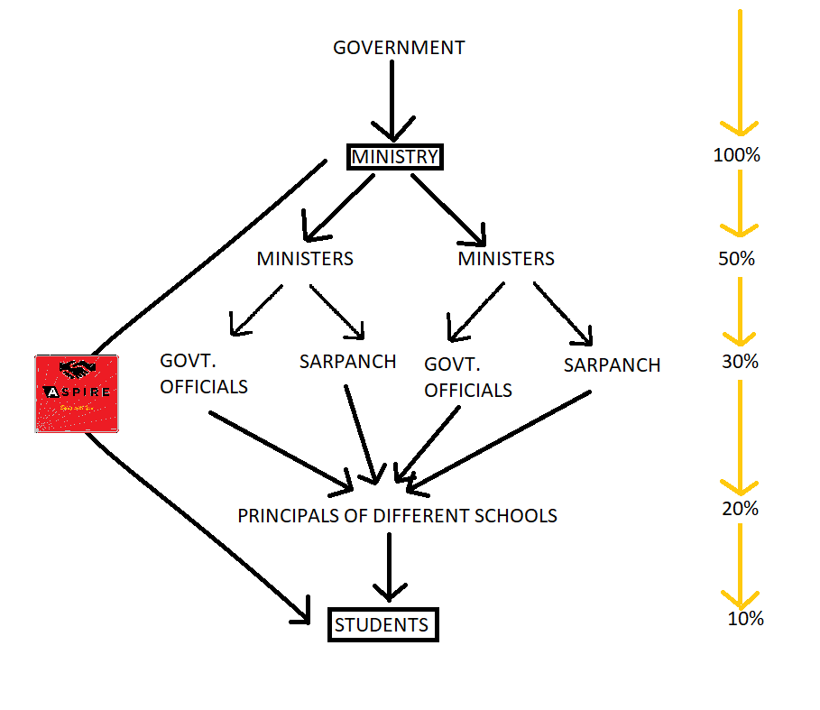
Scholarship Distribution

Slide 4

By Team UMANG

Slide 5

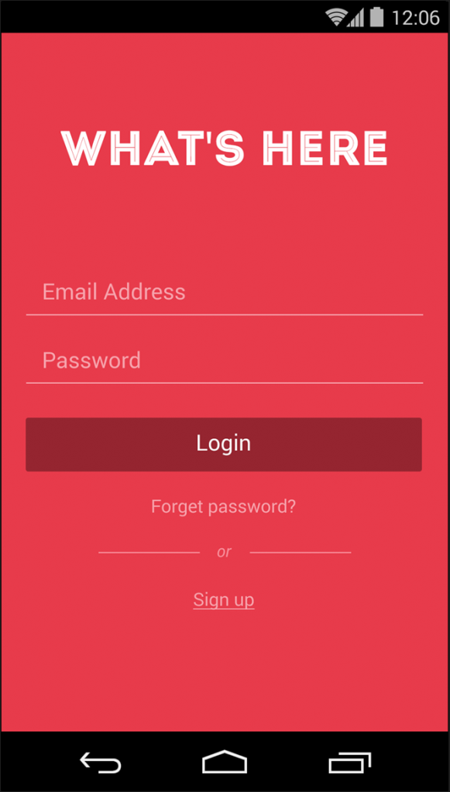


Login Page

Slide 6
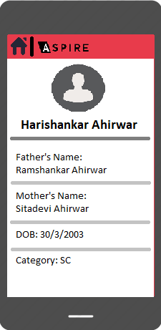

Slide 7
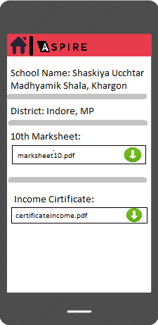

Slide 8
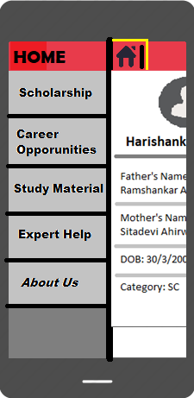

Slide 9
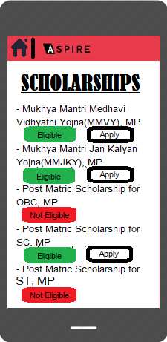

Slide 10
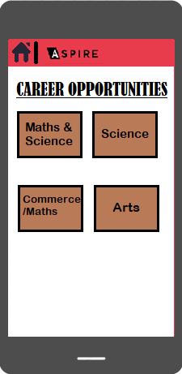

Slide 11
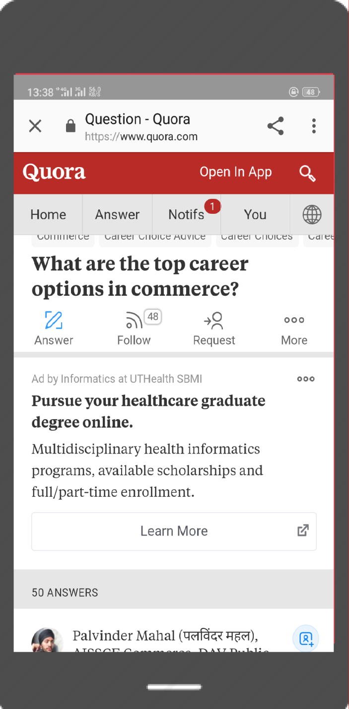

Slide 12
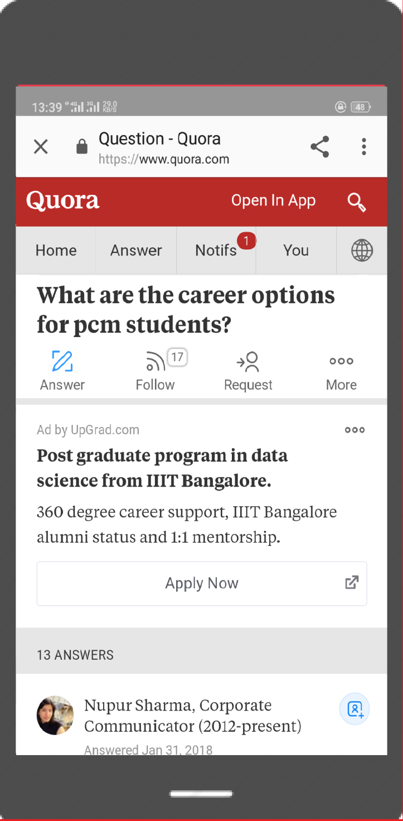

Slide 13
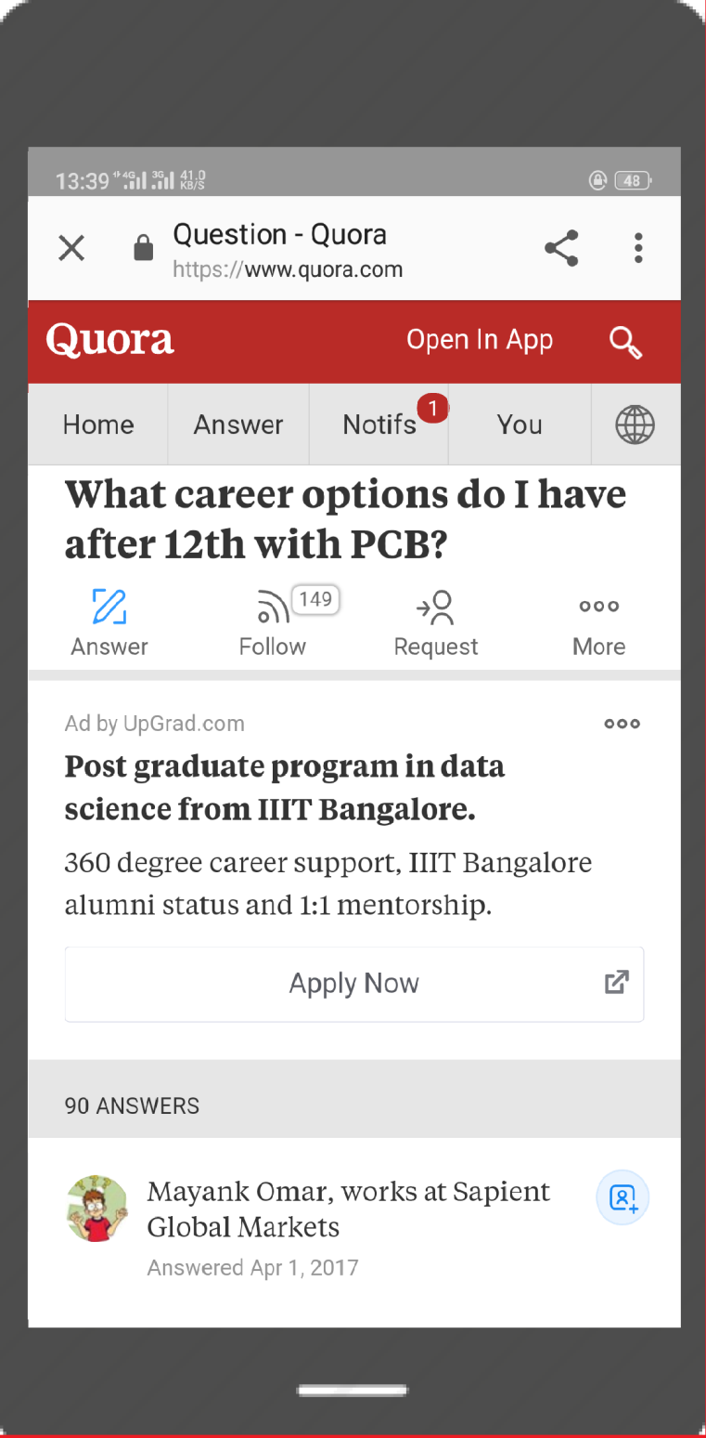

Slide 14
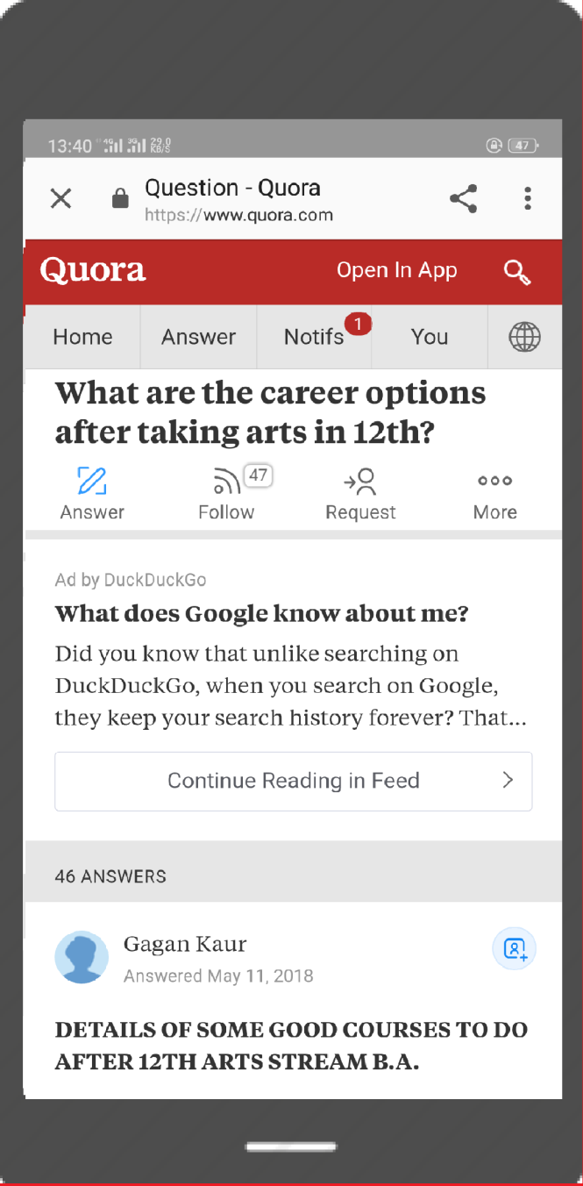

Slide 15
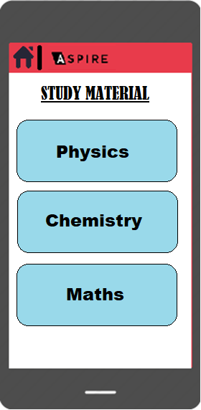

Slide 16
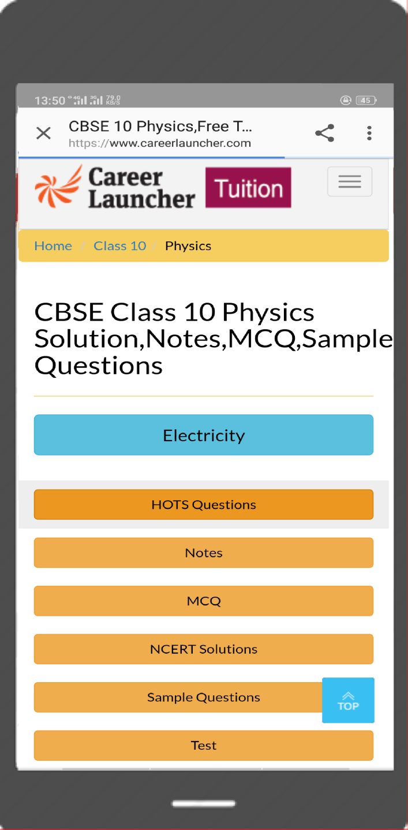

Slide 17
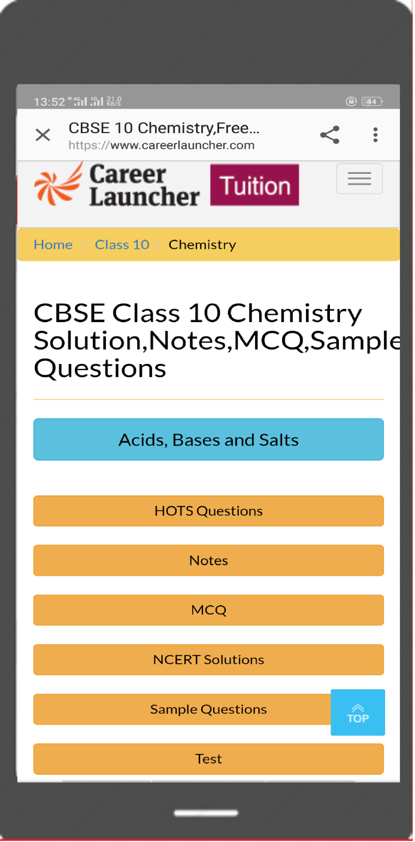

Slide 18
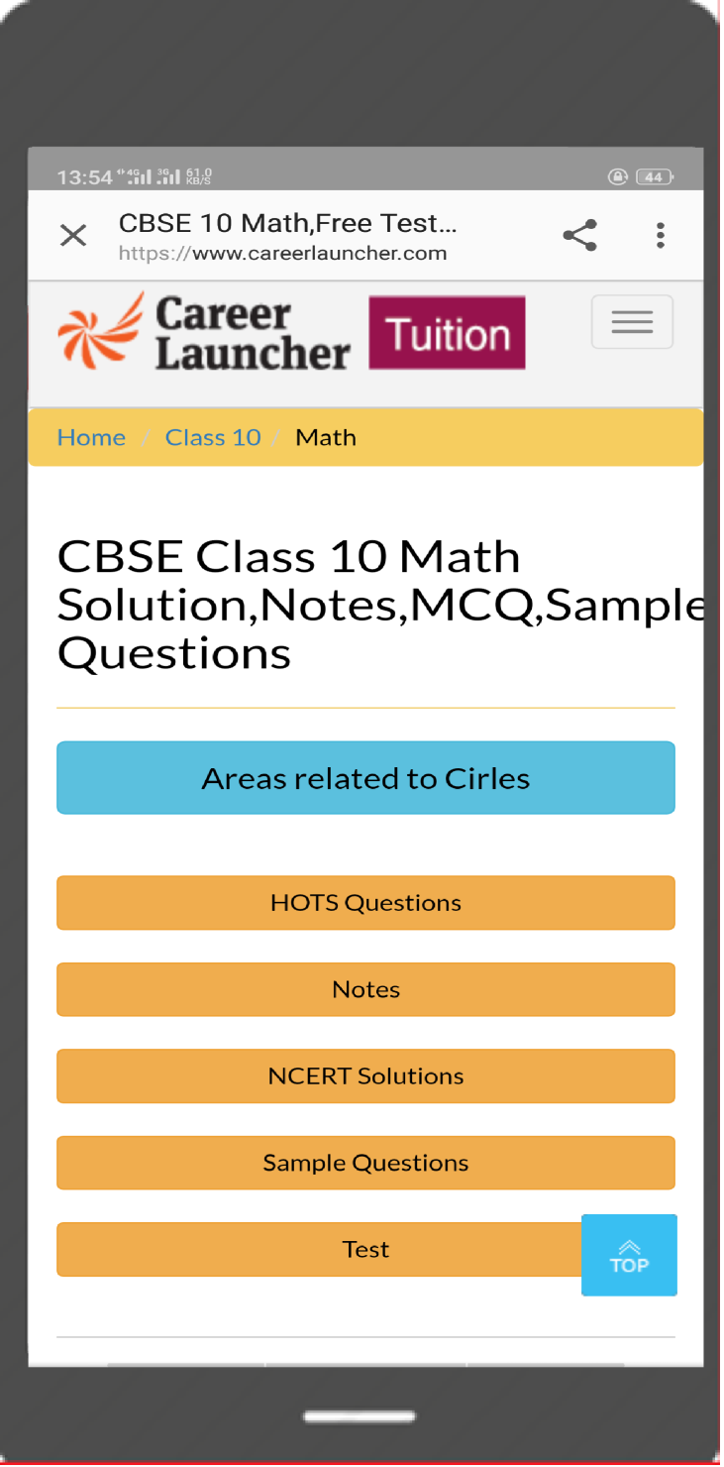

Slide 19
PROOF OF CONCEPT OF APP ‘ASPIRE’
Study Material is provided.
First we will advertise websites like Aglasem.com, Career Launcher, etc. After the government starts using the app, the traffic will increase on the websites and the websites will pay revenue according to the deal.
Career Opportunities are highlighted.
In ASPIRE, career opportunities option is provided so that those students who are facing problem in career selection would be able to take their own decision easily. Career opportunities according to the subject will be shown with the help redirection of websites like quora.com, career360.com. After the government starts using the app, the traffic will increase on the websites and the websites will pay revenue according to the deal.

Slide 20
Literacy Level rises.
Our app supports the education in rural areas. The students will be directly influenced to study well and build their career, which will increase the literacy rate of state and help in betterment of society.
Decrease in crimes.
As already stated, the app ASPIRE ensures rural education. Also the student will be directly informed about the scholarship. This will motivate student to study harder. This will keep them from distractions into with rural kids creep in.

Slide 21
BUSINESS MODULE
We all know that there are approx. 5000 government Higher Secondary schools in MP, among which more than half of then are in rural areas. The condition of rural areas is not that good enough to have the facility of internet and coaching. So, due to this, people residing there are lacking with educational qualifications. So, they cant achieve their goals and get diverted from their paths into the wrong path.
ASPIRE is different from all the apps available in the market in features, specifications and the privacy. We will be only linking to the government to increase the literacy level and social welfare by this app.

