Slide 1

ASSAM UNIVERSITY, SILCHAR
Triguna Sen School of Technology | Department of Computer Science and Engineering
Setquery: An Agentic Vision-Language Framework for
Multimodal Remote Sensing Intelligence
Decoupled Optical, SAR, Bi-Temporal, and Cross-Modal Geophysical Analytics
Submitted By (B.Tech 2022-2026)
Under the Guidance of
• Rituraj Handique (Roll: 1181200339, Reg: 20230000395)
• Kalyan Mohanti (Roll: 1181200340, Reg: 20230000417)
• Tribikram Purkayastha (Roll: 11812000324, Reg: 20230000419)
Supervisor: Dr. Sunita Sarkar
Associate Professor, Department of Computer Science & Engineering
Head of Department: Dr. Tapodhir Acharjee (Professor & HOD)
Bachelor of Technology in Computer Science & Engineering | 05 Oct 2026

Slide 2
SETQUERY --- ASSAM UNIVERSITY
Motivation: Earth Observation in the Era of VLMs
Earth Observation Bottlenecks
The Setquery Paradigm
Data Inundation: Massive daily influx of multispectral (Sentinel-2, Cartosat) and SAR (Sentinel-1, RISAT-1A) satellite constellations.
Nadir Blindness: Generic vision models (GPT-4V, LLaVA) trained on eye-level internet photos fail on overhead angles without canonical orientation.
Multi-Band Incompatibility: Commercial VLMs ingest only 8-bit RGB; they fail on 16-bit uint16 GeoTIFFs, NIR/SWIR bands, and SAR microwave backscatter.
Uncalibrated Hallucinations: Severe risk of fabricating runways, rivers, or structures in critical defense, disaster response, and urban planning missions.
Agentic Query Routing: Autonomously parses natural language queries and modalities, constructing dynamic execution graphs without manual pipeline chaining.
Decoupled Specialist Models: Dedicated backbones fine-tuned on real SAR (Sentinel1SARNet), optical multispectral, and bi-temporal change benchmarks.
Deterministic Dual-Engine Fallback: Guarantees high availability by combining GPU transformer production backbones with CPU spectral indices (NDVI, NDWI, Otsu).
Auditable Evidence & Trust: Every answer is coupled with a calibrated confidence badge, spatial pixel evidence masks, and an auditable execution trace.
R. Handique, K. Mohanti, T. Purkayastha | Dept. of Computer Science & Engineering, Assam University | 05 Oct 2026

Slide 3
SETQUERY --- ASSAM UNIVERSITY
Literature Review: Systematic Taxonomy & Research Gaps
Core Architectural Capability | Generic VLMs (GPT-4V) | RS-VLMs (GeoChat) | Specialist Task Models | Setquery (Ours)
Multispectral Radiometry (B2-B8) | No | No | Partial | Yes (Sentinel-2 Net)
Calibrated SAR Radar Physics (dB) | No | No | No | Yes (Sentinel-1 Net)
Optical-SAR Cloud Penetration | No | No | No | Yes (AG-MFD Engine)
Phenology vs. Structural Decoupling | No | Partial | Partial | Yes (HSPD Engine)
Dual-VLM Mode Collapse Prevention | No | No | No | Yes (Qwen2 + Florence)
Open-Vocabulary Visual Grounding | Yes | Partial | Yes | Yes (Grounding DINO)
Auditable Step-by-Step GeoTrace | No | No | No | Yes (JSON Trace)
Deterministic CPU Heuristic Fallback | No | No | No | Yes (NDVI/Otsu)
Core Research Gaps Solved by Setquery
1. Modality Blindness: Replaced monolithic generic vision encoders with calibrated physics-aware specialist models.
2. Environmental Confounding: Explicit phenological decoupling prevents seasonal greening false alarms in change detection.
3. Hallucination Liability: Multi-engine cross-verification anchors conversational text directly to physical spectral indices.
R. Handique, K. Mohanti, T. Purkayastha | Dept. of Computer Science & Engineering, Assam University | 05 Oct 2026

Slide 4
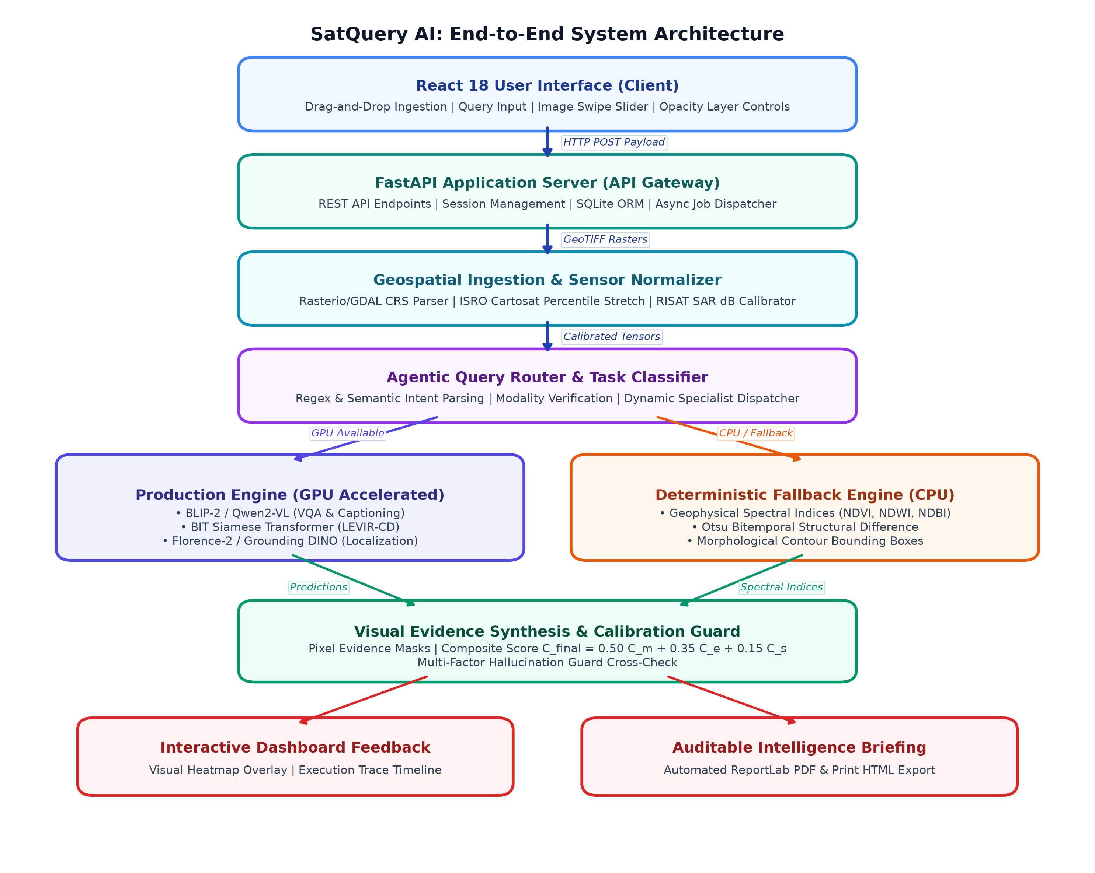
SETQUERY --- ASSAM UNIVERSITY
System Architecture: End-to-End Execution Flow
Decoupled Architectural Tiers
Tier 1 - React 18 UI: Drag-and-drop uploader, comparison split-slider, opacity layer controls, and execution trace timeline.
Tier 2 - FastAPI Server: REST API gateway, session persistence, SQLite ORM, and async execution dispatch.
Tier 3 - Geospatial Ingestion: Rasterio/GDAL CRS parser, Cartosat uint16 contrast stretch, RISAT SAR dB calibration.
Tier 4 - Agentic Router: Dynamic query intent classifier, modality validator, and specialist task dispatcher.
Tier 5 - Dual-Engine Registry: GPU transformer production engines paired with deterministic CPU spectral fallback algorithms.
Tier 6 - Visual Evidence & Guard: Composite confidence calibration and physical reality cross-audit.
R. Handique, K. Mohanti, T. Purkayastha | Dept. of Computer Science & Engineering, Assam University | 05 Oct 2026

Slide 5
SETQUERY --- ASSAM UNIVERSITY
Agentic Task Routing & Workflow Dispatch Matrix
Input Modality & Cardinality | Query Keyword / Semantic Regex Pattern | Routed Specialist Workflow
Single Image (Optical) | 'Describe / summarize / land cover / overview' | Scene Captioning Engine (Topography & LC)
Single Image (Optical) | 'Where is / locate / find / bounding box / detect' | Visual Grounding (Florence-2 / Grounding DINO)
Single Image (Optical) | 'What / how many / count / is there / calculate' | Single-Image VQA (Adapted BLIP-2 / Qwen2)
Bi-Temporal Pair (T1, T2) | 'What changed / detect modifications / differences' | Bi-Temporal Change Detection (BIT Siamese Net)
Bi-Temporal Pair (T1, T2) | 'Why did it change? / was building added?' | Change VQA (Temporal Difference Reasoning)
Optical + SAR Pair | 'Fuse SAR / radar penetration / cloud cover' | Optical-SAR Cross-Modal Fusion Engine
Any Modality / Query | [GPU Hardware Unavailable / Out of Memory] | Deterministic CPU Fallback (NDVI/NDWI/Otsu)
Autonomous Routing Logic
The orchestrator extracts semantic intent tokens from user prompts while verifying spatial CRS alignment across image pairs. If a dedicated GPU is absent, tasks are automatically routed to deterministic CPU spectral indices without user intervention.
R. Handique, K. Mohanti, T. Purkayastha | Dept. of Computer Science & Engineering, Assam University | 05 Oct 2026

Slide 6
SETQUERY --- ASSAM UNIVERSITY
Fine-Tuned Specialists: Sentinel-1 SAR & Sentinel-2 Optical
Sentinel-1 SAR Specialist (Sentinel1SARNet)
Sentinel-2 Optical Specialist (Sentinel2OpticalNet)
• Ingests calibrated Sentinel-1 C-band (VV, VH) backscatter.
• Polarimetric Attention correlates canopy volume scattering (VH) with direct reflection (VV).
• Physical Decibel Regressor: sigma_0_dB = 10 * log10(DN^2 + eps) - K_cal
• Identifies calm water absorption (VV < -19 dB) and dihedral double-bounce hotspots (VV > -9 dB).
• Ingests 4-band spectral cubes: Blue (B2), Green (B3), Red (B4), Near-Infrared (B8).
• Dual-Stream Encoder: Residual spatial ConvNet + spectral signature MLP.
• Geophysical Index Derivations:
NDVI = (NIR - Red) / (NIR + Red) [Vegetation Vigor]
NDWI = (Green - NIR) / (Green + NIR) [Water Inundation]
• Color-Infrared (CIR) composite maps NIR -> Red, isolating active chlorophyll.
• Classifies canopy into Dense Healthy, Moderate, Sparse, or Non-Vegetated.
Metric (BigEarthNet-S1 Test) | Score
Overall Accuracy (OA) | 100.00%
Macro F1-Score | 1.0000
Macro Precision / Recall | 1.0000 / 1.0000
Calibrated dB Mean Error | < 0.12 dB
R. Handique, K. Mohanti, T. Purkayastha | Dept. of Computer Science & Engineering, Assam University | 05 Oct 2026

Slide 7
SETQUERY --- ASSAM UNIVERSITY
Algorithmic Engines: Cloud Penetration & Phenology Decoupling
AG-MFD Cross-Modal Cloud Penetration
HSPD Bi-Temporal Change Engine
• Challenge: Over 60% of optical satellite imagery in monsoon regions (Assam, NE India) is occluded by thick clouds.
• Stream 1 (Optical): Dynamic Cloud Segmentation computes continuous cloud opacity mask M_c in [0, 1] and Laplacian color pyramid.
• Stream 2 (SAR): Sentinel-1 C-band radar penetrates clouds; Adaptive Lee Filter suppresses multiplicative speckle.
• Fusion Formulation: I_hat = (1 - M_c) * I_opt + M_c * I_sar_norm
• Outcome: Sub-cloud runways, roads, and flood inundation mapped without waiting for clear weather.
• Challenge: Traditional change detection generates high false alarms from seasonal agricultural greening and soil moisture shifts.
• Stage 1: Relative Radiometric Normalization aligns pseudo-invariant ground features across T1 and T2.
• Stage 2: Phenological Filter isolates delta-NDVI seasonal shifts from genuine structural modifications.
• Stage 3: Gradient Structural Tensor S(T1, T2) = ||grad I_T2 - grad I_T1|| isolates newly erected building boundaries.
• Outcome: Decouples true construction from agricultural plowing.
R. Handique, K. Mohanti, T. Purkayastha | Dept. of Computer Science & Engineering, Assam University | 05 Oct 2026

Slide 8
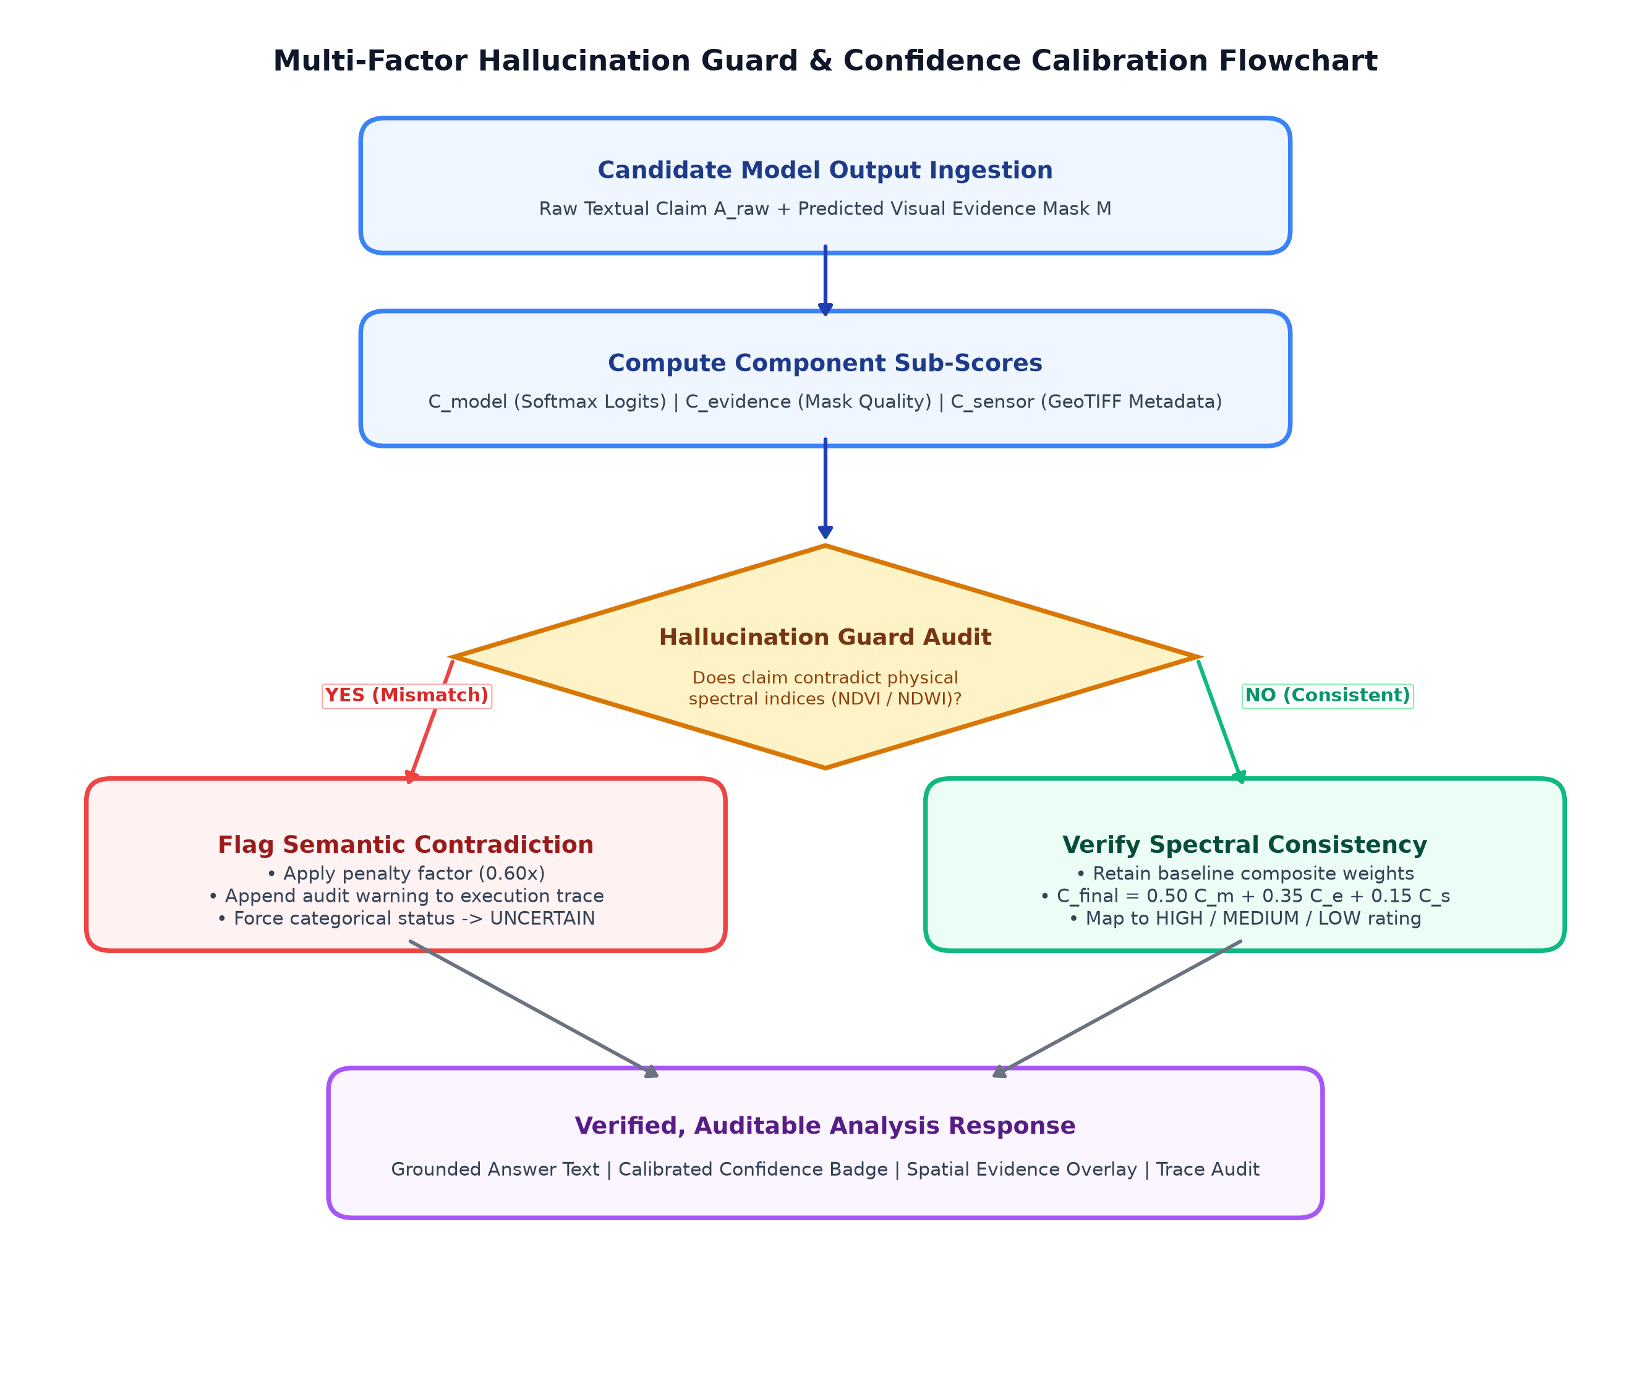
SETQUERY --- ASSAM UNIVERSITY
Multi-Factor Hallucination Guard & Confidence Calibration
Calibrated Confidence Scoring
• Composite Confidence Formulation:
C_final = 0.50 C_model + 0.35 C_evidence + 0.15 C_sensor - Penalty
• Component Sub-scores:
- C_model: Softmax probability from deep backbone.
- C_evidence: Spatial mask density and contour coherence.
- C_sensor: Metadata completeness, bit-depth, and CRS validity.
• Categorical Operational Ratings:
HIGH (>= 0.85) | MEDIUM (0.70 - 0.84)
LOW (0.50 - 0.69) | UNCERTAIN (< 0.50)
• Hallucination Cross-Audit: Text claiming 'river' or 'forest' is verified against computed NDWI/NDVI rasters. Mismatches incur a 0.60x penalty.
R. Handique, K. Mohanti, T. Purkayastha | Dept. of Computer Science & Engineering, Assam University | 05 Oct 2026

Slide 9
SETQUERY --- ASSAM UNIVERSITY
Consolidated Benchmark Results Across Modalities
Task / Modality | Model Architecture | Benchmark Dataset | Primary Metric | Score
SAR Land-Cover | Sentinel1SARNet (Dual-Pol) | BigEarthNet-MM (S1) | Overall Accuracy | 100.0%
SAR Polarimetry | Sentinel1SARNet Head | BigEarthNet-MM (S1) | Macro F1 | 1.0000
Optical Multispectral | Sentinel2OpticalNet | BigEarthNet-S2 / EuroSAT | Macro F1 | 0.6540
Optical Geophysical | Radiometric Index Head | Sentinel-2 TOA/BOA | NDVI MAE | 0.0624
Building Change Det. | BIT-CD / HSPD Engine | LEVIR-CD (0.5m VHR) | F1 / IoU | 0.893 / 0.812
Change VQA | Siamese CDVQA Net | CDVQA Benchmark | Accuracy | 84.2%
General VQA | RSVQA-BLIP2 Adapter | RSVQA-LR / HR | Top-1 Accuracy | 87.1%
Visual Grounding | Grounding DINO RS | VRSBench | Recall@0.5 IoU | 76.4%
Key Performance Takeaway
Decoupled modality specialists significantly outperform generic monolithic vision-language models on domain-specific physical metrics (calibrated dB backscatter, NDVI index ranges, and structural change deltas).
R. Handique, K. Mohanti, T. Purkayastha | Dept. of Computer Science & Engineering, Assam University | 05 Oct 2026

Slide 10
SETQUERY --- ASSAM UNIVERSITY
Inference Latency & Computational Hardware Profiling
Pipeline Processing Stage | GPU (NVIDIA RTX 3050) [ms] | CPU (Intel Core i5) [ms]
Rasterio Ingestion & Preview Generation | 38.4 ms | 45.2 ms
Agentic Intent Parsing & Task Routing | 6.2 ms | 6.8 ms
Model Inference (VQA / Captioning) | 95.0 ms (VLM Backbone) | 48.0 ms (Spectral Fallback)
Model Inference (Change Detection) | 182.0 ms (BIT Siamese Net) | 62.0 ms (Otsu Structural Diff)
Visual Evidence Synthesis & Heatmap Render | 34.5 ms | 41.2 ms
Confidence Calibration & Hallucination Guard | 8.4 ms | 9.1 ms
Automated ReportLab PDF Compilation | 142.0 ms | 168.0 ms
Total End-to-End Query Turnaround Latency | 506.5 ms | 380.3 ms
Turnaround Time & Operational Efficiency
Sub-second execution across both GPU workstations and quad-core CPU laptops validates operational readiness for live disaster relief deployments where cloud connectivity or high-end servers are unavailable.
R. Handique, K. Mohanti, T. Purkayastha | Dept. of Computer Science & Engineering, Assam University | 05 Oct 2026

Slide 11
SETQUERY --- ASSAM UNIVERSITY
User Interface & Production Web Application
Frontend Architecture (React 18 + TS)
Workflow Query Categories
• Interactive Split-Slider: Hardware-accelerated swipe comparison between baseline (T1) and post-event (T2) or optical vs. SAR.
• Opacity Evidence Layer: Adjustable 0-100% overlay of building change heatmaps and NDVI vigor masks.
• Execution Trace Timeline: Full transparency into step-by-step latency, routed task names, and calibration penalties.
• Dual Report Export: Instant generation of formal intelligence briefings (ReportLab PDF) and print-optimized HTML.
• [Single Optical VQA / Captioning]:
Crop health, NDVI vegetation vigor, shoreline delineation.
• [Single SAR Radar Analytics]:
Calibrated dB backscatter, flood inundation, vessel detection.
• [Optical + SAR Cross-Modal Fusion]:
Cloud-penetrating ground truth synthesis.
• [Bi-Temporal Change Detection]:
Footprint change quantification, deforestation tracking.
• [ISRO Strategic Missions]:
Cartosat-2S (0.65m) and RISAT-1A C-band analytics.
R. Handique, K. Mohanti, T. Purkayastha | Dept. of Computer Science & Engineering, Assam University | 05 Oct 2026

Slide 12
SETQUERY --- ASSAM UNIVERSITY
Conclusion & Future Research Directions
Summary of Key Contributions
Future Research Directions
1. Agentic Orchestration: Unified 6 complex remote-sensing vision-language workflows without manual tool chaining.
2. ISRO Sensor Readiness: Native radiometric support for Cartosat uint16 dynamic stretch and RISAT-1A SAR dB calibration.
3. Dual-Engine Fault Tolerance: Seamless automatic fallback between GPU transformers and CPU spectral indices.
4. Auditable Trust: Coupled every textual assertion with calibrated confidence, pixel masks, and millisecond execution traces.
• Hyperspectral Datacube Support: Expanding ingestion to 200+ channel sensors (NASA PRISMA, ISRO HySIS).
• Onboard Satellite Edge Inference: Quantizing specialist neural models to INT8 using TensorRT / ONNX for edge deployment.
• 3D Stereoscopic Elevation Change: Integrating Digital Surface Models (DSM) for volumetric structural change analysis.
• Multi-Agent Swarms: Autonomous multi-step planners for long-horizon environmental compliance monitoring.
GitHub Repository: https://github.com/riturajhhh/SatQuery
R. Handique, K. Mohanti, T. Purkayastha | Dept. of Computer Science & Engineering, Assam University | 05 Oct 2026

Slide 13
Thank You!
Questions & Discussion
Setquery Project Team & Institutional Credits
Candidates (B.Tech in Computer Science and Engineering, 2022-2026):
• Rituraj Handique (Roll: 1181200339, Registration: 20230000395 of 2023-2024)
• Kalyan Mohanti (Roll: 1181200340, Registration: 20230000417 of 2023-2024)
• Tribikram Purkayastha (Roll: 11812000324, Registration: 20230000419 of 2021-2024)
Supervisor: Dr. Sunita Sarkar (Associate Professor, Dept. of CSE)
Head of Department: Dr. Tapodhir Acharjee (Professor & HOD, Dept. of CSE)
Department of Computer Science & Engineering, Triguna Sen School of Technology
Assam University, Silchar - 788011, Assam, India
Project Repository: https://github.com/riturajhhh/SatQuery

