Slide 1
ONLINE ADMISSION SYSTEM(OAS)
Presented by-
Ritu Raj (13000212033)
Kumar Jyoti Saha (13000212014)
Monika Suman (13000212017)
Ananya Kumari (13000212063)

Slide 2
CONTENTS
Introduction
Objectives
Advantages
Details Of Modules
Tables
Hardware Specification
Software Specification
Snapshots
Limitations
Conclusion
Future Scope
Bibliography

Slide 3
INTRODUCTION
Today all the work at the time of admission of the students is done manually by ink and paper, which is very slow and consuming much efforts and time. It is required to Design of a Computerized Automated Student Admission System, to speed up and make it easy to use system.
OAS is an online system targeted towards web enabling the admission application process in colleges

Slide 4
OBJECTIVES
Admission application submission to Colleges has become a tedious and painful process. With the number of students increasing year on year, it has become imperative for Institutions to invest in a system that automates & streamlines the admission process

Slide 5
ADVANTAGES
User friendly interface
Less error
24x7 system availability resulting in application submission anytime in the day
No Waiting in a queues to buy an admission form

Slide 6
DETAILS OF MODULES
There are mainly 2 modules in this software –
Admin module (College Staff)
User Module (Students)

Slide 7
ADMIN MODULE
Admin should be the representative of college only he/she can able to approve student for admission.
The total facility that a Admin gets is listed below:
Admin don’t have to register.
Only Admin can approve student for admission.
Admin can view the registered student by course wise.

Slide 8
USER MODULE
User have to sign up here first. As a viewer, anyone can see the Public website. Only being a member of the website, they can access their own account, and able to apply for the desired course.
The total facility that a user gets is listed below:
User can register by giving their appropriate 10th Percentage and Board’s name, 12th Percentage and Board’s name, and last but not the least JEE rank.
Next time for entering to profile they have to enter the same ID and Password.
User can able to choose desired course.
After all that User can check result just by login with their ID and Password.

Slide 9
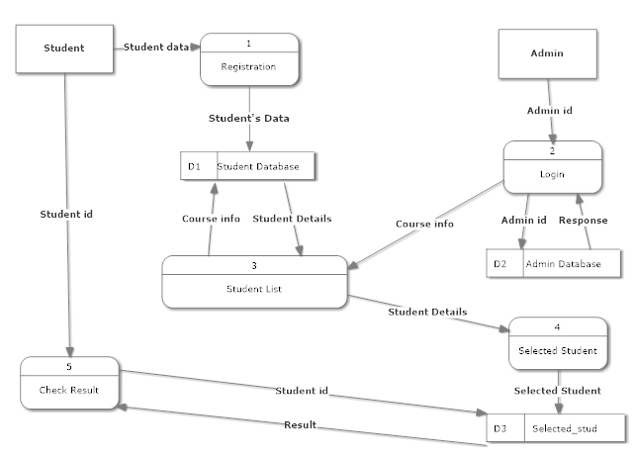
DESIGN(Flow Diagram)

Slide 10
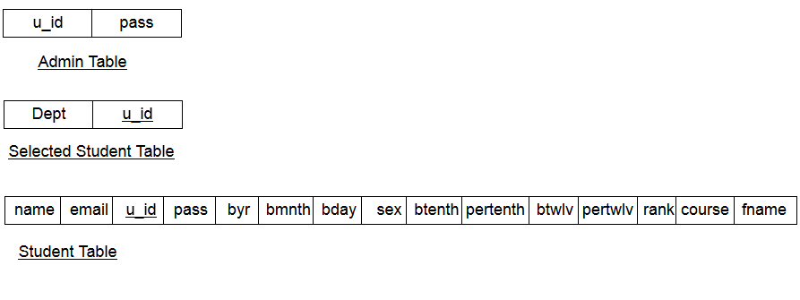
TABLES

Slide 11
HARDWARE SPECIFICATION
Intel Dual Core or above
512 MB RAM or above
10 GB hard disk or above
Network Interface

Slide 12
SOFTWARE SPECIFICATIONS
Operating system : Windows 7 or above
Environment : JDK
Application software : Eclipse Luna
Technology : J2EE
Server : Apache Tomcat 7.0
Database : Oracle database 10g

Slide 13
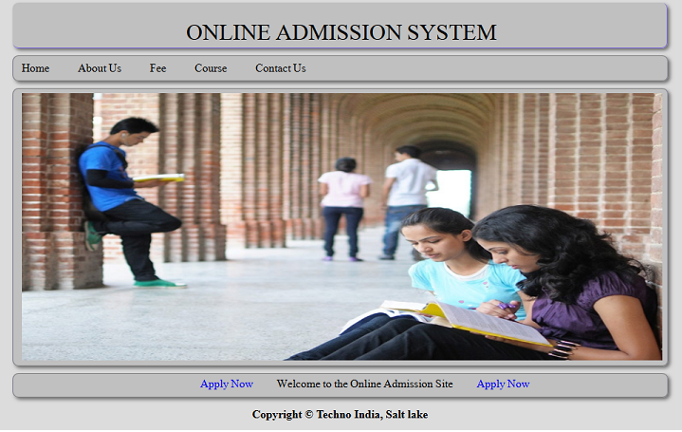
SNAPSHOTS

Slide 14
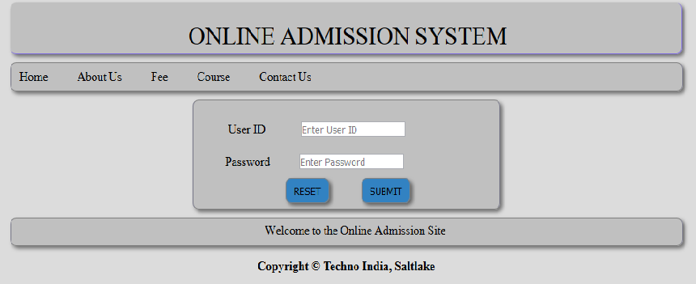
Login

Slide 15
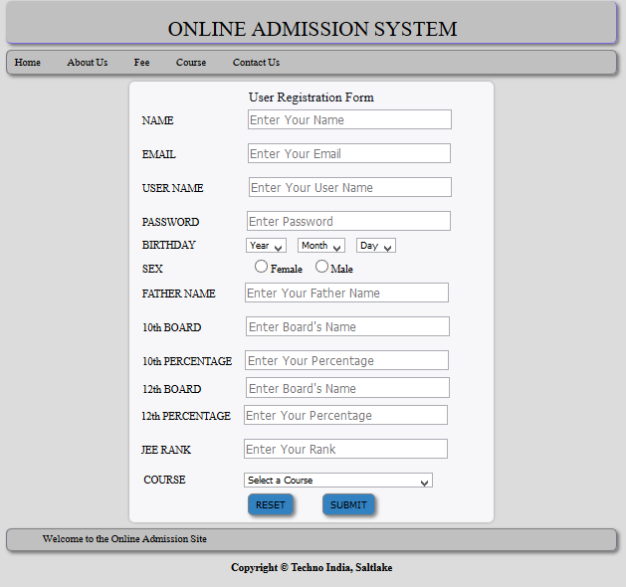
Registration

Slide 16
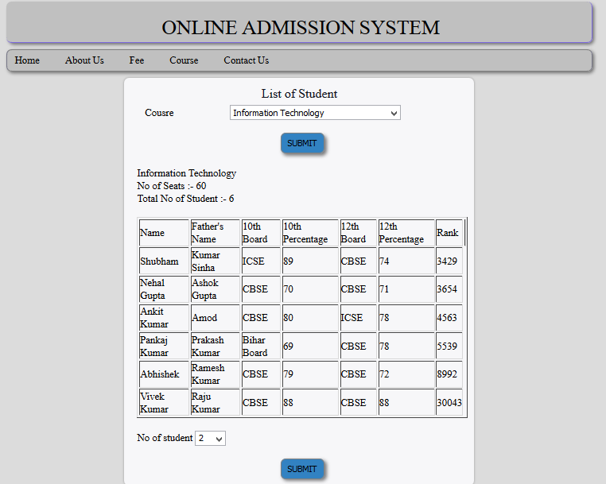
List of Student

Slide 17
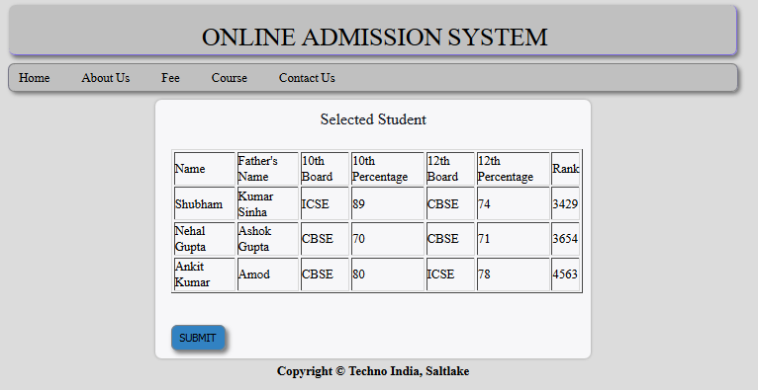
Selected Student

Slide 18
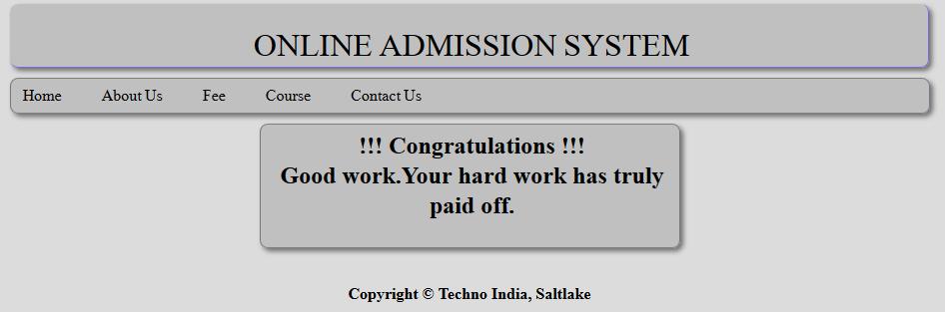
Check Result

Slide 19
LIMITATIONS
Only Logged in Student can apply
Only one course per Student is proved, so Student must be confident
Once the students have registered himself/herself, he/she will not able to change the course , so selection of course is very important

Slide 20
FUTURE SCOPE
This project will have a very bright future if the following can be incorporated:-
There was a lot of thinking’s to increment the project, but for lack of time, many of them are still undone
There is a lot of scope to develop this project in future according to the requirements of particular interested people

Slide 21
CONCLUSION
This project will help every entity of the college in its own specific way.
There are lots of scope to develop Online Admission System and
this project can be extended further with certain modifications specified
by the user.
In brief, this web-based admission system is a user-friendly,
cost effective web application which resolves rather complicated
tasks of a graduate admission office.

Slide 22
BIBLIOGRAPHY
www.w3schools.com
www.tutorialspoint.com
“Head First Java” by Kathy Sierra.

Slide 23


